Slide 1

Part 1
“TRULY KNOWING GOD’S LOVE
WILL CHANGE YOU TO THE CORE”
LifeGate Sermon September 6, 2026

Slide 2
Learning How To Rebuke The
Assignments of The Enemy Against us
“All summer I felt like I was in a funk.”
If anyone does attack you, it will not be my doing; whoever attacks you will surrender to you. Isaiah 54:15 (NIV)
no weapon forged against you will prevail, and you will refute every tongue that accuses you. This is the heritage of the servants of the LORD, and this is their vindication from me," declares the LORD. Isaiah 54:17 (NIV)
The reason the Son of God was made manifest (visible) was to undo (destroy, loosen, and dissolve) the works the devil. 1 John 3:8 (AMP)
Put on the full armor of God so that you can take your stand against the devil's schemes. ¹² For our struggle is not against flesh and blood, but against the rulers, against the authorities, against the powers of this dark world and against the spiritual forces of evil in the heavenly realms.
Ephesians 6:11-12 (NIV) (PSALM 91:3)

Slide 3
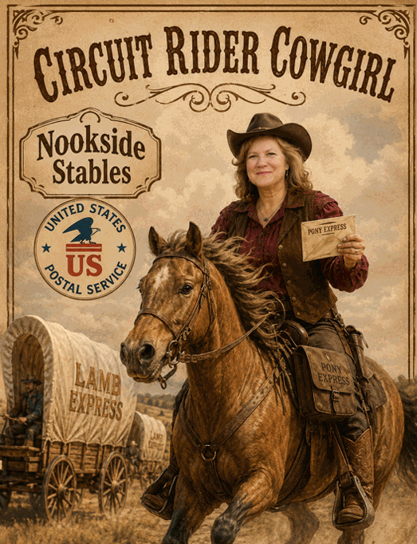


Slide 4


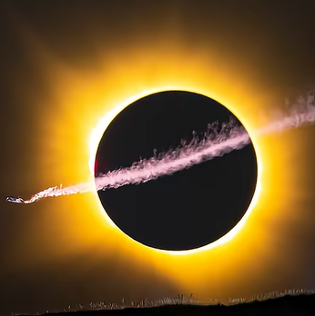
August 12, 2026

Slide 5
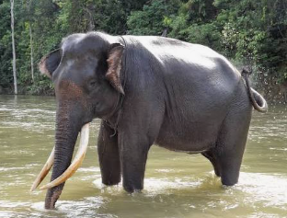
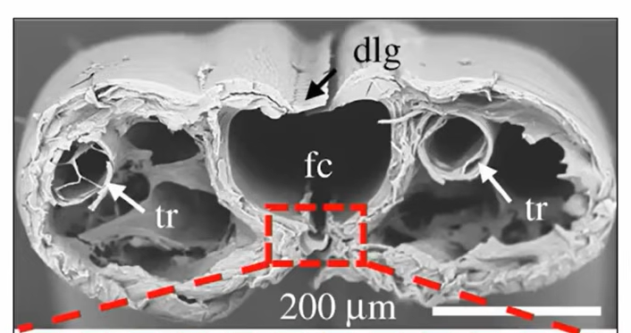
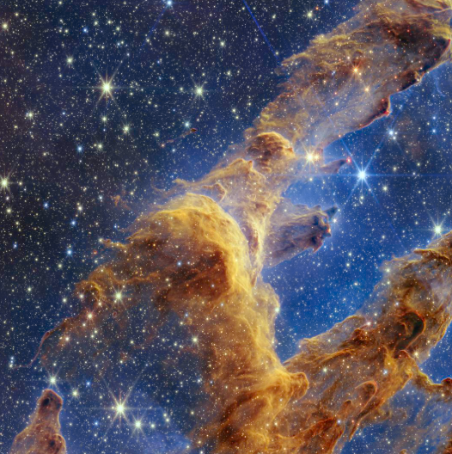

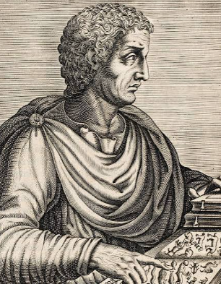
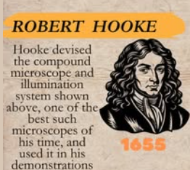
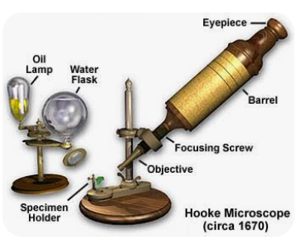
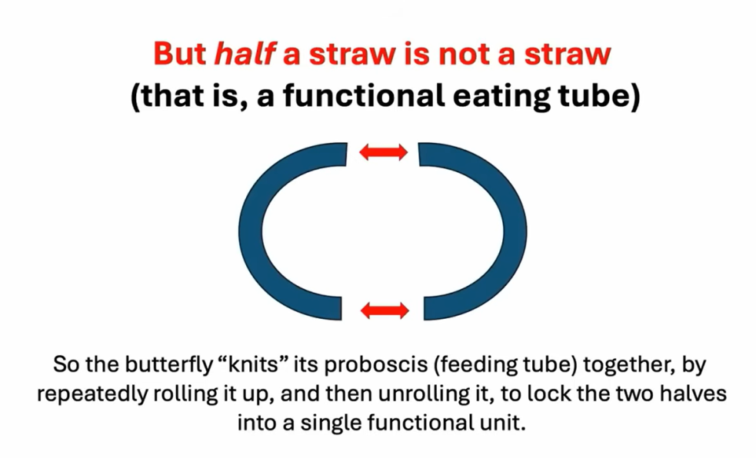
The Glory of God In Creation
“He is not a bashful Engineer”

Slide 6
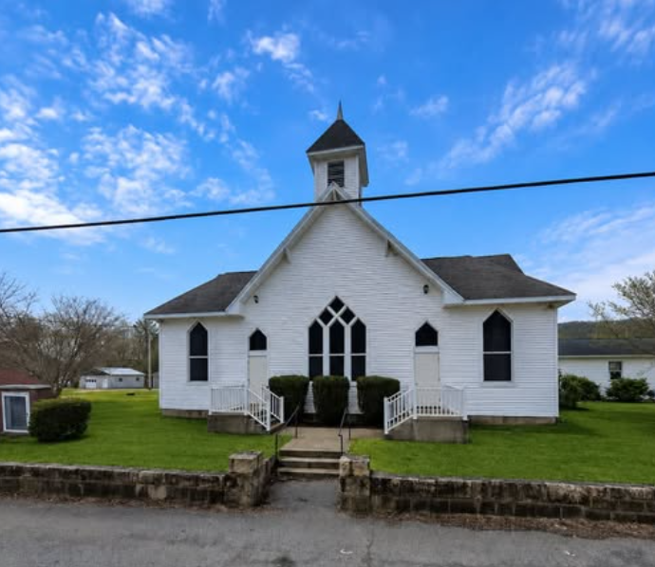
The Grace of God is Still
Pulling Off Change In America
COMMUNITY CHURCH OF MEADOW BRIDGE

Slide 7

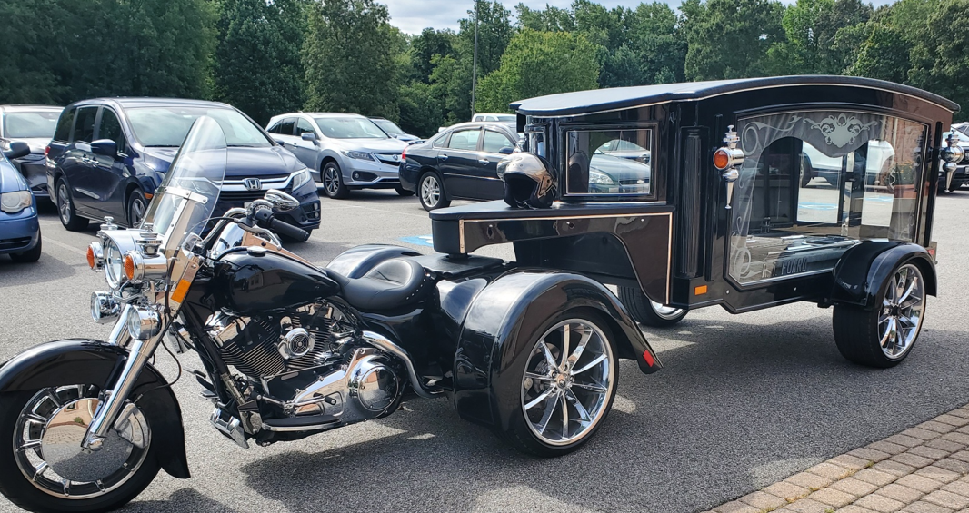
This Man Loved Well

Slide 8
The Three Strands That Make Life Meaningful
That Everyone Is “looking For”
He also has planted eternity in men's hearts and minds [a divinely implanted sense of a purpose working through the ages which nothing under the sun but God alone can satisfy]. Ecclesiastes 3:11 (AMP)
I know I’m Loved/ belong
I know I’m Secure
I know I Have Purpose
And we know that in all things God works for the good of those who love Him, who have been called according to His purpose. Romans 8:28 (NIV)
We have this hope as an anchor for the soul, firm and secure. It enters the inner sanctuary behind the curtain, Hebrews 6:19 (NIV)

Slide 9

FALL SERIES

Slide 10
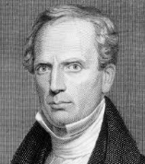
This Fall Series Is Grounded On
This Scripture from 1st John
This is how we know what love is: Jesus Christ laid down His life for us. And we ought to lay down our lives for our brothers.
1 John 3:16 (NIV) (This is How We Know Occurs 7 times)
“Example is the highest moral influence that can be exerted. If God, or any other being, would ask and require others to be loving, He must first manifest love Himself. If the love manifested on the cross does not subdue the selfishness of sinners, their case is hopeless.” –Charles Finney

Slide 11
There’s Something Revealed In Paul’s Ministry in
His Letters – He carried an intense Agape Love for His People and They Caught it
Because our gospel came to you not simply with words, but also with power, with the Holy Spirit and with deep conviction. You know how we lived among you for your sake. 1 Thessalonians 1:5 (NIV)
And this I pray, that your love may abound yet more and more in knowledge and in all judgment; Philippians 1:9 (KJV)
And the Lord make you to increase and abound in love one toward another, and toward all men, even as we do toward you: 1 Thessalonians 3:12 (KJV)

Slide 12
But We Need to Go The Whole Way
Back To Defining What Is Biblical Love
¹⁴ For this reason I kneel before the Father, ¹⁵ from whom His whole family in heaven and on earth derives its name. ¹⁶ I pray that out of His glorious riches He may strengthen you with power through His Spirit in your inner being, ¹⁷ so that Christ may dwell in your hearts through faith. And I pray that you, being rooted and established in love, ¹⁸ may have power, together with all the saints, to grasp how wide and long and high and deep is the love of Christ, ¹⁹ and to know this love that surpasses knowledge--that you may be filled to the measure of all the fullness of God. Ephesians 3:14-19 (NIV)

Slide 13
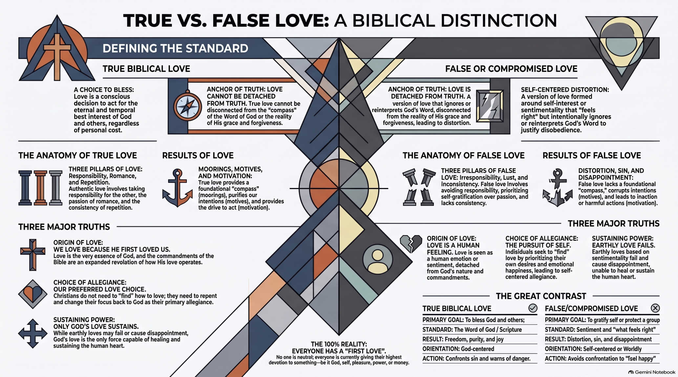
DEFINING BIBLICAL LOVE
“Love is patient, love is kind. It does not envy, it does not boast, it is not proud. ⁵ It is not rude, it is not self-seeking, it is not easily angered, it keeps no record of wrongs. ⁶ Love does not delight in evil but rejoices with the truth. ⁷ It always protects, always trusts, always hopes, always perseveres. ⁸ Love never fails.” 1 Corinthians 13:4-8 (NIV)
They promise them freedom, while they themselves are slaves of depravity--for a man is a slave to whatever has mastered him. 2 Peter 2:19 (NIV)
But God commends His love toward us, in that, while we were yet sinners, Christ died for us. Romans 5:8 (KJV)
1- Biblically aligned
2 - Spirit-directed
3 - Christ-honoring
My command is this: Love each other as I have loved you.
¹³ Greater love has no one than this, that he lay down his life for his friends. John 15:12-13 (NIV)

Slide 14
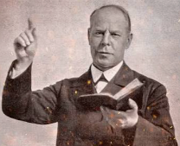
FAITH, AND LOVE AS GRACES.
“Since "The Greatest Things in the World," and "The First Things in the World" are attracting so much attention, it will not be amiss for me to call your attention, more especially, to "Faith" and " Love."
“Faith in Christ is the root grace. Love for God and others is the crowning grace. Faith in Christ is a means to God’s end. Love is the end. Faith is the pioneer grace. "Have faith in God," and all the other graces will follow. The highest form of faith is that which releases LOVE IN ACTION.” Smith Wigglesworth

Slide 15
God doesn’t love us because we deserve it. He loves us because He MADE US and He loves His creation – and operates out of love.
"For God so loved the world that he gave his one and only Son, that whoever believes in him shall not perish but have eternal life.” John 3:16 (NIV)
How great is the love the Father has lavished on us, that we should be called children of God! And that is what we are! The reason the world does not know us is that it did not know him. 1 John 3:1 (NIV)

Slide 16
What Are The Most Essential Qualities
Of God’s Love
Holy - uncorrupted
Universal – no favorites
Unconditional – His choice
Merciful/ Just – He will call to the undeserving but will remain holy and punish all wickedness

Slide 17

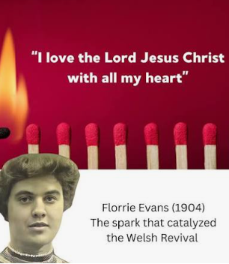
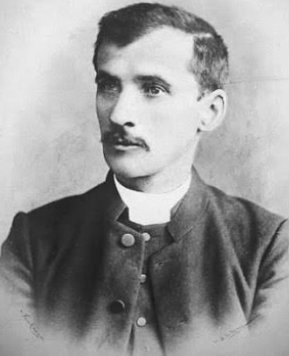
The Love Of God Compels Us
But More Importantly Protects us
From The Encroachment of the World
People
Arrested For
Drunkenness
In Cardiff
1902 9,298
1903 10,528
1904 11,282
1905 8,164
1906 5,490
1907 5,615
Joseph Jenkins

Slide 18
The Three Strands That Make Life Meaningful
That Everyone Is “looking For”
I know I’m Loved/ belong
I know I’m Secure
I know I Have Purpose

Slide 19

Chloe Cole From California
Experienced The False Love of Compromise
Background and Medical History
She was born on July 27, 2004, and grew up in California.
She socially transitioned from a girl to a guy around age 12.
At age 13, she began receiving puberty blockers and testosterone.
YOU HAVE TO HAVE A SENSE OF PURPOSE TO HOLD YOU UP – “I didn’t have one.”
Playing God – this is going to make you who you really want to be.

Slide 20
When the Love Of God Is MISSED
If there is a God who created me – why am I suffering?
In order to open my eyes to the light – God awakened me
God was always working in the background
I Resented myself
I Resented my parents
I Resented doctors
Thinking that you are irredeemable is the biggest lie the enemy plays on us.
We are not a mistake
God has a purpose
We cannot run away from our problems but can Overcome them.
You have to see yourself as someone who has a future
I thought I was always broken - None of us are enough

Slide 21
We Need A Sanctified Imagination
“God doesn’t ask you to earn His love. He demonstrated it at the cross. His love heals what sin, rejection, and broken people have wounded. Don’t mistake survival for love. Let God redefine what love truly looks like, because when you experience His love, you’ll stop settling for counterfeits.
“We love Him because He first loved us.” 1 John 4:19
Nathan Housman 2026
The "love of God" is the only engine powerful enough to drive us through cultural paralysis. We are motivated to push forward because Christ demonstrated a "high-level love" by seeking us out when we were unresponsive and dead in our sins. To break the "strongholds of agitation," we must use the "supernatural weapons" described in 2 Corinthians 10:3-5, which possess Divine power to demolish the barriers in our relationships.

Slide 22
APPLICATION
Get READY to become recalibrated by the REAL LOVE OF GOD this fall - and begin to operate in AGAPE love towards others.
Hand over your disappointments to the Lord to handle – and let Him DO THE HEAVY LIFTING
Get a BOLD FAITH that will prevail in prayer over your life and family to break any assignments the enemy has against you – that they will be thwarted – defeated and overcome.

