Slide 1


Enhancing my Marriage

Slide 2

Couples everywhere are finding Life cHallenging it’s affecting their Marriages

Slide 3

Satan has been attacking the Home from the beginning!

Slide 4
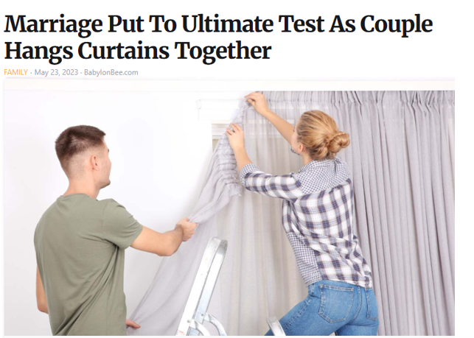
A little Satire to start off -

Slide 5


Slide 6


Slide 7


Slide 8
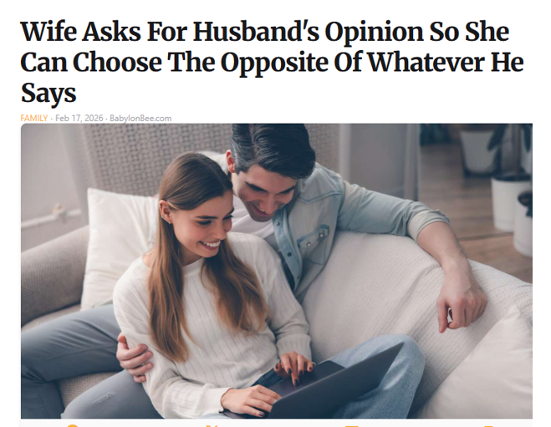

Slide 9
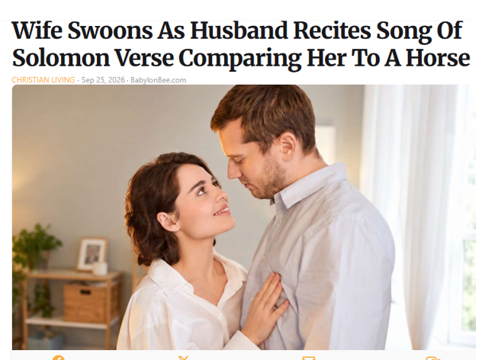

Slide 10
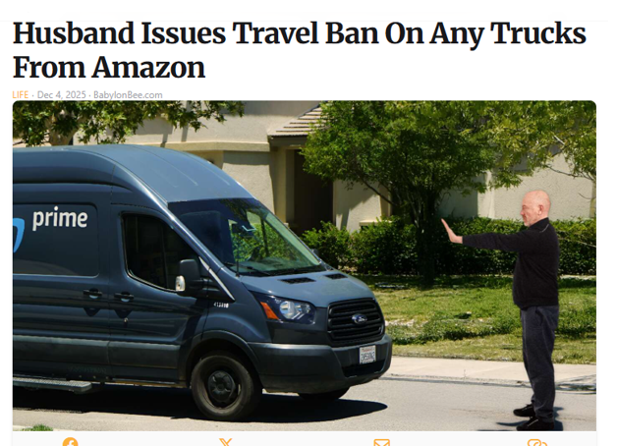

Slide 11


Slide 12
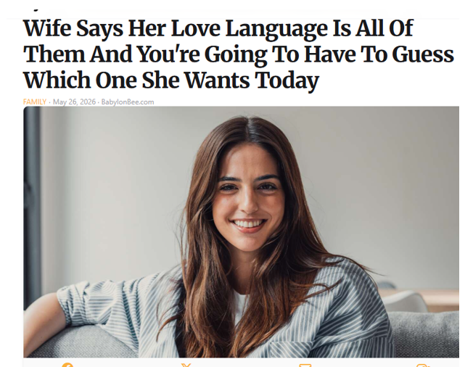

Slide 13
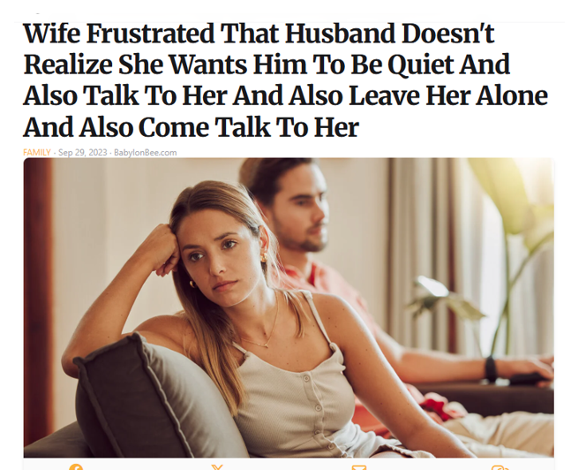

Slide 14
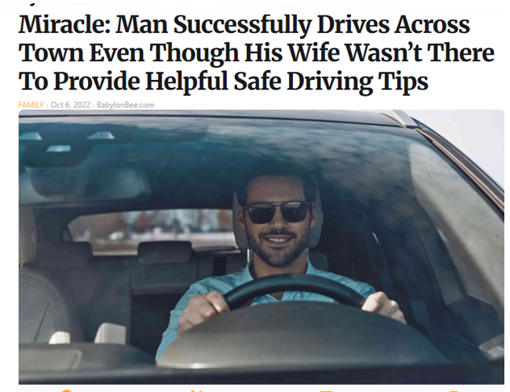

Slide 15
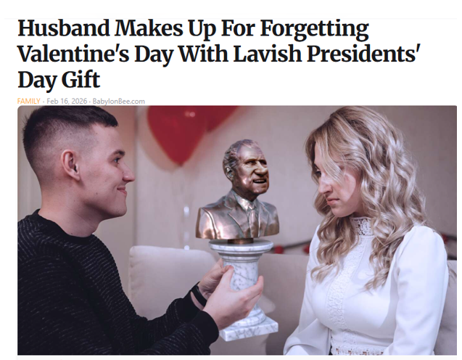

Slide 16
What does the word of God have say:
  Gen. 2: 18 It is not good to have man to be left alone
  Eph. 5: 1-2, 22-33 responsibilities of husbands/ wives
  Eccle. 4: 9 – 12 Partnership is much stronger
  Song of Songs - Romance is a unique journey, blessing
  1 Cor. 7:1-7 Purity and practicality in marital intimacy

Slide 17
Institution under attack -
The is no single issues that undermines marriage – end goal is to destroy it. It’s worth the battle to keep it!
The is no perfect home – don’t fall for the idea everyone else has a great marriage.
We’re calling couples to hang in there!! Don’t quit!!
Look at your spouse with a renewed intent to enhance your relationship and be a blessing to other couples.

Slide 18
Tool Kit - Helping men be better husbands
Invest in your wife’s life – make time for her!
Compliment her - often, at the right time with good heart.
Pray with her – as much as you can. (once a day)
Do devotions together – It will be different for every couple
Show your wife public affection – appropriately
Make a date night – As often as practical (Once a week)
Investing in all these things improve your intimacy with her!

Slide 19
Tool Kit - Helping Women be better wives
Make your husband a priority - over all the other amazing things you do.
Find fresh ways to greet him when comes home –
Show him respect – letting him know what he is doing right.
Encourage him spiritually – each couple has different dynamics
Show him physical attention in public – that he is your prize!
Follow his lead – there will be challenges, but agree on the big issues
Make room for intimacy – work at making time for each other.

Slide 20

Conclusions: Improving our marriages is not for the faint of heart!

Slide 21
LifeGate is committed to seeing our homes and marriages strengthened.
I’m providing the tool kit for couples to take home and read through it together and review. Go deeper where necessary.
As church staff we want to provide any additional assistance we can.
We have number of great no-profits around that can help as well….
We believe that with God’s help we can overcome the society pressures and trends to see healthy homes and marriages.
Our future generation depends on it.

