Slide 1

Love – Foundation of our actions as People of God………

Slide 2
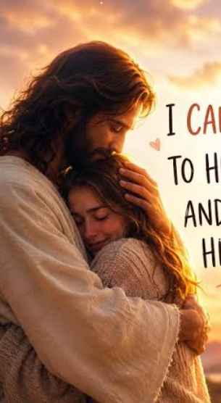
We had no choice of our God being the Loving Compassionate Gracious God that He is……
: "The Lord is gracious and compassionate, slow to anger and rich in love. The Lord is good to all; he has compassion on all he has made." Psalm 145:8-9

Slide 3
Words to describe God
HOLY 1 Peter 1:16
LIGHT 1 John 1:5
LOVE 1 John 4:8
INVISIBLE Col. 1:15- 17

Slide 4

What was the world like in the Garden of Eden?
An Atmosphere of Love and Cooperation!

Slide 5

Sin came into the World!
Satan hijacked the atmosphere of love and kindness for Pride and selfishness.

Slide 6

Rom. 8: 3, 5- 6
The power of the cross defeated the stranglehold the flesh had over our spiritual lives.

Slide 7

Bring Heaven’s Atmosphere to Earth!

Slide 8

I Corinthians 13
Love is essential to Ministry

Slide 9
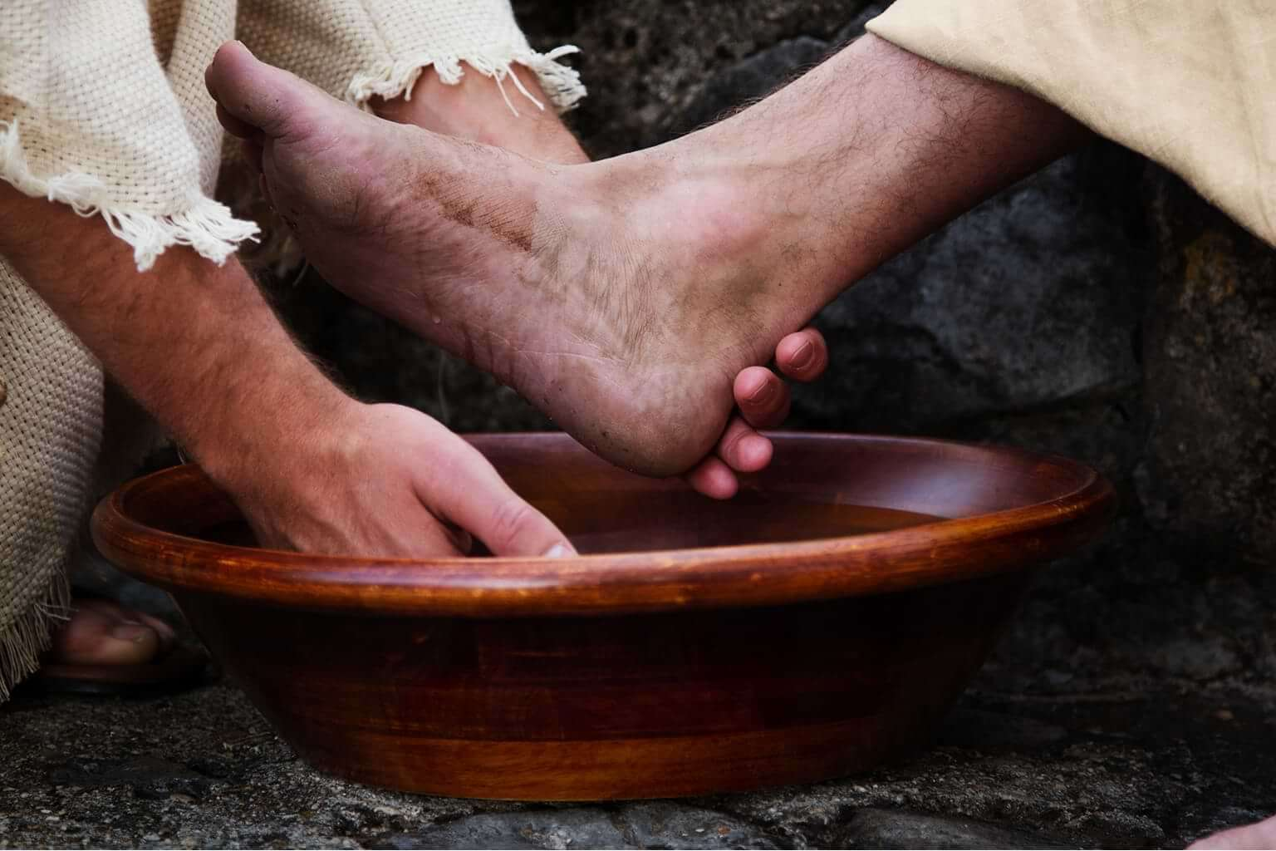
Loving one another through practical service. Leaders showing the way by their own humility.

Slide 10

The world will know you are my disciples by your love! John 13:35

