Slide 1

God is at work in each of our lives for the benefit of our personal growth and for the development of those around us…….

Slide 2

BACK TO SCHOOL QUIZ

Slide 3
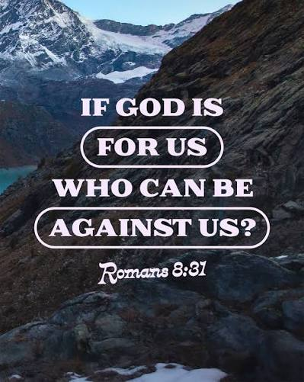

Review messages in June/ July
Connecting with God more deeply and not giving up when it’s not in our timing.

Slide 4
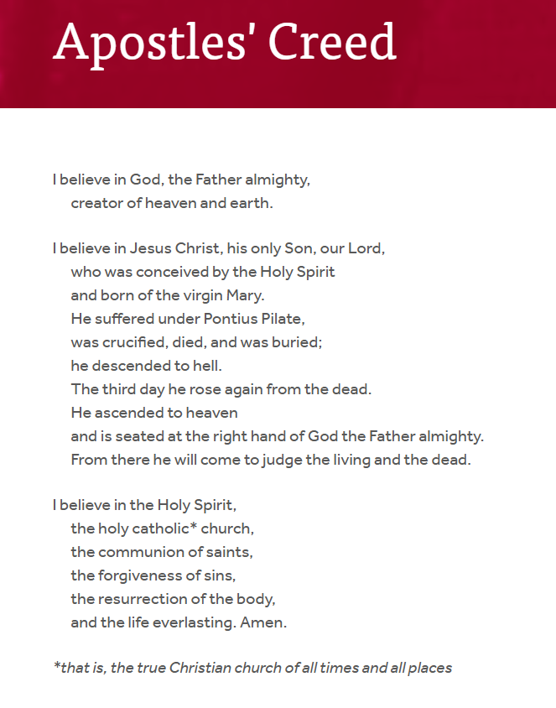
Know the Word
- Obey the word
- Listen to the Spirit
- It’s not just head
knowledge

Slide 5

Contend for the Faith

Slide 6
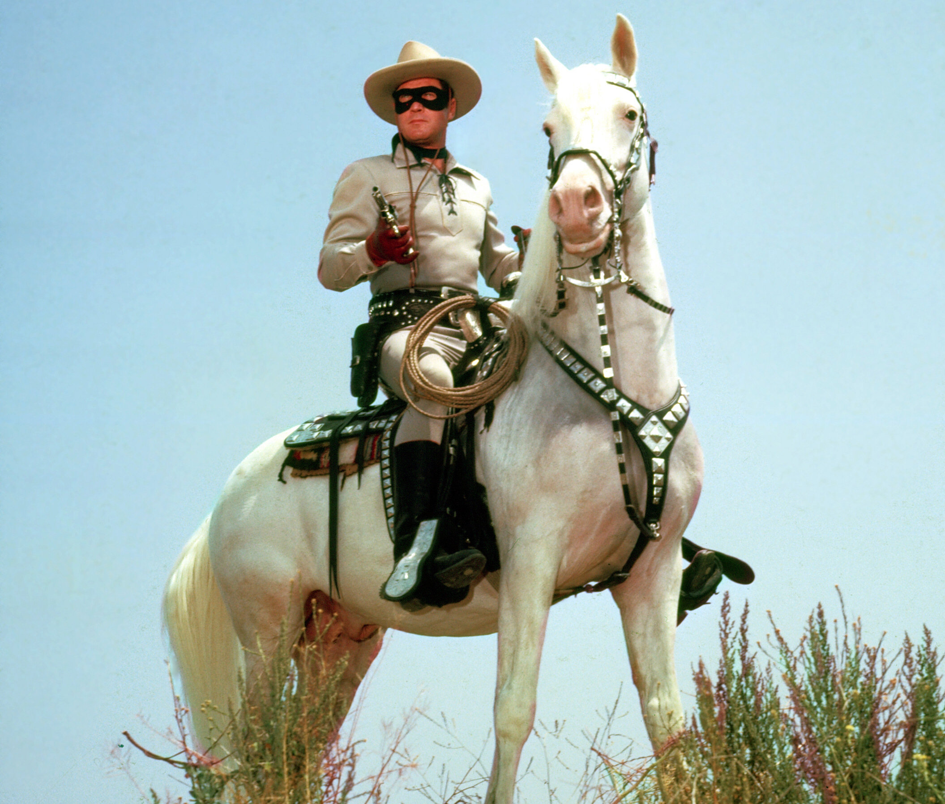
Lone Ranger Christianity
- Over confidence
- No Accountability
- Blindness to living
in holiness

Slide 7

Jesus came for the hurting – not the self confident / “I got it all together” / “I don’t need anything” … person. Matt. 12: 18-22

Slide 8

Spiritual self deception comes from one disobedient response at a time…….
Hebrews 3: 6-8/ 12-15

Slide 9

Putting it off …. only opens the door to a little more numbness and more doubt….
Hebrews 3:13 – Warn each other every day….

Slide 10
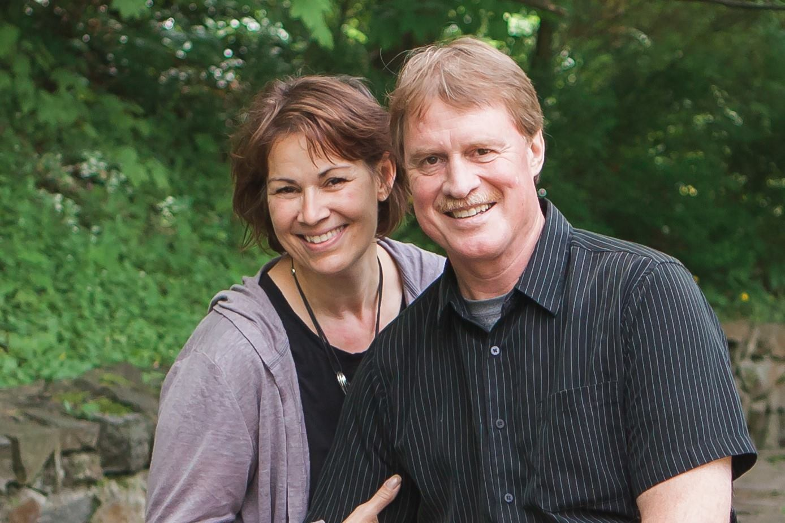

LifeGate is committed to seeing each of you growing in your faith and knowledge of the Lord, as well as finding your specific assignments in the Kingdom of God…….

Slide 11
Our Awesome God - Psalm 33
The Lord merely spoke,
and the heavens were created.
He breathed the word,
and all the stars were born.
⁷ He assigned the sea its boundaries
and locked the oceans in vast reservoirs.
⁸ Let the whole world fear the Lord,
and let everyone stand in awe of him.
⁹ For when he spoke, the world began!
It appeared at his command.
¹⁰ The Lord frustrates the plans of the nations
and thwarts all their schemes.
¹¹ But the Lord’s plans stand firm forever;
his intentions can never be shaken.

Slide 12
The Lord looks down from heaven
and sees the whole human race.
¹⁴ From his throne he observes
all who live on the earth.
¹⁵ He made their hearts,
so he understands everything they do.
We put our hope in the Lord.
He is our help and our shield.
²¹ In him our hearts rejoice,
for we trust in his holy name.
²² Let your unfailing love surround us, Lord,
for our hope is in you alone.

