Slide 1
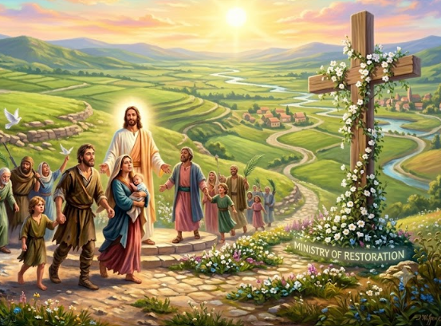
Summer Series (Part 3)
PUTTING JESUS CHRIST IN THE CENTER
“Receiving His Impartation
To Overcome Regret and Resentment”
LifeGate Sermon August 2, 2026

Slide 2
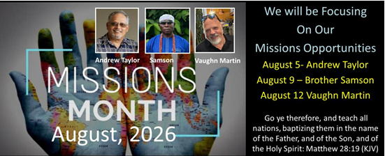

Slide 3
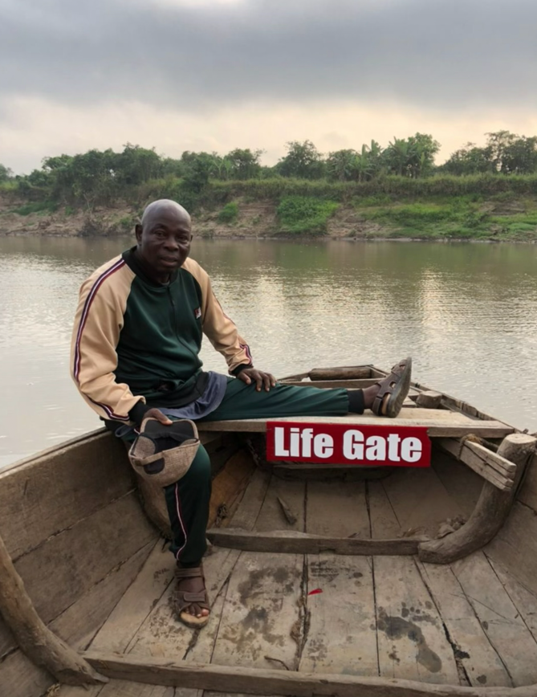

Slide 4
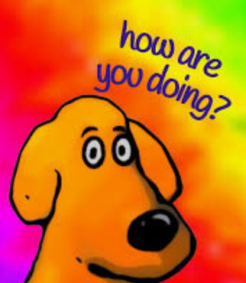
PEOPLE ARE ASKING ME
Super Blessed – Grateful for all the bountiful grace and miracles and provision of the Lord in 2026
Super Desperate – For a greater saturation of His presence and grace and heart-transforming anointings to invade LifeGate and our region – Joshua 15:19
My observation – This is a season of acceleration and URGENCY– God wants to move you toward VICTORY and REVIVAL – if we resist we will not be in NEUTRAL – we will backslide quickly - We need to repent quickly.

Slide 5
The Great Promises Of Impartation
Wherefore, my beloved, as you have always obeyed, not as in my presence only, but now much more in my absence, work out your own salvation with fear and trembling. ¹³ For it is God which works in you both to will and to do of His good pleasure. Philippians 2:12-13 (KJV)
He himself bore our sins in his body on the tree, so that we might die to sins and live for righteousness; by His wounds you have been healed. ²⁵ For you were like sheep going astray, but now you have returned to the Shepherd and Overseer (Sentry – Watchman) of your souls. 1 Peter 2:24-25 (NIV)

Slide 6
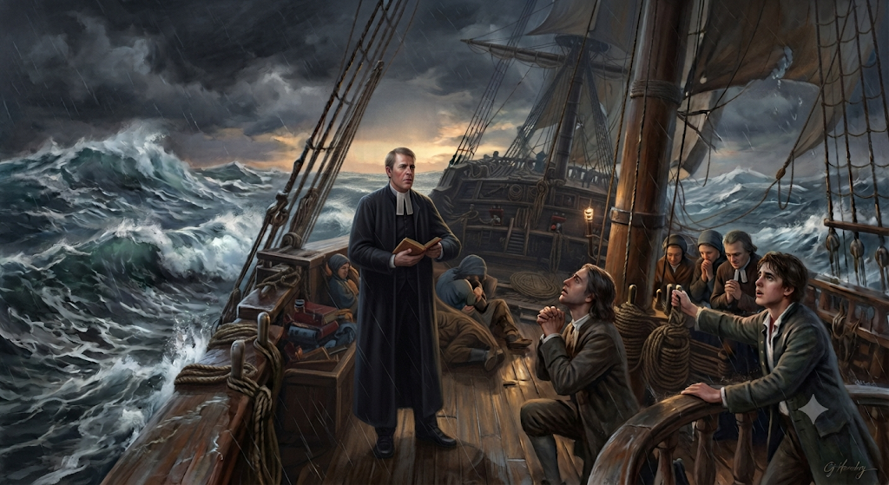
One of The Most Providential Colonial Ship
Voyages and Storm - HMS Simmonds 1735-36
The Moravians Meet John Wesley – January 25 - Storm

Slide 7
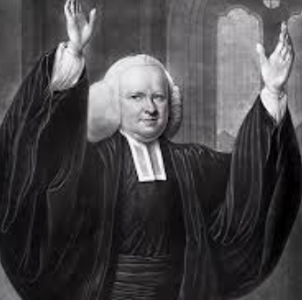
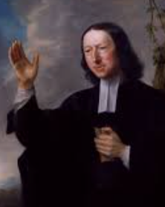
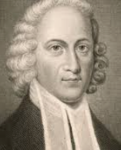
How The First Great Awakening
Clarified The Message of Salvation
Restored
Salvation by Grace through Faith – for the individual by a knowable conversion experience
George
Whitefield
John
Wesley
Johnathan
Edwards
“Bringing the Gospel into the open air gave it an Infectious element to the culture, where it was freed from the artificialities and intolerable stuffiness of a dull and dead church-system and made it again part of the vital experience of mankind."

Slide 8
The Gospel Is The Power
Of God To Save And Transform
For the message of the cross is foolishness to those who are perishing, but to us who are being saved it is the power of God.
1 Corinthians 1:18 (NIV)
Do not conform any longer to the pattern of this world, but be transformed by the renewing of your mind. Then you will be able to test and approve what God's will is--his good, pleasing and perfect will. Romans 12:2 (NIV)

Slide 9
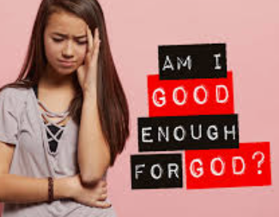

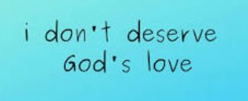
I want To Deal With These
Half-truths
“It feels like I will never get the victory – I’m destined to be a failure.”

Slide 10
God doesn’t love us because we deserve it. He loves us because He MADE US and He loves His creation – and operates out of love.
We can’t earn God’s love. We can’t work for God’s approval in our flesh. We can obey Him by repentance and faith and PLEASE HIM by yielding to the Holy Spirit
So what God is desiring of us – to OBEY HIM THROUGH FAITH – and LOVE HIM BACK through

Slide 11
The Excellency Of Christ – is that
He Still Draws Us Near Even after we wounded Him - Even After We failed Him
I will punish her for the days she burned incense to the Baals; she decked herself with rings and jewelry, and went after her lovers, but she forgot Me ," declares the LORD. ¹⁴ "Therefore I am now going to allure (PERSUADE) her; I will lead her into the desert and speak tenderly to her. ¹⁵ There I will give her back her vineyards, and will make the Valley of Achor (trouble) a door of hope. There she will sing as in the days of her youth, as in the day she came up out of Egypt. Hosea 2:13-15 (NIV)

Slide 12
When We Don’t Deserve His Mercy
He Still Comes To Save Us
In a surge of anger I hid my face from you for a moment, but with everlasting kindness I will have compassion on you," says the LORD your Redeemer. Isaiah 54:8 (NIV)
No weapon forged against you will prevail, and you will refute every tongue that accuses you. This is the heritage of the servants of the LORD, and this is their vindication from me," declares the LORD.
Isaiah 54:17 (NIV)

Slide 13
The Excellency Of Christ
Gives Us An Assurance Of Salvation
Even When We Are Struggling
"If his sons forsake my law and do not follow my statutes, ³¹ if they violate my decrees and fail to keep my commands, ³² I will punish their sin with the rod, their iniquity with flogging; ³³ but I will not take My love from Him, nor will I ever betray My faithfulness. Psalm 89:30-33 (NIV)

Slide 14
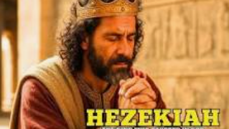
God Contends for Us, Even When
We’re Not Perfectly Aligned With Him
STARTS STRONG - He sought his God and worked wholeheartedly. And so he prospered. 2 Chronicles 31:20-21 (NIV)
Get’s A Miraculous Deliverance – After He operates in FEAR and strips the Gold off the temple – to pays tribute – And God is still jealous over His people – and rescues them – 2 Kings 18
Many brought offerings to Jerusalem for the LORD and valuable gifts for Hezekiah king of Judah. From then on he was highly regarded by all the nations. ²⁴ In those days Hezekiah became ill and was at the point of death. He prayed to the LORD, who answered him. ²⁵ But Hezekiah's heart was proud and he did not respond to the kindness shown him; therefore the LORD's wrath was on him and on Judah and Jerusalem. ²⁶ Then Hezekiah repented of the pride of his heart, as did the people of Jerusalem; therefore the LORD's wrath did not come upon them during the days of Hezekiah. - 2 Chronicles 32:23-26 (NIV)

Slide 15
How Does Jesus Make You “Dig Deeper”
And Motivate You To Obey Him
When You Are At Your Wits End?
Spiritual Storms Follow A Familiar Pattern
For He spoke and (A) stirred up a tempest that lifted high the waves. ²⁶ They mounted up to the heavens and went down to the depths; in their peril their courage melted away. ²⁷ They reeled and staggered like drunken men; (B) they were at their wits' end. ²⁸ (C )Then they cried out to the LORD in their trouble, and (D) He brought them out of their distress. ²⁹ He stilled the storm to a whisper; the waves of the sea were hushed. ³⁰ They were glad when it grew calm, and (E) He guided them to their desired haven. Psalm 107:25-30

Slide 16
So Don’t Count Yourself Out
Live in A DEFEATIST MINDSET
Believe The Lie – You are DAMAGED GOODS
Shout for joy, O heavens; rejoice, O earth; burst into song, O mountains! For the LORD comforts His people and will have compassion on His afflicted ones. ¹⁴ But Zion said, "The LORD has forsaken me, the Lord has forgotten me."
Isaiah 49:13-14 (NIV)
See, I have engraved you on the palms of My hands; your walls are ever before me. ⁻⁻ ¹⁸ Lift up your eyes and look around; all your sons gather and come to you. Isaiah 49:16-18 (NIV)

Slide 17
BREAKING “REGRET AND RESENTMENT”
Regret | Resentment
Is a sense of sadness, disappointment, or remorse about something you did or did not do, wishing things had happened differently | Is a feeling of disappointment, or remorse about something you did or did not do, wishing things had happened differently
Brothers, I do not consider myself yet to have taken hold of it. But one thing I do: Forgetting what is behind and straining toward what is ahead, Philippians 3:13 (NIV) also – Isaiah 43:18, 19 – Behold I do a new thing. | Bear with each other and forgive whatever grievances you may have against one another. Forgive as the Lord forgave you. 14 And over all these virtues put on love, which binds them all together in perfect unity. 15 Let the peace of Christ rule in your hearts, since as members of one body you were called to peace. And be thankful. Colossians 3:13-15 (NIV)
Regret keeps you feeling “YOU WILL NEVER BE GOOD ENOUGH” – WHAT IF? – WHY DID? – and it keeps us beat up and thinking mainly about the past | Resentment keeps you hurt and disappointed. You know someone you love has deeply wounded you – but they are not changing fast enough. So you only expect more hurt and repeated disappointment
THE KEY IS KNOWING JESUS DID FORGIVE ALL YOUR PAST SINS – (Did you confess them to Him – then you have to trust He has forgiven you) | THE KEY IS REALIZING JESUS WALKED WITH YOU – WHEN YOU FAILED HIM – HE STILL LOVED YOU – can you RELEASE YOUR RESENTMENT at the finished work of the cross and forgive those who are still failing you – and walk with them – asking God to continue to pour into them the grace and power and transformational love they need.

Slide 18
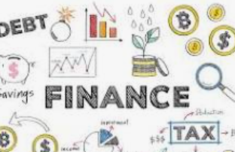

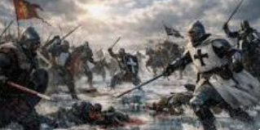
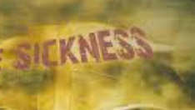
We Need A Sanctified Imagination
To Envision The Outcome
Beyond Our Regrets And Resentment
He chose the lowly things of this world and the despised things--and the things that are not--to nullify the things that are, ²⁹ so that no one may boast before Him. 1 Corinthians 1:28-29 (NIV)
Finances
Struggles
Battles

Slide 19
GOD IS ASKING US TO ALLOW HIS SPIRIT
TO LIFT UP OUR EYES AND ENVISION HIS WORK
¹⁶ I pray that out of His glorious riches He may strengthen you with power through His Spirit in your inner being, ¹⁷ so that Christ may dwell in your hearts through faith. And I pray that you, being rooted and established in love, ¹⁸ may have power, together with all the saints, to grasp how wide and long and high and deep is the love of Christ, ¹⁹ and to know this love that surpasses knowledge--that you may be filled to the measure of all the fullness of God. Now to Him Who is able to do immeasurably more than all we ask or imagine (THINK – COMPREHEND), according to His power that is at work within us, ²¹ to him be glory in the church and in Christ Jesus throughout all generations, for ever and ever! Amen. Ephesians 3:16-21 (NIV)

Slide 20
Envisioning Faith
Is Not “New-Age”
It Is Believing For A New Future
And the peace of God, which transcends all understanding, will guard your hearts and your minds in Christ Jesus. ⁸ Finally, brothers, whatever is true, whatever is noble, whatever is right, whatever is pure, whatever is lovely, whatever is admirable--if anything is excellent or praiseworthy--think about such things. Philippians 4:7-8 (NIV)

Slide 21
God Sets Us Up For
Radical Grace Toward Each Other – Because
He Showed Radical Grace Toward Us
And do not grieve the Holy Spirit of God, with whom you were sealed for the day of redemption. ³¹ Get rid of all bitterness, rage and anger, brawling and slander, along with every form of malice. ³² Be kind and compassionate to one another, forgiving each other, just as in Christ God forgave you.
Ephesians 4:29-32 (NIV)

Slide 22
He Showed Radical Grace To Us
Therefore, as God's chosen people, holy and dearly loved, clothe yourselves with compassion, kindness, humility, gentleness and patience. ¹³ Bear with each other and forgive whatever grievances you may have against one another. Forgive as the Lord forgave you. ¹⁴ And over all these virtues put on love, which binds them all together in perfect unity. Colossians 3:12-14 (NIV)

Slide 23
APPLICATION
Repent of holding on to your regrets and resentments
Hand over your problems to the Lord to handle – DO THE HEAVY LIFTING
Boldly believe for God to do the impossible – ENVISION What is His will – don’t let your eyes only see from the past – or from the present – let your faith be sanctified to see a DIFFERENT FUTURE.

Slide 24
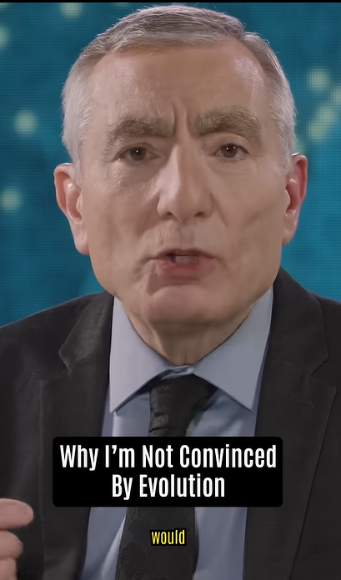
The Excellency of Christ
In Creation
For by Him all things were created: things in heaven and on earth, visible and invisible, whether thrones or powers or rulers or authorities; all things were created by Him and for Him. ¹⁷ He is before all things, and in Him all things hold together. ¹⁸ And He is the head of the body, the church; he is the beginning and the firstborn from among the dead, so that in everything He might have the supremacy. ¹⁹ For God was pleased to have all his fullness dwell in him, ²⁰ and through him to reconcile to himself all things, whether things on earth or things in heaven, by making peace through his blood, shed on the cross. Colossians 1:16-20 (NIV)

