Slide 1
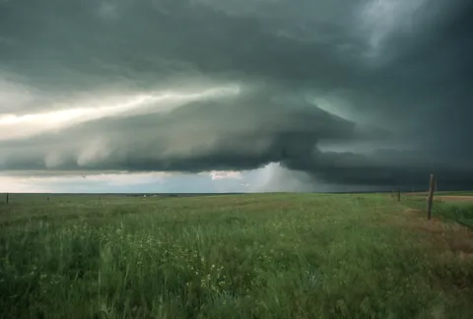
Storms of Life
The World
The Flesh
Constant distractions
Wanting its own
way all time
I have told you these things so that you will not abandon your faith. I have told you all this so that you may have peace in me. Here on earth you will have many trials and sorrows. But take heart, because I have overcome the world.” John 16: 1, 33
The Devil
Turmoil
Attacks and
Deception
Unexpected challenges and trials

Slide 2
Bringing support to our fellow
Christians:
Text a verse of encouragement to a believer you know is going through tough time.
Call someone up and chat for just a few minutes and then pray for them.
Invite someone to pray for you… open up and ask for Gods help in specific area. (This helps open the valves of favor into your life.)
Take a meal or invite someone over to share in hospitality.
Be open to watching young children – so a couple can have a few hours of time off.
Ask Pastor Don how you might be able to use your gifts to bless other.
Send a card of note – to someone needs uplifting.

