Slide 1
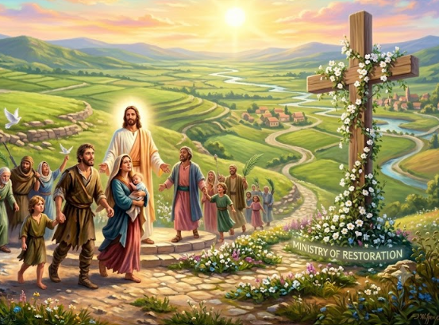
Summer Series (Part 2)
PUTTING JESUS CHRIST IN THE CENTER
AS HE UNFOLDS HIS EXCELLENCY
IN OUR MIDST
“Breaking Soul Ties – Giving A Good Report”
LifeGate Sermon
July 12, 2026

Slide 2
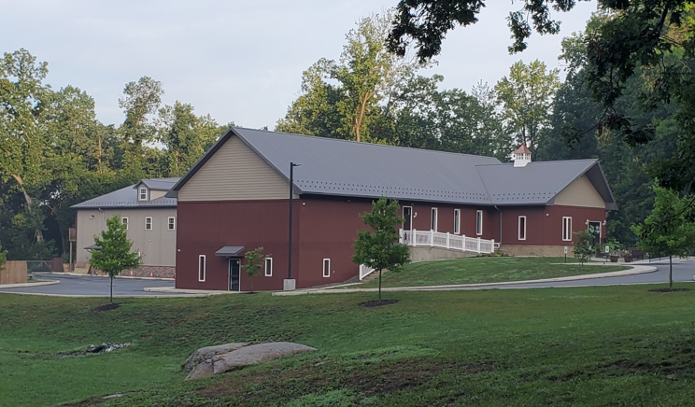
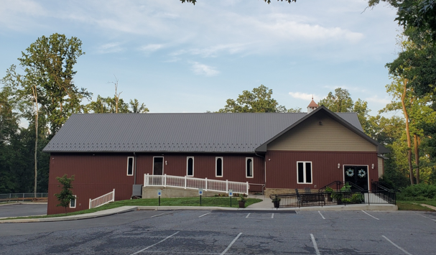
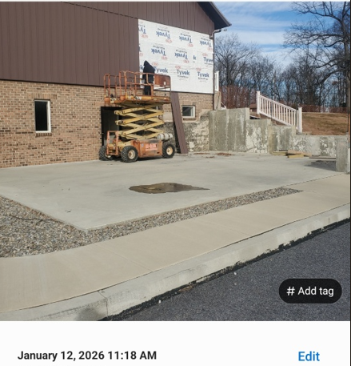
The Start and The finish
182 days – 6 Months

Slide 3
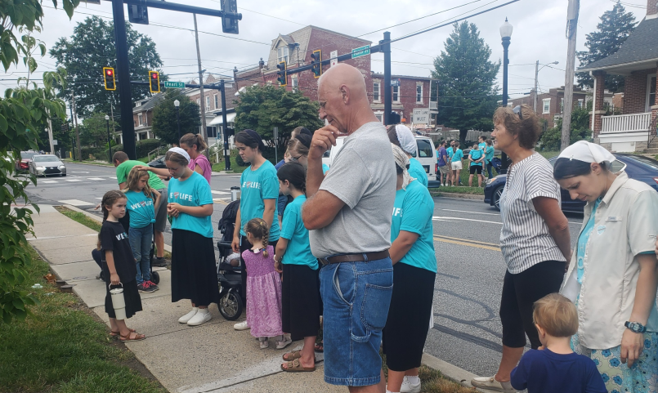
Praying for the end of
Yesterday with Love Life

Slide 4
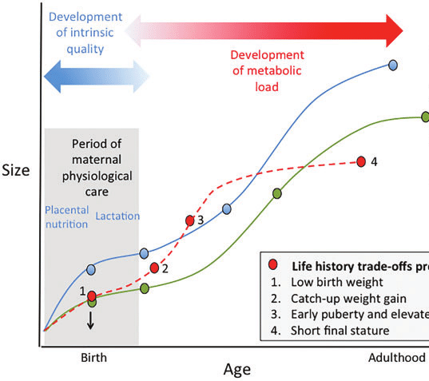
(EACH LIFE COUNTS) For God's gifts and His call are irrevocable. Romans 11:29 (NIV)
Providentially manipulated details
For we are God's workmanship, created in Christ Jesus to do good works, which God prepared in advance for us to do. Ephesians 2:10
All the days ordained for me were written in your book before one of them came to be.
Psalm 139:16
Life Growth
Green dotted Line is God’s Best
Red Dotted Line is you going back and forth
Blue Line Is The Enemy’s corrupted plan for your life

Slide 5
God Contends for Us, Therefore
We will Contend For Others
Then you will know that I am the LORD; those who hope in me will not be disappointed."
Can plunder be taken from warriors, or captives rescued from the fierce? 25 But this is what the LORD says: "Yes, captives will be taken from warriors, and plunder retrieved from the fierce; I will contend with those who contend with you, and your children I will save.
Isaiah 49:23-25 (NIV)

Slide 6

WHAT DOES THE PASTORAL
AND THE PROPHETIC DO TOGETHER?
JESUS OPERATED IN BOTH - Exhorting the Church to PAY THE PRICE – of leveraging their Gospel Privileges – And the UNDERSTANDING that all the Weight of the work does not rest on our shoulders – The LORD DOES THE HEAVY LIFTING
Gospel Privileges
Counting The Cost
I will give you the keys (UNLOCKING BOLT) of the kingdom of heaven; whatever you bind on earth will be bound in heaven, and whatever you loose on earth will be loosed in heaven." Matthew 16:19 (NIV) (REPEATED in Matthew 18_18-20
²⁷ And anyone who does not carry his cross and follow me cannot be my disciple. ²⁸ "Suppose one of you wants to build a tower. Will he not first sit down and COUNT the cost to see if he has enough money to complete it? Luke 14:27-28 (NIV)
God Does The Enabling And the Heavy Lifting
I can do all things through Christ which
strengthens me. Philippians 4:13 (KJV)

Slide 7
There’s Something About Seven Years
In Scripture
We’ve been Through a Crazy Seven
2019- 2026
Jacob – labored seven years –
Got snookered - Leah
Jacob – labored seven more years – For Rachel
Joseph – interpreted Pharaoh's dream there was going to be seven years of plenty and seven years of famine
Deuteronomy chapter 15 every seven years you must set your indentured servants free

Slide 8
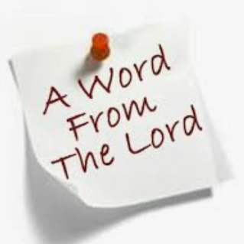
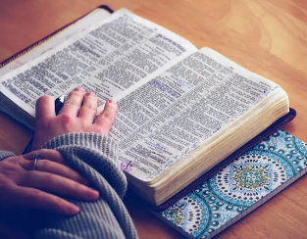
I Sense A “Word From The Lord” For LifeGate
Any “Word from the Lord”
Must align with the Written Word

Slide 9
Primary Text For Today
"Yea doubtless, and I count all things but loss for the excellency of the knowledge of Christ Jesus my Lord: for whom I have suffered the loss of all things, and do count them but dung, that I may win Christ, Philippians 3:8 (KJV)
Nay, I even reckon all things as pure loss because of the priceless privilege of knowing Christ Jesus my Lord. And for His sake I have suffered the loss of everything, and reckon it all as mere refuse, in order that I may win Christ and be found in union with Him, Philippians 3:8 (WEY)

Slide 10
Paul Had A “Soul Tie” To His
Religious Observance of the “LAW”
It is an overwhelming fixation – on a person – addiction – movie star – lifestyle – world-view – trauma event- that controls and hinders God and others – it has a grip that is unhealthy and blinding.
What is a
“soul tie”?
though I myself have reasons for such confidence. If anyone else thinks he has reasons to put confidence in the flesh, I have more: ⁵ circumcised on the eighth day, of the people of Israel, of the tribe of Benjamin, a Hebrew of Hebrews; in regard to the law, a Pharisee; ⁶ as for zeal, persecuting the church; as for legalistic righteousness, faultless. Philippians 3:4-6 (NIV)

Slide 11

A DYNAMIC SHIFT TAKES PLACE
WHEN PAUL COMES UNDER THE EXCELLENCY
OF CHRIST AND HIS LEADERSHIP
This is a faithful saying, and worthy of all acceptance, that Christ Jesus came into the world to save sinners; of whom I am chief. ¹⁶ Howbeit for this cause I obtained mercy, that in me first Jesus Christ might show forth all longsuffering, for a pattern to them which should hereafter believe on Him to life everlasting.
1 Timothy 1:15-16 (KJV)

Slide 12
PAUL IS SET FREE FROM HIS SOUL TIE TO OBSERVING THE LAW TO MANIFEST HIS OWN RIGHTEOUSNESS
and be found in Him, not having a righteousness of my own that comes from the law, but that which is through faith in Christ--the righteousness that comes from God and is by faith. ¹⁰ I want to know Christ and the power of His resurrection and the fellowship of sharing in His sufferings, becoming like Him in His death, ¹¹ and so, somehow, to attain to the resurrection from the dead. ¹² Not that I have already obtained all this, or have already been made perfect, but I press on to take hold of that for which Christ Jesus took hold of me. ¹³ Brothers, I do not consider myself yet to have taken hold of it. But one thing I do: Forgetting what is behind and straining toward what is ahead, ¹⁴ I press on toward the goal to win the prize for which God has called me heavenward in Christ Jesus. Philippians 3:9-14 (NIV)

Slide 13
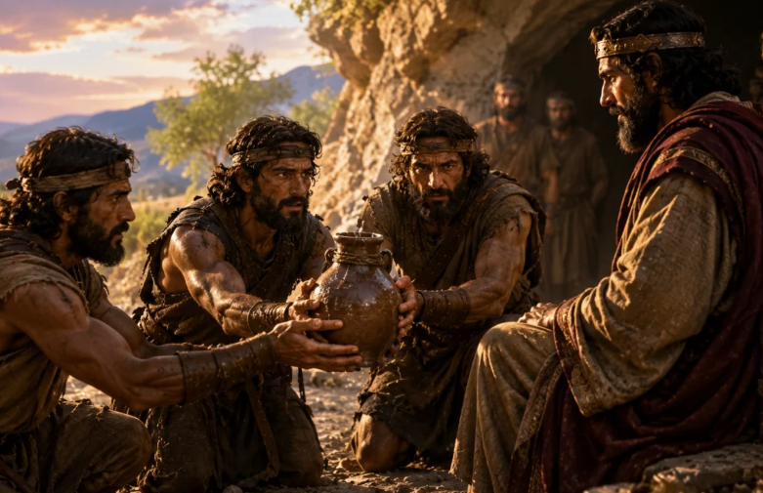
David’s Dynamic Inspiring Leadership Style

Slide 14
David – A Type of Christ – A Charismatic
Inspiring – Motivating Leader
At that time David was in the stronghold, and the Philistine garrison was at Bethlehem. 15 David longed for water and said, "Oh, that someone would get me a drink of water from the well near the gate of Bethlehem!" 16 So the three mighty men broke through the Philistine lines, drew water from the well near the gate of Bethlehem and carried it back to David. But he refused to drink it; instead, he poured it out before the LORD. 17 "Far be it from me, O LORD, to do this!" he said. "Is it not the blood of men who went at the risk of their lives?" And David would not drink it. Such were the exploits of the three mighty men. 2 Samuel 23:8-17 (NIV)

Slide 15
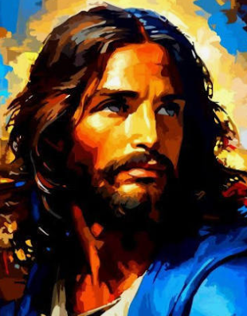
David – A Type of Christ – A Charismatic
Daring – Rescuing - Motivating Leader
Who is this man Who is called the Son of God - called Jesus Christ of Nazareth: Who is so utterly astonishing in magnetism, in beauty, in daring sacrificial rescuing love, and inspiring and evoking awe, loyalty, and full devotion at a level beyond measure?

Slide 16
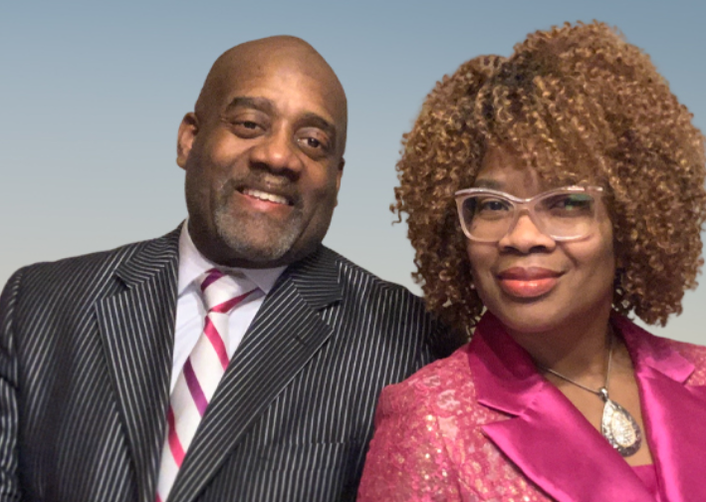

Giving a Cup Of Cold Water
Because Jesus Longs To
Show Himself Through His People
Clarence and Lisa Robbins

Slide 17
Jesus’ Excellency – Overcomes The Apathy and Unbelief of Our Generation
And Teaches Us To Give A “Good Report”
And Caleb stilled the people before Moses, and said, Let us go up at once, and possess it; for we are well able to overcome it. ³¹ But the men that went up with him said, We be not able to go up against the people; for they are stronger than we. ³² And they brought up an evil report of the land which they had searched. Numbers 13:30-32 (KJV)
And these all, having obtained a good report through faith, received not the promise: ⁴⁰ God having provided some better thing for us, that they without us should not be made perfect.
Hebrews 11:39-40 (KJV)

Slide 18
Giving a Good Report
Because Jesus Leads You In Victory
ALL OF THOSE WHO STOOD FOR A PRACTICAL “LINE IN THE STAND” CONCERNING BOYS IN GIRLS LOCKER ROOMS – AND OVER-THE TOP SEXUAL BOOKS IN A PUBLIC SCHOOL LIBRARY - AND THE CULTURE LAUGHED AT YOU AND SAVAGED YOU IN THE NEWS PAPERS– YOU GAVE A GOOD REPORT
ALL WHO PRAYED AND FASTED AND VOTED FOR THE EXPOSING OF CORRUPTION IN OUR NATION – AND AN OUTPOURING OF THE HOLY SPIRIT FOR REVIVAL AND REFORMATION – AND THE ANSWER WAS BEEN DELAYED AT TIMES – YOU GAVE A GOOD REPORT

Slide 19
ALL OF YOU WHO PLAN EVENTS TO INCREASE THE GOSPEL EXPOSURE THROUGH WORSHIP AND EVANGELISM IN THE PUBLIC SPACES – NO MATTER HOW MANY PEOPLE SHOW UP OR RESPOND IN THIS HOUR – STAY FAITHFUL – YOU ARE GIVING A GOOD REPORT
ALL OF YOU WHO ARE LABORING FOR RESTORED AND GRACE-FILLED RELATIONSHIPS AROUND YOU AND THERE IS STILL A LOT OF PRAYING AND HARD WORK AHEAD – YOU ARE GIVING A GOOD REPORT

Slide 20
Spiritual Faith Declarations
Because of the Excellency Of Christ
“Heavenly Father,
I declare that I have repented of my sins and received true pardon from the grace lavished on me at the Cross of Your Son Jesus Christ. In His finished work, I have Your favor today. I declare that I am, by Your Holy Spirit, strong and well able to fulfill my God-given callings through grace.”
“I declare that all my days were ordained for me before I was born. That my mission is to do the works You have prepared for me to accomplish. Your success is upon my family and my labors and I expect to succeed in my mission and not fail.”

Slide 21
“Father, I thank You for causing me to make good decisions with a clear mind. I declare that You are the greatest Leader of the universe and that You work in me “what is well pleasing in Your sight” so that I can do all things through Christ Who strengthens me.”
“Forgive me, when I become obsessed with my needs and problems and the high-drama in America and I stop seeking FIRST Your Kingdom and righteousness by prayer and by sharing the spiritual wealth You already given me.”

Slide 22
“I thank You for Your favor today not JUST because of who I am, but because of Whose I am. I am a child of the Most High God, the Creator of the whole universe. I commit this day to You. I have been saved, adopted, transformed, filled with the Spirit, and given the opportunity to shine Your love and truth into the world.”
“Lord do all Your will in me; and put me in any position which will most fully illustrate and lift up Your grace, only let it greatly glorify Your name. Amen!”

