Slide 1
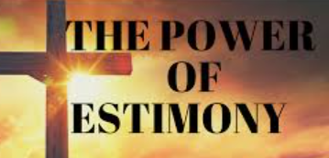
“Why We Value The Culture
Of Testifying At LifeGate”
LifeGate Devotional
February 22, 2026

Slide 2

February 8
Is Jesus Lord Over Your Mouth?
Godly Conversations
March 1
Is Jesus Lord Over Your Wallet?
Biblical Stewardship
March 22
Is Jesus Lord Over Your Imagination?
Biblical Authority Over Technology

Slide 3
Key Verses For Today
One generation will commend your works to another; they will tell of your mighty acts. ⁵ They will speak of the glorious splendor of your majesty, and I will meditate on your wonderful works. ⁶ They will tell of the power of your awesome works, and I will proclaim your great deeds. Psalm 145:4-6 (NIV)
¹⁶ Then they that feared the LORD spake often one to another: and the LORD hearkened, and heard it, and a book of remembrance was written before him for them that feared the LORD, and that thought upon his name. Malachi 3:16 (KJV)

Slide 4
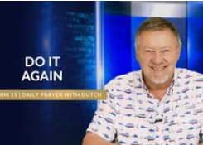
Messianic Rabbi once asked me ( a post from July 25, 2023 ), “Do you know what the Hebrew word for ‘testimony “The root word for ‘testimony’ means ‘to repeat; to do again,’ or ‘do time again.’ “We believe that when one declares God’s Word or shares what He did in the past – a testimony – the same power is released to ‘do it again’.
“We believe that when one declares God’s Word or shares what He did in the past – a testimony – the same power is released to ‘do it again’ today. That’s why we believe it’s so important to tell our children what God did in the past.”

Slide 5
Power and purpose are released through the sound of our voices releasing God’s Word and works through faith: Gina Gholston
shouts of triumph,
worship and thanksgiving to the Lord,
testimonies,
prayers and faith agreement,
decrees,
declarations and proclamations of the Word of God,
forerunning declarations that move mountains, raise valleys, and make crooked places straight, preparing the way for what is to follow.

Slide 6
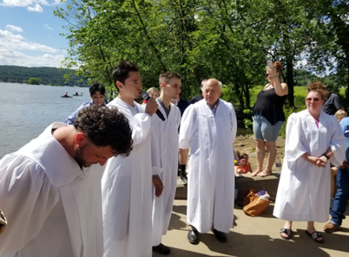
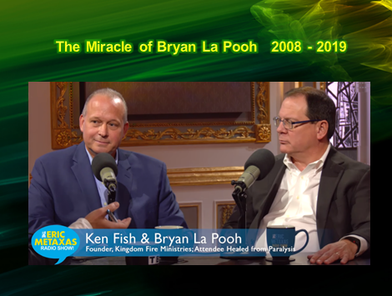
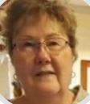
2020 Was A Year Of Craziness
But A Year Of Testimonies
BAPTISMS IN THE
RIVER PENTECOST

Slide 7
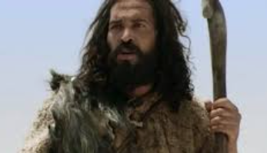
WE ARE THE LENS
THAT THE LIGHT SHINES THROUGH
He (John the Baptist) came as a witness to testify (TO BEAR WITNESS TO GIVE A GOOD REPORT) concerning that light, so that through him all men might believe. ⁸ He himself was not the light; he came only as a witness to the light. ⁹ The true light that gives light to every man was coming into the world. John 1:7-9 (NIV)

Slide 8
Keep Re-Telling Your Stories
To Your Children and Neighbors
The Mercy of God Toward You
Victories Won
Providential Connections
Divine Appointments
Divine Protection
Heavenly Kisses
A Kindness of a Stranger

Slide 9
THE APOSTLES SHARED AND TESTIFIED
The whole assembly became silent as they listened to Barnabas and Paul telling about the miraculous signs and wonders God had done among the Gentiles through them. Acts 15:12 (NIV)
But I have had God's help to this very day, and so I stand here and testify to small and great alike. I am saying nothing beyond what the prophets and Moses said would happen-- ²³ that the Christ would suffer and, as the first to rise from the dead, would proclaim light to His own people and to the Gentiles." Acts 26:22-23 (NIV)

Slide 10
Application
Speak Often To one another
Create a HABIT of testifying of what God has done
Ask others about their stories
Give God all the Glory

