Slide 1

Wisdom in dealing with Things we Can’t Control

Slide 2


Slide 3
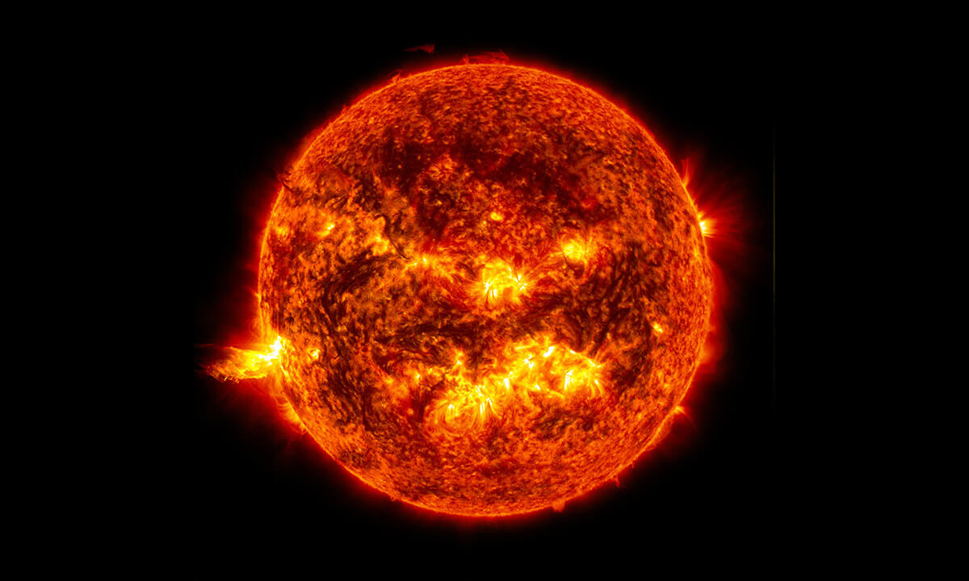
The Sun burns 700,000,000 tons of fuel……..

Slide 4
Things you can control:
What you eat
What you wear
What you listen too
What you watch
The people you hang out with
How much you sleep
Music you listen too
The news you watch

Slide 5
Things you can’t control
The weather
The Economy
Cancer/ Accidents/ breakdowns
What people think of you
Price of gas
The amount of oxygen in the atmosphere
How long you live
The outcome of a football game

Slide 6
Reflect on God’s Greatness
No human wisdom or understanding or plan can stand against the Lord.
³¹ The horse is prepared for the day of battle, but the victory belongs to the Lord.
Prov. 21: 30 -31

Slide 7
Remind ourselves that Human abilities aren’t enough!
Unless the Lord builds a house, the work of the builders is wasted. Unless the Lord protects a city, guarding it with sentries will do no good. ² It is useless for you to work so hard from early morning until late at night, anxiously working for food to eat; for God gives rest to his loved ones.
Psalm 127: 1-2

Slide 8
Tap into God’s “TREST”
Now, God has offered us the promise that we may receive that rest he spoke about. Let us take care, then, that none of you will be found to have failed to receive that promised rest. ² For we have heard the Good News, just as they did. They heard the message, but it did them no good, because when they heard it, they did not accept it with faith. ³ We who believe, then, do receive that rest which God promised.
Heb. 4: 1- 3 GNT

Slide 9
Include extra time to wait on the Lord’s Affirmation
But those who trust in the Lord for help will find their strength renewed. They will rise on wings like eagles; they will run and not get weary; they will walk and not grow weak.
Isa. 40:31

Slide 10
By accepting that things didn’t turn out the way we planned –is not defeat!
⁸ We know that in all things God works for good with those who love him,^{[a]} those whom he has called according to his purpose.
Rom. 8:28

