Slide 1

“Let Your Conversation
Be Seasoned With Salt”
“Is Jesus Lord of Your MOUTH”
LifeGate Message
February 8, 2026

Slide 2
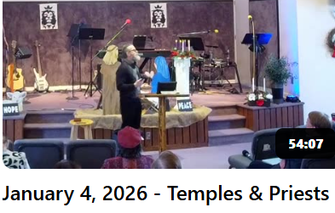

The Synergy Of God Working
But We must Work With Him To Conquer
Being Priests Unto God
Aligning our Will with His Purpose
Living In Our Privileges and Authority
The LORD said to me, "See, I have begun to deliver Sihon and his country over to you. Now begin to conquer and possess his land." Deuteronomy 2:31 (NIV) Cross reference Number 21:23

Slide 3

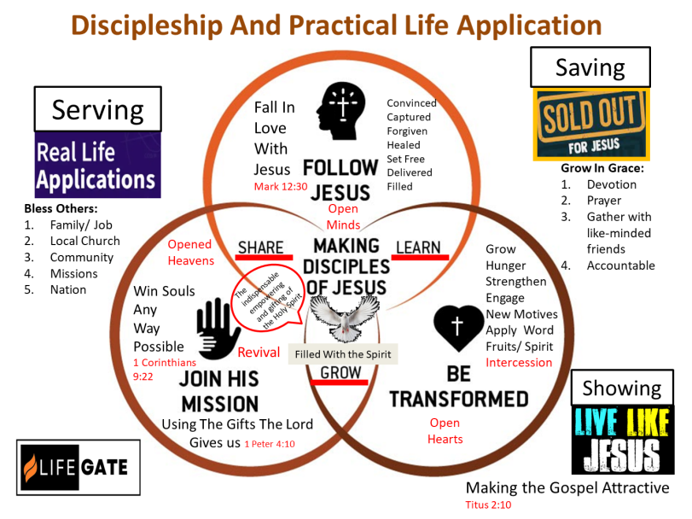

Slide 4

We Are On A Journey Together
We Are NOT Just Into Church Attendance
We Are About Life-Transformation Together
This is Why We Are Passionate About
PRACTICAL DISCIPLESHIP
Follow Jesus
Follow Jesus
1. GOD WANTS YOU TO BELONG TO HIS FAMILY – Embracing people – creating true Biblical community
2. GOD WANTS YOU TO KNOW HIM PERSONALLY IN DEEPER WAYS – Walking– obedience – and daily fellowship with God.
Transformed
Join His Mission
3. GOD WANTS YOU – SET FREE –Inner Healing – Lifting off of addictions – Deliverance/ life on life coaching.
4. GOD WANTS YOU EMPOWERED TO SERVE– Prayer and the Holy Spirit - is essential – to the mission.

Slide 5

February 8
Is Jesus Lord Over Your Mouth?
Godly Conversations
February 22
Is Jesus Lord Over Your Wallet?
Biblical Stewardship
March 1
Is Jesus Lord Over Your Imagination?
Biblical Authority Over Technology

Slide 6
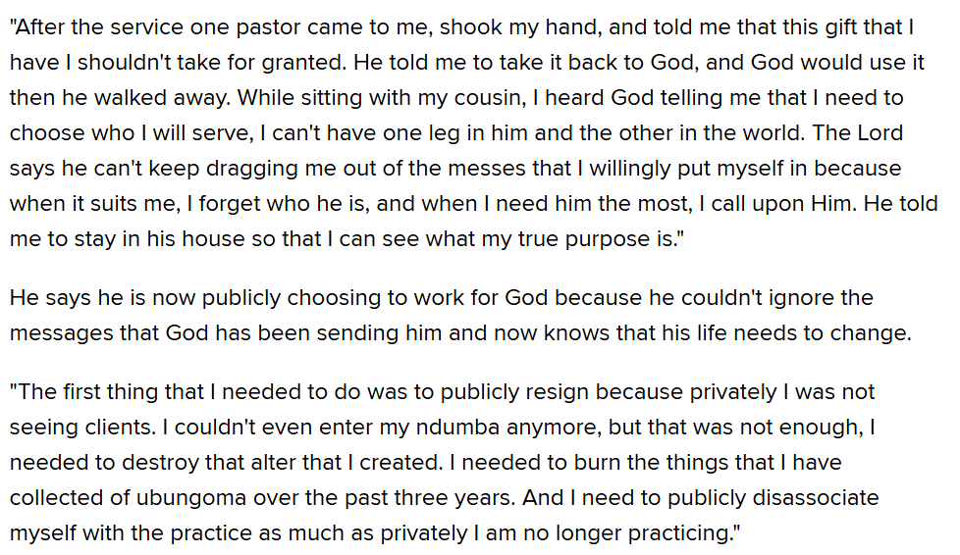
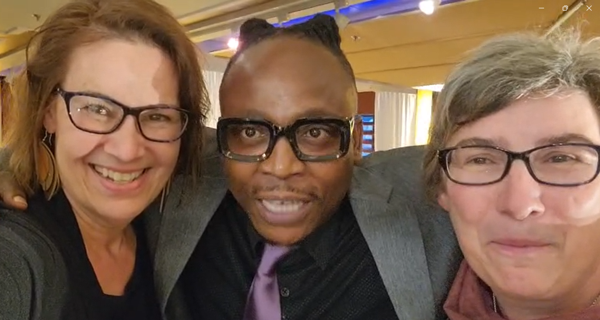

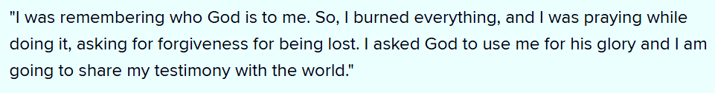
God Is Moving All Around The World
Thabiso Mokhethi

Slide 7
Prayers of Consecration
Lord we consecrate, dedicate, and commit our families to You.
Lord we consecrate, dedicate, and commit our Callings and Visions and Careers and Jobs to You.
Lord we consecrate, dedicate, and commit our relationships to You.
Lord we consecrate, dedicate, and commit our Interests and hobbies to You.
Bikers – climbers – artists – hunters – Kayakers – Sports- Crafts
Writers – Musicians - Inventors -

Slide 8
Key Verses For Today
Let your conversation be always full of grace, seasoned with salt, so that you may know how to answer everyone. Colossians 4:6 (NIV)
Death and life are in the power of the tongue: and they that love it shall eat the fruit thereof. Proverbs 18:21 (KJV)
The tongue that brings healing is a tree of life, but a deceitful tongue crushes the spirit. Proverbs 15:4 (NIV)

Slide 9
These Eight Verses ALONE – Would Change America
Therefore each of you must put off falsehood and speak truthfully to his neighbor, for we are all members of one body. ²⁶ "In your anger do not sin": Do not let the sun go down while you are still angry, ²⁷ and do not give the devil a foothold. ²⁸ He who has been stealing must steal no longer, but must work, doing something useful with his own hands, that he may have something to share with those in need. ²⁹ Do not let any unwholesome talk come out of your mouths, but only what is helpful for building others up according to their needs, that it may benefit those who listen. ³⁰ And do not grieve the Holy Spirit of God, with whom you were sealed for the day of redemption. ³¹ Get rid of all bitterness, rage and anger, brawling and slander, along with every form of malice. ³² Be kind and compassionate to one another, forgiving each other, just as in Christ God forgave you. Ephesians 4:25-32 (NIV)

Slide 10

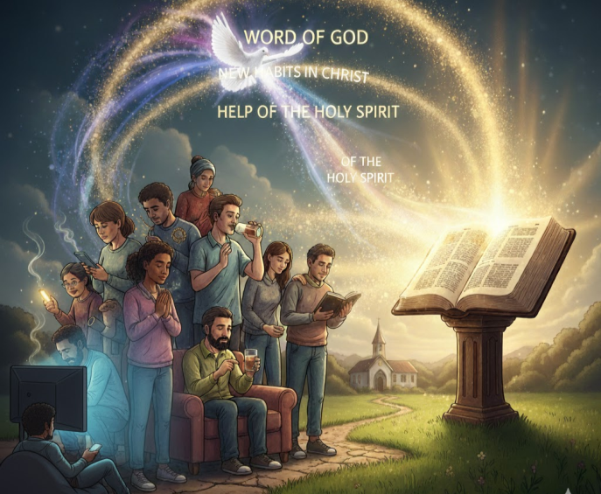

Allowing The Holy Spirit And the Word
(and good Books) To Change Our Habits

Slide 11
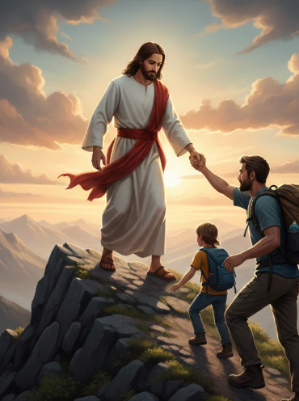
Friendship – Leadership
And Parenting (Grand Parenting) is
Having Jesus Lead us First
So That We can Lead and Guide Others

Slide 12
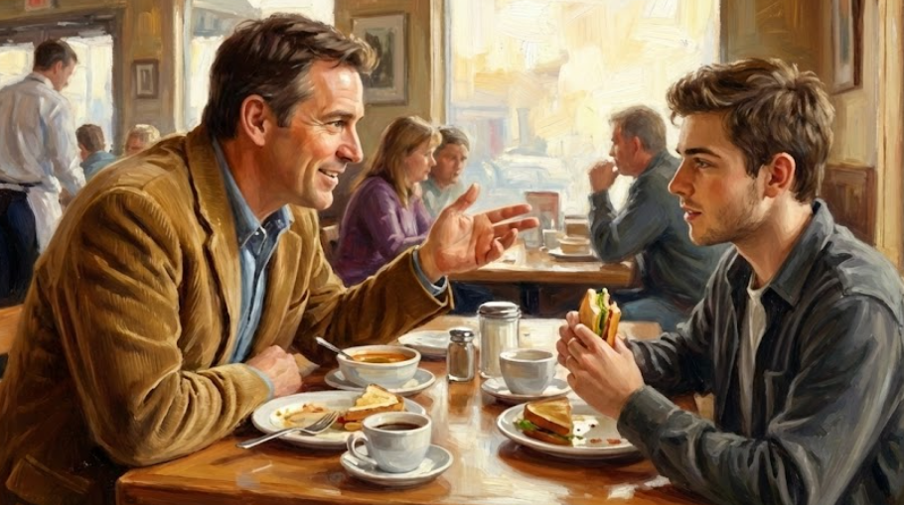
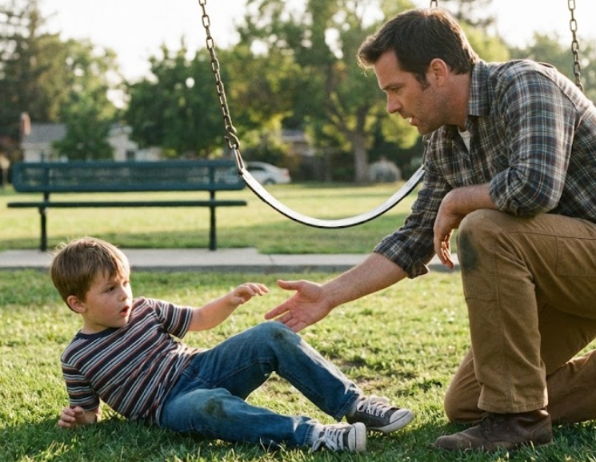
Each Single or Family Gets A Copy Turn to Page 16
Being Parented By God
Go To Page 184
Let’s Read Two Stories
James 5:16 Confess Your faults to one another and be healed

Slide 13

The GRACE in Conversation Is Jesus
and The SALT is the Holy Spirit and the Word of God
Sanctified conversation is the rhythm that turns family into friends and friends into family.
Being intentional about our habits in healthy conversation is the way we begin teaching the culture of friendship
Make room for important conversations – A/ is there a room where it is inviting and there is no TV- B/ Are the phones put away during certain times – C/ As a couple could you light a candle or a fire.

Slide 14
What does The Term
Liturgy Mean in this book
A REPEATED ACT OF WORSHIP OR DEVOTION
In Habits of the Household, Justin Earley (Presbyterian) defines liturgy as repeated patterns of words or actions that form us, much like habits, but with the key difference that liturgy consciously points toward worship, shaping us to love God and our neighbor, even when our daily routines seem mundane. He expands the concept beyond formal church services to include everyday family routines like meals, bedtime, and transitions.

Slide 15
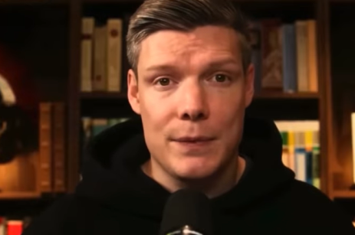
We Were Never Created
For Non- Stop Conversation and Drama
God never created us to need to know the personal opinions of thousands of people all in one moment.
There is only so Much Bandwidth we each have-
We were never deigned for non-stop divisiveness
and criticism and constant negativity – We have
to get GRACE and SALT into our environments
HINT – most Youtube podcasts don’t get popular from being positive – but from be critical
Wess Huff
What if we each lived this out daily – “but only what is helpful for building others up according to their needs, that it may benefit those who listen. ³⁰ And do not grieve the Holy Spirit of God, with whom you were sealed for the day of redemption.”

Slide 16
Through Consecration And Changing our Conversations And Releasing
Revival God Is Building A Community
That Overcomes The World
“At Bethesda Temple in 1949 the atmosphere of the church had a 1/ spirit of prayer that was "characterized by 2/brokenness, 3/ yieldedness,
4/ illumination upon the Word, 5/restfulness in His presence, 6/ loss of appetite for food, (PRAYING AND FASTING CONSTANTLY) and a 7/ flow of love and fellowship that made total strangers feel 'at home' with one another. There was an 8/ inward bubbling of joy, yet also a great seriousness; there was 9/ a liberating freedom yet a sense of the 10/ burning fire of God sanctifying work in one’s personal life.” Ivan Spencer

Slide 17
Be Encouraged – But Be Vigilant
“Every move of the Holy Spirit calls for watchfulness, and the one we are entering into right now is no exception. If this work of grace is to be received in its fullness, every member of the body must guard his or her heart very closely. Do nothing that will grieve the Holy Spirit. He is the key to everything and is so sensitive about sin and compromise that He can pass from among us without our having received the full blessing He desires to give us. Let all selfishness be put away from us. Let our Home life be consistent with our confession. Let us be on guard in all of our conversation. Let there be no word of judgment concerning any brother. Speak more often to God about one another’s faults and there will be fewer fault’s to speak about. Do not neglect family and private intercession. Join in with the church prayer meetings. Instantly obey the Spirit’s promptings, and if He suggests you to speak to someone, do it without questioning. He will give the grace and power.” 1915

Slide 18
Set a guard over my mouth, O LORD; keep watch over the door of my lips. Psalm 141:3 (NIV)
A good man out of the good treasure of his heart brings forth that which is good; and an evil man out of the evil treasure of his heart brings forth that which is evil: for out the abundance of the heart his mouth speaks. Luke 6:45 (KJV)
We all stumble in many ways. If anyone is never at fault in what he says, he is a perfect man, able to keep his whole body in check. James 3:2 (NIV)
With the tongue we praise our Lord and Father, and with it we curse men, who have been made in God's likeness. ¹⁰ Out of the same mouth come praise and cursing. My brothers, this should not be. ¹¹ Can both fresh water and salt water flow from the same spring? ¹² My brothers, can a fig tree bear olives, or a grapevine bear figs? Neither can a salt spring produce fresh water. ¹³ Who is wise and understanding among you? Let him show it by his good life, by deeds done in the humility that comes from wisdom. James 3:9-13 (NIV)

Slide 19
Application
Allow Jesus To Parent you so you can parent your family (grand children) – have you turned your conversations over to Him to be filled with GRACE and SALT for those around you?
What HABITS do you need to change in your RHYTHM of Life to be more accessible to your family and friends to build them up in Christ? – take walks – turn off all devices and have conversations – have a family over and get to know them.
Can You surrender to the counter-intuitive GLORY of the Holy Spirit and work to encourage someone who frustrates you or irritates you at the moment?
Remember We are CALLED to have CLEAN HEARTS – CLEAN LIPS – and CLEAN HANDS.

