Slide 1
Good Soil
Lifegate 2/1/26

Slide 2
Luke 8:4-15
Parable of the Farmer Scattering Seed
4 One day Jesus told a story in the form of a parable to a large crowd that had gathered from many towns to hear him: 5 “A farmer went out to plant his seed. As he scattered it across his field, some seed fell on a footpath, where it was stepped on, and the birds ate it. 6 Other seed fell among rocks. It began to grow, but the plant soon wilted and died for lack of moisture.

Slide 3
Luke 8:4-15
7 Other seed fell among thorns that grew up with it and choked out the tender plants. 8 Still other seed fell on fertile soil. This seed grew and produced a crop that was a hundred times as much as had been planted!” When he had said this, he called out, “Anyone with ears to hear should listen and understand.”
9 His disciples asked him what this parable meant. 10 He replied, “You are permitted to understand the secrets of the Kingdom of God. But I use parables to teach the others so that the Scriptures might be fulfilled:
‘When they look, they won’t really see. When they hear, they won’t understand.’

Slide 4
Luke 8:4-15
11 “This is the meaning of the parable: The seed is God’s word. 12 The seeds that fell on the footpath represent those who hear the message, only to have the devil come and take it away from their hearts and prevent them from believing and being saved. 13 The seeds on the rocky soil represent those who hear the message and receive it with joy. But since they don’t have deep roots, they believe for a while, then they fall away when they face temptation. 14 The seeds that fell among the thorns represent those who hear the message, but all too quickly the message is crowded out by the cares and riches and pleasures of this life. And so they never grow into maturity. 15 And the seeds that fell on the good soil represent honest, good-hearted people who hear God’s word, cling to it, and patiently produce a huge harvest.

Slide 5
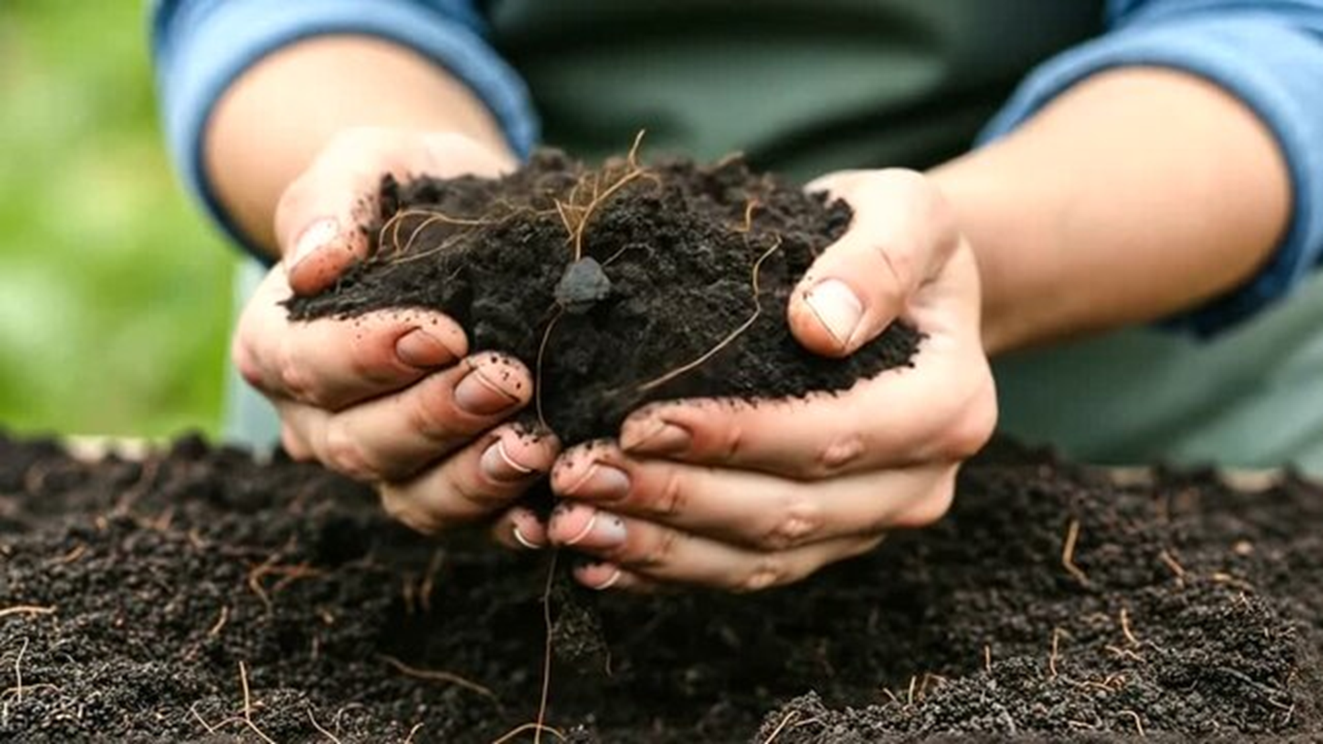
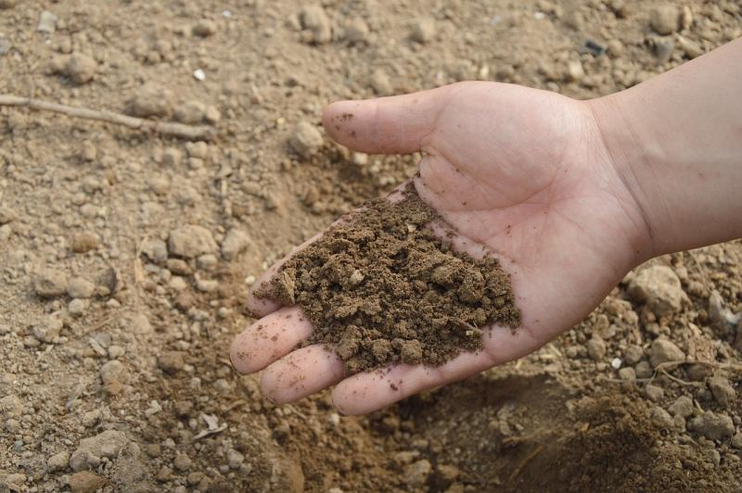
Soil = the heart of the hearer.

Slide 6
What defines “the good soil”?
Matt 13:23
The seed that fell on good soil represents those who truly hear and understand God’s word and produce a harvest of thirty, sixty, or even a hundred times as much as had been planted!” [NLT]
Mark 4:20
20 And the seed that fell on good soil represents those who hear and accept [receive] God’s word and produce a harvest of thirty, sixty, or even a hundred times as much as had been planted! [NLT] [emphasis added]
Luke 8:15
And the seeds that fell on the good soil represent honest, good-hearted people who hear God’s word, cling to it, and patiently produce a huge harvest. [NLT]
“…retain it, and by persevering produce a crop.” [NIV]
“… keep it and bear fruit with patience.” [NKJV]

Slide 7
Think—The land/soil referring to the heart
Proverbs 12:11
Those who work their land will have abundant food, but those who chase fantasies have no sense [NIV]
Proverbs 20:4
Sluggards do not plow in season; so at harvest time they look but find nothing. [NIV]
Hebrews 6:8
But land that produces thorns and thistles is worthless and is in danger of being cursed. In the end it will be burned. [NIV]

Slide 8
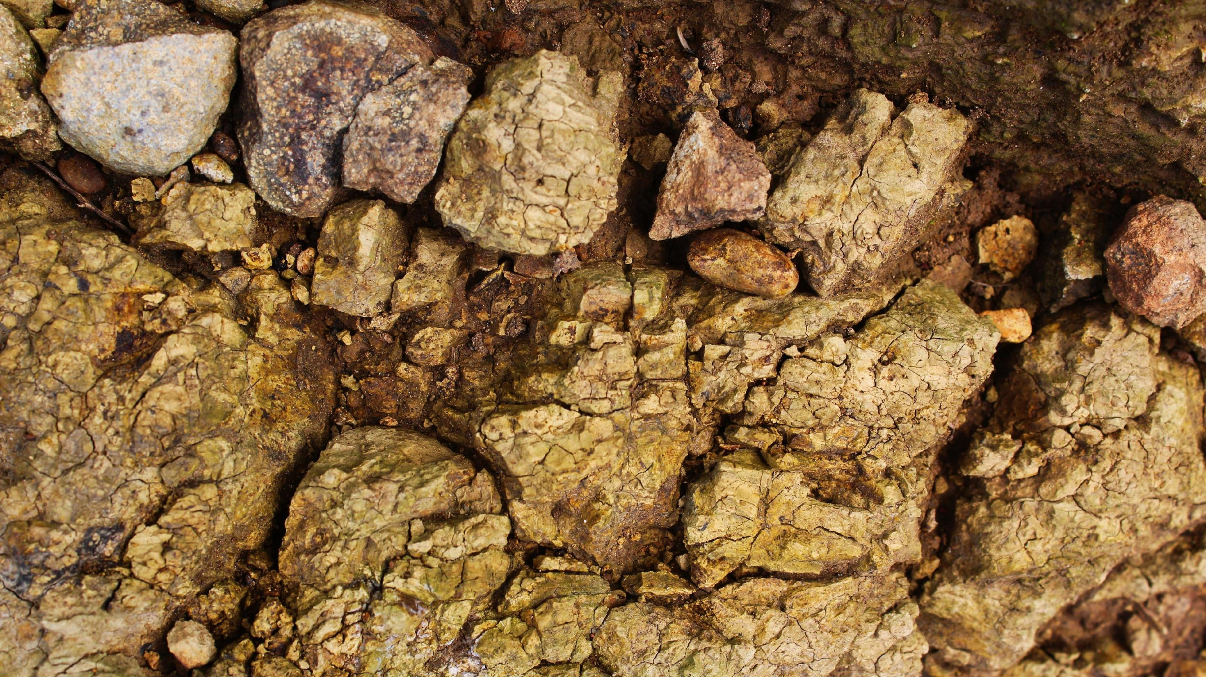

Slide 9
Examples of The Rocks and weeds:
Galatians 5:19-21 “When you follow the desires of your sinful nature, the results are very clear: sexual immorality, impurity, lustful pleasures, 20 idolatry, sorcery, hostility, quarreling, jealousy, outbursts of anger, selfish ambition, dissension, division, 21 envy, drunkenness, wild parties, and other sins like these…” [NLT]
James 3:16 “For where you have envy and selfish ambition, there you find disorder and every evil practice.” [NLT]
Colossians 3:5 “So put to death the sinful, earthly things lurking within you. Have nothing to do with sexual immorality, impurity, lust, and evil desires. Don’t be greedy, for a greedy person is an idolater, worshiping the things of this world.” [NLT]
Ephesians 4:31-32 “Get rid of all bitterness, rage, anger, harsh words, and slander, as well as all types of evil behavior. 32 Instead, be kind to each other, tenderhearted, forgiving one another, just as God through Christ has forgiven you.” [NLT]
Ephesians 5:3-4 “Let there be no sexual immorality, impurity, or greed among you. Such sins have no place among God’s people. 4 Obscene stories, foolish talk, and coarse jokes—these are not for you. Instead, let there be thankfulness to God.” [NLT]

Slide 10
Warning against the hardening of the heart
Hebrews 3:12-14
See to it, brothers and sisters, that none of you has a sinful, unbelieving heart that turns away from the living God. 13 But encourage one another daily, as long as it is called “Today,” so that none of you may be hardened by sin’s deceitfulness. 14 We have come to share in Christ, if indeed we hold our original conviction firmly to the very end. [NIV]

Slide 11
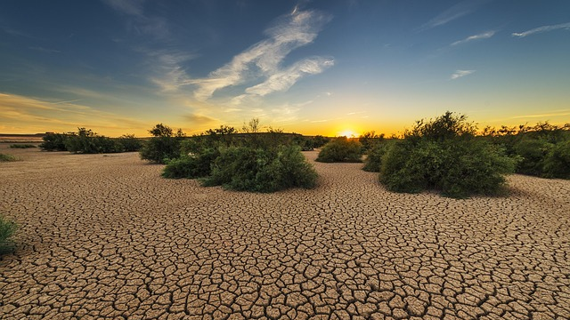

Slide 12
Drink of the Holy Spirit
John 7:37-38
…Jesus stood and said in a loud voice, “Let anyone who is thirsty come to me and drink. 38 Whoever believes in me, as Scripture has said, rivers of living water will flow from within them.” [NIV]
John 4:14
But those who drink the water I give will never be thirsty again. It becomes a fresh, bubbling spring within them, giving them eternal life.” [NLT]

Slide 13
Caring for the garden of communion/ intimacy with the Lord—your heart
Genesis 2:15
The Lord God took the man and put him in the Garden of Eden to work it and take care of it.
Today, the garden of intimacy is our hearts.
The work:
Break up the fallow ground. Till up the soil. Pull the weeds. Removed the rocks of hinderance. Fertilize the soil.

Slide 14
Post-Fall labor/Because of sin…
Genesis 3:17-19
¹⁷ To Adam he said, “Because you listened to your wife and ate fruit from the tree about which I commanded you, ‘You must not eat from it,’
“Cursed is the ground because of you;
through painful toil you will eat food from it
all the days of your life.
¹⁸ It will produce thorns and thistles for you,
and you will eat the plants of the field.
¹⁹ By the sweat of your brow
you will eat your food
until you return to the ground,
since from it you were taken;
for dust you are
and to dust you will return.” [NIV]

Slide 15
What is the Fallow ground?
Fallow ground—land that has not been tilled up and cultivated; A heart that still needs to be broken up through repentance, prayer, and seeking the Lord.
Tilling up the soil is partnership, where the individual works, but God then provides the increase.
Partnership with God is stewardship of the garden of intimacy (your heart).
The Land/Soil is a person's heart (internal, while the Fruit is external

Slide 16
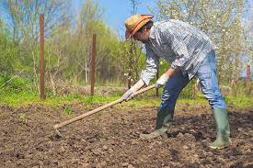
Till up the soil of your heart
Hosea 10:12 NLT
I said, ‘Plant the good seeds of righteousness, and you will harvest a crop of love. Plow up the hard ground of your hearts, for now is the time to seek the LORD, that he may come and shower righteousness upon you.’

Slide 17
Why did the soil not produce?
Because, the soil was not tilled. The ground had not been worked.
Luke 8:6
6 Some fell on rocky ground, and when it came up, the plants withered because they had no moisture.
Luke 13:6-9
6 Then he told this parable: “A man had a fig tree growing in his vineyard, and he went to look for fruit on it but did not find any. 7 So he said to the man who took care of the vineyard, ‘For three years now I’ve been coming to look for fruit on this fig tree and haven’t found any. Cut it down! Why should it use up the soil?’ 8 “‘Sir,’ the man replied, ‘leave it alone for one more year, and I’ll dig around it and fertilize it. 9 If it bears fruit next year, fine! If not, then cut it down.’”

Slide 18
We partner with God for the cultivation of our hearts
1 Corinthians 3:9
For we are both God’s workers. And you are God’s field. You are God’s building.[NLT]
Ezekiel 36:25-27
“Then I will sprinkle clean water on you, and you will be clean. Your filth will be washed away, and you will no longer worship idols. 26 And I will give you a new heart, and I will put a new spirit in you. I will take out your stony, stubborn heart and give you a tender, responsive heart. 27 And I will put my Spirit in you so that you will follow my decrees and be careful to obey my regulations. [NLT]

Slide 19


Slide 20
What does the good soil do?
In response to hearing the Word:
“Good soil” is able to—accept, receive, understand, obey, cling/holds fast to, retain and persevere
Matthew 17:20
“…Truly I tell you, if you have faith as small as a mustard seed, you can say to this mountain, ‘Move from here to there,’ and it will move. Nothing will be impossible for you.”
[If you have been given a mustard seed, are you doing anything with it?]

Slide 21
Heart check
Ask and reflect:
Is my heart functioning as good soil?
Have I been ignoring or neglecting any rocks and weeds in the garden of my heart?
Have I planted the mustard seed? Or is it still sitting in the package?

Slide 22
If you want to see change in your life
SEEK and THE LORD DAILY!
Matthew 6:6
But when you pray, go into your room, close the door and pray to your Father, who is unseen. Then your Father, who sees what is done in secret, will reward you. [NIV]
Matthew 6:31-33
“So don’t worry about these things, saying, ‘What will we eat? What will we drink? What will we wear?’ 32 These things dominate the thoughts of unbelievers, but your heavenly Father already knows all your needs. 33 Seek the Kingdom of God above all else, and live righteously, and he will give you everything you need. [NLT]

Slide 23
How we improve the soil:
Our Part/tilling up of the soil:
Repentance—confessing and renouncing the rocks and weeds of sin
Prayer—talking to and listening to God, how you learn to recognize His voice
Seeking the Lord daily—time in the secret place, the Word, His presence
His part in us:
He fulfills his promise forgive and cleanse; the watering of the Holy Spirit/provision of His power to do it!
The growth/maturity—He cleanses us and gives us new desires!
The increase/fruit—lives changed now impacting the world around them

Slide 24
