Slide 1

Part 6 –
“Living A Consecrated Life”
We Are Crossing Over Into Greater Fulfillment
LifeGate Sermon
January 11, 2026

Slide 2
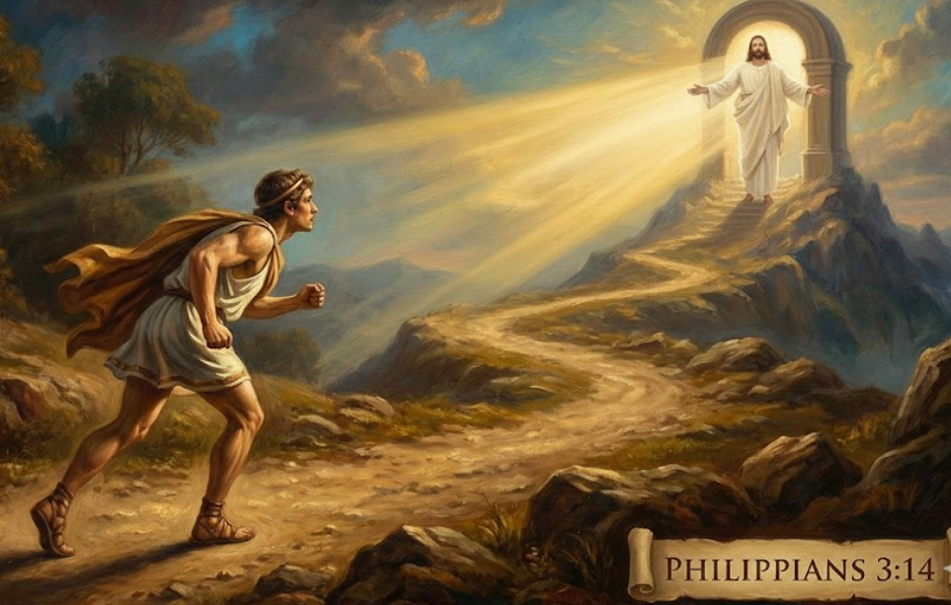
WE ARE CROSSING OVER – THE LORD SAYS:
“I AM CALLING YOU UP HIGHER”
I press toward the mark (goal) for the prize of the high (upward - Heavenward) calling of God in Christ Jesus. Philippians 3:14 (KJV)

Slide 3

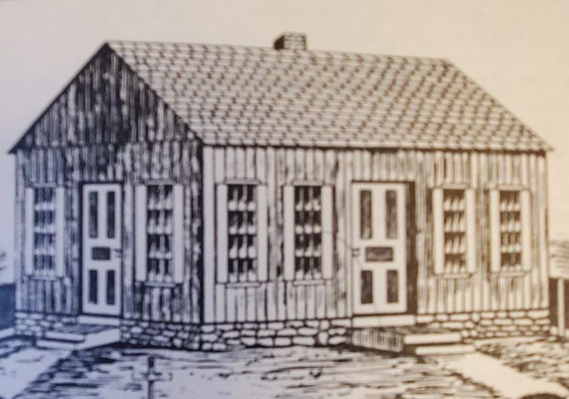

The Blessing And The Miracle
He is the source (AUTHOR – Causative Agent) of eternal salvation for those who obey Him. (Hebrews 5:9)

Slide 4

Preaching
Teaching
Discipleship
Welcome Feedback
Now the Bereans were of more noble character than the Thessalonians, for they received the message with great eagerness and examined the Scriptures every day to see if what Paul said was true. Acts 17:11 (NIV)

Slide 5
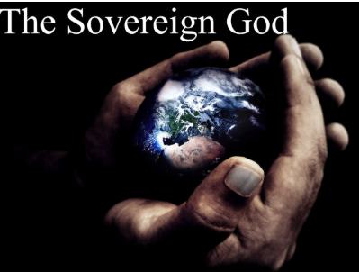
God is Going To Be Boldly Engaged In The Days Ahead
You Have Free Will But There Are Times God Gets Very
Intentional in His Grace And Pushes Things For His Purpose
"'You say, "We want to be like the nations, like the peoples of the world, who serve wood and stone." But what you have in mind will never happen. ³³ As surely as I live, declares the Sovereign LORD, I will rule over you with a mighty hand and an outstretched arm and with outpoured wrath. Ezekiel 20:32-33 (NIV)
God is a Gentleman
In That He gives us a choice – He DOES NOT FORCE US TO LOVE HIM

Slide 6
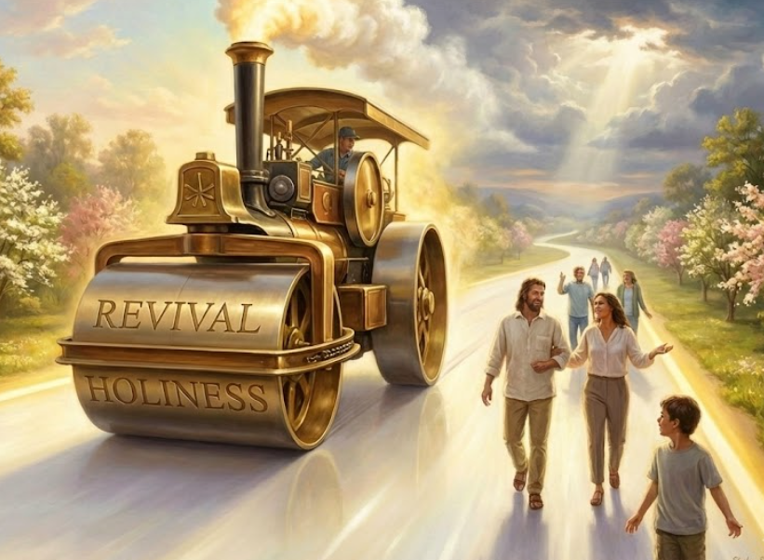
And a highway will be there; it will be called the Way of Holiness. The unclean will not journey on it;. Isaiah 35:8 (NIV)
Then the angel of the LORD said, "LORD Almighty, how long will you withhold mercy from Jerusalem and from the towns of Judah, which you have been angry with these seventy years?" ¹³ So the LORD spoke kind and comforting words to the angel who talked with me. ¹⁴ Then the angel who was speaking to me said, "Proclaim this word: This is what the LORD Almighty says: 'I am very jealous for Jerusalem and Zion, Zechariah 1:12-14 (NIV)

Slide 7
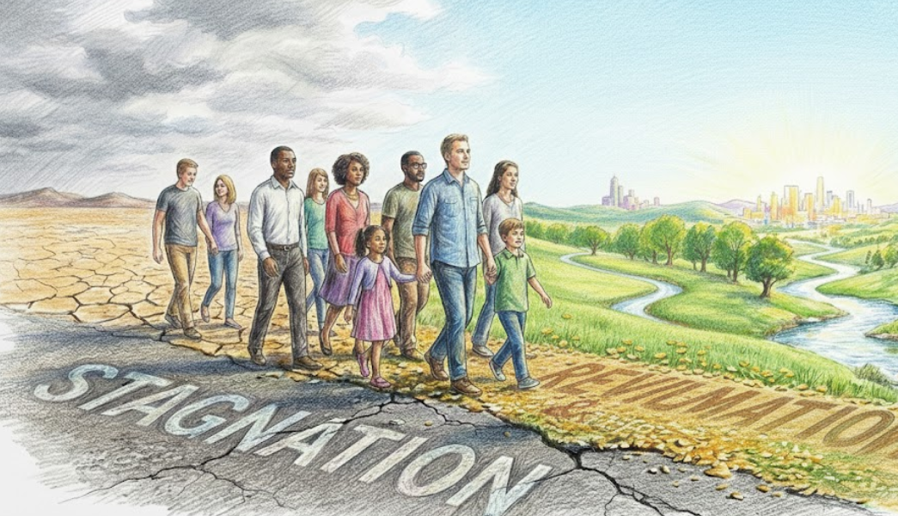

This is the Season For
Crossing Over Into Greater “Fulfillment”
Joshua told the people, "Consecrate (sanctify) yourselves, for tomorrow the LORD will do amazing things among you." Joshua 3:5 (NIV)

Slide 8

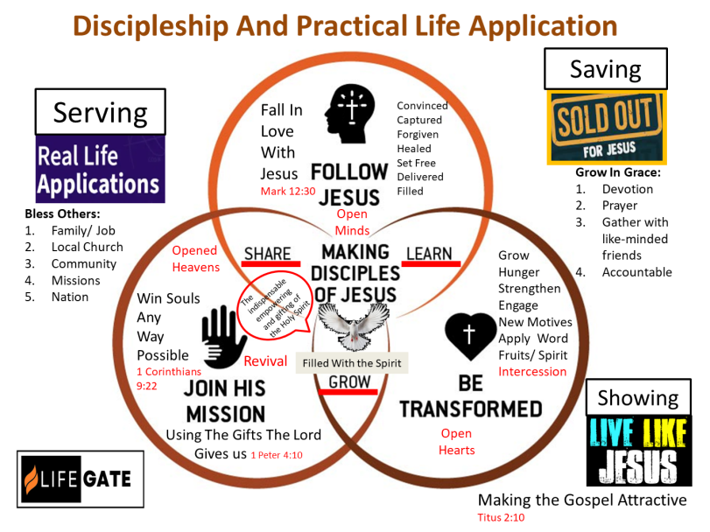
GRAPHIC ON DIFFERENT PRACTICAL
APPLICATIONS OF THE GOSPEL

Slide 9
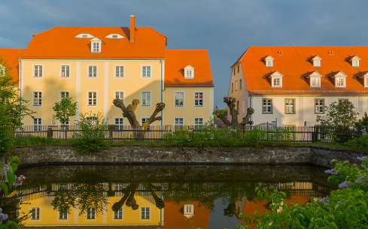
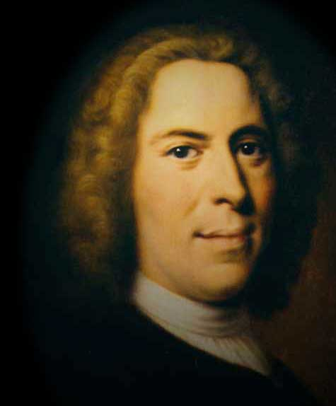
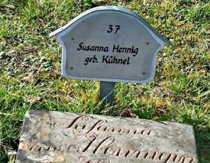
Hungry People Sometimes Struggle
To Came Through
They Consecrated Themselves To The Lord
Count Zinzendorf
He was 27 years old when the revival broke out in 1727
Hernhut Germany
Susanna Kühnel

Slide 10
Does This Feel Familiar?
A Young Community Christian Wants To Do The Right Thing
An in-breaking of Hunger for God
Deep Encounters begin to Happen
Difficulties – hard times – situations and relational battles
Zinzendorf would spend significant time discipling the children and praying for an outpouring of the Spirit on the children.
“The revival amongst the children had a great influence on the parents and the rest of the inhabitants. After this outpouring of the Spirit, the Lord spoke to Zinzendorf from Leviticus 6:13, that the fire should never go out on the altar! Because of the sacrifice of Christ, they should respond with unceasing night and day prayer because of the absolute worth of the Jesus!”

Slide 11
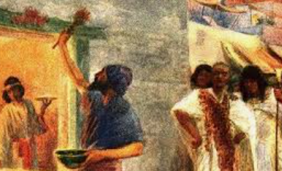
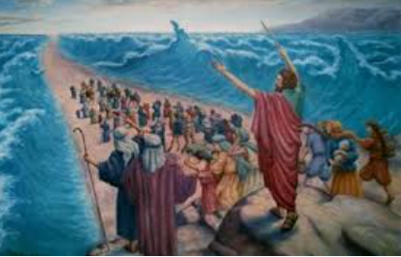
The Old Testament Is A Prophetic Picture of Salvation
For I do not want you to be ignorant of the fact, brothers, that our forefathers were all under the cloud and that they all passed through the sea. ² They were all baptized into Moses in the cloud and in the sea. ³ They all ate the same spiritual food ⁴ and drank the same spiritual drink; for they drank from the spiritual rock that accompanied them, and that rock was Christ. ⁵ Nevertheless, God was not pleased with most of them; their bodies were scattered over the desert. ⁶ Now these things occurred as examples to keep us from setting our hearts on evil things as they did. ⁷ Do not be idolaters, as some of them were; as it is written: "The people sat down to eat and drink and got up to indulge in pagan revelry." 1 Corinthians 10:1-7 (NIV)
Exodus 12
Exodus 14
Passover Is A
Picture of Salvation
Without the Blood of the “Lamb” No one is saved
REDEMPTION/
FLESH REMOVED
CIRCUMCISION
CONSECRATE FIRST BORN
Passing Through The Red Sea
Is A Picture of “Baptism”
We are WASHED by the Blood and The Spirit
BAPTISM OF FREEDOM

Slide 12
Let’s Review This One Amazing Fact
You Could Not Participate
In the Passover Unless You were Circumcised
⁵ And it shall be when the LORD shall bring you into the land of the Canaanites, and the Hittites, and the Amorites, and the Hivites, and the Jebusites, which he sware unto thy fathers to give thee, a land flowing with milk and honey, that thou shalt keep this service in this month. Exodus 13:5 (KJV)
"An alien living among you who wants to celebrate the LORD's Passover must have all the males in his household circumcised; then he may take part like one born in the land. No uncircumcised male may eat of it. Exodus 12:48 (NIV)
CIRCUMCISION – IS THAT GOD HAS TO OFFEND OUR AFFAIR WITH THE WORLD AND FLESH TO SHOCK US INTO CHANGE - IF WE ARE NOT SHOCKED – IF WE ARE NOT OFFENDED – IF WE DO NOT HAVE A CRISIS IN OUR WILL –WE WILL NOT HAVE BREAKTHROUGH

Slide 13
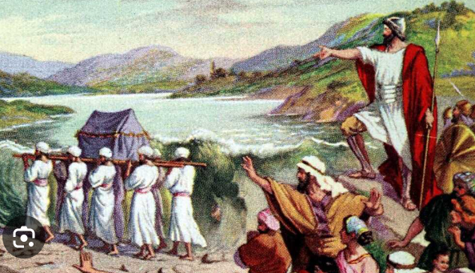
Crossing The Joran River Is A
Prophetic Picture of Fulfillment And Destiny

Slide 14
One of The Greatest Transitions of the Ages
² "Moses my servant is dead. Now then, you and all these people, get ready to cross the Jordan River into the land I am about to give to them--to the Israelites. ³ I will give you every place where you set your foot, as I promised Moses. ⁴ Your territory will extend from the desert to Lebanon …. ⁵ No one will be able to stand up against you all the days of your life. As I was with Moses, so I will be with you; I will never leave you nor forsake you. ⁶ "Be strong and courageous, because you will lead these people to inherit (occupy possess – Luke 19:13) the land I swore to their forefathers to give them. ⁷ Be strong and very courageous. Be careful to obey all the law my servant Moses gave you; do not turn from it to the right or to the left, that you may be successful wherever you go. ⁸ Do not let this Book of the Law depart from your mouth; meditate on it day and night, so that you may be careful to do everything written in it. Then you will be prosperous and successful. Joshua 1:2-8 (NIV)

Slide 15
And Joshua said unto the people, CONSECRATE Sanctify (TO BE OR PRONOUNCE SOMETHING PURE) yourselves: for to morrow the LORD will do wonders among you. Joshua 3:5 (KJV)
Delight thyself also in the LORD; and He shall give thee the desires of thine heart. ⁵ COMMIT your way unto the LORD; trust also in Him; and He shall bring it to pass. Psalm 37:4-5 (KJV)
After three days the officers went throughout the camp, ³ giving orders to the people: "When you see the ark of the covenant of the LORD your God, and the priests, who are Levites, carrying it, you are to move out from your positions and follow it. ⁴ Then you will know which way to go, since you have never been this way before. But keep a distance of about a thousand yards between you and the ark; do not go near it." ⁵ Joshua told the people, "Consecrate yourselves, for tomorrow the LORD will do amazing things among you." Joshua 3:2-5 (NIV)

Slide 16
Out Of This Consecration
Out Of The Glory Of God “Doing Wonders”
God Was Building A “Dynamic Devoted Community”
He said to the Israelites, "In the future when your descendants ask their fathers, 'What do these stones mean?' ²² tell them, 'Israel crossed the Jordan on dry ground.' ²³ For the LORD your God dried up the Jordan before you until you had crossed over. The LORD your God did to the Jordan just what he had done to the Red Sea when he dried it up before us until we had crossed over. ²⁴ He did this so that all the peoples of the earth might know that the hand of the LORD is powerful and so that you might always fear the LORD your God." Joshua 4:21-24 (NIV)

Slide 17
Through Consecration And
Revival God Is Building A Community
That Overcomes The World
They devoted (TO BE EARNEST AND TO ATTEND TO) themselves to the apostles' teaching (MESSAGE) and to the fellowship, (MEETINGS) to the breaking of bread (MUNCHIES) and to prayer. (MANIFEST PRESENCE) ⁴³ Everyone was filled with awe, and many wonders and miraculous signs were done by the apostles. ⁴⁴ All the believers were together and had everything in common. ⁴⁵ Selling their possessions and goods, they gave to anyone as he had need. ⁴⁶ Every day they continued to meet together in the temple courts. They broke bread in their homes and ate together with glad and sincere hearts, ⁴⁷ praising God and enjoying the favor of all the people. And the Lord added to their number daily those who were being saved. Acts 2:42-47 (NIV)

Slide 18

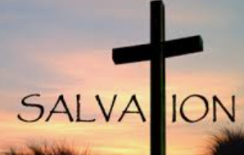
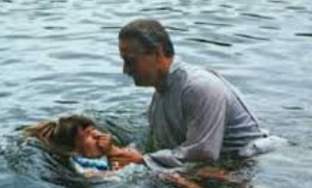
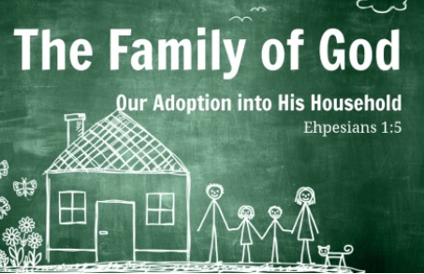
Let’s Review
1
2
3
Then We CROSS OVER into our INHERITANCE IN CHRIST – first in our earthly life of LIFE – SERVICE – AND MINISTRY – and ultimately when we Cross over into Eternity with God in Christ
Through The Price of Jesus – Our Passover Lamb
We become – Circumcised – Cut to the heart – and Saved by the Blood and the Death Angel Passes us by
BAPTISM
Then We make public proclamation that We BELONG TO JESUS – through Baptism – Signifying He raised us from the dead
DYNAMIC COMMUNITY
God is taking us past FIERCE INDEPENDENCE where we have all the answers by ourselves – and is building an interconnected – Spirit-Filled Family of God that works together and loves deeply and honors the diverse Gifts among His Body.
4

Slide 19
Once We Consecrate Ourselves To God
We Must Allow Him To Help Us Cross Over
Into Unhindered Victory
GET PAST YOU OWN FAILURES
WHAT OTHERS HAVE DONE TO YOU
LEARN TO ALLOW YOURSELF TO BE BROKEN
BUT DON’T GET CAUGHT IN THE HEAVINESS
AND SHAME OF YOUR PAST
THE LORD DEALT WITH
YOUR BROKEN IDENTITY ON THE CROSS
DON’T KEEP YOURSELF IN THE PAST
DON’T BE DEFINED BY YOUR CIRCUMSTANCES

Slide 20
Jesus Took Away Our Shame – ONCE AND FOR ALL - We Do Not Have To Carry Our Failures
So We Need To Stay Up-To-Date With God
Let us fix our eyes on Jesus, the author(SOURCE) and Perfecter (FINISHER – COMPLETER) of our faith, who for the joy set before him endured the cross, scorning its shame, and sat down at the right hand of the throne of God.
Hebrews 12:2 (NIV)
"To the angel of the church in Laodicea write: These are the words of the Amen, the faithful and true witness, the ruler of God's creation. ¹⁵ I know your deeds, that you are neither cold nor hot. I wish you were either one or the other! ¹⁶ So, because you are lukewarm--neither hot nor cold--I am about to spit you out of my mouth. ¹⁷ You say, 'I am rich; I have acquired wealth and do not need a thing.' But you do not realize that you are wretched, pitiful, poor, blind and naked. ¹⁸ I counsel you to buy from me gold refined in the fire, so you can become rich; and white clothes to wear, so you can cover your shameful nakedness; and salve to put on your eyes, so you can see. ¹⁹ Those whom I love I rebuke and discipline. So be earnest, and repent. ²⁰ Here I am! I stand at the door and knock. If anyone hears my voice and opens the door, I will come in and eat with him, and he with me. Revelation 3:14-20 (NIV)

Slide 21
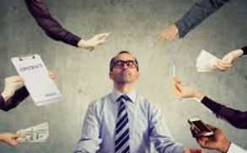

Consecration Will Also Change The Rhythm Of
Life – We Will Make Room/ Time For God
Taming Your Busyness and Chaos
“The secret of failure everywhere is the neglect of private (AND PUBLIC) deep communion with God. India lives too much of a public life to have deep Christianity. The Indian (AMERICAN) Christians will have to alter many of their customs before they will get deeper. It is better to do a little well and prayerfully then to fulfill a whole bunch of engagements with undue haste and rush around and have little effectual power.” Walker of Tinnevelly India (1905)

Slide 22
God Has Promised Us A Good Land
We Inherit the Land of
Devoted Living
Victorious Faith
Purified Hearts and Lives
Healthy Relationships
Revival and Awakening
Dynamic Community
Reformation in the Culture
Continued Unveiling Of God’s Goodness

Slide 23
Let’s Pray Some Prayers of Consecration
Dear Heavenly Father, in the Name of Your Son Jesus Christ and through the Holy Spirit, I consecrate, dedicate, and commit my HEART, MIND, SOUL, and SPIRIT to You – use me anyway you see fit to glorify Your Name and further the Gospel in the earth.
Dear Heavenly Father, in the Name of Your Son Jesus Christ and through the Holy Spirit, I consecrate, dedicate, and commit my family and relationships and connections to you for Your glory and purposes.
Dear Heavenly Father, in the Name of Your Son Jesus Christ and through the Holy Spirit, I consecrate, dedicate, and commit my earthly possessions, finances, home, vehicles, pets, and job to you for Your glory.
Dear Heavenly Father, in the Name of Your Son Jesus Christ and through the Holy Spirit, I consecrate, dedicate, and commit my spiritual inheritance, my spiritual gifts and calling and LifeGate and any future ministry to You for Your glory – AMEN!

Slide 24
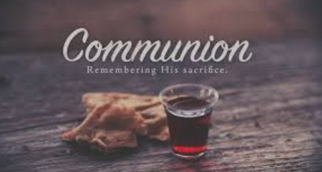

Slide 25
Application
Have you responded yet to this GOOD NEWS - HAVE YOU TAKEN HOLD OF JESUS THE GIFT– His Name is Jesus – have turned your life over to Him to save you from a heart of sin and from the world of darkness around you?
Are you willing to SHARE THE GIFT OF JESUS with others? – Remember God has given each person the GRACE to receive this gift – pray that they would ACTIVATE the faith that comes from the Gospel and the revelation of Christ.

