Slide 1


Living my life in God’s Grace in 2026
2 Peter 1:3-11

Slide 2
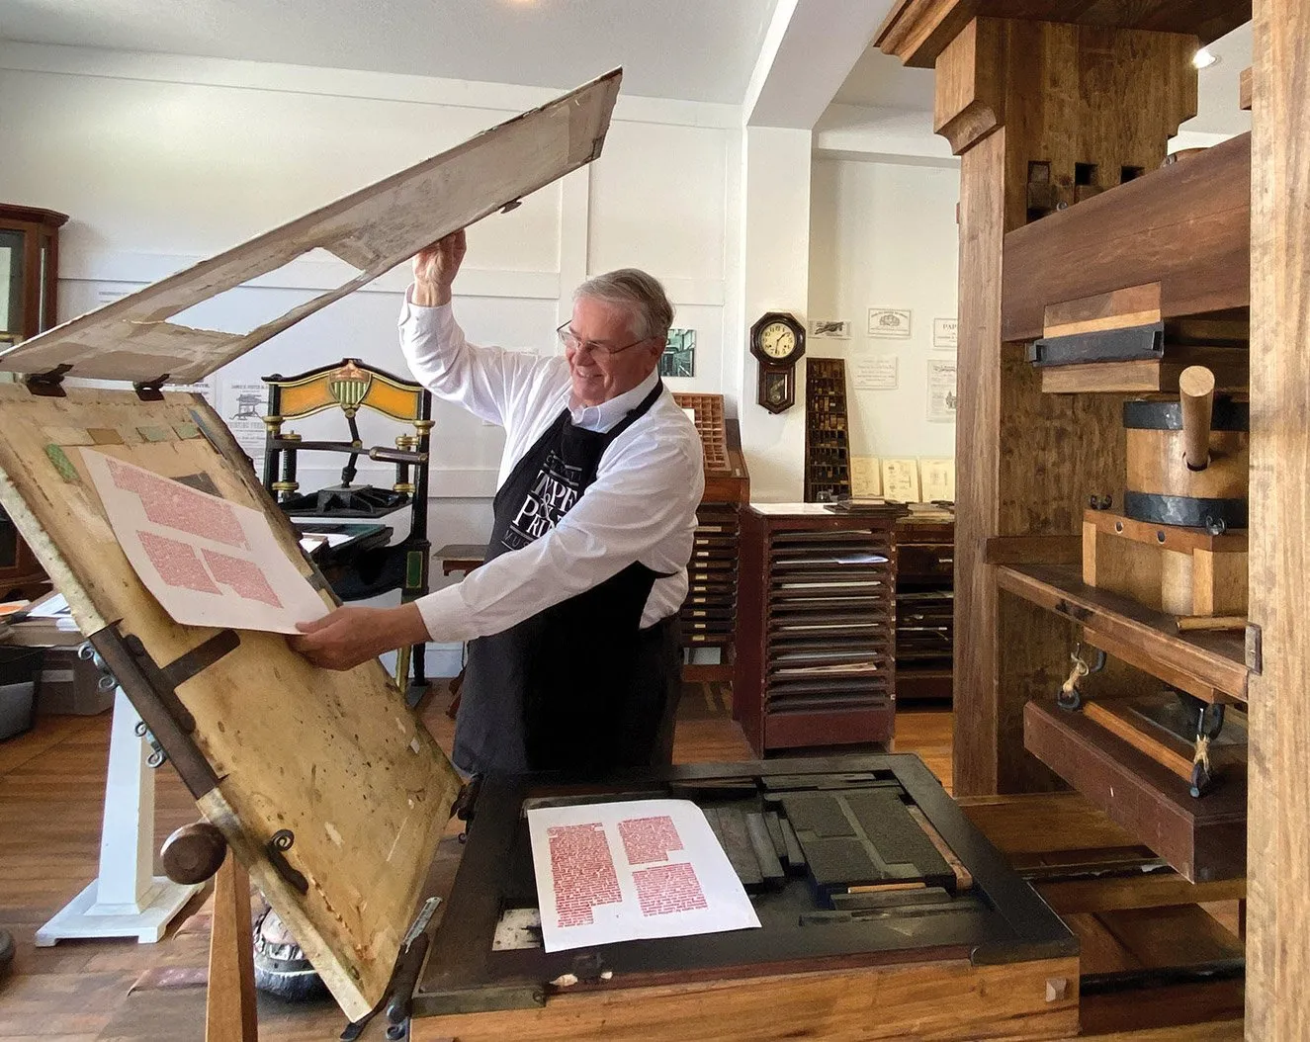
You would think with all the tools at our disposal the Christian life would be Easy!
625 years since the Gutenberg press invented

Slide 3
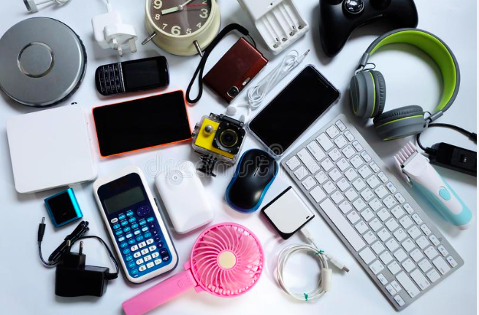
Look at all the tools at our disposal!!
So simple to read the bible, gather information, connect with other Christians, be accountable, grow…….. Really?

Slide 4

Some Misconceptions about being a Christian
I thought life was going to be easier once I accepted Christ as my savior.
Why am I still wasting my time at a job when I can do more as a Missionary?
3) Shouldn’t I get to a point where I’m beyond temptations and the flesh?

Slide 5

Key Components to a Strong Christian Life
God has the tools and resources we need to do it.
His promises are the foundation to victory.
Peter elaborate on key building blocks of our life….
- Faith - Goodness - Knowledge
- Self Control - Perseverance - Godliness
- Brotherly affection - Love
These will keep us form being immature.
Ignoring them will result in spiritual blindness.
Keep walking in the Spirit regardless of the stress.
2 Peter 1:3-11

Slide 6
Conclusions:
Rest in God’s Faithfulness
Make your walk with the Lord more of a priority – even over physical exercise, and financial security.
Step out in faith and courage to fight the fight. He’s got you!

Slide 7
Psalm 121
I look up to the hills,
but where will my help really come from?
² My help comes from the Lord,
the Creator of heaven and earth.
³ He will not let you fall.
Your Protector will not fall asleep.

Slide 8
Israel’s Protector does not get tired.
He never sleeps.
⁵ The Lord is your Protector.
The Lord stands by your side, shading and protecting you.
⁶ The sun cannot harm you during the day,
and the moon cannot harm you at night.

Slide 9
The Lord will protect you from every danger.
He will protect your soul.
⁸ The Lord will protect you as you come and go, both now and forever!

