Slide 1

KINGDOM GOALS FOR THE UNFOLDING INTERVENTIONS OF THIS YEAR
LifeGate
January 5, 2025

Slide 2
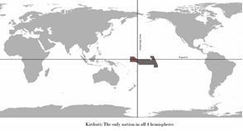
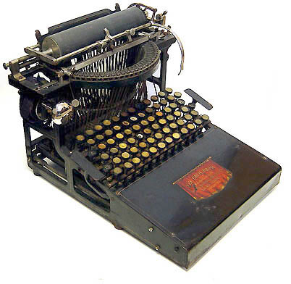
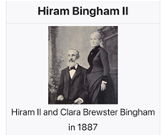
THE FIRST NATION TO EXPERIENCE
THE NEW YEAR
And The Translation of Scriptures
And A Broken Typewriter
The nation of Kiribati (formerly known as the Gilbert Islands).
This nation is actually pronounced “Kiribas.” Why. Because the language was unwritten until Missionary Hiram Bingham II came to the island and created a written language in 1887. But there was a problem. His typewriter “S” key was broken. So he substituted “ti” for “S.” Thus Kiribati is pronounced “Kiribas.”
There is a Starbucks on the Island (that is pronounced “Starbucks,”) but it is spelled “Titarbuckti.”

Slide 3
Read This Scripture Over LifeGate For 2025
The Spirit of the Sovereign LORD is upon me, because the LORD has anointed me to preach good news to the poor. He has sent me to bind up the brokenhearted, to proclaim freedom for the captives and release from darkness for the prisoners, ² to proclaim the year of the LORD's favor and the day of vengeance of our God, to comfort all who mourn, ³ and provide for those who grieve in Zion-- to bestow on them a crown of beauty instead of ashes, the oil of gladness instead of mourning, and a garment of praise instead of a spirit of despair. They will be called oaks of righteousness, a planting of the LORD for the display of His splendor. Isaiah 61:1-3 (NIV)

Slide 4
THREE MAJOR GOALS IN 2025
1 - Mature our understanding of Christ transforming us – and our role in His Church (a crown of beauty instead of ashes.)
Today’s Focus
2 - Move into a greater FULLNESS of the Holy Spirit among us in greater measures (The Spirit of the Sovereign LORD is on me.)
3 - Multiplication of hunger, repentance, encounters, conversions, healings, release, and transformation (To proclaim the year of the LORD's favor.)

Slide 5
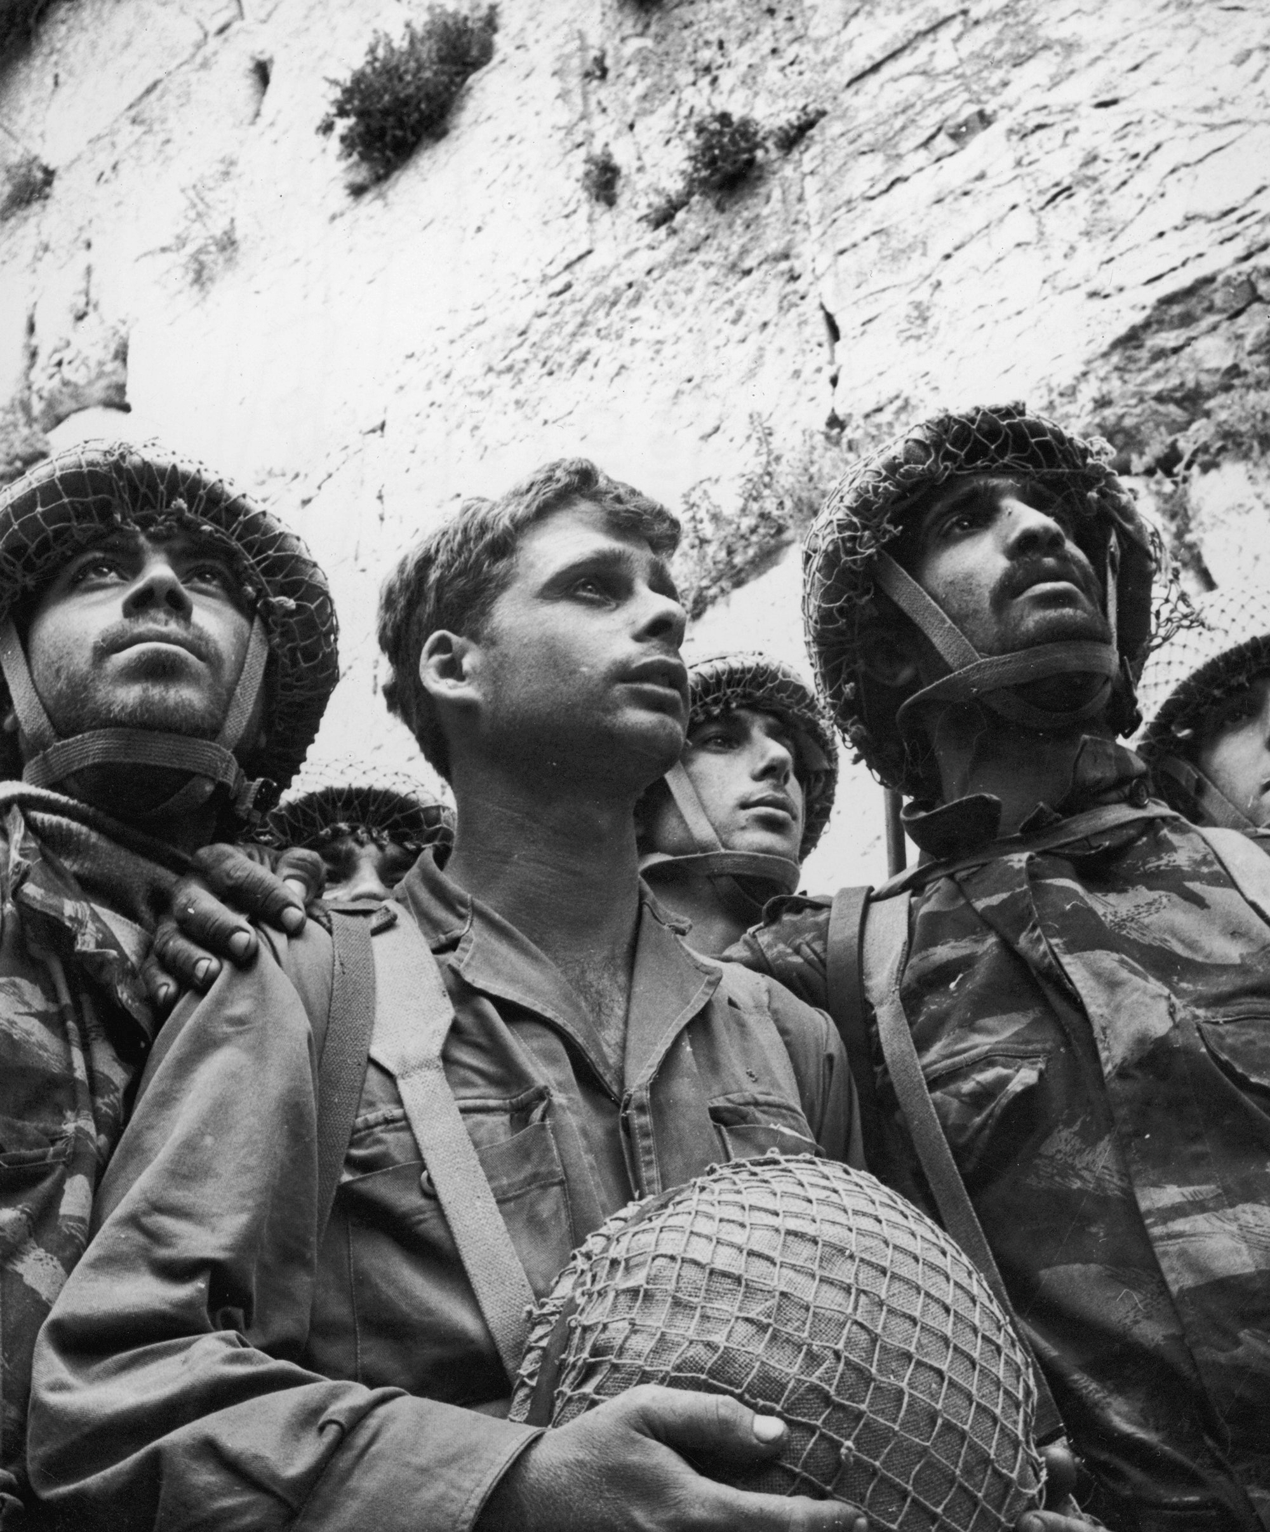
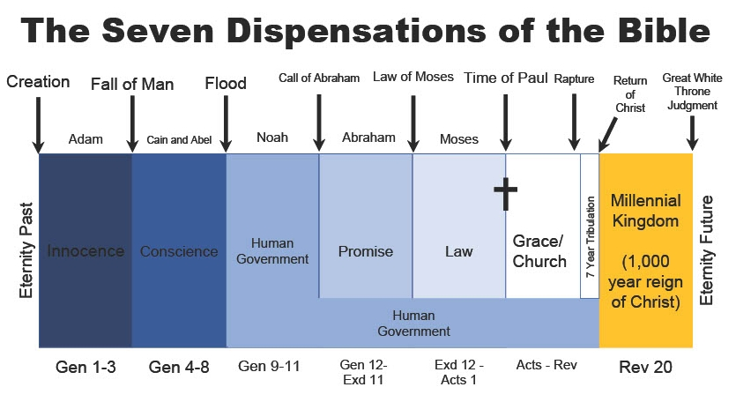
People Ask Where Are We At On God’s Timeline?
Jerusalem will be trampled on by the Gentiles until the times of the Gentiles are fulfilled. Luke 21:24b
We are clearly at the end of the Church age – The Final Harvest is being brought in.
1967
= 1897
Years
And this Gospel of the kingdom will be preached in the whole world as a testimony to all nations, and then the end will come. Matthew 24:14 (NIV)
Six Months
1656 Years
300 Years
500 Years
1300 Years
2025 Years
Innocence
Adam
and
Eve
In the last days the mountain of the LORD's temple will be established as chief among the mountains; it will be raised above the hills, and all nations will stream to it. Isaiah 2:2 (NIV)
God Uses Israel
God Uses The Church

Slide 6

The Promise Of End Time Harvest
'And afterward, I will pour out my Spirit on all people. Your sons and daughters will prophesy, your old men will dream dreams, your young men will see visions. Joel 2:28 (NIV)
In the last days the mountain of the LORD's temple will be established as chief among the mountains; it will be raised above the hills, and all nations will stream to it. Isaiah 2:2 (NIV)
"On that day I will make the leaders of Judah like a firepot in a woodpile, like a flaming torch among sheaves. They will consume right and left all the surrounding peoples, but Jerusalem will remain intact in her place. Zechariah 12:6 (NIV)
²⁵ In the day of great slaughter, when the towers fall, streams of water will flow on every high mountain and every lofty hill. ²⁶ The moon will shine like the sun, and the sunlight will be seven times brighter, like the light of seven full days, when the LORD binds up the bruises of his people and heals the wounds he inflicted. Isaiah 30:25-26 (NIV)

Slide 7


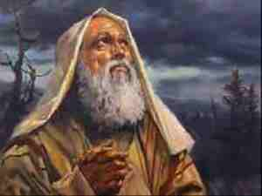
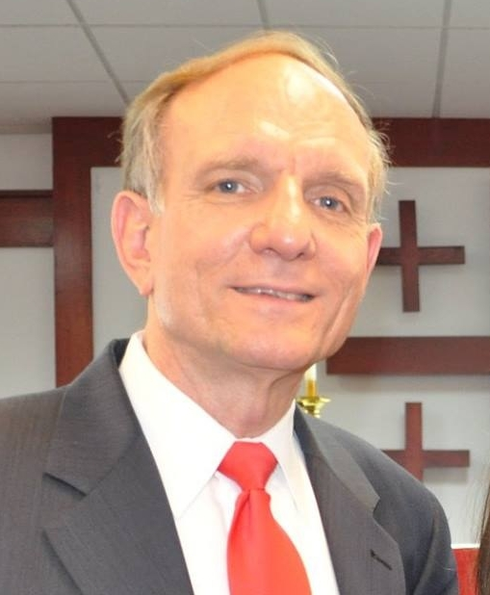
There is a “Yes” In The Atmosphere
Tony Hall
2 Kings 7
Famine in
Samaria
For no matter how many promises God has made, they are "Yes" in Christ. And so through him the "Amen" is spoken by us to the glory of God
I will give you the keys of the kingdom of heaven; whatever you bind on earth will be bound in heaven, and whatever you loose (release) on earth will be loosed in heaven." Matthew 16:19 (NIV)

Slide 8
THE MERCY OF GOD OVER AMERICA – WE ARE EXPECTED TO BEAR FRUIT BECAUSE HE GAVE MERCY
Then He told this parable: "A man had a fig tree, planted in his vineyard, and he went to look for fruit on it, but did not find any. 7 So he said to the man who took care of the vineyard, 'For three years now I've been coming to look for fruit on this fig tree and haven't found any. Cut it down! Why should it use up the soil?' 8 "'Sir,' the man replied, 'leave it alone for one more year, and I'll dig around it and fertilize it. 9 If it bears fruit next year, fine! If not, then cut it down.'" Luke 13:6-9 (NIV)
But blessed are your eyes because they see, and your ears because they hear. ¹⁷ For I tell you the truth, many prophets and righteous men longed to see what you see but did not see it, and to hear what you hear but did not hear it. Matthew 13:16-17 (NIV)

Slide 9
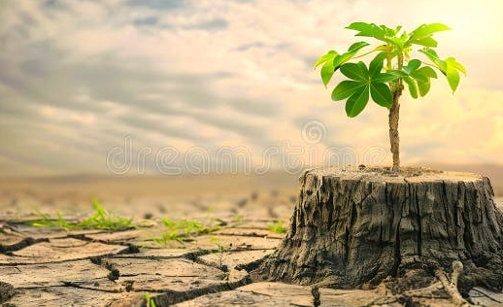
2025 Speaking Destiny
Over The Dormant Places
“Its roots may grow old in the ground and its stump die in the soil, (THE DYING TO SELF) 9 yet at the scent of water it will bud and put forth shoots like a plant.” Job 14:8-9 (NIV)
THEREFORE, WE KEEP SPEAKING DESTINY – FULFILLMENT, AND COMPLETION AND RESTORATION OVER THE STUMPS THAT ARE IN THE GROUND – OF OUR FAMILIES – PEOPLE – VISIONS – MINISTRIES – AND COMMUNITY THAT HAS BEEN STUNTED, HINDERED BY THE LACK OF INTERCESSION, TRANSFORMATION, AND SPIRITUAL MATURITY – AND QUIRKY RELATIONSHIP BATTLES.

Slide 10
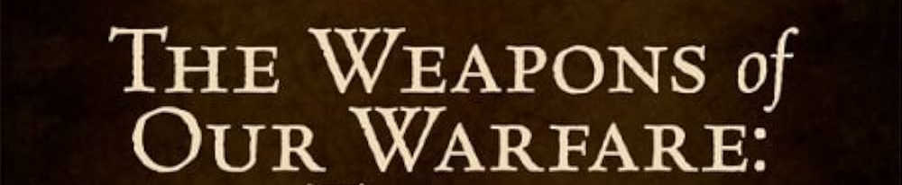



Jesus Brings Healing And Kingdom Strategies No Matter What Type Of Drought or Drama We’ve Been Through
Daily Drama Syndrome
Breakthrough-Hungry Spirit declarations over the day-to-day- “Lord shape this day.”
Produces weariness and excuses to check out – steals your joy
Brain Fog
Word of God proclamations to take captive our thoughts and heal our minds.
Produces confusion and insecurity and depression – suffocates your hope
Faith-filled Life-giving prevailing prayer that refuses to accept “NO” and stands in the gap for intervention and healing and provision.
Heavy-spirited PTSD
Produces angst and fear and emotional edginess and unbelief - steals your joy

Slide 11
WALKING IN THE RICHES OF CHRIST –
10 ESSENTIAL PRIVILEGES
Scripture | Riches of Grace In Christ
Romans 3:24 | JUSTIFIED FREELY BY HIS GRACE
Ephesians 1:5; 2:6,7 Romans 8:17 | RESURRECTED/ ADOPTED AS A SON – A CO-HEIR WITH CHRIST
2 Corinthians 12:9 | HIS GRACE IS SUFFICIENT
Ephesians 2:10 | CREATED FOR GOOD WORKS IN CHRIST
Romans 12:5 | BEING MADE A MEMBER OF THE BODY OF CHRIST
1 Cor. 2:16, Rom 12:2 | A SANCTIFIED/ RENEWED MIND
Acts 15:9 | A PURIFIED HEART/ COMPELLED TO OBEY
Colossians 1:27 | CHRIST IN ME THE HOPE OF GLORY
Matthew 10:1 | KINGDOM AUTHORITY
Acts 2:38 | FILLING OF THE HOLY SPIRIT

Slide 12



A Radically Renewed Mind
WILL RADICALLY CHANGE OUR TONGUES
M i n d
An offended brother is more unyielding than a fortified city, and disputes are like the barred gates of a citadel. Proverbs 18:19
²² He who finds a wife finds what is good and receives favor from the LORD. Proverbs 18:22 (NIV)
“The tongue (mind) has the power of life and death, and those who love it will eat its fruit.” Proverbs 18:21

Slide 13

LET’S LOOK AT A RELATIONSHIP
HEALING STRATEGY
BUT MANY TIMES WE PUNISH THOSE WHO HURT US –EVEN UNINTENTIONALLY – WE WITHHOLD AFFIRMATION OR AFFECTION FROM THOSE WHO WE DEEM NOT WHERE THEY NEED TO BE – “I DON’T WANT TO SEND THE MESSAGE THAT THEY ARE DOING OK – THEY WILL NEVER GET SERIOUS AND CHANGE.”
WE HAVE MADE HUGE STRIDES IN UNDERSTANDING THE BLENDING OF
- ACCOUNTABILITY:
- HEALTHY BOUNDARIES:
- HEALTHY EMOTIONAL SPIRITUALITY
NOT ENABLING SOMEONE
TOUGH LOVE
We have spoken freely to you, Corinthians, and opened wide our hearts to you. 12 We are not withholding our affection from you, but you are withholding yours from us. 13 As a fair exchange--I speak as to my children--open wide your hearts also. 2 Corinthians 6:11-13

Slide 14


We Have To Go Through The Transformation Process of Finding Christ – Who Deals With Our Own Ego and Wounds – Before We Get Healthy Views of Others
For Christ's love compels us, because we are convinced that one died for all, and therefore all died. ⁻⁻ ¹⁶ So from now on we regard no one from a worldly point of view. (mindset) Though we once regarded Christ in this way, we do so no longer. ¹⁷ Therefore, if anyone is in Christ, he is a new creation; the old has gone, the new has come! 2 Corinthians 5:14-17 (NIV)

Slide 15
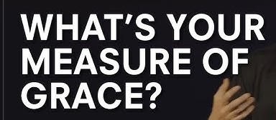

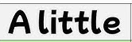
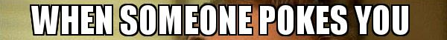
But unto every one of us is given grace according to the measure of the gift of Christ. Ephesians 4:7 (KJV)
WHEN WE ARE POKED - It can reveal an wound that is not healed deep inside of you that you have been unaware of - or ignoring.
“GIVE ME HONEST FEEDBACK – HOW AM I DOING?”

Slide 16
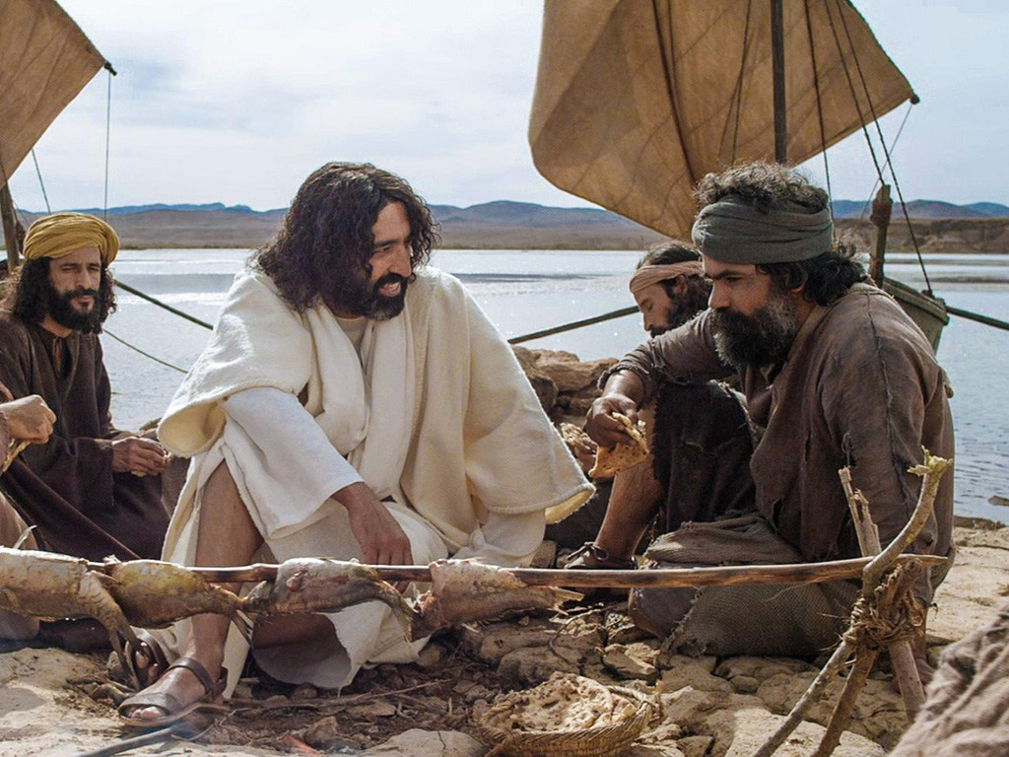
HOW DID JESUS BRING ILLUMINATION AND CORRECTION AND RESTORATION TO PETER WITHOUT PUNISHING HIM WITH A COLD SHOULDER? (John 21:15-17)
Affirm and bless those who are in process of being refined – don’t curse or withhold your blessing and affection because they failed you. - You could say, “I love you and I know there is still work to be done.”
Speak life-giving words even during the process of correction. Don’t gloss over what needs to change but don’t punish through your frustration either.
“LORD REMOVE THE OVER-ARCHING INSECURITY – DEFENSIVENESS AND SELF-PROTECTION OVER THIS GENERATION – HELP US TO MAKE OURSELVES VULNERABLE TO GOD-FEARING ACCOUNTABILITY PARTNERS.”

Slide 17
The Grace Is In This Moment To Change
“In your assignment you do not walk alone. God has provided co-warriors to fight the fight of faith with you. There are many more coming your way. Just think of the precious souls through your assignment that will be won for Christ. Buttress up you heart and soul and walk as an overcomer on this assignment.” 2022
Expect God to come through in your battles. To get freedom from hindering personality traits – negative childhood shaping – generational sins, and cultural bondage through the Supernatural working of the Holy Spirit’s internal transforming glory that will CARRY YOU THROUGH into purity, freedom, purpose, healing, hope, and endurance.

Slide 18
THE THREE KINGDOM IMPERATIVES OF 2025
BREAKING UP THE HARD AREAS OF OUR HEARTS
YOU HAVE TO WIN THESE BATTLEs. (OVER FLESH – OVER SELF- OVER PERSONALITY – OVER PRINCIPALITIES)
GOD IS NOT ALLOWING YOU TO BE IN CONTROL OF YOUR HEALING PROCESS ALONE – HE’S TAKING OVER –SENDING CIRCUMSTANCES AND PEOPLE TO HELP YOU DEAL WITH HIDDEN WEAKNESSES.
WE SHOULD NOT LEGITIMIZE WHAT GOD IS TRYING TO CRUCIFY.

Slide 19


In Spite of These Clear Course Corrections
In All Of Our Lives – God Is Not Beating You Up
True Godly conviction and sorrow brings life – the flesh or Satan brings condemnation and endless pity-parties
Comfort, comfort my people, says your God. ² Speak tenderly to Jerusalem, and proclaim to her that her hard service has been completed, that her sin has been paid for, Isaiah 40:1-2 (NIV)
¹⁴ "Therefore I am now going to allure her; I will lead her into the desert and speak tenderly to her. ¹⁵ There I will give her back her vineyards, and will make the Valley of Achor a door of hope. There she will sing as in the days of he youth, as in the day she came up out of Egypt. Hosea 2:14-15 (NIV)

Slide 20


Slide 21
THREE MAJOR GOALS IN 2025
1 - Mature our understanding of Christ transforming us – and our role in His Church (a crown of beauty instead of ashes.)
2 - Move into a greater FULLNESS of the Holy Spirit among us in greater measures (The Spirit of the Sovereign LORD is on me.)
3 - Multiplication of hunger, repentance, encounters, conversions, healings, release, and transformation (To proclaim the year of the LORD's favor.)

Slide 22
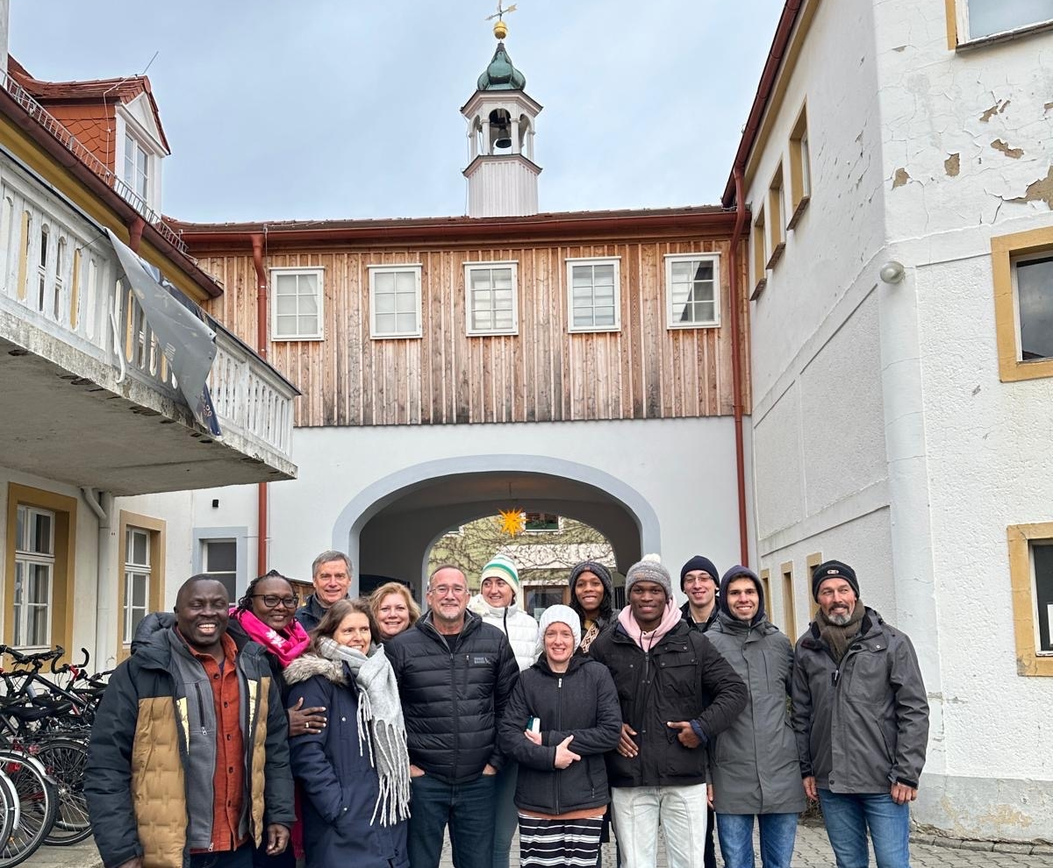
Overcoming Differences
Being Conformed By
The Presence Of Christ
The Prayer Of The Moravians
“They were ashamed of their “religious quarrels”, and were unanimously disposed to bury them in oblivion. They also sincerely renounced self-love, self-will, disobedience, and freethinking. They were desirous to become poor in spirit; none of them sought a preference above the rest; and each one wished to be taught of the Holy Spirit in all things; they were not only convinced, but carried away and overpowered by the operating grace of our Lord Jesus Christ.” Moravians August 1727

Slide 23
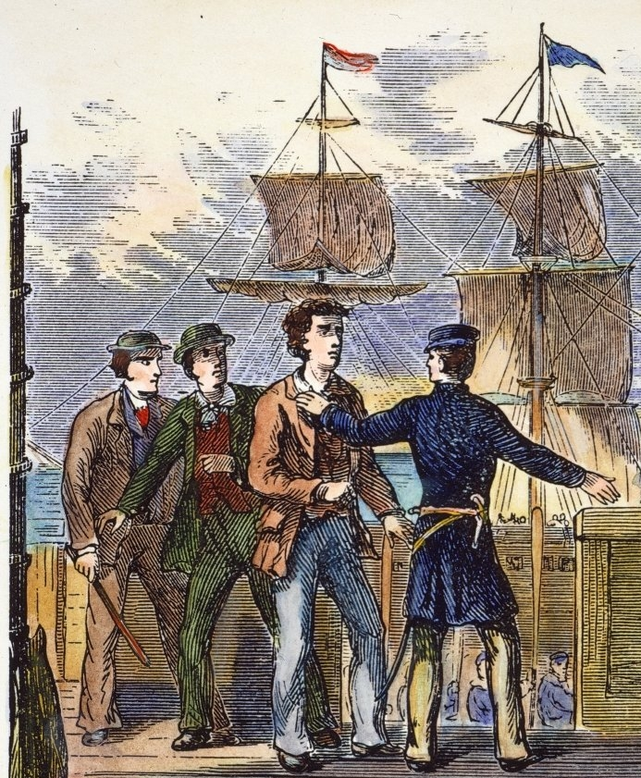
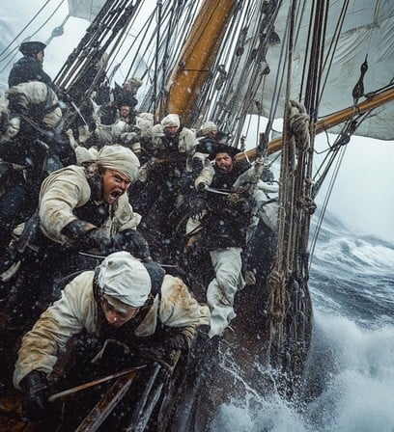
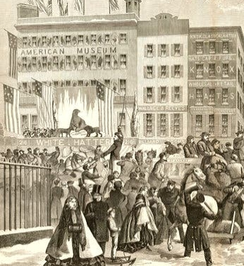
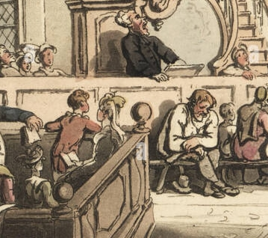
THE ARROWS OF GOD’S RIGHTEOUS GRACE
“Sailor – say your prayers in fair weather.”
Part your heavens, O LORD, and come down; touch the mountains, so that they smoke. ⁶ Send forth lightning and scatter [the enemies]; shoot your arrows and rout them. ⁷ Reach down your hand from on high; deliver me and rescue me from the mighty waters, from the hands of foreigners Psalm 144:5-7 (NIV)

Slide 24
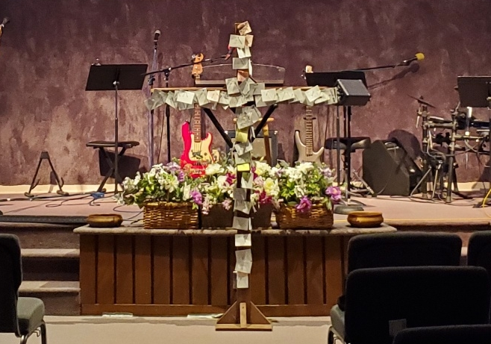
We Are Going To Prevail For Favor
Over People Who Need Transformed By Jesus
Come put the name of a family member – friend – co-worker – anyone on a post-it note and we will pray God’s redeeming grace to invade their life.

Slide 25
THANKFUL PRAYERS OF BREAKTHROUGH
AND STRENGTH FOR 2025
1/ Thank You Lord for breaking off the heaviness - Let Heaven break loose.
2/ Thank You Lord for removing the roadblocks – Your grace overwhelms the warfare –
3/ Thank You Lord for breaking the spirit of delay -– “For bringing acceleration to Your promises.”
4/ Thank You Lord for teaching us to labor from a place of FAITH – not fretting – not exhausted – not feeling overwhelmed.
5/ Thank You Lord for steady growth –. “For releasing Your Fruitfulness in us.”
6/ Thank You Lord for clear strategic instructions - “For teaching us to make room for You)

Slide 27
THE CRY OF A BRITISH REVIVALISTS
HENRY BREEDEN
PRAY MUCH – I GAVE MY SELF EARNESTLY TO FERVENT INTERCESSION.
LIVE NEAR THE LORD.
KEEP MY SOUL CLEAR (ABIDING) IN THE ENJOYMENT OF FULL SURRENDER AND CLEANSING.
DO MY UTMOST TO FULFILL THE WHOLE WILL OF GOD.
EXPECT CLEAR REVELATIONS OF JESUS – RELEASING A CHANGING AND TRANSFORMING INFLUENCE UPON ME AND MY COMMUNITY. Henry Breeden

Slide 28
THE GOSPEL CHANGES OUR
PERSPECTIVE ON EVERYTHING –
EVEN GIFTINGS THAT ANNOY US
³⁷ "Anyone who loves his father or mother more than me is not worthy of me; anyone who loves his son or daughter more than me is not worthy of me; ³⁸ and anyone who does not take his cross and follow me is not worthy of me. ³⁹ Whoever finds his life will lose it, and whoever loses his life for my sake will find it. ⁴⁰ "He who receives you receives me, and he who receives me receives the one who sent me. ⁴¹ Anyone who receives a prophet because he is a prophet will receive a prophet's reward, and anyone who receives a righteous man because he is a righteous man will receive a righteous man's reward. ⁴² And if anyone gives even a cup of cold water to one of these little ones because he is my disciple, I tell you the truth, he will certainly not lose his reward." Matthew 10:37-42 (NIV)

Slide 29
Bringing Appreciation To The Different Gifts in the Body of Christ – Through a Maturing Of Our Understanding
I’m Tired of the emphasis on prayer all the time
Prophets and the prophetic annoy me
Can you give it up already on evangelism – evangelism - evangelism
Do we really have to talk about miracles and healings
I’ve heard enough about deliverance
Do we have to keep feeding the poor – can’t they just get a job.
And if anyone gives even a cup of cold water to one of these little ones because he is my disciple, I tell you the truth, he will certainly not lose his reward." Matthew 10:42 (NIV)

Slide 30
“People carry on and don't want to believe the truth of My words being fulfilled in real time, but I'm here to declare to you there is now an acceleration, an acceleration in the Spirit, an acceleration of glory for those overcomers who will now move from glory to glory as I mature them, strengthen them, and give them an even deeper understanding of what is now to be done. Parallel to this is the acceleration of evil. This also must play out so that choices are made, because I tell you, the hourglass is empty and the choice must be made for Me or against Me, and this, the tribulation of My church, is THE LAST CALL! Julie Whedbee Dec. 2024

