Slide 1
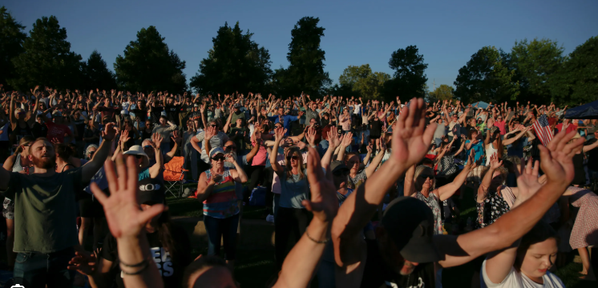
Pursuing God’s Goals 2025
We are entering a time for our lives, our church, and our nation like no other. Things we have
only dreamed about are going to happen. Now we have to step
Into it.

Slide 2

Group Participation
What does God’s word say about His Faithfulness?

Slide 3
Spiritual insight from Glenn Edwards:
Have you ever considered that God has allowed the obstacles in your life for a purpose? This is not to imply that the Lord has caused trouble for you or has set you up to fail. Rather, He permits hurdles on your path as an opportunity for you to trust Him more. He wants you to see that He has the full picture, and He will get you where He wants you to be despite challenges along the way. After all, there are no hindrances that are a match for the wisdom and power of God.

Slide 4
Prophetic word for 2025
“I’m dealing with you by watermarks and landmarks
“Note well where the water has been. Remember how high the water reached, then watch and see as I cause the waters to rise up again, surpassing every flow of My glory that you have ever seen or experienced.
What I do this time will leave no room for questions, for surely people will take notice that God has come down. The landmarks of former revivals will now serve as signposts, pointing to My glory. Do not camp in the past, but let it catapult you into what I am now releasing. “
The time is short. It is time to streamline your life. Prepare for what you have prayed for.” To Lydia Marrow – January 3, 2025

Slide 5
My Goals for 2025
Don’t do this Do this instead
1. Be patient with your flesh, sin 1. Be patient with others
2. Be content with mediocrity 2. Be content with blessings and provisions God has supplied
3. Be independent with your 3. Be independent and stand,
struggles/ battles, stay alone speak up for godliness
when no one else does
4. Be afraid of the future and 4. Have the fear of God in
focus on lies of the enemy your heart, respect Him
5. Trust in your own wisdom and 5. Trust in the Lord’s power
strength get you thru 2025 and grace for 2025
Trust in the Lord with all your heart; do not depend on your own understanding. ⁶ Seek his will in all you do, and he will show you which path to take. ⁷ Don’t be impressed with your own wisdom. Instead, fear the Lord and turn away from evil. ⁸ Then you will have healing for your body,
And soul… Prov. 3:5 – 8
“Do not camp in the past, but let it catapult you into what I am now doing.
The time is short, it is time to streamline your life, prepare for what you have
been praying for.” Lydia Marrow - Jan. 3rd 2025

Slide 6
APPLICATION:
1. Identify someone in your life that your can be an encouragement too.
2. Identify someone in your life that you can be a light to. Share your faith or invite to church.
3. Ask God where you might use your gifts to serve at LifeGate.

