Slide 1

LifeGate
January 19, 2025

Slide 2

If God Used Spiritual Volts
"Which of you fathers, if your son asks for a fish, will give him a snake instead? ¹² Or if he asks for an egg, will give him a scorpion? ¹³ If you then, though you are evil, know how to give good gifts to your children, how much more will your Father in heaven give the Holy Spirit to those who ask him!" Luke 11:11-13 (NIV)
LET’S SAY IT TOOK GOD 14 BILLION SPIRITUAL VOLTS TO SAVE AMERICA FROM GOVERNMENTAL TYRANNY – AND GOD CARED ENOUGH TO PUT ON HOLD THE ONE WORLD GOVERNMENT
HOW MUCH MORE IS GOD WILLING TO USE 14 TRILLION SPIRITUAL VOLTS TO SAVE SOULS IN AMERICA

Slide 3
LifeGate Is A Pro-Life Church
Because God Is Pro-Life
“You killed the Author (prince, chief, ruler) of life, but God raised him from the dead. We are witnesses of this. ¹⁶ By faith in the Name of Jesus, this man whom you see and know was made strong. It is Jesus' Name and the faith that comes through Him that has given this complete healing to him.” Acts 3:15-16 (NIV)
You alone are the LORD. You made the heavens, even the highest heavens, and all their starry host, the earth and all that is on it, the seas and all that is in them. You give life (make alive, preserve, revive, quicken) to everything, and the multitudes of heaven worship You. Nehemiah 9:6 (NIV)

Slide 4


Slide 5



HOW YOU RESPOND WILL SHAPE THE WAY YOU LIVE EVERYDAY
GOD CREATED YOU – YOU GOT CAUGHT UP IN YOUR FLESH AND REBELLED AGAINST HIS LOVE – HE DIED FOR YOU ON A ROMAN CROSS 2000 YEARS AGO TO BE SAVED FROM SIN AND HE CALLS YOU BACK TO HIMSELF THROUGH FAITH AND OBEDIENCE (John 10:10)
1
2
BUT THEN - YOU WILL LIVE ON FOREVER WHEN YOU WAKE UP IN THE AFTERLIFE- THIS LIFE IS A TEST TO SEE IF YOU WILL ACCEPT GOD’S OFFER OF GRACE AND FOLLOW HIM – THE PLACE YOU END UP LIVING FOREVER WILL BE DETERMINED HOW YOU RESPOND TO THIS OFFER/ THERE IS A REAL HEAVEN AND HELL.

Slide 6
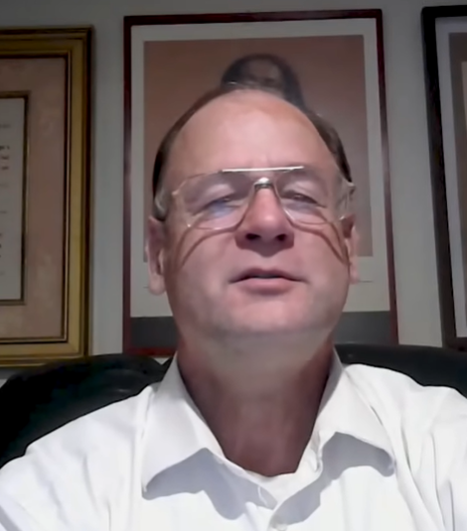
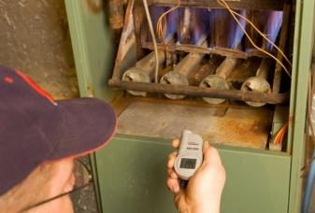
Your Life Is Soooooo Precious
Don’t try and light an OLD natural gas furnace if the pilot light is out and the gas is still on.
He Called Out As Two Demons Came with Shackles to take him to hell
Crazy story – as Jesus revealed things to him
Karl Falken
Died in 1995 and found out as a church-attender - He wasn’t saved
1 - He came to an understanding that he was VERY PASSIVE – even in his encounter with Jesus
2 - He came to an understanding that YOUR MOTIVES ARE EVERYTHING – He didn’t live for the Lord but himself.

Slide 7
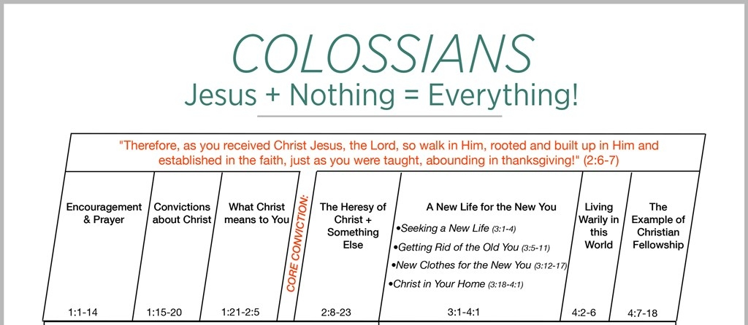
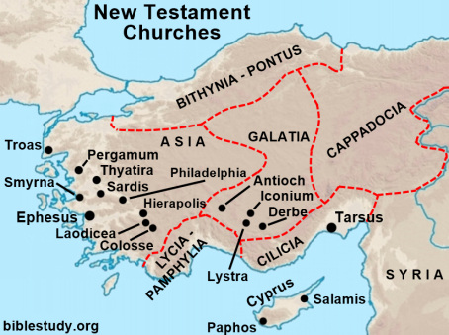
INTRODUCING THE BOOK OF COLOSSIANS
Written By Paul - Either in prison in Rome or Caesarea – around 57 AD

Slide 8
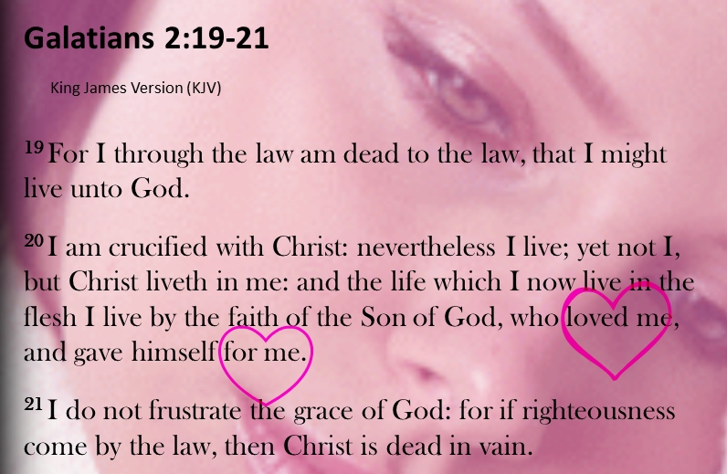
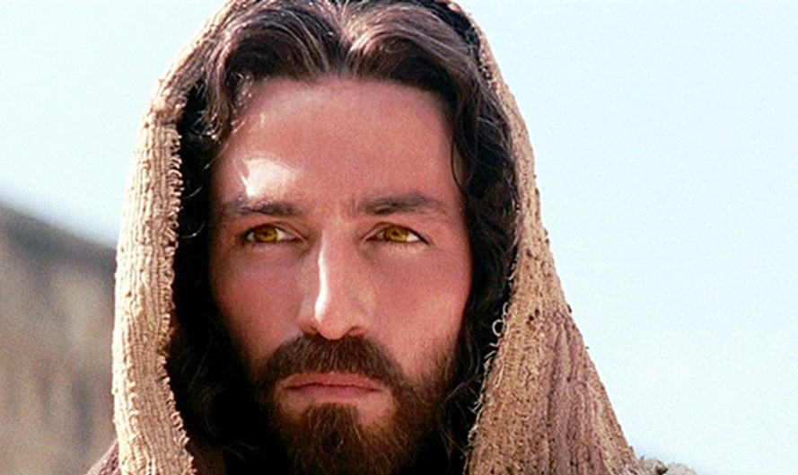
¹⁹ For through the law I died to the law so that I might live for God. ²⁰ I have been crucified with Christ and I no longer live, but Christ lives in me. The life I live in the body, I live by faith in the Son of God, who loved me and gave himself for me. Galatians 2:19-20 (NIV)

Slide 9

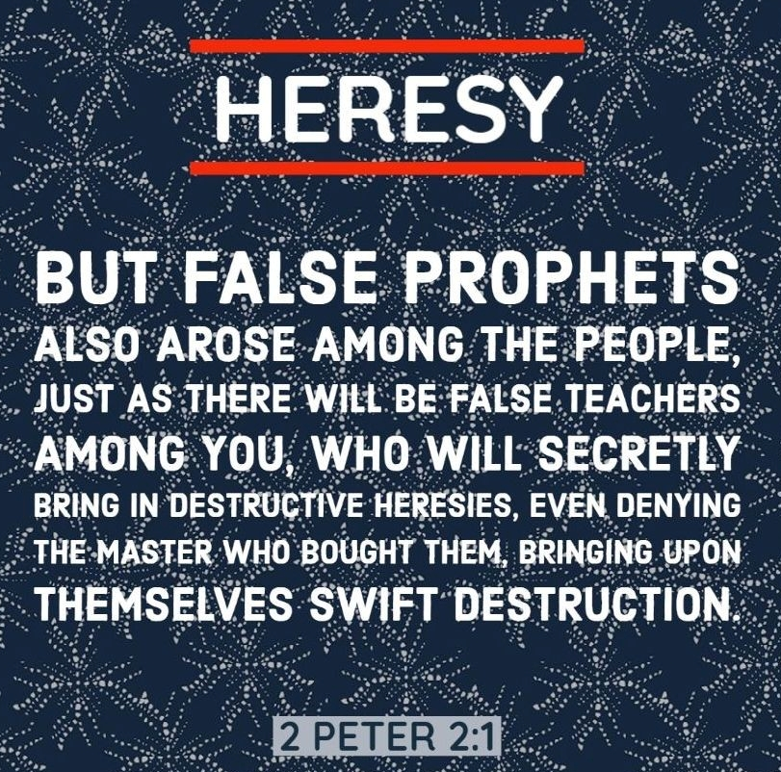
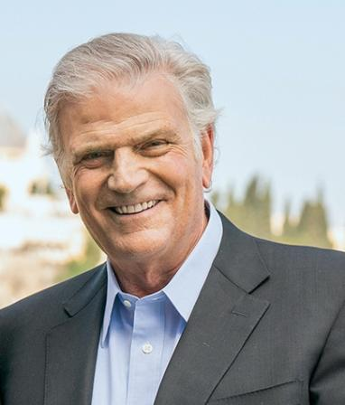
LOOK AT IT THIS WAY – WHY DID PAUL WRITE THIS LETTER ? EPAPHRAS – CAME BACK TO PAUL AFTER TEN YEARS HELPING LEAD THE CHURCH AND SAID WE ARE LOSING THE NARRATIVE .
MAJOR THEME OF COLOSSIANS
OVERCOMING FALSE TEACHING
WE ARE GOING TO HAVE
TO BE ROOTED IN CHRIST
AND THE WORD IN THESE
LAST DAYS

Slide 10



Slide 11
THREE MAJOR GOALS IN 2025
1 - Mature our understanding of Christ transforming us – and our role in His Church (a crown of beauty instead of ashes.)
2 - Move into a greater FULLNESS of the Holy Spirit among us in greater measures (The Spirit of the Sovereign LORD is on me.)
Today’s Focus
3 - Multiplication of hunger, repentance, encounters, conversions, healings, release, and transformation (To proclaim the year of the LORD's favor.)

Slide 12

We Are Not Going To Overcome
Without Opening Ourselves Up More and More
To The Fullness Of The Holy Spirit
But the Counselor, the Holy Spirit, whom the Father will send in my name, will teach you all things and will remind you of everything I have said to you. John 14:26
Trying to find out the time and circumstances to which the Spirit of Christ in them was pointing when He predicted the sufferings of Christ and the glories that would follow. 12 It was revealed to them that they were not serving themselves but you, when they spoke of the things that have now been told you by those who have preached the gospel to you by the (same) Holy Spirit sent from heaven. (1 Peter 1:10-12 (NIV)
“Here’s all your gifts – but don’t open them.”

Slide 13
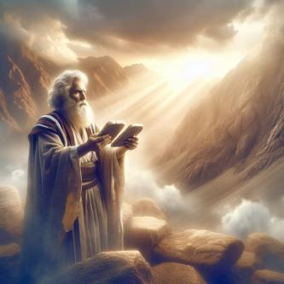
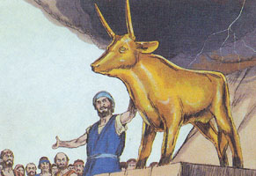
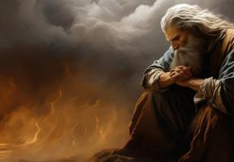
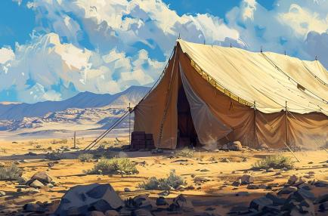
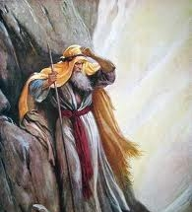
Moses Models Something Almost Beyond Comprehension (Exodus – chapters 32,33)
You can take the people out of EGYPT – but you can’t take EGYPT out of the people
So Moses goes back up to God and intercedes for the people
Then Moses made a tent of meeting
God then says – “Take this people up to the Promised land – But I may not go with you because I might have to judge the people.”
Then Moses said “Don’t send us up on this mission unless You go with us – Oh By the way – SHOW ME MORE OF YOUR GLORY.”

Slide 14
Paul Talks About Light And Darkness
And do this, understanding the present time. The hour has come for you to wake up from your slumber, because our salvation is nearer now than when we first believed. 12 The night (OF THE FALLEN WORLD RULED BY THE FLESH) is nearly over; the day (OF A NEW HEAVENS AND EARTH RULED BY THE SPIRIT) is almost here. So let us put aside the deeds of darkness and put on the armor of light. 13 Let us behave decently, as in the daytime, not in parties and drunkenness, not in sexual immorality and debauchery, not in dissension and jealousy. 14 Rather, clothe (ENFOLD) yourselves with the Lord Jesus Christ, and do not think about how to gratify the desires of the sinful nature. Romans 13:11-14 (NIV)

Slide 15
Paul Repeats This Theme
For you were once darkness (FLESH), but now you are light (SPIRIT) in the Lord. Live as children of light 9 (for the fruit of the light consists in all goodness, righteousness and truth) 10 and find out what pleases the Lord. (MOTIVES)11 Have nothing to do with the fruitless deeds of darkness, but rather expose them. --- This is why it is said: "Wake up, O sleeper, rise from the dead, and Christ will shine on you." 15 Be very careful, then, how you live--not as unwise but as wise, 16 making the most of every opportunity, because the days are evil. 17 Therefore do not be foolish (IGNORANT, MINDLESS, UNBELIEVING), but understand (PUT THE PIECES TOGETHER) what the Lord's will is. 18 Do not get drunk (intoxicated) on wine, which leads to debauchery. Instead, be (EVER BE BEING) filled with the Spirit. Ephesians 5:8-18 (NIV)

Slide 16


WE ARE DETERMINED TO BE A TENT
OF MEETING – WHERE GOD IS REVEALED
AMONG US BY THE HOLY SPIRIT IN HEARTS
CATCH ON FIRE – WITH LOVE FOR
THE PRESENCE OF GOD
THE WORD OF GOD
SHARING THE GOSPEL AND HIS LOVE
BECAUSE OF THE RICHES CHRIST HAS GIVEN US – WE WANT TO SHARE THEM WITH EVERYONE WE MEET

Slide 17
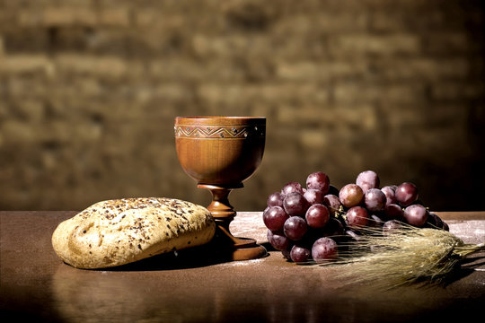
As We Get Ready To Take The Lord’s Supper
We Come With Thanksgiving
“LORD WE CONFESS THAT YOUR COSTLY GRACE IS BEYOND OUR COMPREHENSION. YET WE HUMBLY RECEIVE YOUR FINISHED WORK AS THE HIGHEST GIFT WE WILL EVER PARTAKE OF. WE THANK YOU FOR DYING – RAISING AGAIN – AND BEING AT THE RIGHTHAND OF THE FATHER – RECEIVE OUR GRATEFUL PRAISE AND OBEDIENCE, AMEN.

Slide 18
THANKFUL PRAYERS OF BREAKTHROUGH
AND STRENGTH FOR 2025
1/ Thank You Lord for breaking off the heaviness - Let Heaven break loose.
2/ Thank You Lord for removing the roadblocks – Let Your grace overwhelms the warfare –
3/ Thank You Lord for breaking the spirit of delay -– “Lord bring acceleration to Your promises.”
4/ Thank You Lord for teaching us to labor from a place of FAITH – Helping us not fret – not get exhausted – not feeling overwhelmed.
5/ Thank You Lord for steady growth –. “Lord release Your Fruitfulness in us.”
6/ Thank You Lord for clear strategic instructions - “Lord teach us how to make room for Your leading)

