Slide 1

LifeGate
February 16, 2025

Slide 2
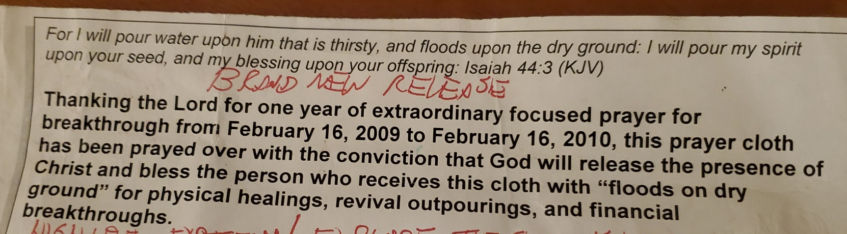

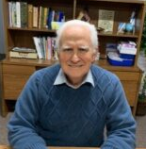
The Mercy Of God In Spawning
Desperate Prayer
16 Years Ago
Today – Was Monday, February 16, 2009
July 26th , 2020 – Through February 16, 2025
1666 Days of Continuous Prayer

Slide 3
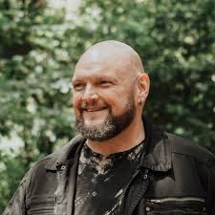
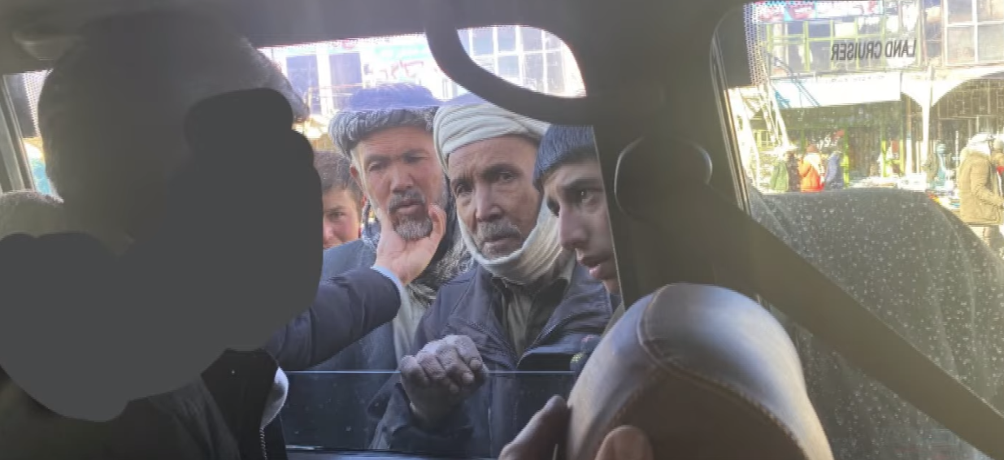
The Power of God Working
In All The Challenges
Robby Dawkins 2021 in Afghanistan

Slide 4
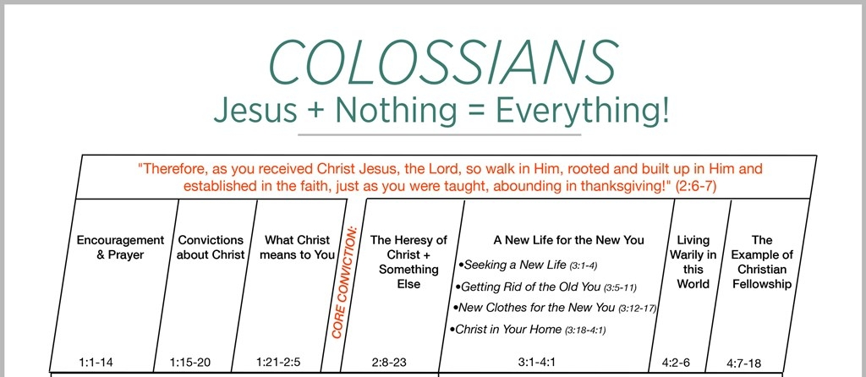
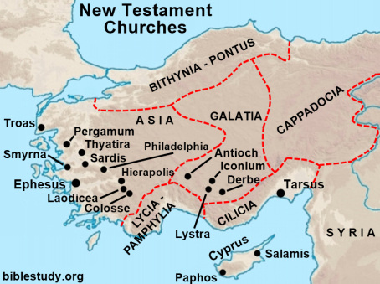
THE BOOK OF COLOSSIANS
Written By Paul - Either in prison in Rome or Caesarea – around 57 AD

Slide 5
Chapter Two Verses 1 to 3
I want you to know how much I am struggling for you and for those at Laodicea, and for all who have not met me personally. 2 My purpose is that they may be encouraged in heart and united in love, so that they may have the full riches of complete understanding, in order that they may know the mystery of God, namely, Christ, 3 in whom are hidden all the treasures of wisdom and knowledge.

Slide 6
Are Hidden All The Treasures
Of Wisdom And Knowledge
THE RICHES OF UNDERSTANDING IN CHRIST:
Jesus holds your future
Jesus has the answers for your problems
Jesus knows your battles and temptations and has solutions
Jesus becomes this overwhelmingly captivating TREASURE of beauty and motivation and TRUE MEANING AND FRIENDSHIP.
Jesus is the KNOWN CAUSE AND FACTOR – and puts us at peace with all the UNKNOWN.

Slide 7
TIMES OF REVIVAL AND HIGH SPIRITUAL ACTIVITY – DON’T ALWAYS MEAN LEADERS
STAY TRUE TO THE WORD OF GOD
LEADERS CAN RISE UP IN A GOOD WORK WITH AN AGENDA
4 I tell you this so that no one may deceive (mislead – beguile) you by fine-sounding arguments. (enticing words) 5 For though I am absent from you in body, I am present with you in spirit and delight to see how orderly you are and how firm your faith in Christ is. 6 So then, just as you received Christ Jesus as Lord, continue to live in Him, 7 rooted and built up in Him, strengthened in the faith as you were taught, and overflowing with thankfulness.

Slide 8
BEING ROOTED IN CHRIST
IS NOT ALLOWING AN EMPHASIS OR TEACHING
ABOUT GOD – TO TAKE THE PLACE OF GOD
GOOD TEACHING IS ALWAYS GOING TO BRING YOU CLOSER TO CHRIST – HE IS GOING TO BE THE CENTER
For I resolved to know nothing while I was with you except Jesus Christ and Him crucified. 1 Corinthians 2:2 (NIV)
7. Continue to live in Him, rooted (stable) and built up in Him, strengthened in the faith as you were taught,
Learn about Jewish Festivals
For in Christ Jesus neither circumcision nor uncircumcision has any value. The only thing that counts is faith (IN CHRIST) expressing itself through love. Galatians 5:6 (NIV)
Learn about the last days theology
Learn about a certain technique

Slide 9
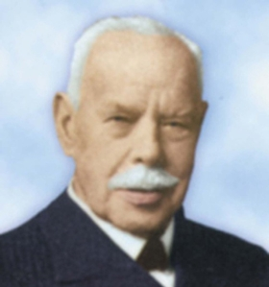
The Greatest Teachers Are Christ-Centric
“I want to impress upon you the importance that - it is not healing that I am presenting to you – (it is not deliverance that I am presenting to you) - it is not miracles that I am presenting to you it is the Living Lord Jesus Christ. It is a glorious fact that the Son of God came down to bring Liberty to set the captives free and oh how it is important that you are filled with the Holy Spirit - it was so with the Lord Jesus Christ Himself.” Smith Wigglesworth

Slide 10
Paul Shifts Gears on These Gentile Believers
And Uses A Jewish Tradition to Illustrate Salvation
AS GENTILES - THIS VITAL UNION WITH JESUS THROUGH SALVATION IN CHRIST HAS SPIRITUAL POWER – TO STRIP YOUR FLESH OF IT’S ALLURING POWER AND MAKE IT DESPICABLE BECAUSE IT COST JESUS HIS LIFE TO SAVE YOU FROM JUDGMENT AND HELL.
11 In him (CHRIST) you were also circumcised (AS GENTILES), in the putting off of the sinful nature, not with a circumcision done by the hands of men but with the circumcision done by Christ, 12 having been buried with Him in baptism and raised with him through your faith in the power of God, who raised him from the dead.
Those who belong to Christ Jesus have crucified the sinful nature with its passions and desires. Galatians 5:24 (NIV)
14 May I never boast except in the cross of our Lord Jesus Christ, through which the world has been crucified to me, and I to the world. Galatians 6:14 (NIV)

Slide 11
MAN-MADE RELIGION CAN CREATE A SPIRITUALITY
THAT COMES FROM RELIGIOSITY
JESUS DOESN’T NEED ENHANCED – AUGMENTED OR FILTERED
8 See to it that no one takes you captive through hollow and deceptive philosophy, which depends on human tradition and the basic principles of this world rather than on Christ.
9 For in Christ all the fullness of the Deity lives in bodily form, 10 and you have been given fullness in Christ, (THROUGH YOUR FAITH AND VITAL UNION IN HIM) Who is the head over every power and authority.
Apostate seeker friendly
New Age
Rigid traditionalism
Jewish Torah Pushers

Slide 12
Paul Expands on The Fullness of This Costly
Intervention Of Jesus On The Cross
13 When you were dead in your sins and in the uncircumcision of your sinful nature (FALLEN PAGANS), God made you alive with Christ. He forgave us all our sins, 14 having canceled the written code, with its regulations, that was against us and that stood opposed to us; He took it away, nailing it to the cross. 15 And having disarmed the powers and authorities, He made a public spectacle of them, triumphing over them by the cross.
COMPLETED – ULTIMATE JUDGMENT
INTERIM – ALLOWED TESTING
LIMITED PERMISSION
¹⁸ I am the Living One; I was dead, and behold I am alive for ever and ever! And I hold the keys of death and Hades. Revelation 1:18 (NIV)
THIS FINISHED WORK OF CHRIST – THE SOURCE OF FORGIVENESS – Literally put a nail in the coffin of the LAW that condemned everyone to hell – and the Accuser of the Brethren Satan having an UNBROKEN access and claim on our life

Slide 13
PAUL WAS ALWAYS WORKING AGAINST THE SLICK AND CONVINCING JUDIAZERS – WHO GOT GENTILES TO VIEW OBSERVING THE TORAH AS BEING MORE SPIRITUAL
16 Therefore do not let anyone judge you by what you eat or drink, or with regard to a religious festival, a New Moon celebration or a Sabbath day. 17 These are a shadow of the things that were to come; the reality (WHOLE), however, is found in Christ.
Watch out for those dogs, those men who do evil, those mutilators of the flesh. 3 For it is we who are the circumcision, we who worship by the Spirit of God, who glory in Christ Jesus, and who put no confidence in the flesh-- Philippians 3:2-3 (NIV)

Slide 14
Paul Knew Better Than Anyone That Works And Religious Duty Cannot Sanctify Your Selfish Flesh
20 Since you died with Christ to the basic principles of this world (AS PURSUED BY APOSTATE OR SUPPER RELIGIOUS PHARISEES OF THE DAY) , why, as though you still belonged to it, do you submit to its rules: 21 "Do not handle! Do not taste! Do not touch!"? 22 These are all destined to perish with use, because they are based on human commands and teachings.
23 Such regulations indeed have an appearance of wisdom, with their self-imposed worship, their false humility and their harsh treatment of the body, but they lack any value in restraining sensual indulgence. Colossians 2:1-23

Slide 15
Paul Eposes Those Who Go Beyond The Law And Go Into Hyper-focusing On Experiences As Being More Important Than Faith In Christ
18 Do not let anyone who delights in false humility and the worship of angels disqualify you for the prize (DEFRAUD YOU OF YOUR REWARD). Such a person goes into great detail about what he has seen, and his unspiritual mind puffs him up with idle notions. 19 He has lost connection with the Head, from whom the whole body, supported and held together by its ligaments and sinews, grows as God causes it to grow.
THIS IS VERY IMPORTANT ABOUT MODELING TESTIMONIES – GOD DOES VISIT US – HE DOES GIVE US ENCOUNTERS – BUT WE STILL GET TO TEST THEM – AND WE MUST KEEP BRINGING JESUS TO THE CENTER – OR ELSE WE BECOME PUFFED UP AND IT BECOMES ABOUT US.

Slide 16
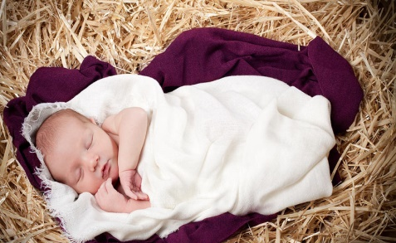
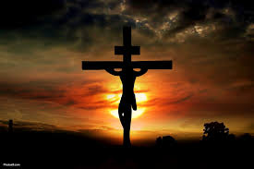
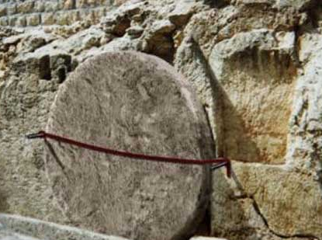
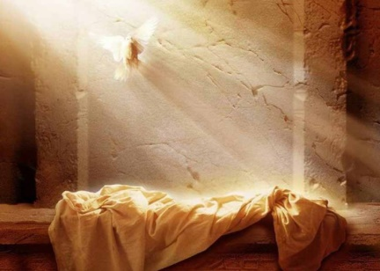
Everything Comes To Us Through Christ
That Means Everything Comes:
Through the Incarnation
Through the Cross
The Burial
And through the Resurrection
And ascension

Slide 17
Here is The Antidote For Our Selfish
Hearts – Live In the Resurrection Power Of Christ
¹ Since, then, you have been raised with Christ, set your hearts on things above, where Christ is seated at the right hand of God. Colossians 3:1 (NIV)

Slide 18
PAUL LAID OUT FOUR ESSENTIALS
TO VICTORIOUS LIVING IN THIS CHAPTER
1 - Situational Awareness – what is subtle traps or deceptions that are at work
2 - Understanding the Roots of the battle – Man and the enemy always go after your flesh and ego
3 -Spiritual Encouragement – In Christ are hidden all spiritual treasures of wisdom and knowledge.
4 - Receiving the Grace Of God for Intervention – Our greatest blessing is that we HAVE JESUS TO TURN TO – We are not looking to our own ability to win the day – we are raised up with Christ and have Him AS OUR SOURCE.

Slide 19
Prayer Of Response
Lord I will absolutely give You my heart. I give You my actions, I give You my affections, I give You my life. I give You my future. I give you my problems. I give You my challenges, and I give You my strengths and weaknesses.
Lord You have been faithful to me the whole time. Help me to grow in the areas that I am weak and struggling. I realize this is a process but I also acknowledge that it is more about being ROOTED IN YOU and Your effectual grace than my ability to be a strong runner. Thank You for giving me the desire to want to run this race well. I want to be pleasing in Your sight. Thank You for adopting me into Your family. Help me to leverage this amazing relationship to live out my calling and bear fruit for Your glory! Amen!

