Slide 1
Paul’s Instructions
Colossians: 4: 1 – 6
Changed by Christ – different living
- Your Life in the world should reflect your connection to Christ
- Our prayer will Sustain each of us trough the challenges that come against us
- Outreach and Evangelism are always places to demonstrate good attitudes

Slide 2
New Life in Christ/ Act like a true believer in world
Col. 3: 18- 4:1
- Christian Marriage should look different than the world’s marriage
- Christian Children should behave different then the world’s children
- Christin Employees should behave differently then the world’s
- Christian Bosses should behave differently then the world’s
- Christian Nurses/ Layers/ Truck drivers/ Students/ Teachers..
That doesn’t mean we’re weird, overbearing, have a religious spirit, acting like we’re better than everyone else.

Slide 3
Prayer is key component to a successful Christian journey!!
Devoted to Prayer. ( Col. 4: 2)
- To Adhere - To be faithful - To intently engage
The bible mentions prayer over 650 times

Slide 4
Paul asked for prayer:
Paul’s life Journey: ( Denise McCallum)
- Got saved when he was 28 years old – trip to Damascus
- Spent three years being equipped and mentored – Arabia
- Grew in Faith and made tents for living for 5 -6 years
- Went on his first missionary journey - Acts 13 - AD 48
- Second missionary journey - Acts 15
- Third Missionary Journey - Acts 18
- Comes back Jerusalem - Arrested AD 52
- Spends the next 9 -10 years on journeys with arrest AD 63
- Spent 2 years in Rome - released short time.
- Martyred in Rome AD 65 - 67

Slide 5
Colossians 4: 5 – 6 Live in a way people a drawn to the Christian Faith through your actions
I Peter 2: 12, 15 -1 6 - They will see your honorable
lifestyle and be inclined to become a believer as well.
Honesty/ Integrity
Support and practical help
Compassion and listening
Good attitude
Humility and Kindness

Slide 6
Review to previous teachings from Colossians:
1) The notion that legalistic or “Special” diets or traditions
that will make you more spiritual. If you don’t follow them you are out of touch with God. Spiritual Leaders looking to
prop up their image and make you feel like failure.
2) A deep relationship with Christ will suffice!! He is the essence of our true power and victory. ( Col.2:6-7, 3 )

Slide 7
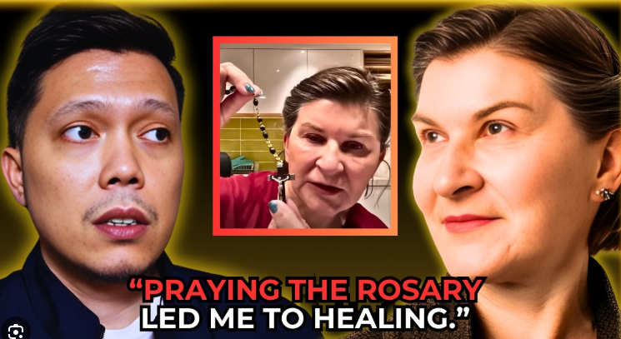
Unusual Example of God’s Grace

Slide 8
Take aways for us:
- What can I do when I feel like others around me are getting it and I continue to struggle?
Identify that God has a different path for each of us….
Realize that God is with you in the midst of your path….
Cling to the revelation that Jesus is not giving up on you!
Savoring the daily moments when I can easily miss the provisions and connections with God.
Slow down enough to talk out loud and say you Love Him…
Notice the Manna He brings into your life each day….
- People - sunshine - creation - reminder salvation

Slide 9
When assignments or interruptions come, seek the Lord to see if they are invitations to be a part of or a distraction to take you off track.
Not everything that comes your way is of God….seek discernment
Sometimes the interruption is God and he’s redirecting you
Sometimes the interruption is devil and he’s distracting you from your assignment.
Sometimes it’s a broken world and you won’t find out until eternity
In every case you need to keep your Focus on the Lord’s purpose

Slide 10
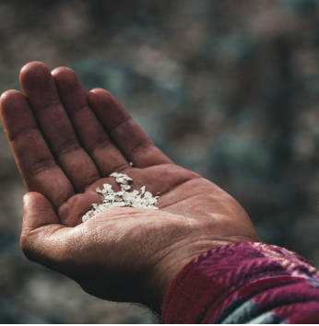
Living on Daily Manna -
A Lifestyle of letting God be in charge of tomorrow
Matt. 6: 25 – 34
Don’t worry
Lean into the
Power of Trusting

