Slide 1

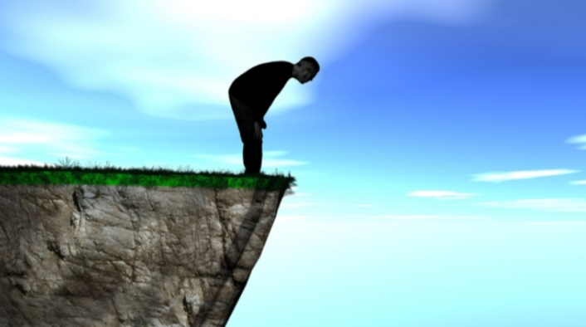
God And Facing The Edge
Of Impossibility
LifeGate Sermon
April 6, 2025

Slide 2
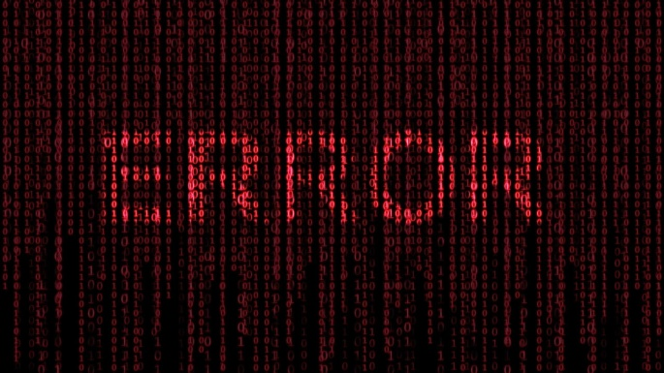
Two Strategic Flaws In Mankind
Since the FALL – when God calls hearts to repentance from selfishness – THERE IS THIS FEAR – I WILL NOT HAVE ANY MORE FUN!!
Since the FALL – it seems like we are PRELOADED with a fear that God will ask me to do something that I DON’T WANT TO DO.” “Oh Lord Don’t tell me to go to Africa as a missionary.”

Slide 3
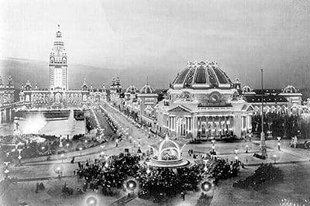
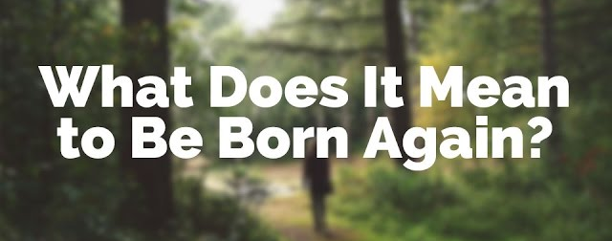
CONCERNED THAT SOME DO NOT FULLY
KNOW WHAT THE REALITY
OF BEING BORN-AGAIN
1901
Pan –American World’s Fair
Buffalo, NY
In reply Jesus declared, "I tell you the truth, no one can see the
kingdom of God unless
he is born again." John 3:3
COME FORWARD AND GET RIGHT WITH GOD
COME FORWARD RIGHT NOW AND SURRENDER YOUR WHOLE LIFE TO JESUS – HE IS WAITING
COME FORWARD AND GIVE YOUR HEART TO THE LORD
COME FORWARD AND MAKE SURE YOU ARE GOING TO HEAVEN TONIGHT IF YOU DIE
COME FORWARD AND REPENT OF YOUR IDOLATRY AND BE BORN AGAIN

Slide 4
Jesus Was Not Seeker Friendly
"One thing you lack," He said. "Go, sell everything you have and give to the poor, and you will have treasure in heaven. Then come, follow Me." 22 At this the man's face fell. He went away sad, Mark 10:21,22
10 TIMES – (follow Me – 12 Xs more)
7 TIMES
Whosoever will come after Me, let him deny himself, and take up his cross, and follow Me.
WHO EVER “BELIEVES” STATEMENTS
TO HAVE FAITH
TO ENTRUST
TO COMMIT ONESELF
but whosoever will lose his life for My sake, the same shall save it.
that whoever believes in Him shall not perish but have eternal life
the man who hates his life in this world will keep it for eternal life.
Whoever believes in me, as the Scripture has said, streams of living water
will flow

Slide 5
SO WHAT IS THE HEART JOURNEY
OF BEING BORN AGAIN?
IT MEANS YOU ARE CONVINCED JESUS IS WHO HE SAYS HE IS (FAITH) (Matthew 16:15)
IT MEANS YOU ACCEPT HIS CALL ON YOUR LIFE – TO FOLLOW HIM – ABOVE YOUR OWN LIFE AND YOU LAY DOWN YOUR IDOLS OF PLEASURE TO WORSHIP HIM ALONE (REPENTANCE) (Mark 8:34)
IT MEANS YOU ALLOW THE HOLY SPIRIT TO BRING FORTH IN YOU THE NEW CREATION OF JESUS’ NATURE IN YOU – DISPLACING THE OLD MAN – (FILLED WITH THE SPIRIT) (John 7:38)

Slide 6
Prayer To Be Born Again
⁹ That if you confess with your mouth, "Jesus is Lord," and believe in your heart that God raised him from the dead, you will be saved. Romans 10:9 (NIV)
LORD JESUS I receive the Gospel as YOUR TRUTH
And I will no longer resist YOUR LEADERSHIP in my life
I RENOUNCE ALL IDOLATRY AND SELF WORSHIP
And put YOU FIRST IN MY LIFE
I surrender to YOU by faith and repentance
And I give YOU my life - I give YOU my rights
I give YOU every area of my life that I recognize at this moment
I SURRENDER and YIELD TO YOU
My Mind, Body, Soul, and Spirit
My actions to PLEASE YOU - My heart to LOVE YOU
My will to FOLLOW YOU
My spirit to be FILLED with YOUR SPIRIT
And if I fall into sin and idolatry
I will quickly repent and give back CONTROL of my life to YOU
Thank You for YOUR amazing MERCY and FORGIVENESS

Slide 7
WHY DOES GOD TAKE US TO THE EDGE OF
HOPELESSNESS AND
THEN BRING THE BREAKTHROUGH?
MOSES
Moses returned to the LORD and said, "O Lord, why have you brought trouble upon this people? Is this why you sent me? 23 Ever since I went to Pharaoh to speak in your name, he has brought trouble upon this people, and you have not rescued your people at all." Exodus 5:22-23 (NIV)
DAVID
⁶ David was greatly distressed because the men were talking of stoning him; each one was bitter in spirit because of his sons and daughters. But David found strength in the LORD his God. 1 Samuel 30:6 (NIV)
And David enquired at the LORD, And He answered him, Pursue: for thou shalt surely overtake them, and without fail recover all. 1 Samuel 30:8 (KJV)

Slide 8
Letter From A Missionary In India 1906
“You know how the Lord has been blessing us; but it seems as if, since we began to pray for Revival, there has been trouble upon trouble, difficulty upon difficulty. Last week we were getting desperate because things seemed to be getting worse. "Do not imagine that all is peace and sunshine in our little Church here. But many times the Lord gave us the word, 'I will work, and who shall reverse it?' So we are trusting Him to finish what He surely has begun."
PUSHED TO THE LIMIT
SPIRITUAL ATTACKS AND TRIALS
HEALTH ATTACKS AND TRIALS
FINANCIAL ATTACKS AND TRIALS
RELATIONAL ATTACKS AND TRIALS
PASSING OF LOVED ONES –
MINISTRY ATTACKS AND TRIALS
COMMUNITY/NATION ATTACKS AND TRIALS

Slide 9
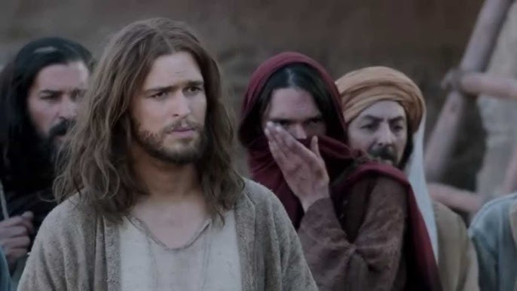
TWO WEEKS BEFORE JESUS WAS CRUCIFIED – ONE WEEK BEFORE
THE TRIUMPHAL ENTRY THERE WAS A CRISIS THAT JESUS APPEARED - NOT TO BE DESPERATE TO HELP WITH
John 11:1-44
The Tragedy and Miracle
Of Lazarus
So the sisters sent word to Jesus, "Lord, the one you love is sick.“4 When He heard this, Jesus said, "This sickness will not end in death.
THE PROBLEM IS REVEALED
BUT JESUS LETS IT GET WORSE
Yet when He heard that Lazarus was sick, He stayed where He was two more days

Slide 10
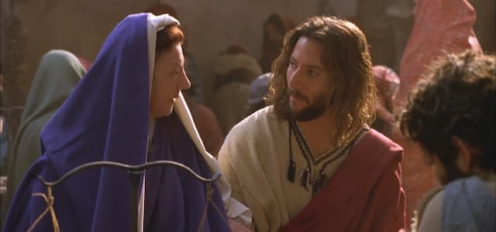
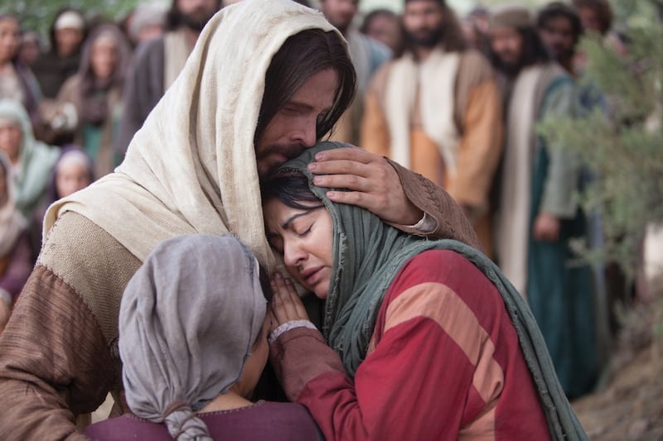
JESUS SPEAKS HOPE –
BUT THEY ARE CONFUSED
So then He told them plainly, "Lazarus is dead, 15 and for your sake I am glad I was not there, so that you may believe
THEY ARE BEYOND DISAPPOINTED JESUS DIDN’T MAKE IT
"Lord," Martha said to Jesus, "if you had been here, my brother would not have died. 22 But I know that even now God will give You whatever You ask."

Slide 11
THE REDEMPTIVE GLORY OF JESUS
IS OPENLY DECLARED
Our emotions get in the way of hearing His declarations over the situation.
23 Jesus said to her, "Your brother will rise again."
24 Martha answered, "I know he will rise again in the resurrection at the last day."
25 Jesus said to her, "I am the resurrection and the life. He who believes in Me will live, even though he dies; 26 and whoever lives and believes in Me will never die
"Yes, Lord," she told him, "I that you are the Christ, the Son of God, who was to come into the world."

Slide 12
Jesus Enters Into Our Sorrows
⁴ Surely he took up our infirmities and carried
our sorrows- Isaiah 53:4A (NIV)
34 "Where have you laid him?" He asked. "Come and see, Lord," they replied. 35 Jesus wept. 36 Then the Jews said, "See how He loved him!" 37 But some of them said, "Could not He who opened the eyes of the blind man have kept this man from dying?"
33 When Jesus saw her weeping, and the Jews who had come along with her also weeping, He was deeply moved in spirit and troubled.
IN JESUS - THERE WAS A CRESCENDO OF BROKENNESS AND YET A - RESOLVE TO THESE WOUNDED HEARTS THE FATHER’S GLORY
38 Jesus, once more deeply moved, came to the tomb. It was a cave with a stone laid across the entrance.

Slide 13
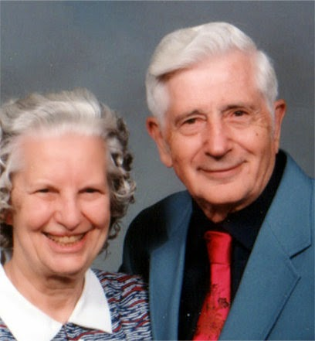
THE MIRACLE MANY TIMES REQUIRES
RADICAL SIMPLE OBEDIENCE
AND HE PARTNERS WITH OUR FAITH
RADICAL SIMPLE OBEDIENCE MANY TIMES IS COUNTER-INTUITIVE
"Take away the stone," he said. "But, Lord," said Martha, the sister of the dead man, "by this time there is a bad odor, for he has been there four days."
The Argentina
Revival 1949
Edward Miller
43 When he had said this, Jesus called in a loud voice, "Lazarus, come out!" 44 The dead man came out, his hands and feet wrapped with strips of linen, and a cloth around his face.
40 Then Jesus said, "Did I not tell you that if you believed, you would see the glory of God?" 41 So they took away the stone.

Slide 14
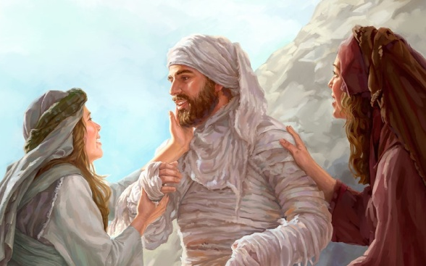
THE FINAL STEP IS
COOPERATING WITH THE MIRACLE
Jesus said to them, "Take off the grave clothes and let him go." John 11:1-44
Let’s Review
God allows the problem to get worse than we wanted
God delays and keeps stretching us – WHILE DECLARING HIS CHARACTER OVER THE PROBLEM
God does initiate a miracle by giving a WORD
We have to obey when it feels impossible
He brings the Miracle to bring gory to the Father
Then we have to continue to move with Him

Slide 15
THE LORD DOES THE WORK – BUT WE HAVE TO STEP INTO THE PLACE WHERE HE WORKS THROUGH US (SIMPLE OBEDIENCE)
AN IMPOSSIBILITY SURFACES
GOD ALREADY HAS A PLAN – BUT DOES NOT REVEAL IT
WE HAVE TO LATCH ON TO HIS PROMISES
HE THEN ASKS US TO PARTNER WITH HIM IN OBEDIENCE
THEN WHEN WE ARE READY TO GIVE UP
THE MIRACLE MANY TIMES COMES
IT IS CLEAR THAT GOD WANTS US TO REALLY GET IT – THAT WE ARE NOT THE SOURCE OF ANYTHING – WE BECOME THE CONDUIT – WE BECOME THE CHANNEL – BUT WE ARE NOT THE SOURCE. WE CANNOT DO IT WITHOUT GOD – HE IS THE EQUATION-CHANGER – BUT AT THE SAME TIME HE NEEDS OUR FAITH TO BLESS THE SITUATION THE WAY HE WANTS TO.

Slide 16
Final Application
THE INTERNAL MECHANISMS OF YOUR FAITH HAVE TO BE ROBUST AND GROW THROUGH THE PAINS OF THE IMPOSSIBILITIES WITHOUT GIVING UP ON THE MIRACLE.
ALSO - WE WANT TO GIVE THOSE IN THE FIRE OF THE TRIAL - THE COMPASSION AND SUPPORT THEY NEED.
HOWEVER, IF PEOPLE ARE NOT HUNGRY FOR CHANGE IN THE MIDST OF THE TRIAL – OR RESENT WISE COUNSEL – WE ARE LEFT WITH INTERCESSION ALONE – TO PRAY THEM THROUGH.

