Slide 1


Reveals The Brilliance
of the Godhead
LifeGate Easter Sermon
April 20, 2025

Slide 2
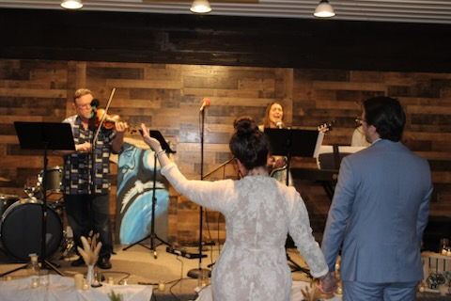
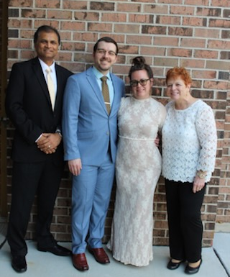
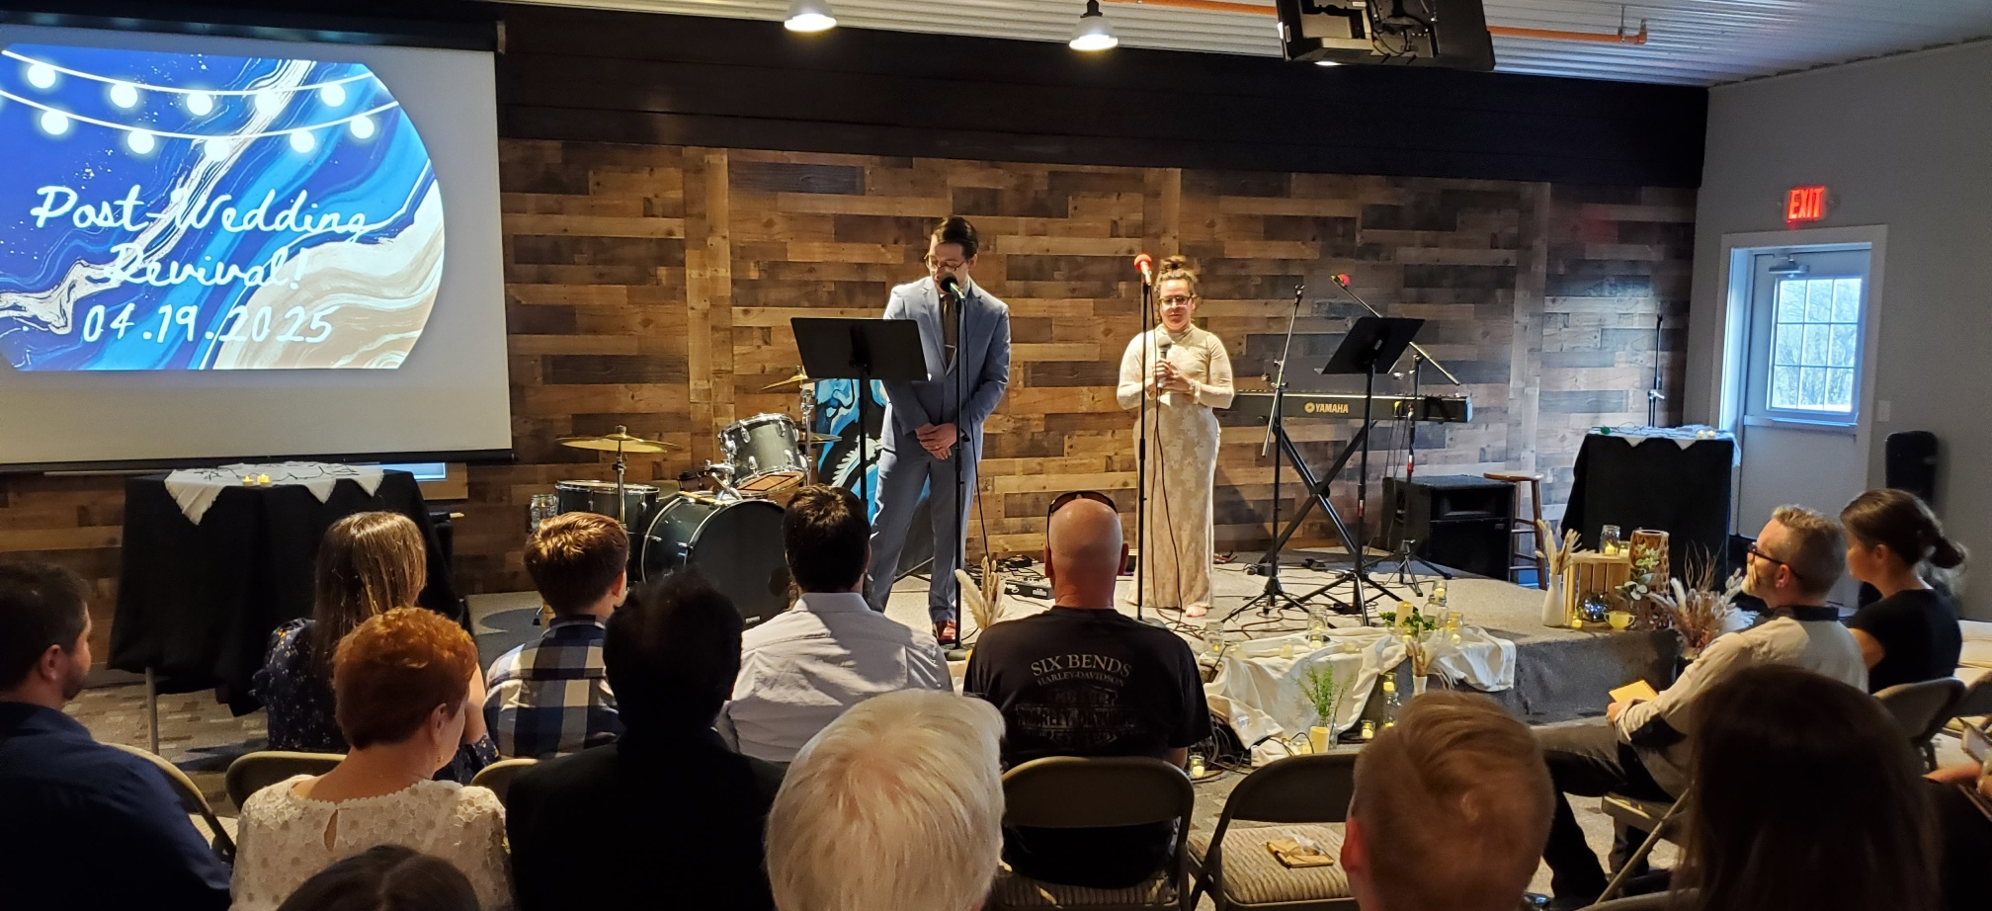
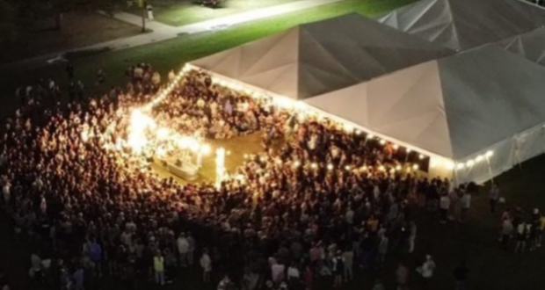
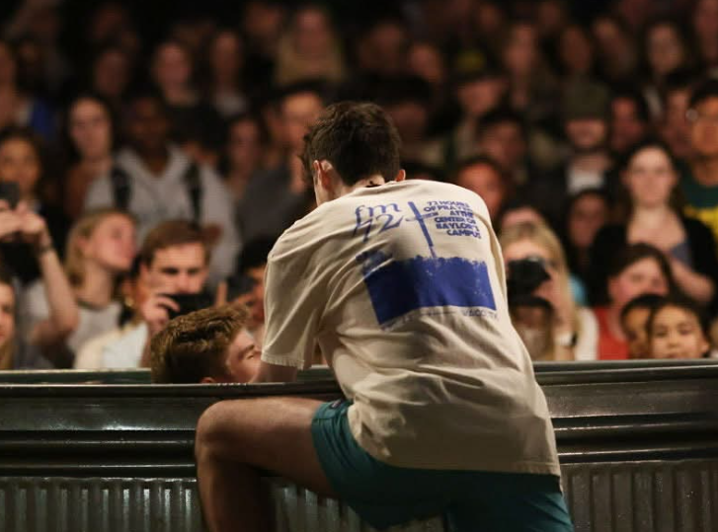
72 Hours of Prayer
Baylor University
PRAISE GOD FOR THE CONTINUAL
AWAKENING IN AMERICA

Slide 3
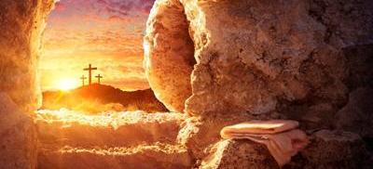
WHAT AN ETERNAL GLORIOUS REALITY
Just as Christ was raised from the dead through the glory of the Father, we too may live a new life.
Romans 6:4 (NIV)
THE RESURRECTION OF JESUS CHRIST – WAS NEVER IN DOUBT – HE SAID HE WOULD LAY DOWN HIS LIFE AND PICK IT BACK UP AGAIN (JOHN 10:17,18) – THE RESURRECTION SEALED THE DEAL – IT PROVIDED THE WAY FOR THE FATHER TO RECONCILE REBELS BACK INTO HIS HOUSEHOLD – AND ALLOWED THE FATHER TO BE ABLE TO BLESS ALL MEN WITH EVERY SPIRITUAL BLESSING IN HEAVENLY PLACES THROUGH THE GIFT OF FAITH AND REPENTANCE.
The CROSS bought for us unlimited forgiveness as long as we repent of our sins - and opened up eternal access and connection with God. The RESURRECTION sealed eternal mediated blessings through Christ’s ONENESS WITH THE FATHER - and provided greater and greater baptisms of the Holy Spirit.

Slide 4
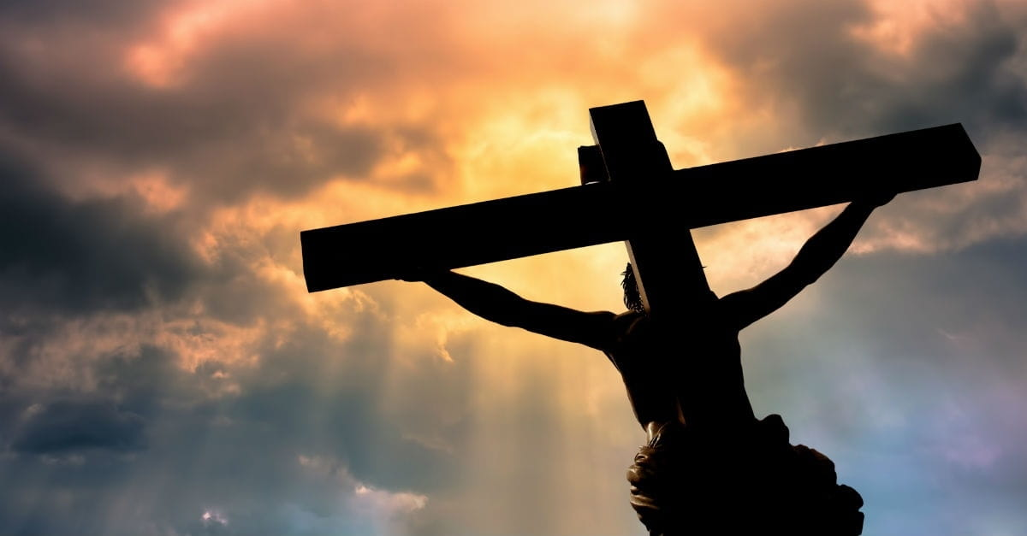
THANK YOU LORD THAT YOU HAVE OUT-MANEUVERED THE ENEMY EVERY TIME

Slide 5
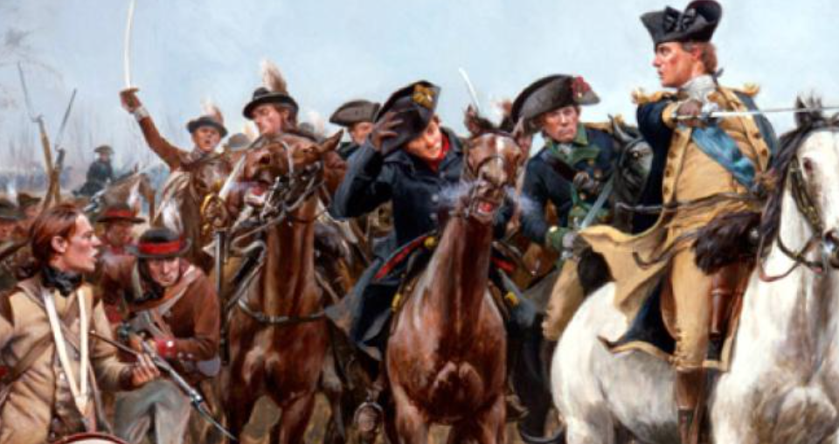
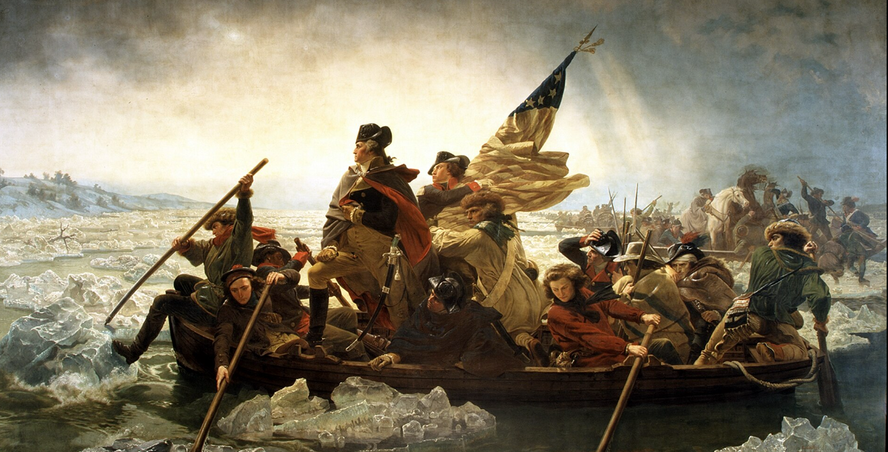
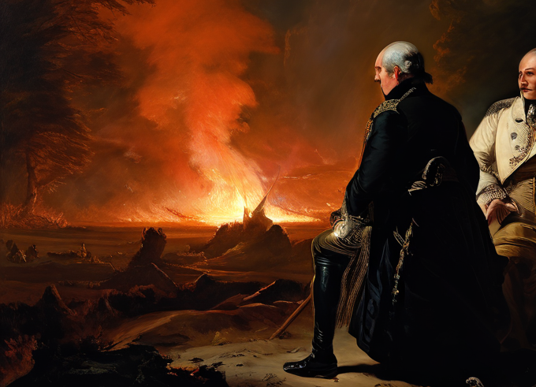
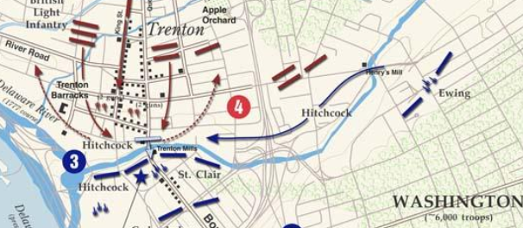
How Do You Maneuver Strategically
And Get The Enemy To Do What You Want?
First Battle of Trenton
December 26,1776
34 year old General Washington Risks
All and Crosses the Delaware River
Second Battle of Trenton
January 2,1777
"We've got the old fox safe now. We'll go over and bag him in the morning." Cornwallis then moved his army to a hill north of Trenton for the night.
Battle Of Princeton, January 3, 1777

Slide 6
THE MYSTERY - THE HIDDEN WISDOM
OF THE GOSPEL THE GREATEST
OUT MANEUVER IN SPIRITUAL WARFARE HISTORY
Now to Him who is able to establish you by my gospel and the proclamation of Jesus Christ, according to the revelation of the mystery hidden for long ages past, ²⁶ but now revealed and made known through the prophetic writings by the command of the eternal God, so that all nations might believe and obey Him-- Romans 16:25-26 (NIV)
No, we speak of God's secret wisdom, a wisdom that has been hidden (Concealed) and that God destined for our glory before time began. 8 None of the rulers (princes) of this age understood it, for if they had, they would not have crucified the Lord of glory. 1 Corinthians 2:7-8 (NIV)

Slide 7
THE ENEMY HAD SOME CLUE –
BUT NOT THE WHOLE PICTURE
The tempter came to Him and said, "If you are the Son of God, tell these stones to become bread." Matthew 4:3 (NIV)
He Knew Jesus was the Son of God – He was mocking Him.
"What do you want with us, Son of God?" they shouted. "Have you come here to torture us before the appointed time?" Matthew 8:29 – Mark 3:10 - Luke 4:35;41
The demons knew Jesus was the Son of God – they were afraid of Him.
Satan (in a futile way) hated Jesus – and wanted Him betrayed and MISSION – COMPROMISED. – Not knowing FULLY – that this was going to fit into God’s plan
As soon as Judas took the bread, Satan entered into him. "What you are about to do, do quickly," Jesus told him, John 13:27 (NIV)

Slide 8
THE ENEMY HAD SOME CLUE –
BUT NOT THE WHOLE PICTURE
So we know that Satan could quote Scripture – but he probably had little CLARITY as to how Jesus as Messiah was going to accomplish His Mission
Therefore the (FATHER) will divide Him a portion with the great, and He shall divide the spoil with the strong; because He has poured out His soul unto death: and He was numbered with the transgressors; and He bore the sin of many, and made intercession for the transgressors. Isaiah 53:12 (KJV)
Satan knew the different interpretations of Old Testament prophecies and maybe saw Jesus coming as a KING MESSIAH.
But he probably had no idea of the SUFFERING MESSIAH – so that was way under his radar.
Furthermore, the OT Prophecies on the Resurrection are very scarce
Satan thinks he’s winning on Good Friday – when actually he’s being permanently disarmed and defeated and lured into great defeat
though the LORD makes His life a guilt offering, He will see His offspring and prolong His days, and the will of the LORD will prosper in His hand. ¹¹ After the suffering of His soul, He will see the light [of life] and be satisfied. Isaiah 53:10-11

Slide 9
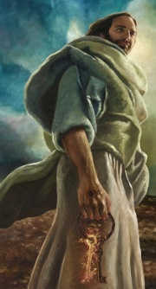
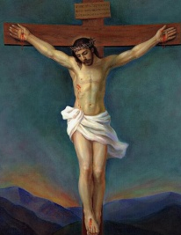
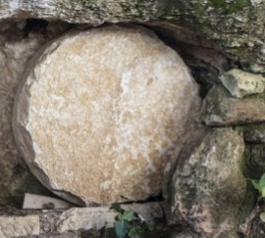
EVEN IF THE ENEMY HAD A WHIFF
OF THE POSSIBILITY OF THE RESURRECTION
Jesus answered them, "Destroy this temple, and I will raise it
again in three days." John 2:19 (NIV)
So somewhere in the super intelligence of Satan he may possibly thought – “well even if Jesus rises from the dead – I will still have the whole world – He will only RESTORE ISRAEL.”
He is the atoning sacrifice for our sins, and not only for ours (JEWS) but also for the sins of the whole world.
1 John 2:2
For there is no difference between Jew and Gentile--the same Lord is Lord of all and richly blesses all who call on Him, 13 for, "Everyone who calls on the Name of the Lord will be saved." Romans 10:12-13
So things went really bad for Satan – He didn’t foresee the damage to his kingdom.
I am the Living One; I was dead, and behold I am alive for ever and ever! And I hold the keys of death and Hades. Revelation 1:17-18 (NIV)
Jesus’ Spirit
Went To The Father
Jesus’ Body
Went Into The Grave
Jesus’ Soul
Went To
Hades

Slide 10
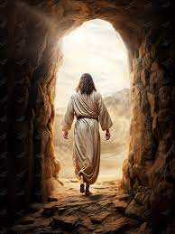
THE GREATEST OUT MANEUVER
IN SPIRITUAL WARFARE
SATAN IS DISARMED BY AN ACTION
THAT HE INITIATED
God (FATHER) made you alive with Christ. He forgave us all our sins, ¹⁴ having canceled the written code, with its regulations, that was against us and that stood opposed to us; He (JESUS) took it away, nailing it to the cross. ¹⁵ And having disarmed (SPOILED) the powers and authorities, He (CHRIST) made a public spectacle (SHOW ) of them, triumphing (CONQUER, GAIN THE VICTORY) over them by the cross.
Colossians 2:13b-15 (NIV)

Slide 11

You will be able to understand my insight into the mystery of Christ, ⁵ which was not made known to men in other generations as it has now been revealed by the Spirit to God's holy apostles and prophets. ⁶ This mystery is that through the Gospel the Gentiles are heirs together with Israel, members together of one body, and sharers together in the promise in Christ Jesus. Ephesians 3:4-6 (NIV)
THIS IS LIKE A REOCCURRING DEVASTATING BLOW THAT NEVER STOPS HITTING SATAN

Slide 12
The DAZZLING GLORY OF GOD
SURPRISING EVERYONE
THROUGH SALVATION BEING OFFERED
FOR THE WHOLE WORLD
However, as it is written: "No eye has seen, no ear has heard, no mind has conceived what God has prepared for those who love Him"-- ¹⁰ For us, however, God has drawn aside the veil through the teaching of the Spirit; for the Spirit searches everything, including the deep things of God.
1 Corinthians 2:9-10 NIV/ WEY

Slide 13
THIS PASSAGE IN REVELATION CHAPTER 12
COULD EASILY BE THE DESCRIPTION OF THE
DISARMING OF PRINCIPALITIES ON THE CROSS
And there was war in heaven. Michael and his angels fought against the dragon, and the dragon and his angels fought back. 8 But he was not strong enough, and they lost their place in heaven. 9 The great dragon was hurled down (BY THE FINISHED WORK ON THE CROSS Matthew 28:18) --that ancient serpent called the devil, or Satan, who leads the whole world astray. He was hurled to the earth, and his angels with him. 10 Then I heard a loud voice in heaven say: "Now have come the salvation and the power and the kingdom of our God, and the authority of His Christ. For the accuser of our brothers, who accuses them before our God day and night, has been hurled down. 11 They overcame him (Satan) by the blood of the Lamb (CROSS) and by the word of their testimony (EARLY CHURCH BOLDNESS; they did not love their lives so much as to shrink from death. (EARLY CHURCH MARTYRS) Revelation 12:7-11

Slide 14
Final Application
BE IN A CONSTANT STATE OF THANKFULNESS - THANK THE FATHER FOR THE INFINITE – IDENTIFICATIONAL GRACE THAT COMES THROUGH HIS SON’S FINISHED WORK ON THE CROSS AND HIS BURIAL AND RESURRECTION.
FREELY RECEIVE, BY FAITH, ALL THAT HE HAS PURCHASED FOR YOU.
THE COVENANT OF FULL SALVATION/ HOLINESS/ VICTORY
THE COVENANT OF FULL DELIVERANCE/ LIBERTY
THE COVENANT OF FULL FILLINGS OF THE HOLY SPIRIT
THE COVENANT OF FULL HEALING/ WISDOM
THE COVENANT OF FULL REVIVAL/ TRANSFORMATION
MAKE OTHERS SPIRITUALLY JEALOUS BY THE GLORY THAT IS RECEIVED INTO THIS REGION – AND PROVOKE HEARTS TO LIVE OUT THE FULLNESS OF THE RESURRECTION OF JESUS.

