Slide 1



Relationship
Surgery (Part 1)
LifeGate Sermon
May 4th, 2025

Slide 2
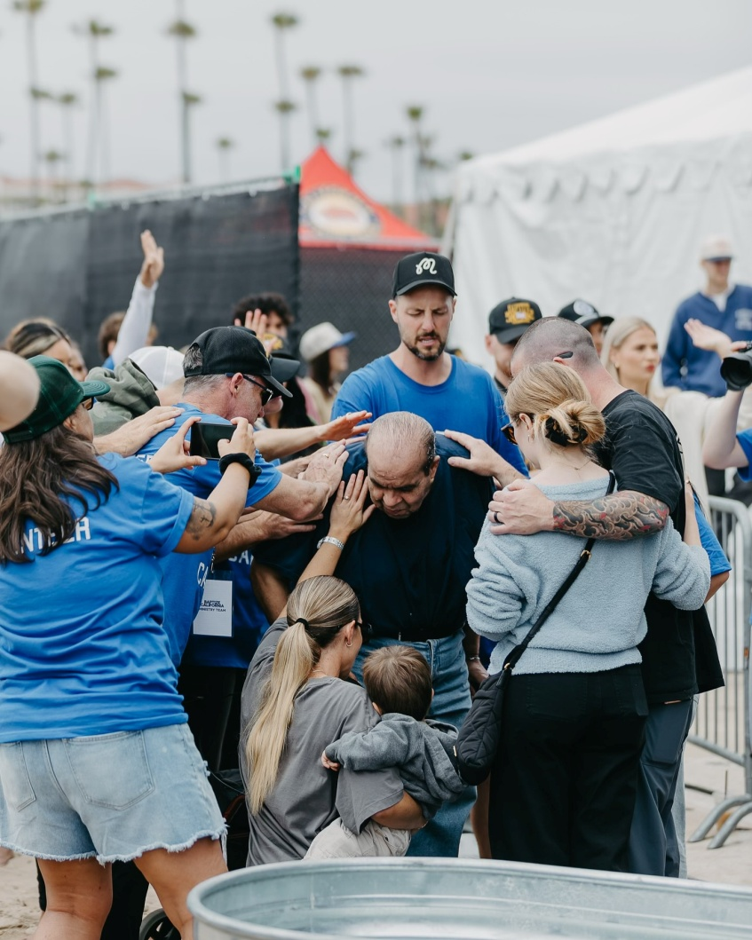
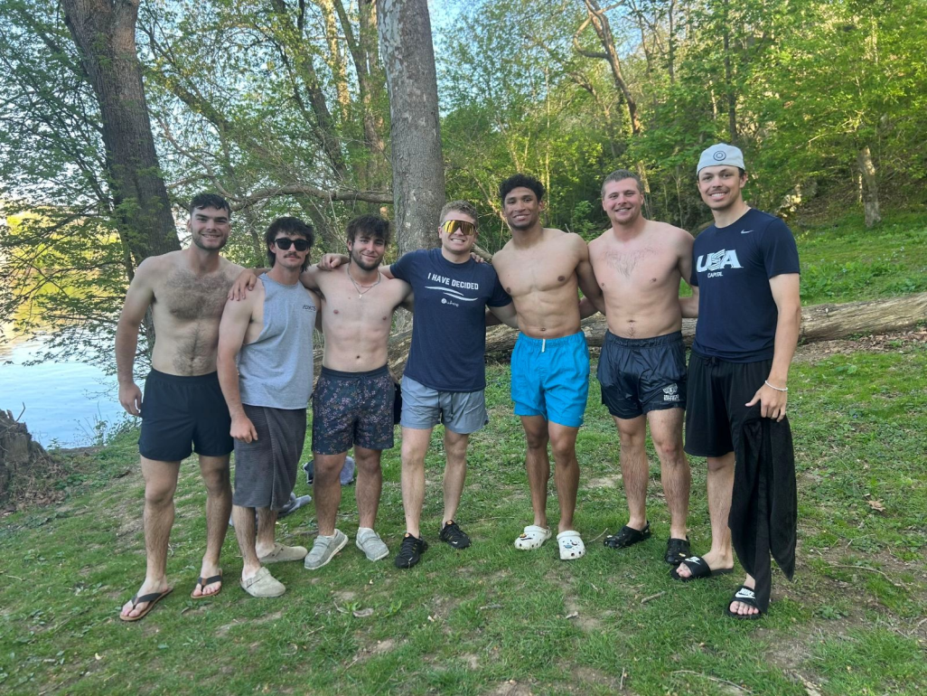
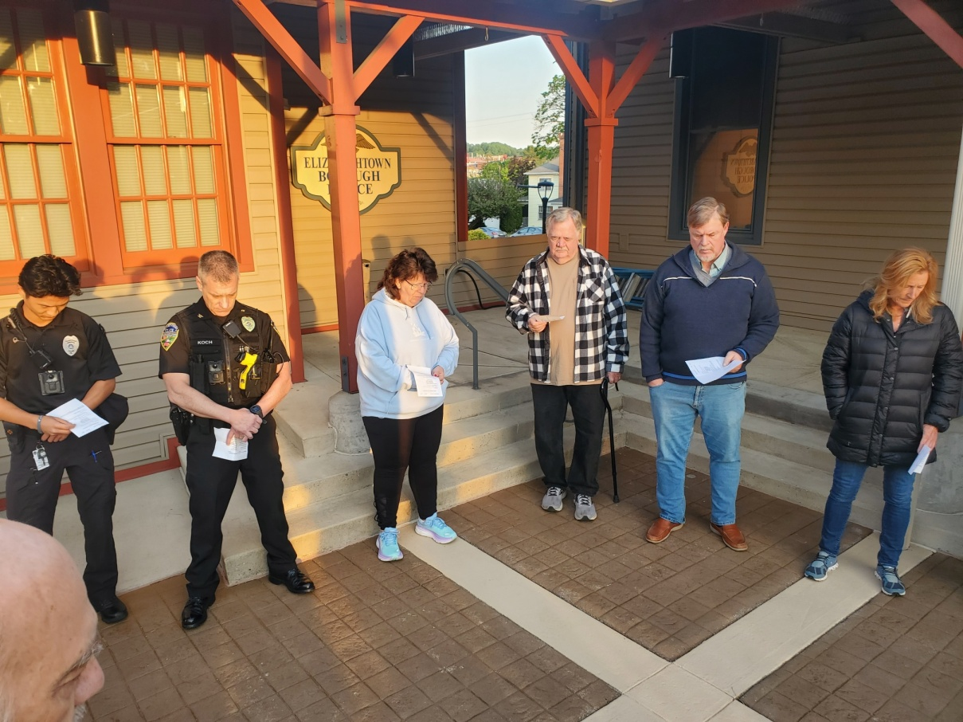
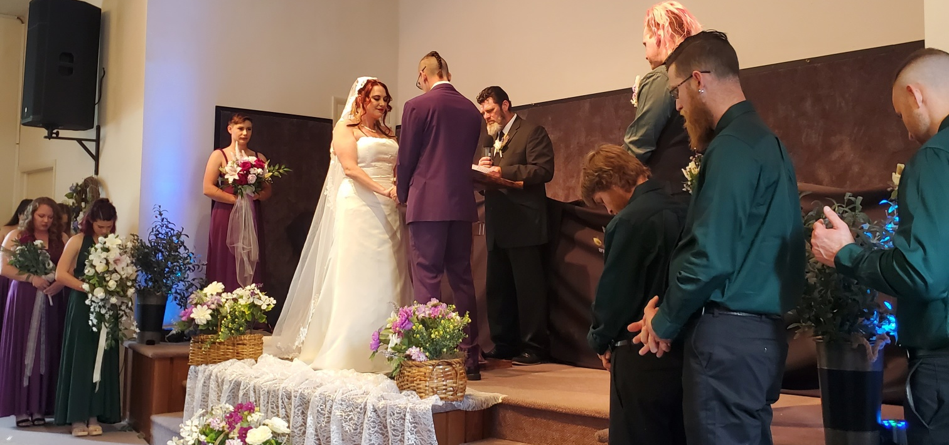
GOD CONTINUES TO STIR IN MANY WAYS

Slide 3
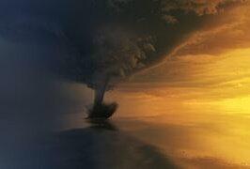
Why All The Drama
In The Last Six Months?
The moon will shine like the sun, and the sunlight will be seven times brighter, like the light of seven full days, when the LORD binds up the bruises (vexation) of His people and heals the wounds He inflicted. Isaiah 30:25-26 (NIV)
Some of the wise will stumble so that they may be refined, purified and made spotless until the time of the end, for it will still come at the appointed time. Daniel 11:35 (NIV)
Let us rejoice and be glad and give Him glory! For the wedding of the Lamb has come, and His bride has made herself ready. Revelation 19:7 (NIV)
"He is wooing you from the jaws of distress to a spacious place free from restriction, to the comfort of your table laden with choice food. Job 36:16

Slide 4
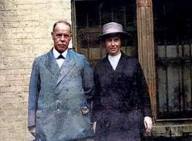
Smith Wigglesworth
On Facing The Refining
Seasons of God Preparing You
Beloved, if you read the Scriptures you will never find anything about the easy time. All the glories come out of hard times. And if you are really transformed it will be in a hard time, it won’t be in a singing meeting, but at a time when you think all things are dried up, when you think there is no hope for you, and you will have passed everything, then it is at this time that God makes the man or woman, when tried by fire, that God purges you, takes the dross away, and brings forth the pure gold. Only melted gold is minted. Only moistened clay becomes configured to the mold. Smith Wigglesworth

Slide 5
IS THERE A BALM IN GILEAD?
FOR ALL THE HEAVINESS
FOR ALL THE BATTLES
FOR ALL THE SCHISMS
FOR ALL THE STRUGGLING RELATIONSHIPS
FOR ALL THE HI-JACKED EMOTIONS
FOR ALL THE BATTLES WITH FORGIVENESS AND HURT
FOR ALL THE QUIRKY RESPONSES
FOR ALL THE GENERATIONAL STRONGHOLDS
FOR ALL THE STRESS AND FRUSTRATION OVER UNFORESEEN DRAMA
Is there no balm in Gilead? Is there no physician there? Why then is there no healing for the wound of my people? Jeremiah 8:22 (NIV)
I will heal their backsliding, I will love them freely: for My anger is turned away from him. Hosea 14:4 (KJV)

Slide 6



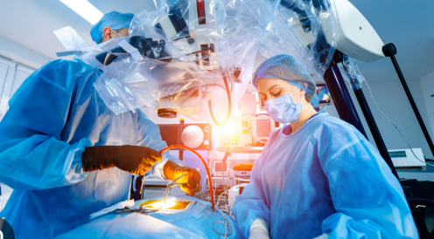

Jesus Is the Chief Surgeon
The Holy Spirit Is the
Attending Physician
Don Lamb Is the
Nurse practitioner
Don’t Underestimate What God Wants To Do This Morning -
Even One Nugget Of Truth Could Begin A Cascading Effect of Healing
Mr. And Mrs. Ambivalent

Slide 7
THE ENEMY KEEPS YOU GOING AROUND IN
WOUNDED CYCLES INSTEAD OF FINDING FREEDOM
What causes fights and quarrels among you? Don't they come from your desires that battle within you? 2 You want something but don't get it. James 4:1,2
You Don’t Love me the way I Want
Cycle of
Wounding
Therefore, I’m going to have to punish you – and withhold my affection - or you will think I’m affirming your bad behavior
I don’t understand why you don’t value spending time with me
FLATTERS/ SHALLOW DISENGAGING TALK
he (shall) corrupt by flatteries (by dividing) : but the people that do know their God shall be strong (conquer and restrain), and do exploits (take action - commit). Daniel 11:32 (KJV)
DISTORTS
ATTACKS
INSTIGATES

Slide 8
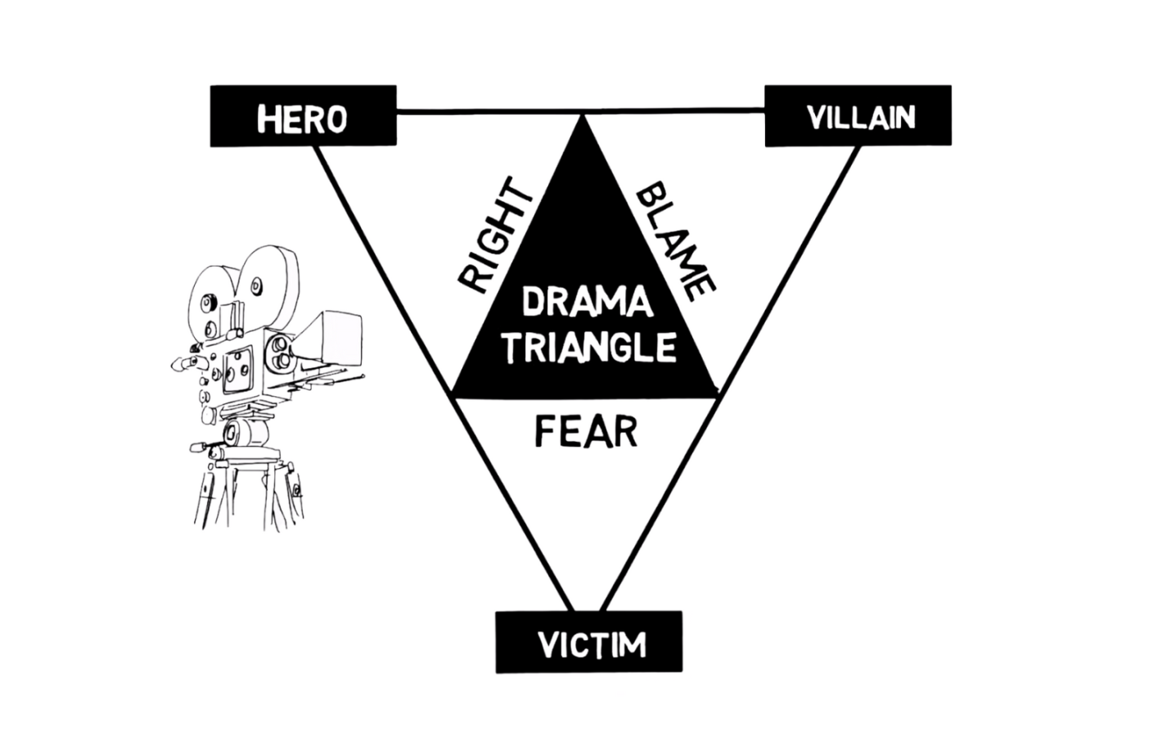
The Uncrucified Flesh’s Playground
False Manipulation
Critical Spirit
Refusal to Acknowledge Own Issues
Husbands, in the same way be considerate as you live with your wives, and treat them with respect as the weaker partner and as heirs with you of the gracious gift of life, so that nothing will hinder your prayers. ⁸ Finally, all of you, live in harmony with one another; be sympathetic, love as brothers, be compassionate and humble. ⁹ Do not repay evil with evil or insult with insult, but with blessing, because to this you were called so that you may inherit a blessing. 1 Peter 3:7-9 (NIV)

Slide 9


True Relational Revival Is Characterized
By Openness and Repentance and Forgiveness
We have spoken freely to you, Corinthians, and opened wide our hearts to you. ¹² We are not withholding our affection from you, but you are withholding yours from us. ¹³ As a fair exchange--I speak as to my children--open wide your hearts also. 2 Corinthians 6:11-13
Growth
Change
Openness
Repentance
Forgiveness
Healing
Breaking A Closed Spirit
Admit you have one
Let the Lord search you and heal your heart
Repent and ask for forgiveness
You can have joy while still believing and working for CHANGE

Slide 10
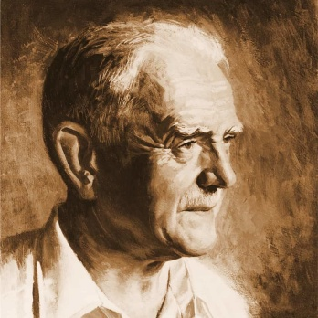
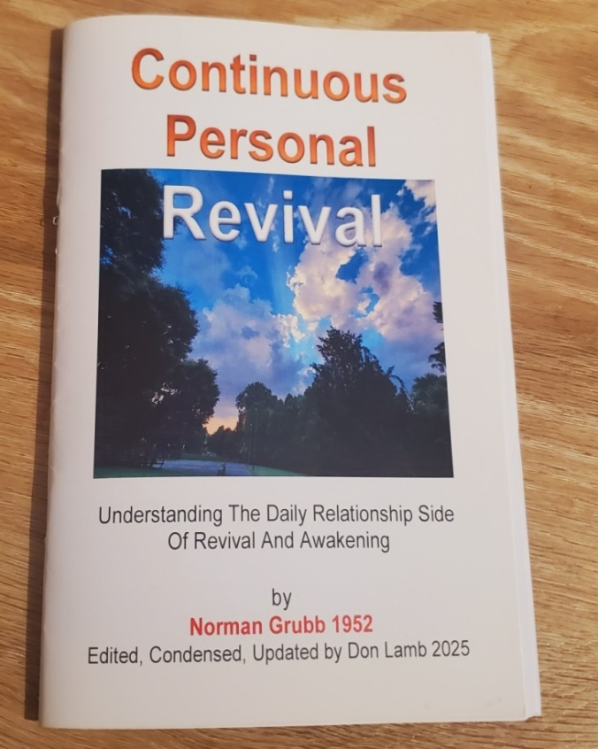
A POWERFUL CLASSIC WAS WRITTEN IN 1952
BY NORMAN GRUBB
God told Norman that He would not give him love for the Africans, but that He would be love in and through Norman. That night in the jungle he made a headstone saying, “Here lies Norman Grubb” and he took by faith what the scriptures said…that it was not Norman’s love; not Norman’s life; …but all belonged to God!
“So revival comes through obedience. Indeed revival is really just obeying the Holy Spirit. God's plan in these last days is revival in His world-wide church, and through the revived church the reaping of a final great harvest of souls. I believe that what is outlined in these pages is the way of the Spirit, within the reach of all believers, both to begin and continue such a revival.” Norman Grubb

Slide 11
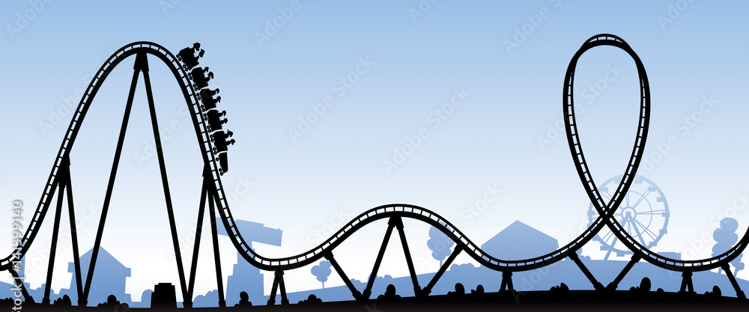
You Don’t Have To Wait For The Big Revival
HIGH TIDE OF REVIVAL TIME OF GREAT POWER AND CRISIS
HIGH TIDE OF REVIVAL TIME OF GREAT POWER AND CRISIS
Continuous
Personal Revival
The Cycles of Awakenings In The Church

Slide 12


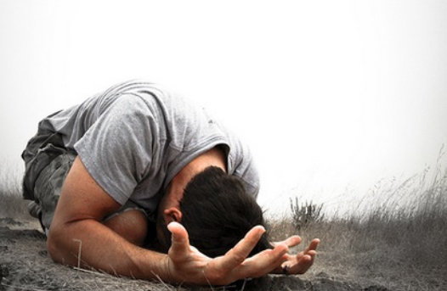

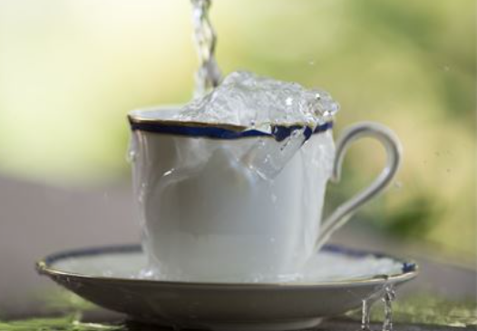

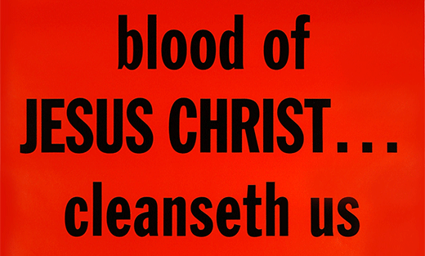

THE BUILDING BLOCKS OF:
Humble Brokenness
Cup’s Running Over

Slide 13
WALKING WITH JESUS
HUMBLE BROKENNESS
Humble Brokenness
When We walk With Jesus He becomes more consuming than the imperfections of those we love or work with or do ministry with.
When my heart was grieved and my spirit embittered, ²² I was senseless and ignorant; I was a brute beast before you. Psalm 73:21-22 (NIV)

Slide 14
TEAR OFF THE ROOF
TEAR DOWN THE WALLS
Many pride themselves in a deep walk with God vertically but they have huge struggles with their horizontal relationships - .
20 If anyone says, "I love God," yet hates his brother, he is a liar. For anyone who does not love his brother, whom he has seen, cannot love God, whom he has not seen. 21 And he has given us this command: Whoever loves God must also love his brother. 1 John 4:20-21 (NIV)

Slide 15
CUPS RUNNING OVER
THE BLOOD OF CHRIST CLEANSES
Cup’s Running Over
With the ROOF OFF and the WALLS DOWN we can walk in the OVERFLOWING WATERS of the Holy Spirit. If the waters stop – we can immediately confess and be cleansed
But if we walk in the light, as he is in the light, we have fellowship with one another, and the blood of Jesus, his Son, purifies us from all sin. 8 If we claim to be without sin, we deceive ourselves and the truth is not in us. 9 If we confess our sins, he is faithful and just and will forgive us our sins and purify us from all unrighteousness. 1 John 1:7-9 (NIV)

Slide 16
How Does This All Fit Together?
“None of us lives unto ourselves. Our faces, our attitudes, and our very personal atmosphere is either poisoning or blessing all those with whom we come in contact.” Norman Grubb
“A quarrel between a husband and wife or brother and sister, for instance, reaches out in its effect far beyond those two. It affects the whole household. It affects visitors in the home, workmates in the business, and above all fellow-believers in the church. Remember it is not a question of confessing sin, but of PRAISING GOD FOR OVERCOMING AND BEING FORGIVEN, and giving others the chance of praising Him with us.” Norman Grubb
But if we start WALKING IN THEN LIGHT with others about the Lord's daily dealings with us, telling them when the shadow of sin has darkened our path and how God has dealt with us over it, we shall suddenly find two things: first, that we have an altogether new sense of brokenness for sin; and second, an altogether new sense of cleansing and liberation from the sin when we repent. Norman Grubb

Slide 17
Let Our Lives Be Tabernacles of Surrender – So That You Can Fill Us.
LORD WE PRAISE YOU FOR THE BEAUTY OF FORGIVENESS –
LORD WE PRAISE YOU FOR THE BEAUTY OF SURRENDER
LORD WE PRAISE YOU FOR THE BEAUTY OF TENDER-HEARTEDNESS
LORD WE PRAISE YOU FOR THE BEAUTY OF CONVICTION BY THE HOLY SPIRIT
LORD WE PRAISE YOU FOR THE BEAUTY OF BEING SENSITIVE TO YOUR VOICE
LORD WE PRAISE YOU FOR THE BEAUTY OF FALLING IN LOVE WITH YOU
LORD WE PRAISE YOU FOR THE BEAUTY OF A HEART THAT LOVES IN SPITE OF HURTING
LORD WE PRAISE YOU FOR THE BEAUTY OF HEALED RELATIONSHIPS – BETTER THAN THEY WERE BEFORE

Slide 18
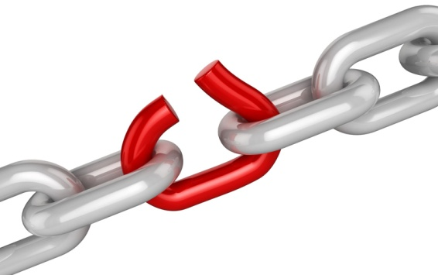
Lord Help Us To Identify
What We May Be Missing
Lord Open Our Eyes
To See What We Can’t See Right Now
LORD IDENTIFY THE WEAKEST LINK IN EACH OF US – AND CHANGE US FROM THE INSIDE OUT – BRING KINGDOM FREEDOM IN PLACE OF BONDAGE – AND LIMITATION – BRING KINGDOM AWARENESS INSTEAD OF SOULISH BLINDNESS
Lord Bless my relationships with Your grace, revelations, Holy Spirit nurturing and healthy communication skills

Slide 19
Final Application
LORD FATHER, IN THE NAME OF JESUS :
SINK ALL OF OUR AMBITIONS AND PERSONALITIES AND RELATIONSHIP ANOMALIES AND QUIRKY INTERACTIONS UNDER THE WEIGHT OF YOUR GLORY
BREAK EVERY UNEASY SPIRIT THAT ATTACKS OUR RELATIONSHIPS – BRING– CONVICTION – ALIGNMENT - PEACE – RIGHTEOUSNESS AND JOY IN THE HOLY SPIRIT.
HELP US BE PATIENT WHEN WE ARE LOOKING AT SOMEONE WHO IS STRUGGLING TO GRASP THE NEED TO CHANGE – AND HELP US LOOK INTO OUR OWN HEART AND IDENTIFY WHAT YOU ARE WORKING ON.

Slide 20
Cleansing Comes From The Blood
But It Requires Repentance and Forgiving Others
I believe there are a great many people who would be healed, but they are harboring things in their hearts that are acting as a blight. Let these things go. Forgive, and the Lord will forgive you. There are many good people, people who mean well, but they have no power to do anything for God. There is just some little thing that came in their hearts years ago, and their faith has been paralyzed ever since. Bring everything into the light. God will sweep it all away if you will let Him. Let the precious blood of Christ cleanse from all sin. Smith Wigglesworth

Slide 21
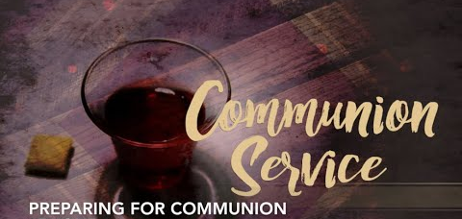
Cleanse our lips Lord to only speak life – truth – love, FAITH, and grace into our relationships
Wash away all our bitterness – frustration – anger – unforgiveness and unbelief for change

Slide 22

THE GLORY OF GOD MAKING OUR HEARTS WILLING TO WALK IN SUBMISSION AND SURRENDER
Restore to me the joy of Your salvation and grant me a willing spirit, to sustain me.
Psalm 51:12 (NIV)
Thy people shall be willing (TO OFFER FREELY AND VOLUNTARILY) in the day of thy power, in the beauty of holiness from the womb of the morning:. Psalm 110:3 (KJV)

