Slide 1



Relationship
Surgery (Part 2)
LifeGate Mother’s Day Sermon
May 11th, 2025

Slide 2
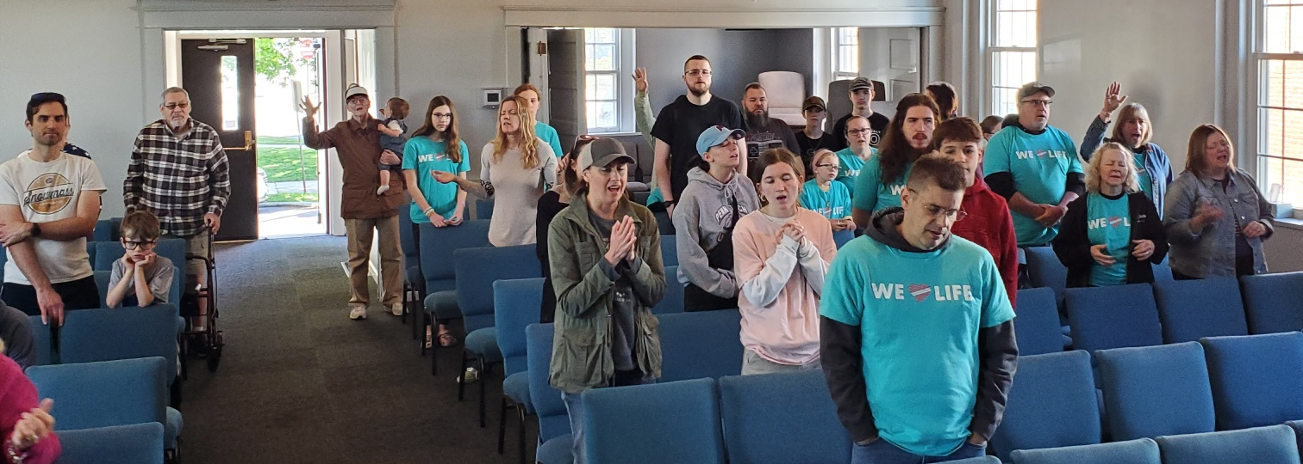
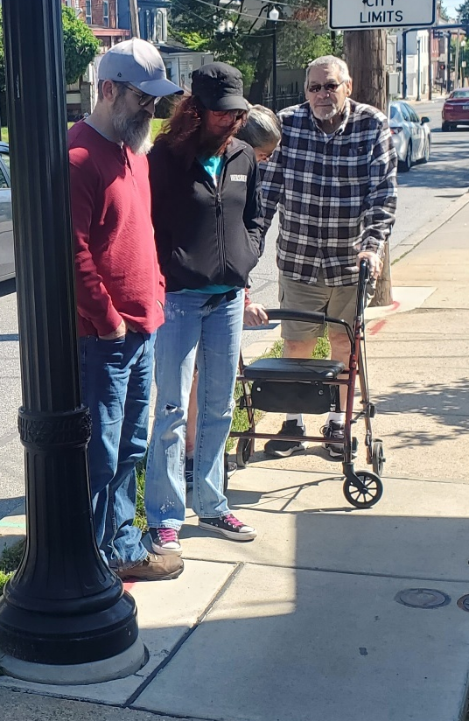
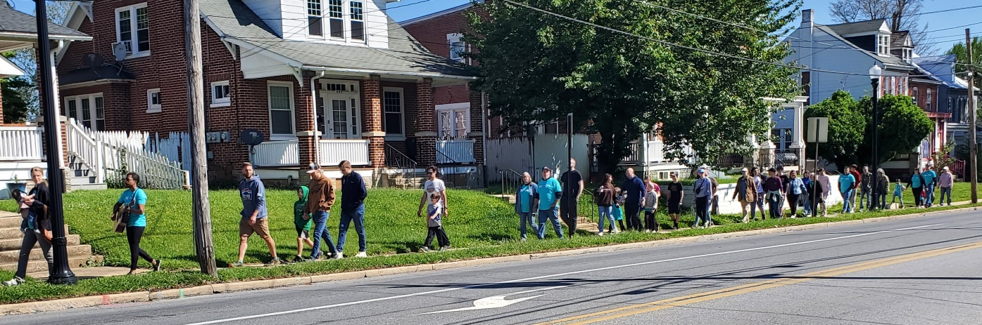
Beautiful Day Of Standing In The Gap

Slide 3
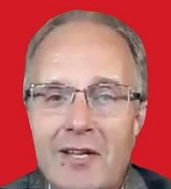
Troy Anderson
Dr. Bekker (Dean of Reagent University) shares bold insights into the spiritual condition of America, the global revival rising among the next generation, and how are living in the Nineveh Moment that Billy Graham foresaw in 2013 - “A window of mercy and repentance before judgment.” We also discuss the rising role of unlikely spiritual leaders- and what it will take for believers and churches to prepare for this Great Awakening, led by a rising generation hungry for truth, worship, and consecration.

Slide 4



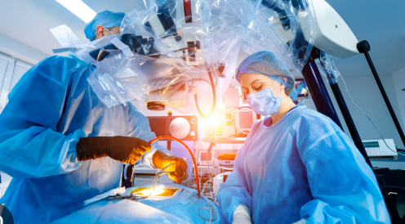
Jesus Is the Chief Surgeon
The Holy Spirit Is the
Attending Physician
Don Lamb Is the
Nurse practitioner
Don’t Underestimate What God Wants To Do This Morning - On This
Mother’s Day

Slide 5
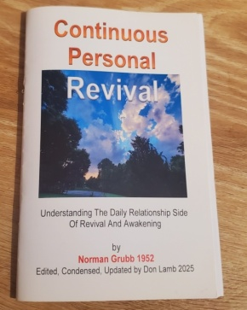
The Saints In Scripture – Have Their Whole
Life Displayed – and God Shows
His Redemption Grace and Glory
“But let us note that the key to the reality of the whole of Scripture is the openness of the saints in the Bible. We know of God's most intimate dealings with them, their sins and failures every bit as much as their successes. How do we know the details of Abraham's false step with Hagar, or Jacob's tricks with Isaac and Esau, or Moses' private act of disobedience concerning striking the rock: Or Elijah's running away and God's secret rebuke, or the inner history of Jonah? How did the disciples know the inside story of Jesus' temptations to record for us? Only because they all shared openly before their contemporaries. They lived in the LIGHT with each other as with God.” Norman Grubb – page 15

Slide 6
THREE MOTHER’S OF HEART RENDING
STORIES TURNED TO REDEMPTIVE GLORY
(JOSEPH’S SIDE OF THE FAMILY OF JESUS) The son of Melea, the son of Menna, the son of Mattatha, the son of Nathan, the son of David, Luke 3:31 (NIV)
(MARY’S SIDE OF THE FAMILY OF JESUS) Salmon fathered Boaz by Rahab, Boaz fathered Obed by RUTH, Obed fathered Jesse, Matthew 1:5 (HCSB)
and Jesse the father of King David. David was the father of Solomon, whose mother (BATHSHEBA) had been Uriah's wife, Matthew 1:6 (NIV)

Slide 7
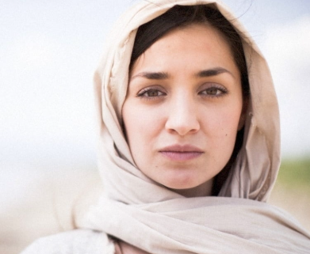
Ruth
No Ammonite or Moabite or any of their descendants may enter the assembly of the LORD, even down to the tenth generation. ⁴ For they did not come to meet you with bread and water on your way when you came out of Egypt, Deuteronomy 23:3, 4 (NIV)
Paul wrote that not all Israel is Israel (Rom 9:6), - Ruth places herself under the Lord’s covenant (Ruth 1:16-17; 2:18) and became part of his people.
Upon returning to the Bethlehem Ruth gleans grain in the field of Naomi’s wealthy kinsman Boaz and is noticed by him (Ruth 2:1-23). Then, according to Naomi’s advice, Ruth appeals to Boaz to perform his opportunity toward her as Noami’s kinsman-redeemer

Slide 8
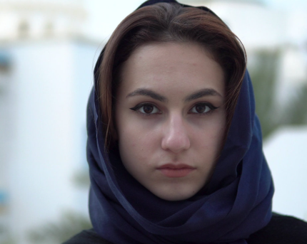
Bathsheba
When Uriah's wife heard that her husband was dead, she mourned for him. ²⁷ After the time of mourning was over, David had her brought to his house, and she became his wife and bore him a son. But the thing David had done displeased the LORD. 2 Samuel 11:26-27 (NIV)
Then Nathan asked Bathsheba, Solomon's mother, "Have you not heard that Adonijah, the son of Haggith, has become king without our lord David's knowing it? ¹² Now then, let me advise you how you can save your own life and the life of your son Solomon. 1 Kings 1:11-12 (NIV)

Slide 9
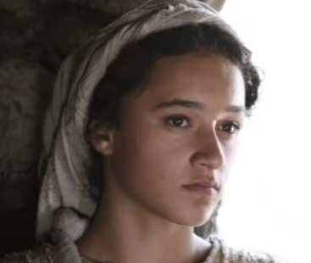
Mary
God sent the angel Gabriel to Nazareth, a town in Galilee, ²⁷ to a virgin pledged to be married to a man named Joseph, a descendant of David. The virgin's name was Mary. ²⁸ The angel went to her and said, "Greetings, you who are highly favored! The Lord is with you." ²⁹ Mary was greatly troubled at his words and wondered what kind of greeting this might be. ³⁰ But the angel said to her, "Do not be afraid, Mary, you have found favor with God. ³¹ You will be with child and give birth to a son, and you are to give him the name Jesus. Luke 1:26-31 (NIV)
³⁵ The angel answered, "The Holy Spirit will come upon you, and the power of the Most High will overshadow you. So the holy one to be born will be called the Son of God. ³⁶ Even Elizabeth your relative is going to have a child in her old age, and she who was said to be barren is in her sixth month. ³⁷ For nothing is impossible with God." ³⁸ "I am the Lord's servant," Mary answered. "May it be to me as you have said." Then the angel left her. Luke 1:35-38 (NIV)

Slide 10


Summary Of These Three Amazing Mothers
Ruth, is a young woman from Moab—a nation hostile to Israel—she marries a Jewish man, but after he, his brother, and his father die, Ruth chooses to stay loyal to her widowed mother-in-law, Naomi. Despite Naomi's urging to remain in Moab and remarry, Ruth faithfully follows her to Bethlehem, where she eventually meets Boaz, a wealthy relative of Naomi. Boaz redeems Ruth by marrying her, securing both her future and Naomi’s inheritance, and Ruth becomes the great-grandmother of King David. | Bathsheba, known for her beauty and wisdom, is married to a loyal soldier but becomes entangled in King David’s sin when he seduces her while her husband is away at war. After her husband's death and the loss of her first child, Bathsheba moves into the palace, where she eventually gives birth to Solomon and walks a path of forgiveness and resilience. She navigates palace intrigue and betrayal, ultimately ensuring Solomon’s rise to the throne, who becomes part of the royal lineage to Jesus. | Mary of Nazareth was chosen for a Divine mission, conceiving Jesus through the Holy Spirit after the angel Gabriel's announcement, and gave birth in Bethlehem during a Roman census. Despite societal judgment and personal challenges, she raised Jesus with Joseph, witnessing Jesus’ ministry, crucifixion, and resurrection. Mary's enduring faith led her to be present with the Apostles during the outpouring of the Holy Spirit at Pentecost, marking her as a central figure in early Christianity.

Slide 11
The Battles They Had To Win
Ruth
Bathsheba
Mary
Bitterness toward God for allowing the sudden death of her husband Frustration that life was so complicated and that many calamities happened all around her Willingness to risk rejection by leaving her birth family and then risking with BOAZ after having so much pain | Bitterness for being taken advantage of by someone who was a national hero and a godly King. Frustration with God for allowing her husband to die and not having him to help her work through this crisis Unforgiveness toward David and actually supporting Absalom and Adonijah in bringing down David. She forgave and moved forward. | The confusion of being honored by such a high calling that was fraught with so much scandal. Hardening of her heart through the ups and down of watching her Son walk out His calling. Discouragement that her son was humiliated and crucified in front of everyone.

Slide 12


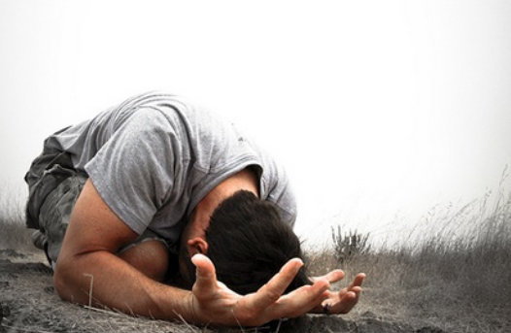

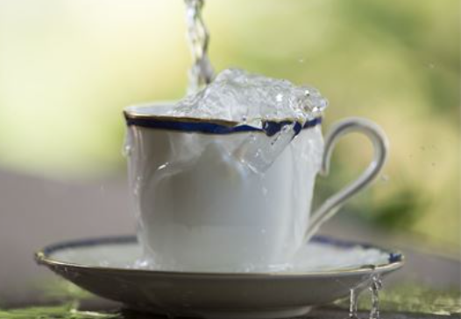

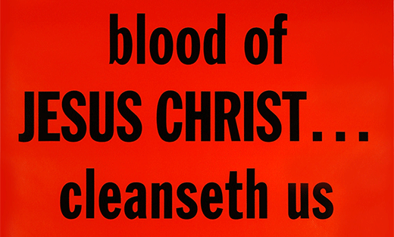

THE BUILDING BLOCKS OF:
Humble Brokenness
Cup’s Running Over

Slide 13


What Primary Lessons Do
These Mother’s Teach Us.
Ruth
Mary
Bathsheba
Humble Brokenness
Cup’s Running Over
And Mary said: "My soul glorifies the Lord ⁴⁷ and my spirit rejoices in God my Savior, ⁴⁸ for He has been mindful of the humble state of His servant. From now on all generations will call me blessed, Luke 1:46-48

Slide 14

They Each Had To Believe
That God’s Favor Was Upon Them
The LORD will open the heavens, the storehouse of His bounty, to send rain on your land in season and to bless all the work of your hands.
Deuteronomy 28:12a (NIV)
May the favor (SPLENDOR, GRACE, BEAUTY) of the Lord our God rest upon us; establish the work of our hands for us-- yes, establish the work of our hands. Psalm 90:17 (NIV)
²⁴ This is the day which the LORD hath made; we will rejoice and be glad in it. ²⁵ Save now, I beseech thee, O LORD: O LORD, I beseech thee, send now prosperity. (TO PUSH FORWARD) Psalm 118:24-25 (KJV)

Slide 15
Let Our Lives Be Tabernacles of Surrender – So That You Can Fill Us.
LORD WE PRAISE YOU FOR THE BEAUTY OF FORGIVENESS –
LORD WE PRAISE YOU FOR THE BEAUTY OF SURRENDER
LORD WE PRAISE YOU FOR THE BEAUTY OF TENDER-HEARTEDNESS
LORD WE PRAISE YOU FOR THE BEAUTY OF CONVICTION BY THE HOLY SPIRIT
LORD WE PRAISE YOU FOR THE BEAUTY OF BEING SENSITIVE TO YOUR VOICE
LORD WE PRAISE YOU FOR THE BEAUTY OF FALLING IN LOVE WITH YOU
LORD WE PRAISE YOU FOR THE BEAUTY OF A HEART THAT LOVES IN SPITE OF HURTING
LORD WE PRAISE YOU FOR THE BEAUTY OF HEALED RELATIONSHIPS – BETTER THAN THEY WERE BEFORE

Slide 16
Her children arise and call her blessed; her husband also, and he praises her: "Many women do noble things, but you surpass them all." Proverbs 31:28-29
(May God) make you perfect in every good work to do His will, working in you that which is well-pleasing (fully agreeable) in His sight, through Jesus Christ; to Whom be glory for ever and ever. Amen. Hebrews 13:21 (KJV)

Slide 17
Final Application
(Isaiah 61 Moment)
The Spirit of the Sovereign LORD is on YOU, the LORD has anointed YOU to preach good news to the poor. He has sent YOU to bind up the brokenhearted, to proclaim freedom for the captives
To proclaim the year of the LORD's favor upon YOUR FAMILY and CHURCH and COMMUNITY
To provide for those who grieve in Zion-- to bestow on YOU a crown of beauty instead of ashes, the oil of gladness instead of mourning, and a garment of praise instead of a spirit of despair. YOU will be called oaks of righteousness, a planting of the LORD for the display of His splendor

