Slide 1
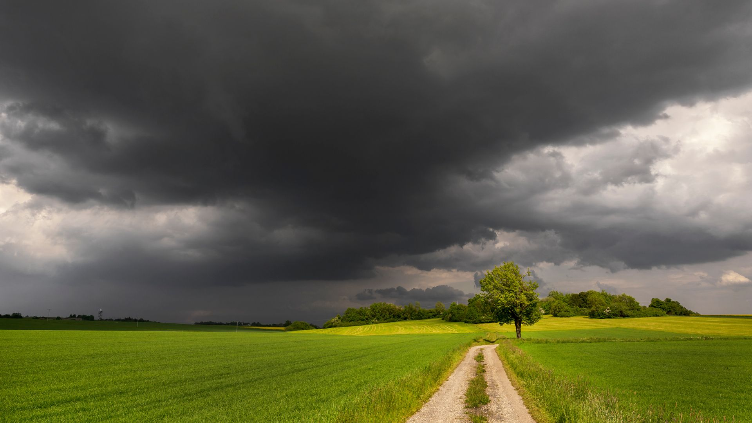
Trusting God in the Storm

Slide 2
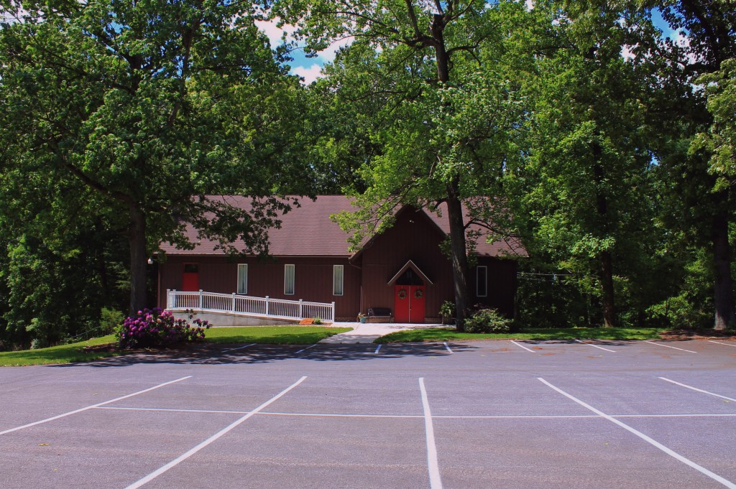
LifeGate’s Goals for Believers

Slide 3

Fundamental truths about our Journey with the Lord:

Slide 4

God has written a Book about you

Slide 5

Stumbling blocks that can take us out in our faith walk.

Slide 6

Building blocks that can increase our faith level.

Slide 7
Conclusions:
A) Walking with the Lord in the ups and downs is a priviledge
B) You will never become the person God wants you to be without testings
C) We’ve got to trust the Lord’s superior knowledge
D) Praise and Worship from the midst of the storm is very
meaningful and pure.
E) People are watching us….
E) Your testimony becomes a steppingstone for others to come
to faith in Christ.

Slide 8
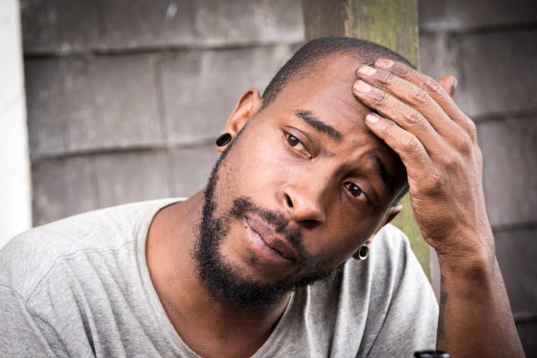
Wrapping up
Does God understand when I seem to flounder with the emotional swings of life?

