Slide 1

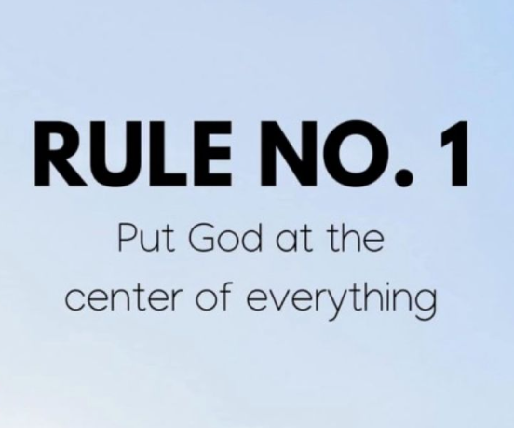
God’s Grace is Sufficient for all of
Life’s challenges and circumstances
My grace is sufficient for you, for my power is made perfect in weakness.
2 Cor. 12: 9

Slide 2
Whatever is coming at you, give it all back to the Lord and lean into His Grace to move forward.
Give your burdens to the Lord,
and he will take care of you.
He will not permit the godly to slip and fall. Psalm 55: 22
So humble yourselves under the mighty power of God, and at the right time he will lift you up in honor. ⁷ Give all your worries and cares to God, for he cares about you.
⁸ Stay alert! Watch out for your great enemy, the devil. He prowls around like a roaring lion, looking for someone to devour. I Peter 5: 6- 8

Slide 3
Five points of todays message
True Satisfaction in life comes from a life connected
to the will and purposes of God.
Stop dwelling on life’s challenges without acknowledging that God is well aware of them and has a plan to deal with them.
God’s promises in the scriptures are not meant to be just good luck charms, but are meant to be activated in your life.
Invite the Holy Spirit into you Life to create balance.
Discovering and walking in your unique calling will
bring about a harvest of righteousness and
fulfillment, even in the midst of the storms.

Slide 4
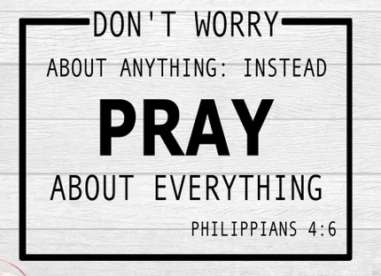
Sometimes the simplest task is the hardest…

Slide 5

The battle of the human mind and the world’s priorities….
But people who long to be rich fall into temptation and are trapped by many foolish and harmful desires that plunge them into ruin and destruction. 1 Tim. 6: 9

Slide 6
To counter act the worlds ideas …..
Make being close to God - Top priority… There are no substitutes.
Make quality time with your family priority…. They are the one thing
money can’t buy!
Make the regular engagement with the Church Family a priority.
Don’t allow your circumstances to define your journey.
¹⁶ For his Spirit joins with our spirit to affirm that we are God’s children. ¹⁷ And since we are his children, we are his heirs. In fact, together with Christ we are heirs of God’s glory. But if we are to share his glory, we must also share his suffering.
¹⁸ Yet what we suffer now is nothing compared to the glory he will reveal to us later. Rom. 8: 16 – 18

Slide 7
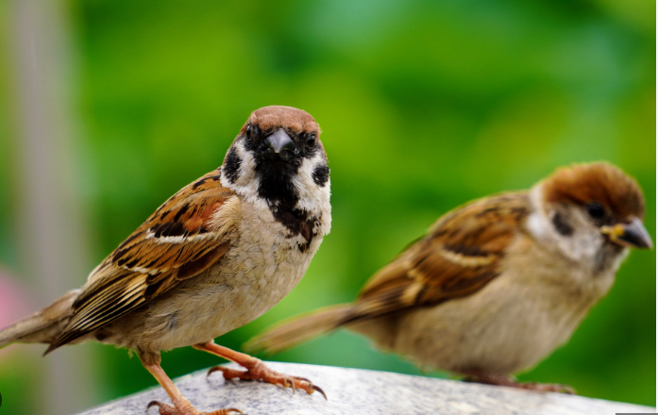
Stop dwelling on life’s challenges without acknowledging that God is well aware of them and has plans to deal them.
What is the price of two sparrows—one copper coin^{[a]}? But not a single sparrow can fall to the ground without your Father knowing it. ³⁰ And the very hairs on your head are all numbered. ³¹ So don’t be afraid; you are more valuable to God than a whole flock of sparrows. Matt. 10: 29 – 31

Slide 8
God’s Promises in scripture are not just good luck charms, but are meant to be activated in your life.
You are here for a purpose. God has assignments for you to complete. When you disengage and struggle to fine purpose,
your mission suffers and hopelessness takes over.
³ By his divine power, God has given us everything we need for living a godly life. We have received all of this by coming to know him, the one who called us to himself by means of his marvelous glory and excellence. ⁴ And because of his glory and excellence, he has given us great and precious promises. These are the promises that enable you to share his divine nature and escape the world’s corruption caused by human desires. 2 Peter 1: 3- 4

Slide 9
Specific Prophetic words of confirmation and
support….
God also allows specific words to be spoken into your lives, through
- Specific times with the Holy Spirit - in devotions
- Through sermons or Podcast - revelation comes
- Through prayer times when someone prays over us
- Prophetic word is spoken over us.
¹⁴ Do not neglect the spiritual gift you received through the prophecy spoken over you when the elders of the church laid their hands on you. ¹⁵ Give your complete attention to these matters. Throw yourself into your tasks so that everyone will see your progress. ¹⁶ Keep a close watch on how you live and on your teaching. Stay true to what is right for the sake of your own salvation and the salvation of those who hear you. 1 Timothy 4: 14 – 16
It is the same with my word.
I send it out, and it always produces fruit.
It will accomplish all I want it to,
and it will prosper everywhere I send it. Isa. 55:11

Slide 10
Invite the Holy Spirit to modulate your live:
Bring a balance and calmness to all the noise…….
One of the Modern dilemmas we face, is that culture today tries to
prevent anything bad, challenging or difficult from coming into a
child’s life. It’s intended to prevent trauma, or feeling of failure or loss.
Kids need to learn what it is to……
Loose a soccer game Get challenged by coach
Fail at a science project Redo the pottery jar
Get picked last for the kickball team…..
Something happens when we learn to deal with setbacks and disappointments in the right way. Not avoiding them. But learning from
them. Finding resilience, determination and courage.
As believers we know that our well being doesn’t depend on winning all the time. But our sufficiency is in the Grace and Support of God in our lies each day. 2 Cor. 12: 9

Slide 11
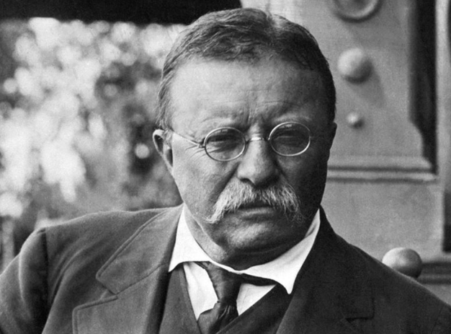
Teddy Roosevelt
"It is not the critic who counts: not the man who points out how the strong man stumbles or where the doer of deeds could have done better. The credit belongs to the man who is actually in the arena, whose face is marred by dust and sweat and blood, who strives valiantly, who errs and comes up short again and again, because there is no effort without error or shortcoming, but who knows the great enthusiasms, the great devotions, who spends himself for a worthy cause; who, at the best, knows, in the end, the triumph of high achievement, and who, at the worst, if he fails, at least he fails while daring greatly, so that his place shall never be with those cold and timid souls who knew neither victory nor defeat." Paris 1910

Slide 12
Jesus laid it out for us:
³³ I have told you all this so that you may have peace in me. Here on earth you will have many trials and sorrows. But take heart, because I have overcome the world.” John 16: 33
²³ Let us hold tightly without wavering to the hope we affirm, for God can be trusted to keep his promise. ²⁴ Let us think of ways to motivate one another to acts of love and good works. ²⁵ And let us not neglect our meeting together, as some people do, but encourage one another, especially now that the day of his return is drawing near. Heb. 10: 23 – 25
³⁵ So do not throw away this confident trust in the Lord. Remember the great reward it brings you! ³⁶ Patient endurance is what you need now, so that you will continue to do God’s will. Then you will receive all that he has promised. Heb. 10: 35- 36

Slide 13
Discovering and walking in your unique calling will bring about a harvest of righteousness and fulfillment, even in the midst of storms.
Trying to live life on our own:
This is what the Lord says:
“Cursed are those who put their trust in mere humans,
who rely on human strength
and turn their hearts away from the Lord. Jer. 17: 5
“But blessed are those who trust in the Lord
and have made the Lord their hope and confidence.
⁸ They are like trees planted along a riverbank,
with roots that reach deep into the water.
Such trees are not bothered by the heat
or worried by long months of drought.
Their leaves stay green,
and they never stop producing fruit. Jer. 17: 7 – 8

Slide 14
It’s our hour as the church in 2025. No one else is coming to our rescue but God. He is going to empower us, equip us and sustain us.
¹⁶ But it is no shame to suffer for being a Christian. Praise God for the privilege of being called by his name! ¹⁷ For the time has come for judgment, and it must begin with God’s household. And if judgment begins with us, what terrible fate awaits those who have never obeyed God’s Good News? ¹⁸ And also,
“If the righteous are barely saved,
what will happen to godless sinners?”^{[a]}
¹⁹ So if you are suffering in a manner that pleases God, keep on doing what is right, and trust your lives to the God who created you, for he will never fail you.
- God is your strength - God is your source - God is your provider
He defeated the enemy - He can provide peace and grace for every
Situation.

Slide 15
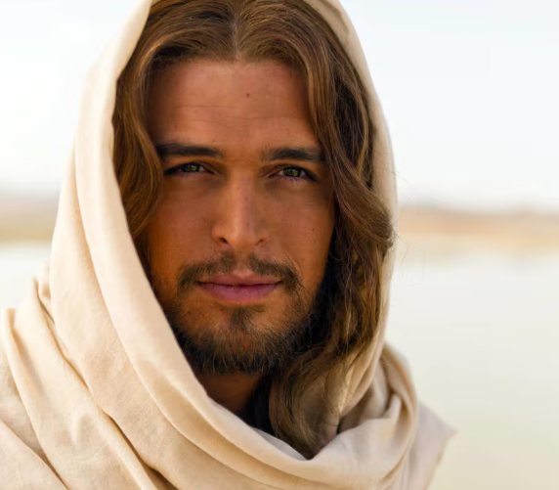
Jesus selected you to be on His team for
a reason. Let’s stand in the confidence He
Is going to see your mission fulfilled.
You didn’t choose me. I chose you. I appointed you to go and produce lasting fruit, so that the Father will give you whatever you ask for, using my name. John 15: 16
And I am certain that God, who began the good work within you, will continue his work until it is finally finished on the day when Christ Jesus returns. Phil. 1:6
VICTORY IN JESUS

