Slide 1

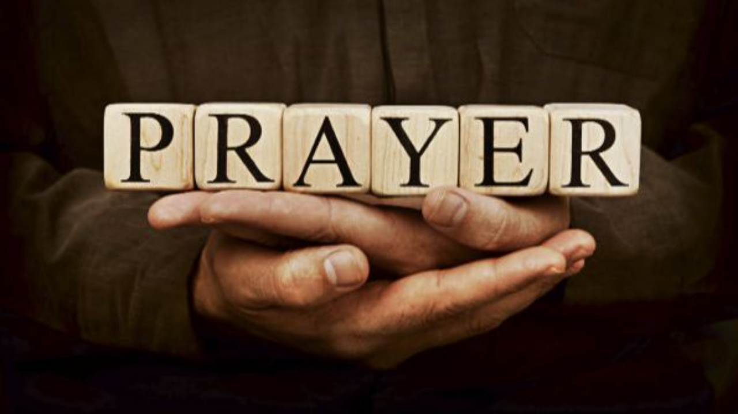
Pressing Through The Veil
By Means Of
LifeGate Sermon
June 29th, 2025

Slide 2
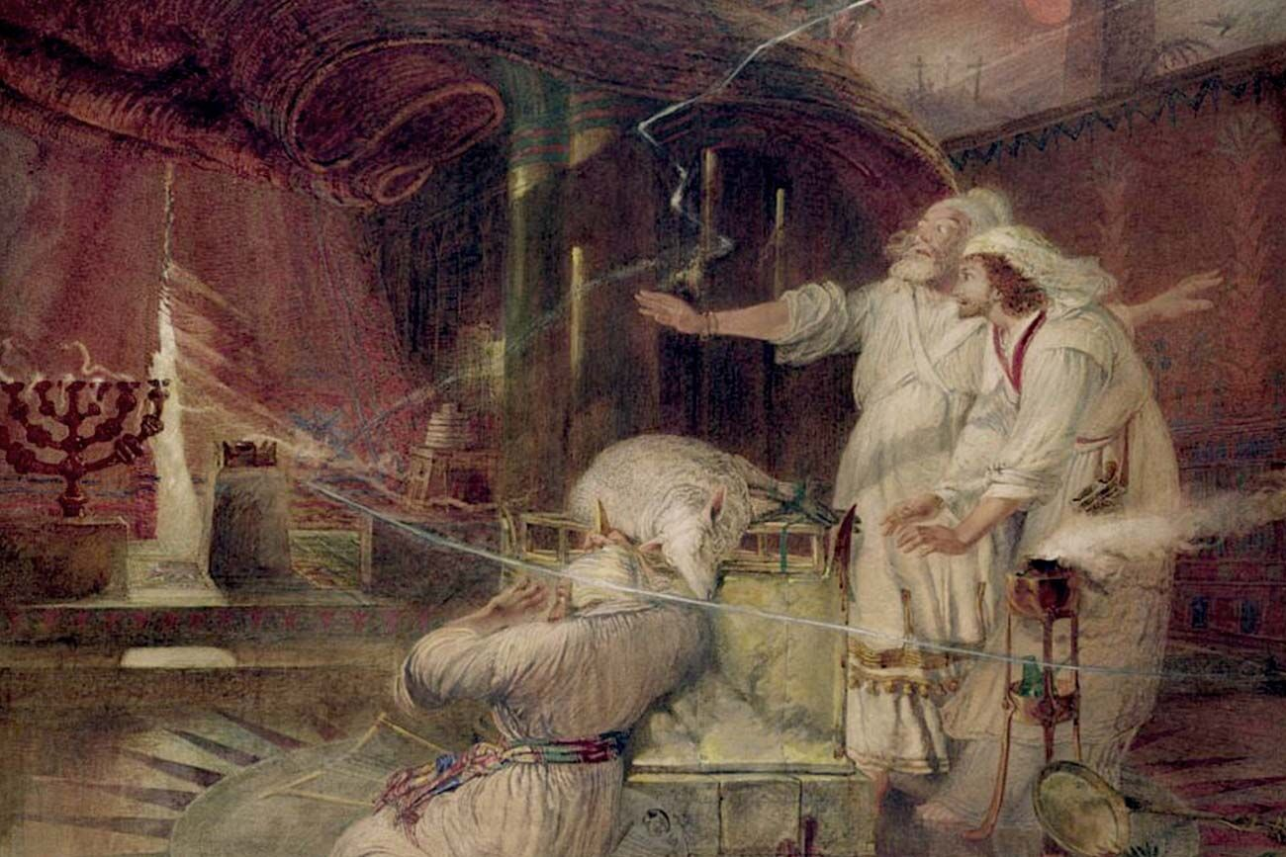

Slide 3
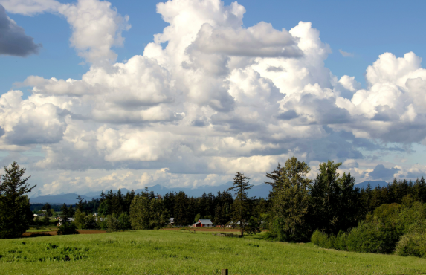
The Veil Between God’s
Realm And Ours
That your days may be multiplied, and the days of your children, in the land which the LORD swore unto your fathers to give them, as the days of heaven upon the earth. Deuteronomy 11:21 (KJV)
Part your heavens, O LORD, and come down; touch the mountains, so that they smoke. Psalm 144:5 (NIV) (Isaiah 64:1)
Faithfulness springs forth from the earth, and righteousness looks down from heaven. Psalm 85:11 (NIV)
"In that day I will respond," declares the LORD-- "I will respond to the skies, and they will respond to the earth; Hosea 2:21 (NIV)

Slide 4
The Three Main Column of Prayers?
Not Yet Answered It is Unfolding God says “I’m working it out.” “It IS MY WILL” The answer is not yet manifested | Unknown – Maybe YES/ or NO – NOT SURE - what is the “Clear will of God” – Have sought the Lord but no Clarity – “Not my will but Yours be done.” | Victory Answered “It is Done” The Answer is manifested. God is glorified in being revealed
DIE TO YOUR DEFAULT PRAYER CALVINISM/ FATALISM
DIE TO YOUR PRAYER LAZINESS/ INSECURITY
DIE TO YOUR PUSH BUTTON/ TECHNOLOGY ADDICTIONS
DIE TO YOUR INDEPENDENT SPIRIT OF I’ll PRAY AT HOME BY MYSELF

Slide 5
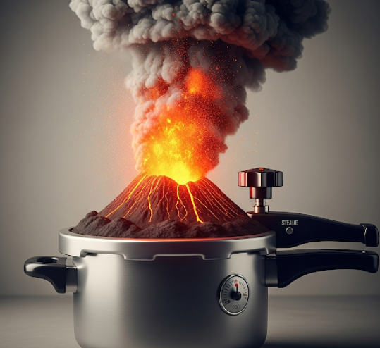
What Is An “Idiomatic Metaphor”
“Walking on egg shells”
“Under the gun”
“Powder Keg”
“Tempest in a Teapot”
Volcano In A Pressure Cooker

Slide 6
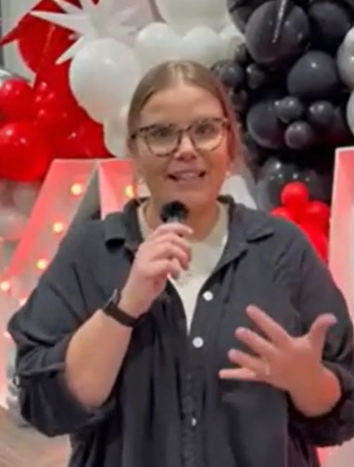
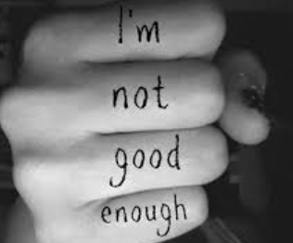
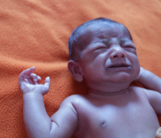
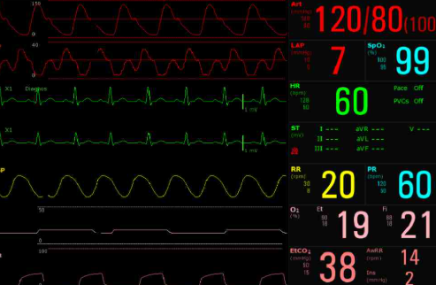

In The Midst Of All the Battles
God is Coloring Outside the Lines
Main Two Reasons People Don’t Feel They’re able to come to God
1/ They Don’t want to leave their sins at the cross so they remain convicted.
2/ They are TOO BAD To be forgiven.
Abby Johnson
Did A Study With North Georgia Revival on Covenant and Our Privileges and Authority In Christ.
DON’T WAIT TILL ITS TOO LATE TO FIND OUT WHAT YOU NEED TO KNOW NOW.” Abby Johnson
Austin is given an assignment – Go see your uncle Aaron in the Hospital.

Slide 7

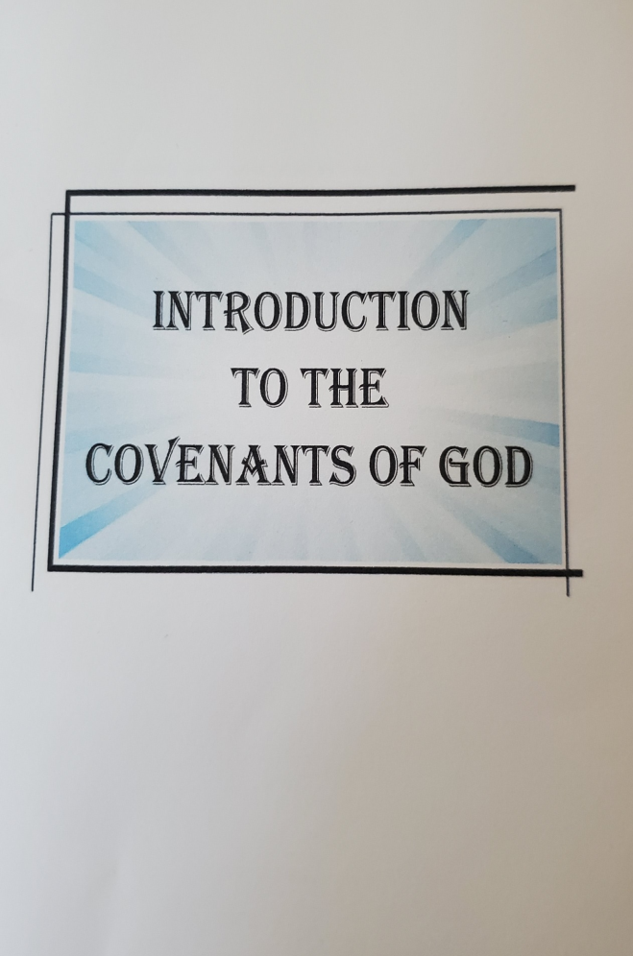
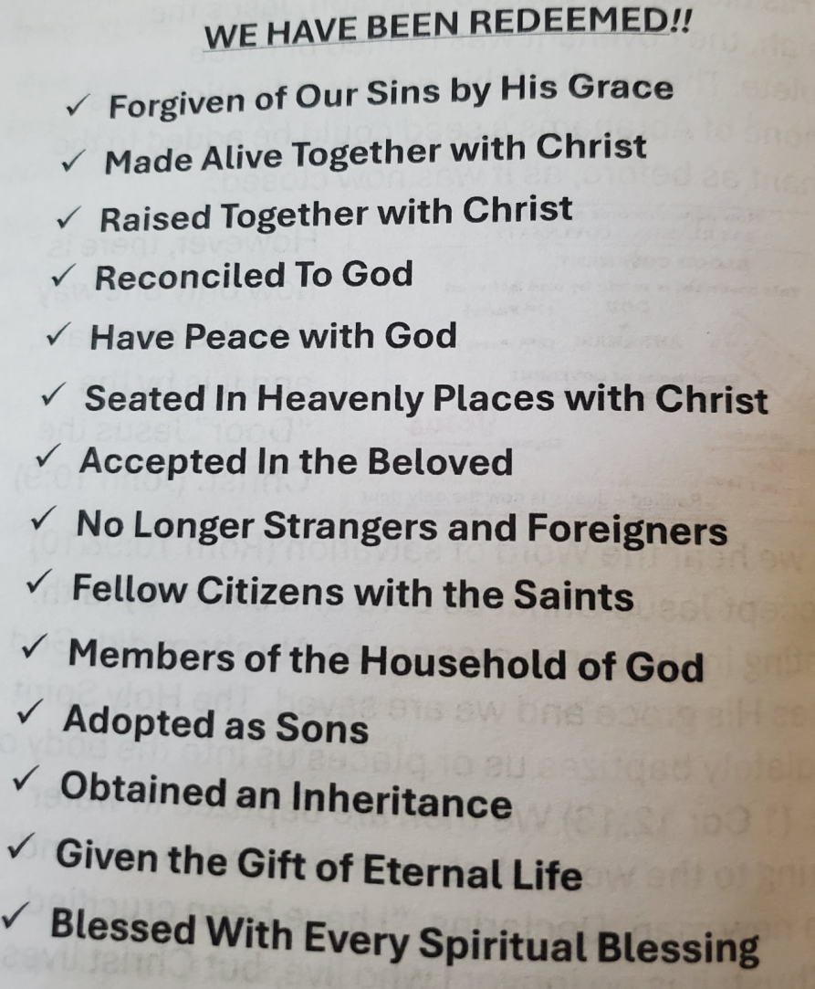
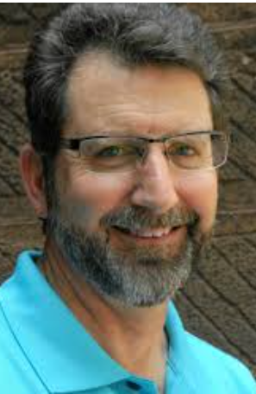
Allan
Chambers
The Covenants
Of God
Page 12

Slide 8






Reverently Bold
That Spiritually Impacts The World
Let’s Look At Genesis 18:17-33

Slide 9
Fear not, little flock; for it is your Father's good pleasure to give you the kingdom (THE REALM AND RULE FROM ROYALTY). Luke 12:32 (KJV)
And I confer (Appoint and bequeath) on you a kingdom, just as my Father conferred one on me, 30 so that you may eat and drink at My table in My kingdom and sit on thrones, judging the twelve tribes of Israel. Luke 22:29-30
To understand the amazing reach of the Scripture’s promises –we should search them out, and study them, with all the interest and curiosity of a inheritor searching the will of a rich benefactor; that we may plead them with unfailing confidence, and eager expectation, for their fulfillment. Eli Wigle 1880
Devoutly study the Word (and its promises), to know your privilege and responsibility, and being "filled with the Holy Spirit," Who is infinitely concerned that you should have an answer to your prayer,

Slide 10
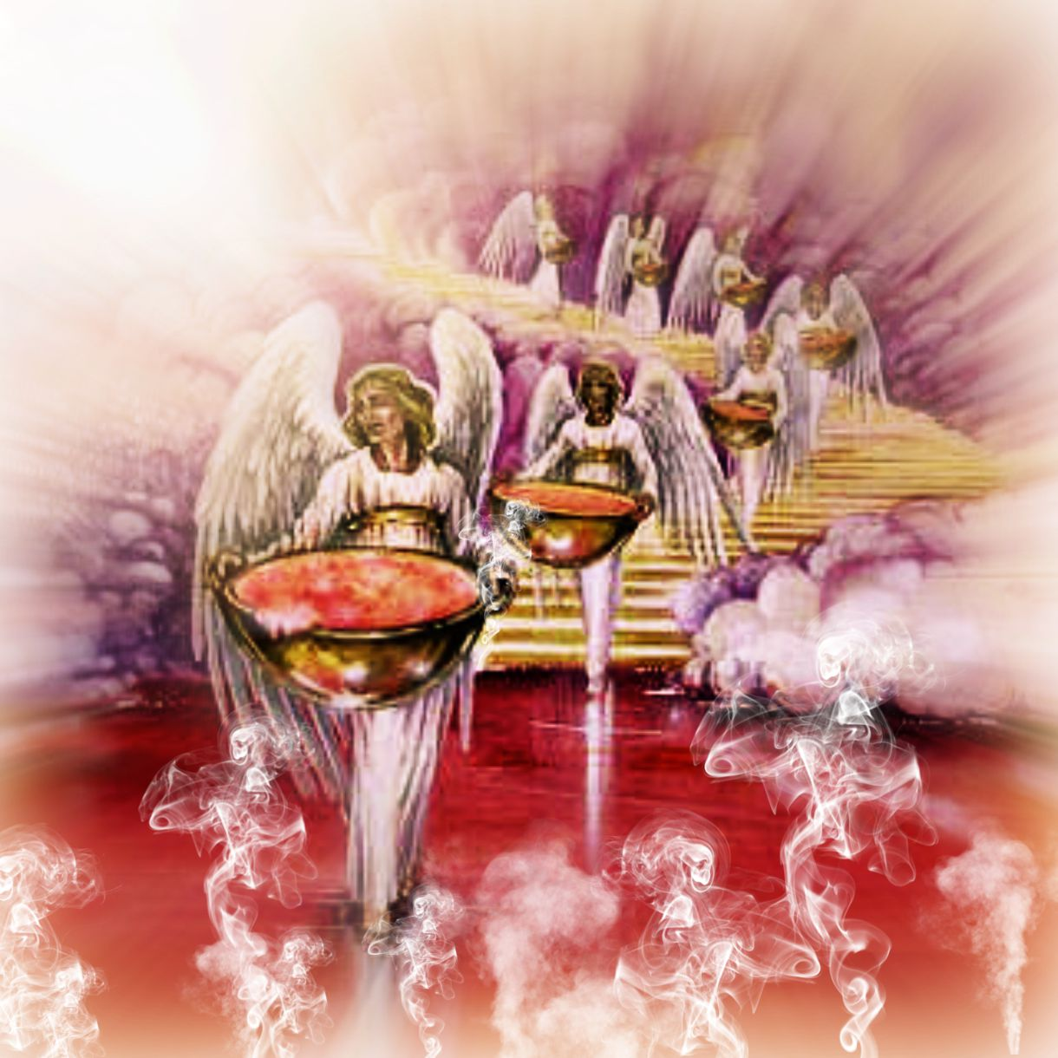
Why Does God Value Our Prayers?
Each one had a harp and they were holding golden bowls full of incense (fragrant Odors), which are the prayers of the saints.
Revelation 5:8
HE IS BLESSED AND MARVELS – THAT YOU PUSH THROUGH THE VEIL OF THIS FLESHLY EARTH – THROUGH FAITH - The cries of faith and the intercession and the prayers of the Saints pushing through the physical veil of a fallen world full of problems chaos hurt bitterness and groaning becomes incense in heaven

Slide 11

The Cinderella Of The Church
Let’s read page 173 at the bottom
The Cinderella of the Church today is the prayer meeting. The handmaid of the Lord is unloved and uncourted because she is not dripping with pearls (DEEP THEOLOGICAL) intellectualism.... She wears the homespuns of sincerity and humility and so is not afraid to kneel.” Leonard Ravenhill

Slide 12

The Corporate Prayer Meeting
The New Testament
Doesn’t Shy Away
From The Importance
Of Vertical Intercession
According to the NIV Exhaustive Concordance, the word pray is used 121 times, not including the various conjugations of the verb. After pray, you have
prayed at 68 times,
prayer at 106 times,
prayers at 32 times,
praying at 36 times
and prays at 12 times,
for a total of 375 times.

Slide 13
The Benefits of Vibrant
Corporate Prayer Meetings
They create the atmosphere for God to move
They Create (STIR UP) Faith in God in your church
They create a habitation for His presence
They Create Kingdom encounters
They create the platform (ENVIRONMENT) for people to be saved
Bottom of page 177

Slide 14

You Guys Are Seeking An Experience
No – I’m seeking a PERSON – Who happens to be INVISIBLE BUT REAL and who I can ENCOUNTER
And the peace of God, which transcends all understanding, will guard your hearts and your minds in Christ Jesus. Philippians 4:7 (NIV)
With This
God did this so that men would seek Him and perhaps reach out for Him and find Him, though He is not far from each one of us. Acts 17:27 (NIV) -
SEEK – GREEK – ZAY-TEHH- OE - TO DESIRE – INQUIRE AND SEEK AFTER
REACH OUT FOR FEEL AFTER THE MOST CLEAR VERSE OF ENCOUNTERING GOD - GREEK – SAY-LAH-FAH-OE – TO VERIFY BY CONTACT – TO TOUCH – (FROM THE ROOT – TO RUB – TO TOUCH A STRINGED INSTRUMENT)
FIND – GREEK – HUE-RISK-OE - TO GET – TO OBTAIN – TO PERCEIVE AND SEE

Slide 15

God Is
For Revival/ Harvest
DIE TO YOUR DEFAULT PRAYER CALVINISM/ FATALISM
DIE TO YOUR PRAYER LAZINESS/ INSECURITY
DIE TO YOUR PUSH BUTTON/ TECHNOLOGY ADDICTIONS
DIE TO YOUR INDEPENDENT SPIRIT OF I’ll PRAY AT HOME BY MYSELF
THIS IS NOT JUST TRAINING – THIS IS FRONT LINE BATTLE TACTICS – WE ARE IN THE FIGHT BY STANDING IN PRAYER. WE ARE IN THE FIGHT BY NOT CAVING TO UNBELIEF BECAUSE THE SITUATIONS IN THE WORLD LOOK IMPOSSIBLE.

Slide 16
Die To Your Default Prayer Calvinism Fatalism
When I came, why was there no one? When I called, why was there no one to answer? Was my arm too short to ransom you? Do I lack the strength to rescue you?
Isaiah 50:2
WE PRAY THAT SUCH A POWER OF GOD’S GLORY WILL COME THAT WE WILL NO LONGER PROCESS THE FUTURE UNFOLDING ANSWERS TO PRAYER FROM THE ANGUISH OF HUGE IMPOSSIBLE SITUATIONS THAT HAVE NOT YET BEEN ANSWERED FROM THE PAST. THAT WE WOULD NOT WALK IN A TENTATIVE FAITH BECAUSE SOMETHING FROM OUR LIFE IN THE PAST IS STILL NOT FIGURED OUT.
THERE IS A MYSTERIOUS PART OF GOD’S WAYS – IT IS THAT HE IS ASKING US TO DRAW ON HIS SOVEREIGNTY (TO INFRINGE ON HIM) TO SHIFT THINGS IN THE EARTH – NOT ALWAYS PASSIVELY ACCEPT THINGS THE WAY THEY ARE.

Slide 17

Die To Your Prayer Insecurity
We Have Every Right To Expect God To Direct Us – And Then Unfold the Answers To Our Spirit-Led Intercession
OUR SINS ARE FORGIVEN/ BLOTTED OUT
THE ENEMY IS COMPLETELY DEFEATED AND DISARMED
THE CURSE OF THE LAW AND SIN IS BROKEN
THE STOREHOUSE OF HEAVEN’S FULL BOUNTY IS OPEN
THE GIFT OF THE SPIRIT IS RELEASED IN FULL MEASURE WITH HIS FRUITS AND GIFTS/ AND ENDUEMENT OF POWER
OUR CONSCIENCE AND HEART AND MIND ARE DELIVERED AND HEALED

Slide 18
LIVING OUT OF AN ASSURANCE OF
SALVATION – FORGIVENESS – COVENANT INHERITANCE
Once We TRULY REPENT AND TURN TO THE LORD AND INVITE HIM AS LORD OF OUR LIFE - WE ARE SAVED – SEALED - SENT
I write these things to you who believe in the name of the Son of God so that you may know that you have eternal life. ¹⁴ This is the confidence we have in approaching God: that if we ask anything according to His will, he hears us. ¹⁵ And if we know that He hears us--whatever we ask--we know that we have what we asked of Him. 1 John 5:13-15 (NIV)

Slide 19
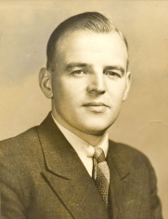
Die To Your Technology and Addictions
I believe that sometimes the social and entertainment life of American Christians can be a hindrance to being filled with the Holy Spirit. In America – we have reached the highest height of civilization the world has ever known. Consider that no one has really come to know the luxuries we enjoy in America. But it can be a curse that we have reached this High level civilization and what happens is we have beautiful comfortable homes that have become a snare through social life, entertainment, and ease.
Sadly there is a sin in our American church today and it is that we lack in travailing in prayer for our nation and when we lack in travailing we become these churches where everyone is chatty and friendly, and there is nothing wrong with that, but how can the Holy Spirit work and bring souls to Christ in our community if we do not have the spirit of travail? - JAMES STEWART

Slide 20
Die To Your Technology and Addictions
What I mean, brothers, is that the time is short. From now on those who have wives should live as if they had none; ³⁰ those who mourn, as if they did not; those who are happy, as if they were not; those who buy something, as if it were not theirs to keep; ³¹ those who use the things of the world, as if not engrossed in them. For this world in its present form is passing away. 1 Corinthians 7:29-31 (NIV)
³⁵ I am saying this for your own good, not to restrict you, but that you may live in a right way in undivided devotion to the Lord. 1 Corinthians 7:35 (NIV)
I believe that we are right on the threshold of wonderful things, but I want to emphasize that all these things will be through the power of the Holy Spirit. You must not think that these gifts will fall upon you like ripe cherries. There is a sense in which you have to pay the price for everything you get. We must be covetous for God’s best gifts, and say Amen to any preparation the Lord takes us through, in order that we may be humble, useable vessels through whom He Himself can operate by means of the Spirit’s power. 1923 Smith Wigglesworth

Slide 21
Die To Your Independent Spirit
As long as it is day, we must do the work of Him who sent me. (IT IS NECESSARY FOR US TO DO THE WORKS OF HIM WHO SENT ME) Night (Death or Tribulation) is coming, when no one can work. 5 While I am in the world, I am the light of the world." John 9:3-5 (NIV)
Let us hold unswervingly to the hope we profess, for he who promised is faithful. ²⁴ And let us consider how we may spur (provoke, incite) one another on toward love and good deeds. ²⁵ Let us not give up meeting together, as some are in the habit of doing, but let us encourage one another--and all the more as you see the Day approaching. Hebrews 10:23-25 (NIV)

Slide 22
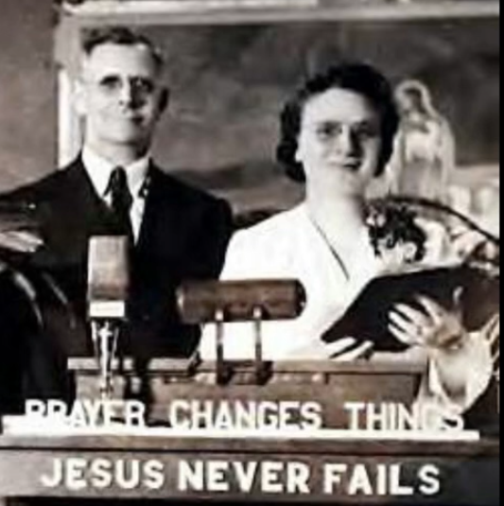
The IMPACT OF OUR PRAYERS are Real
The story is well known how, in one place, a whole wagon-load of Methodists were taken before the magistrates; but when the question was asked in court what they had done, a profound silence fell over the whole assembly, for no one was prepared with a charge against them, till somebody exclaimed, "They pretended to be better than other people, and they prayed from morning till night!" And another voice shouted out, "And they've converted my wife; till she went to their meetings, she had a tongue of her own, and now she's as quiet as a lamb!"
"Take them all back, take them all back," said the magistrate, "and let them convert the rest of the town!"
Myrtle Beal
1948

Slide 23
Praying From A Place
of Faith And Passion For God’s Glory
Thou shalt also decree (root word means to decide) a thing, and it shall be established (to be accomplished) unto thee: and the light shall shine upon thy ways. Job 22:28 (KJV)
WHAT IF NINETY PERCENT OF YOUR PRAYERS WE BIRTHED BY THE HOLY SPIRIT – AND LED TO NINETY PERCENT OF YOUR PRAYERS WERE ANSWERED WITHIN SIX MONTHS

Slide 24
APPLICATION
I’M GOING TO LIVE ALL THE PRACTICAL ASSIGNMENTS YOU GIVE ME TO DO,
I WILL IMMEDIATELY REPENT WHEN I SEEK MY OWN INTEREST ABOVE YOURS.
I AM GOING TO DAILY COURT YOUR PRESENCE, AND STIR UP THE GIFT OF PRAYER
AND I WILL SOW YOUR WORD INTO MY HEART AND FAMILY.

