Slide 1

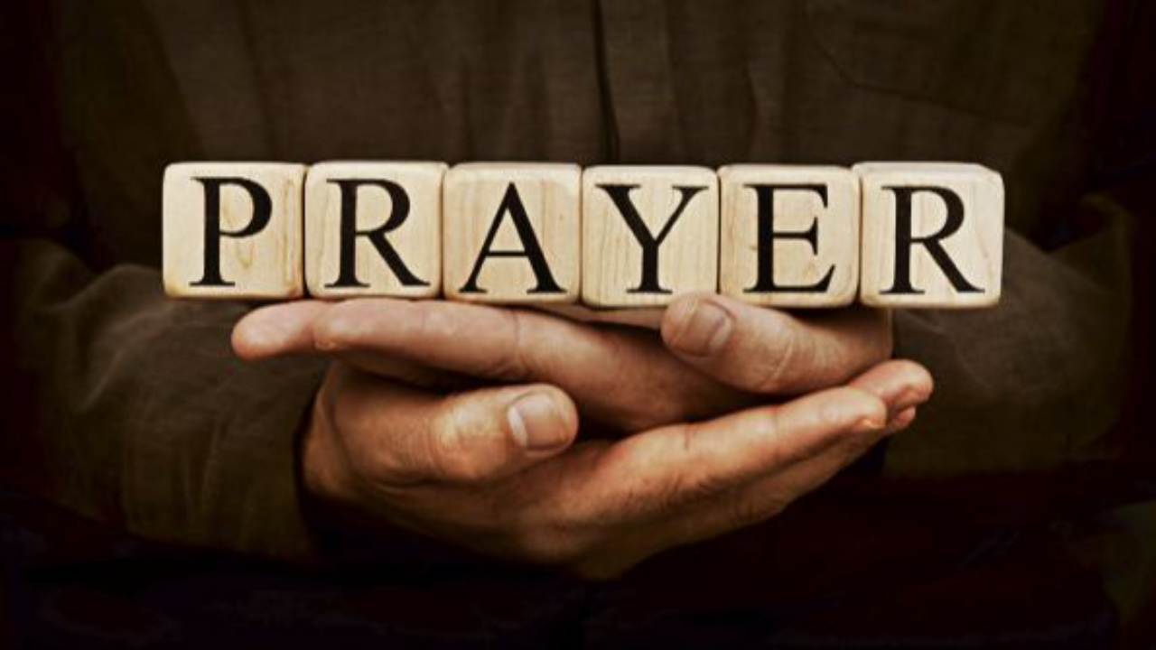
Pressing Through The Veil
By Means Of
Part 2
LifeGate Sermon
July 20th, 2025

Slide 2
Praying From A Place of COVENANT
Faith And Passion For God’s Glory
Thou shalt also decree (root word means to decide) a thing, and it shall be established (to be accomplished) unto thee: and the light shall shine upon thy ways. Job 22:28 (KJV)
WHAT IF NINETY PERCENT OF YOUR PRAYERS (BIRTHED BY THE HOLY SPIRIT) – LED TO NINETY PERCENT OF YOUR PRAYERS BEING ANSWERED WITHIN SIX MONTHS???

Slide 3
The Three Main
Columns of Prayers
Not Yet Answered It is Unfolding God says “I’m working it out.” “It IS MY WILL” The answer is not yet manifested | Unknown – Maybe YES/ or NO – NOT SURE - what is the “Clear will of God” – Have sought the Lord but no Clarity – “Not my will but Yours be done.” | Victory Answered “It is Done” The Answer is manifested. God is glorified in being revealed
He (Jesus) answered, and said, O faithless generation, how long shall I be with you? how long shall I suffer you? bring him unto me. Mark 9:19 (KJV)

Slide 4



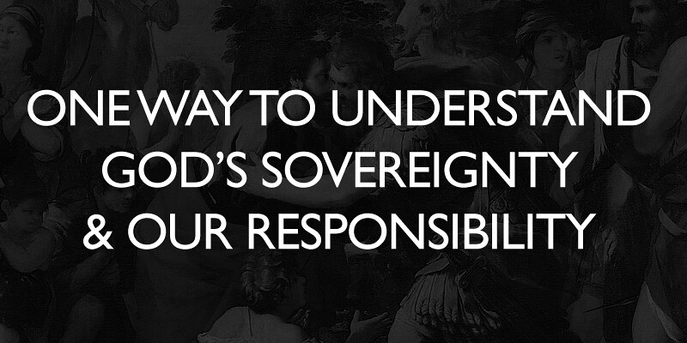

Work out your own salvation with fear and trembling. ¹³ For it is God which works in you both to will and to do of His good pleasure. Philippians 2:12-13 (KJV) DL
PERMISSIBLE
SOVEREIGNTY
SO THE LORD IS ABOVE EVERYTHING – AND HE IS WORKING IN EVERYTHING BUT HE DOES NOT YET DIRECTLY CONTROL EVERYTHING ON EARTH AT THIS MOMENT – HE WAITS ON HIS PEOPLE TO AGREE WITH HIM AND SEEK HIS FACE AND HE WILL COME TO THEIR AID AND ANSWER THEIR PRAYERS AND FLOW THROUGH THEM INTO THEIR SITUATIONS.
And put everything under His feet." In putting everything under Him, God left nothing that is not subject to Him. Yet at present we do not see everything subject to Him. Hebrews 2:8 (NIV)

Slide 5
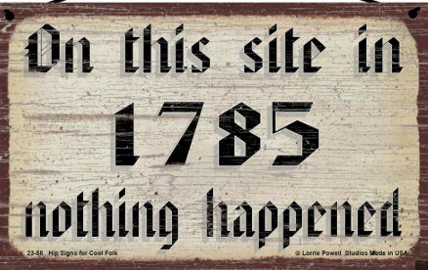
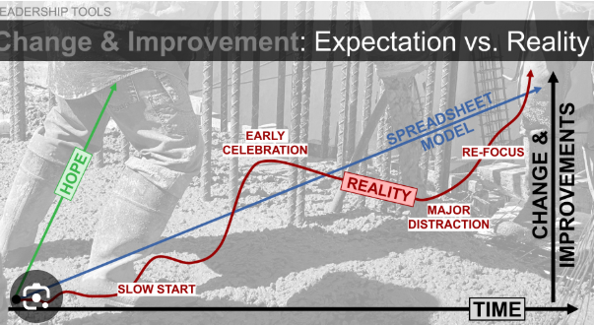
Don’t Let False Views Of God’s Sovereignty
Produce A Lack Of Faith Expectation
Faith Trajectory
Hope
BREAKTHROUGH
Birth of
Prevailing Prayer

Slide 6

What Is An Outpouring of the Holy Spirit?
Old Testament
New
Testament
Proverbs 1:23 Isaiah 30:25
Isaiah 32:15
Isaiah 44:2,3
Isaiah 64:1,2
Ezekiel 39:29
Joel 2:28-29
Zechariah 12:10
Luke 24:49
John 7:37-39
Acts 1:8
Acts 2:1-39
Acts 10:45
Romans 5:5
Titus 3:6
An outpouring of the Spirit is a OVERWHELMING SUPPLY – it is a beyond normal measure of His influences and working in the earth. Something promised expressly for the New Testament Age.
“This was a season of very extraordinary dealings from the Lord. God had gone way beyond His usual and ordinary ways. The work in this community, and others around us had been extraordinary in the scope and universal impact that it had among all the people. Jonathan Edwards 1735 – Massachusetts

Slide 7
Understanding Joel Chapter 2
And Acts Chapter 2
¹⁴ Then Peter stood up with the Eleven, raised his voice and addressed the crowd: "Fellow Jews and all of you who live in Jerusalem, let me explain this to you; listen carefully to what I say. ¹⁵ These men are not drunk, as you suppose. It's only nine in the morning! ¹⁶ No, this is what was spoken by the prophet Joel: ¹⁷ "'In the last days, God says, I will pour out my Spirit on all people. Your sons and daughters will prophesy, your young men will see visions, your old men will dream dreams. ¹⁸ Even on my servants, both men and women, I will pour out my Spirit in those days, and they will prophesy. Acts 2:14-18 (NIV)

Slide 8
Joel Chapter Two
'And afterward, (and it shall come to pass) I will pour out my Spirit on all people. Your sons and daughters will prophesy, your old men will dream dreams, your young men will see visions. ²⁹ Even on my servants, both men and women, I will pour out my Spirit in those days. ³⁰ I will show wonders in the heavens and on the earth, blood and fire and billows of smoke. ³¹ The sun will be turned to darkness and the moon to blood before the coming of the great and dreadful day of the LORD. ³² And everyone who calls on the name of the LORD will be saved; for on Mount Zion and in Jerusalem there will be deliverance, as the LORD has said, among the survivors whom the LORD calls. Joel 2:28-32 (NIV)
THIS IS THE ABUNDANT PROSPERITY JOE 2:28 PROMISES
Be glad, O people of Zion, rejoice in the LORD your God, for He has given you the former rains in righteousness. He sends you abundant showers, both former and latter rains, as before. ²⁴ The threshing floors will be filled with grain; the vats will overflow with new wine and oil. ²⁵ 'I will repay you for the years the locusts have eaten-- the great locust and the young locust, the other locusts and the locust swarm-- my great army that I sent among you. ²⁶ You will have plenty to eat, until you are full, and you will praise the name of the LORD your God, Who has worked wonders for you; never again will My people be shamed. Joel 2:23-26 NIV DL

Slide 9



The Deeper Understanding of Joel 2
HEBREW WORD – AH-KAR – (over 700 times) AFTER – mainly – after – afterwards – but also means follow – behind, it follows)
Dual Meaning
And Abraham lifted up his eyes, and looked, and behold behind him a ram (was) caught in a thicket by his horns:. Genesis 22:13 (KJV) /DL
And Pharaoh said unto Joseph, Forasmuch as God hath shewed thee all this, there is none so discreet and wise as thou art: Genesis 41:39 (KJV)
²⁴ But my servant Caleb, because he had another spirit with him, and hath followed me fully, him will I bring into the land --; and his seed shall possess it. Numbers 14:24 (KJV)

Slide 10
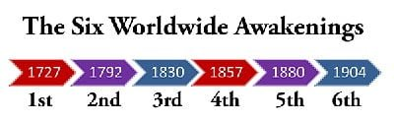
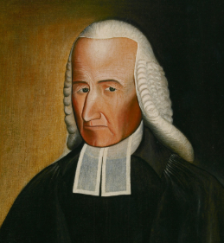
The Source Has Been Identified
– What Has Been Behind Every
Breakthrough In Last 2000 Years
Has Been A Move Of The Holy Spirit
But there have been certain seasons called revivals—when God has “poured His Spirit out on His people.” These times—also called awakenings— occurred when the presence of God is experienced in powerful manifestations of the Holy Spirit. – J. Edwin Orr
1948-55
1967-75
1967-75
1992-97
2023- ?
In the day of great slaughter, when the towers fall, streams of water will flow on every high mountain and every lofty hill. ²⁶ The moon will shine like the sun, and the sunlight will be seven times brighter, like the light of seven full days, when the LORD binds up the bruises of his people and heals the wounds he inflicted. Isaiah 30:25-26 (NIV)
Samuel Buell
1741- 1764 – revivals

Slide 11



Just As God’s Works of Grace In
Outpourings Of The Spirit Have a DESIGN
So God Has DESIGNED Us For His Purposes
God has made us a temple to be filled with His glory!
² I saw the Holy City, the new Jerusalem, coming down out of heaven from God, prepared as a bride beautifully dressed for her husband. ³ And I heard a loud voice from the throne saying, "Now the dwelling of God is with men, and He will live with them. They will be His people, and God Himself will be with them
and be their God. Revelation 21:2-3 (NIV)

Slide 12
We Are Each A Temple of the Lord
(Corporately and Individually)
Don't you know that you yourselves are God's temple and that God's Spirit lives in you? 1 Corinthians 3:16 (NIV) (1 Cor. 6:19 – 20)
WHY DID PAUL – ASK THIS PROBING QUESTION? (THERE WAS BOTH AN IGNORANCE HERE – BUT ALSO AS YOUNG BELIEVERS - SUCH A FLESHLY AFFINITY THAT THEY DID NOT KNOW HOW TO PAY ATTENTION TO THE HOLY SPIRIT AND GAIN HIS STRONG LEADING IN THEIR LIFE – THE FLESH WAS TOO PREDOMINATE – THEY HAD NOT LEARNED TO LEVERAGE HIS GREAT STRENGTHENING AND ANOINTING AND GRACE.)

Slide 13
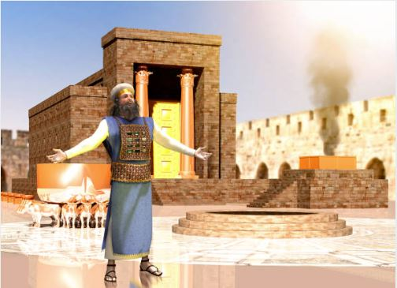
Did You Know The Old Testament Is A Picture of Our Spiritual Makeup
But he who unites himself with the Lord is one with Him in spirit. 1 Corinthians 6:17 (NIV)

Slide 14
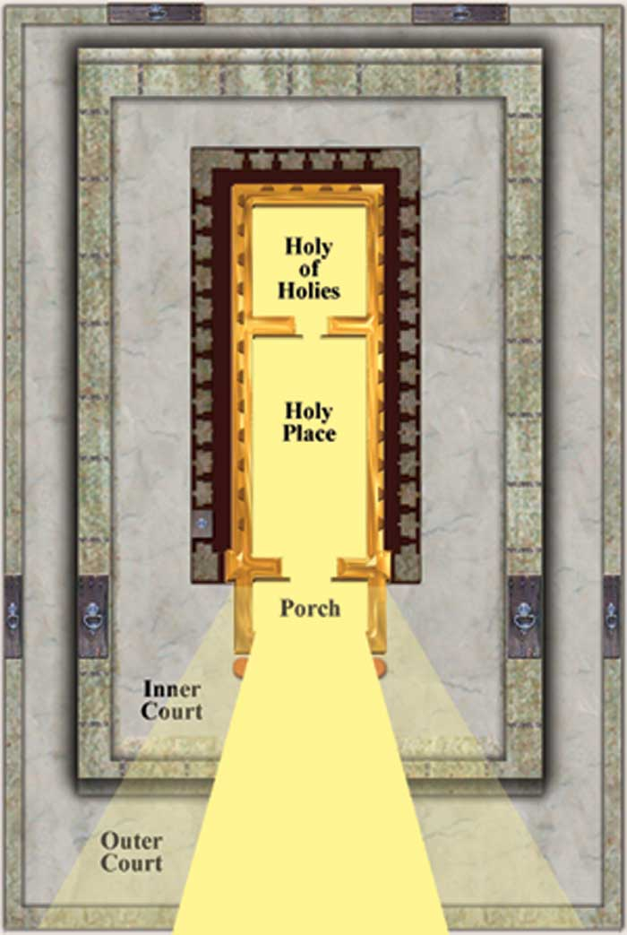
The Temple A Picture of Our Spiritual Makeup

Slide 15
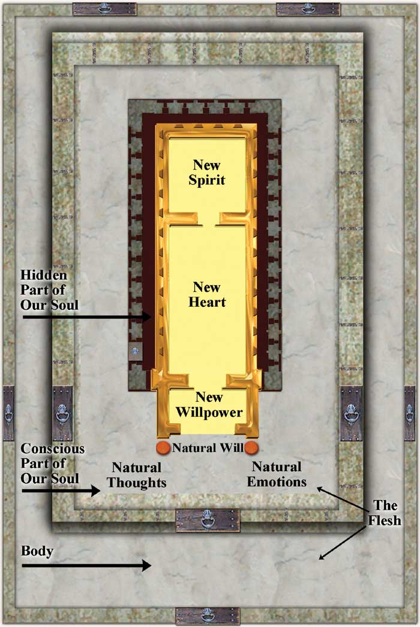
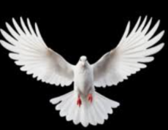

The Temple A Picture of Spiritual Application
Heart
Inner
Court
Outer Court

Slide 16
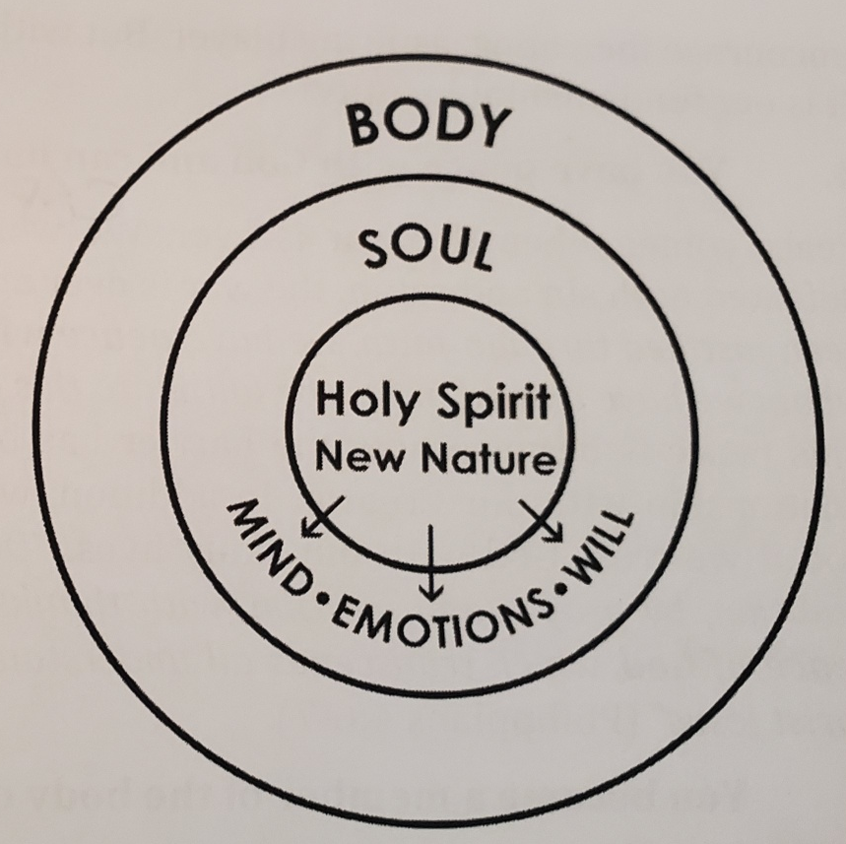


May God himself, the God of peace, sanctify you through and through. May your whole spirit, soul and body be kept blameless at the coming of our Lord Jesus Christ. 1 Thessalonians 5:23 (NIV)
And thou shalt love the Lord thy God with all thy heart, and with all thy soul, and with all thy mind, and with all thy strength: this is the first commandment. Mark 12:30 (KJV)
Flesh
Heart
10 But if Christ is in you, your body is dead because of sin, yet your spirit is alive because of righteousness. Romans 8:10 (NIV)

Slide 17
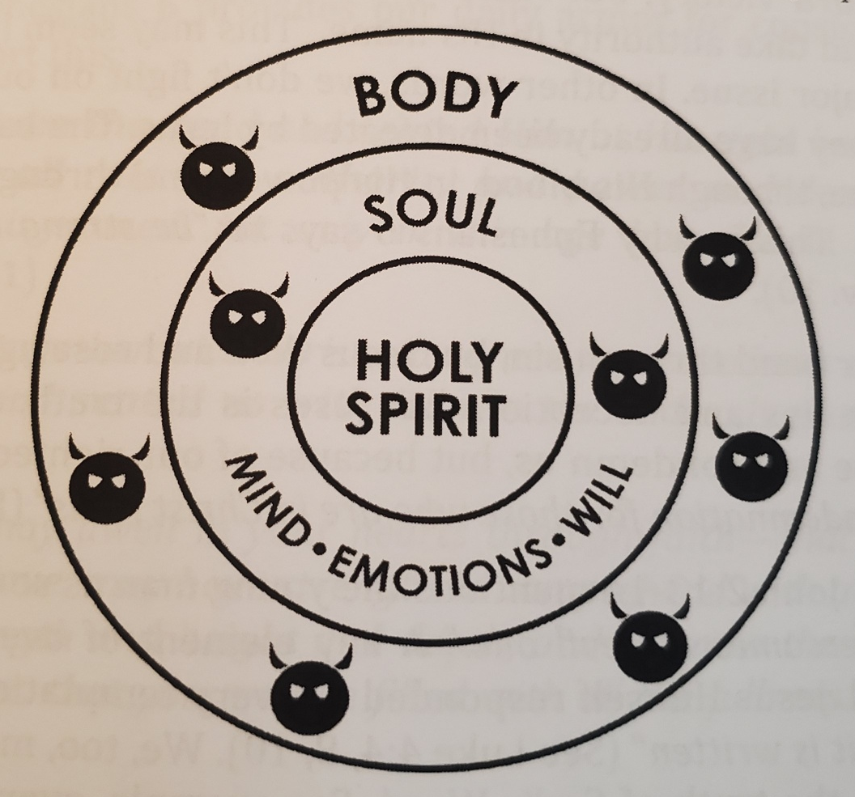
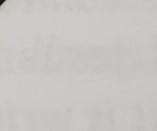
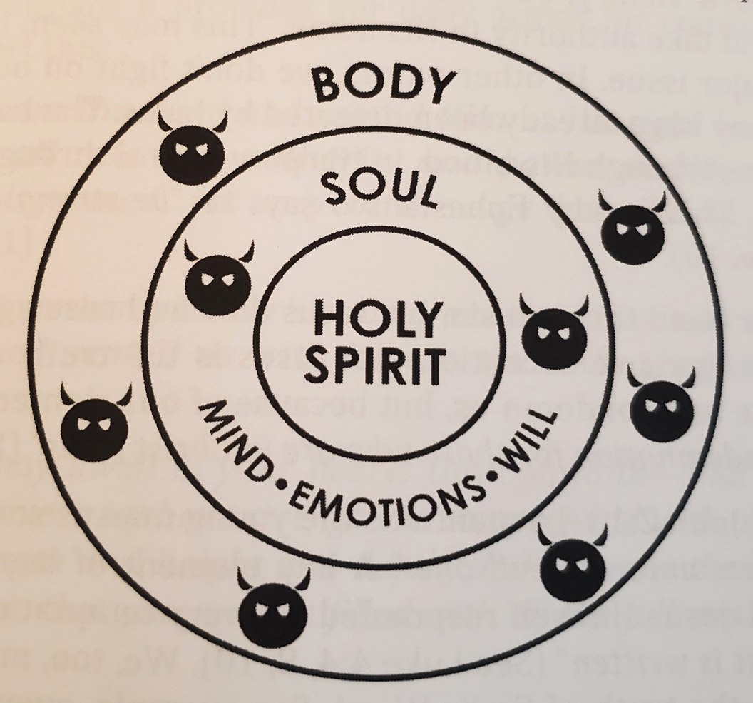
May God himself, the God of peace, sanctify you through and through. May your whole spirit, soul and body be kept blameless at the coming of our Lord Jesus Christ. 1 Thessalonians 5:23 (NIV)
And do not grieve the Holy Spirit of God, with whom you were sealed for the day of redemption. Ephesians 4:30 (NIV)
Flesh
Heart
and do not give the devil a foothold (place). Ephesians 4:27 (NIV)
FOOTHOLD of an Oppressing and
Afflicting spirit

Slide 18

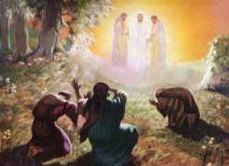

The Purpose God Made You A Temple
Was to Reveal His Glory In
Your Inner Court to:
1
We did not follow cleverly invented stories when we told you about the power and coming of our Lord Jesus Christ, but we were eyewitnesses of his majesty. 2 Peter 1:16 (NIV)
2
But you, dear friends, build yourselves up in your most holy faith and pray in the Holy Spirit. ²² Be merciful to those who doubt; ²³ snatch others from the fire and save them. Jude 1:20-22-23

Slide 19

Leveraging Our Authority To Pray For The Lost
Chapter 24
“The prayer ministry of a church should be so strong and spiritually violent that when an unsaved person gets within close proximity of that church (family) the enemy should lose his influence and spiritual leverage over that person. The Spirit of God neutralizes the devil’s voice and agenda, and for a moment the light of the Gospel becomes compelling and clear.” Page 219
³ And even if our gospel is veiled, it is veiled to those who are perishing. ⁴ The god of this age has blinded the minds of unbelievers, so that they cannot see the light of the gospel of the glory of Christ, Who is the image of God. 2 Corinthians 4:3-4 (NIV)

Slide 20
Prevailing Prayers For The Lost
In the Name of Jesus resist the devil’s activity in the person you are prevailing for.
In the Name of Jesus bind and cast down every excuse and ask the Lord to remove every obstacle
Persevere – peel off the layers through persistent intercession
Pray for God to strategically maneuver Christ-loving Believers into their life. (Matthew 9:37) -laborers
Page 220

Slide 21
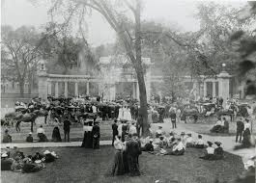
One Of The Saddest “Tales of Warning”
In The History of The Church In America
Oberlin College
Opened in 1833
Only 12 years after the first revivals broke out in New York
Under Charles Finney 1821
“Oberlin was intimately linked with the lifework of President Finney, an epoch-shaping force in modern Christendom. Three presidents of the United States- Hayes, Garfield and McKinley-have spoken in emphatic tribute of what this college has wrought for the higher life of the country. The late General Jacob D. Cox has shown that it was the mighty and incessant work of the Oberlin reformers and the thousands of Oberlin students who went forth as fathers, mothers, teachers, lecturers, and missionaries that turned the scales in the Antislavery contest, and led to the election of Abraham Lincoln in 1860 and the gigantic results which followed, making for the saving of the Union and Freedom. America owes a great debt.” Author Unknown

Slide 22
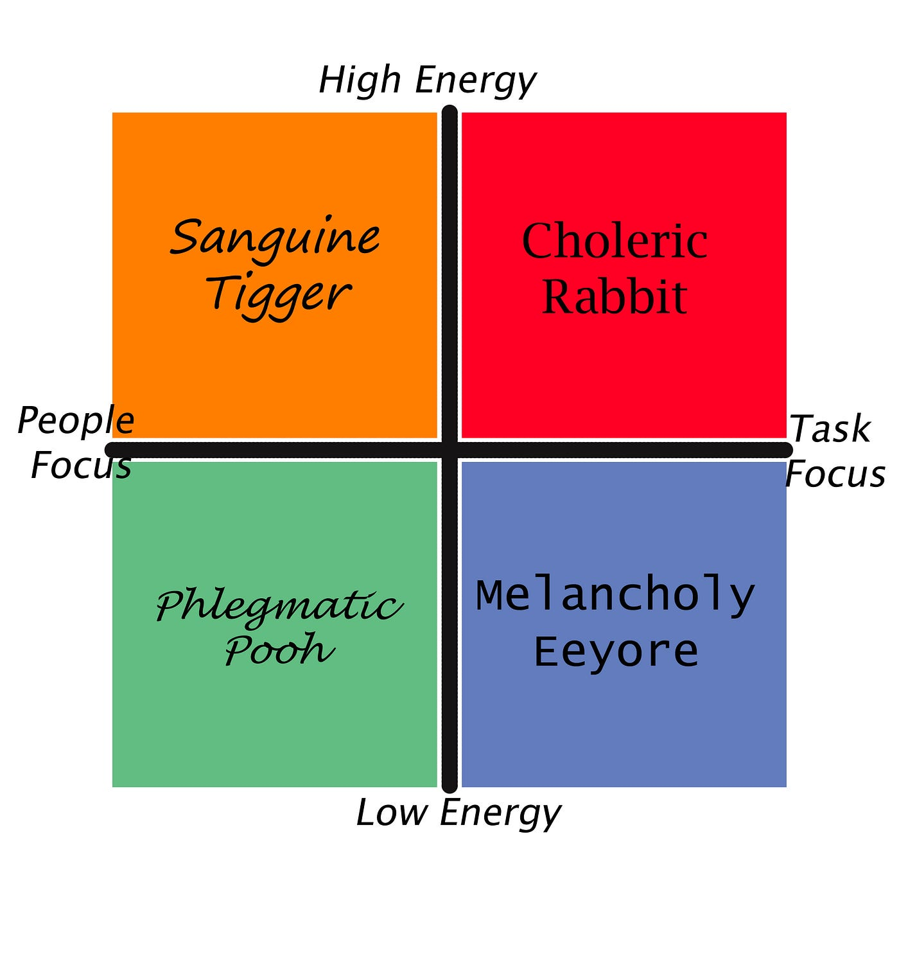
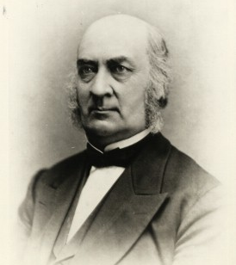





Becoming A Temple Filled With His Glory
Our Temperaments Can Hinder
James Fairchild
Oberlin College
“He was a natural gentleman, genial, moral, of composed temperament, and highly intellectual; non-impulsive, and little tempted toward flesh and outward sins. He passed through those great revival seasons which changed so many of us without any deep sense of his own need for a baptism with the Holy Spirit, and with little intentionality to obtain it.”

Slide 23

God Is
For Revival/ Harvest
DIE TO YOUR DEFAULT PRAYER CALVINISM/ FATALISM
DIE TO YOUR PRAYER LAZINESS/ INSECURITY
DIE TO YOUR PUSH BUTTON/ TECHNOLOGY ADDICTIONS AND DISTRACTIONS
DIE TO YOUR INDEPENDENT SPIRIT OF “I’ll PRAY AT HOME BY MYSELF.”
THIS IS NOT JUST TRAINING – THIS IS FRONT LINE BATTLE TACTICS – WE ARE IN THE FIGHT BY STANDING IN PRAYER. WE ARE IN THE FIGHT BY NOT CAVING TO UNBELIEF BECAUSE THE SITUATIONS IN THE WORLD LOOK IMPOSSIBLE.

Slide 24
APPLICATION
I’M GOING TO ALLOW THE HOLY SPIRIT TO CLEANSE MY TEMPLE DAILY- EVEN SEEK HELP TO BREAK OFF AFFLICTING SPIRITS THAT HAVE A FOOTHOLD IN MY LIFE.
I WILL IMMEDIATELY REPENT WHEN I SEEK MY OWN INTEREST ABOVE GOD’S.
I AM GOING TO DAILY COURT YOUR PRESENCE, AND STIR UP THE GIFT OF PRAYER FOR MY LOVED ONES AND THE LOST
AND I WILL SOW YOUR WORD INTO MY HEART AND FAMILY.
I WILL INTERCEDE FOR AND STAND IN EXPECTATION OF THE OUTPOURINGS OF THE SPIRIT TO BE THE SOURCE OF ALL THE FULFILLED PROMISES THAT ARE UNFOLDING IN THIS MOMENT IN TIME.

