Slide 1


Pressing Through The Veil
By Means Of
Part 3 – Being The Bride Of Christ In The Last Days
LifeGate Sermon
August 3rd, 2025

Slide 2
“WE ARE LIVING ON THE EDGE OF THE END
WE CAN SEE THE FRONTIER OF FOREVER.”
Carol Ketchum - November 2020
"Now learn this lesson from the fig tree (Israel): As soon as its twigs get tender and its leaves come out (Sprouts – 1948), you know that summer is near. ³³ Even so, when you see all these things, you know that it is near, right at the door. ³⁴ I tell you the truth, this generation will certainly not pass away until all these things have happened. ³⁵ Heaven and earth will pass away, but My words will never pass away.
Matthew 24:32-35 (NIV)

Slide 3
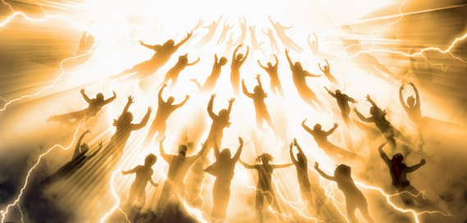
The Word of God Is Not Written For Sensationalism – But The Revelations in it are EPIC
Brothers, we do not want you to be ignorant about those who fall asleep, or to grieve like the rest of men, who have no hope. ¹⁴ We believe that Jesus died and rose again and so we believe that God will bring with Jesus those who have fallen asleep in Him. ¹⁵ According to the Lord's own word, we tell you that we who are still alive, who are left till the coming of the Lord, will certainly not precede those who have fallen asleep. ¹⁶ For the Lord himself will come down from heaven, with a loud command, with the voice of the archangel and with the trumpet call of God, and the dead in Christ will rise first. ¹⁷ After that, we who are still alive and are left will be caught up (Harpod-zoe – to catch away – Acts 8:39 Philip) together with them in the clouds to meet the Lord in the air. And so we will be with the Lord forever. ¹⁸ Therefore encourage (comfort) each other with these words. 1 Thessalonians 4:13-18

Slide 4
KEY VERSES FOR THE SERMON TODAY
Henceforth, (Consequently,) there is laid up for me a crown of righteousness, which the Lord, the righteous Judge, shall give me at that day: and not to me only, but unto all them also that love (long for - AGAPE) His appearing (MANIFESTATION –[epee-fahn-iah] epiphany). 2 Timothy 4:8
For the grace of God that brings salvation has appeared to all men. ¹² It teaches us to say "No" to ungodliness and worldly passions, and to live self-controlled, upright and godly lives in this present age, ¹³ while we wait (Look) for the “blessed hope”--the glorious appearing MANIFESTATION of our great God and Savior, Jesus Christ, ¹⁴ who gave Himself for us to redeem us from all wickedness and to purify for Himself a people (BRIDE) that are His very own, eager to do what is good. Titus 2:11-14

Slide 5
We Desire To Teach The WHOLE COUNSEL
OF GOD at LifeGate
THE GLORIOUS GOSPEL OF CHRIST 2 Corinthians 4:4
THE GLORIOUS GRACE WHICH HE HAS FREELY GIVEN US Ephesians 1:6
THE GLORIOUS RICHES IN CHRIST Philippians 4:19
THE GLORIOUS LIBERTY OF THE SONS OF GOD Romans 8:21
THE GLORIOUS MINISTRY THAT BRINGS RIGHTEOUSNESS 2 Corinthians 3:9
THE GLORIOUS CHURCH Ephesians 5:27
THE GLORIOUS INHERITANCE IN THE SAINTS Ephesians 1:18
THE BLESSED HOPE OF THE GLORIOUS APPEARING OF OUR GREAT GOD AND SAVIOR JESUS CHRIST. Titus 2:13 -
until we all reach unity in the faith and in the knowledge of the Son of God and become mature, attaining to the whole measure of the fullness of Christ. Ephesians 4:13 (NIV)
Study to show thyself approved unto God, a workman that needs not to be ashamed, rightly dividing the word of truth.
2 Timothy 2:15 (KJV)

Slide 6





Why We Don’t Preach
As Much On The Last Days?
OUR PRIMARY FOCUS – IS THE FACE OF GOD – HIS GREAT WORK OF SALVATION IN THE EARTH – OUR RESPONSE TO HIS COSTLY GRACE
AND THE MISSION HE HAS FOR US
OUR SECONDARY FOCUS – WE HAVE TO COMFORT ONE ANOTHER IN THE LORD WHEN THINGS ARE HARD WE ARE GOING TO A BETTER PLACE (THE VERY PRESENCE OF JESUS) THROUGH THE RESURRECTION AND APPEARING OF THE LORD

Slide 7



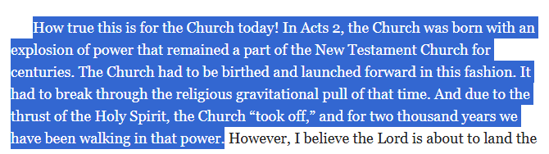

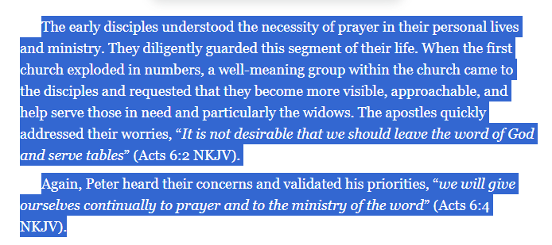
The Early Church Was the First
Eight Minutes of the Church’s
Takeoff
Pages
128- 130

Slide 8
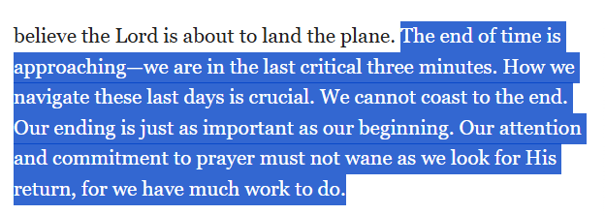
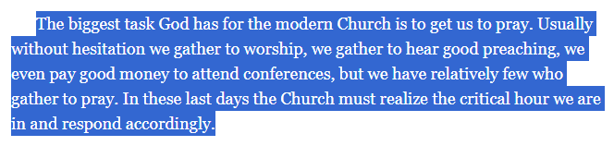
Chapter 19
“The Critical 11 Minutes”

Slide 9
Why Is What Todd Smith Is
Emphasizing So Important?
BECAUSE THERE IS THIS DIABOLICAL INFERRED HALF-TRUTH IN MODERN CHRISTIAN MINISTRY PHILOSOPHY - THAT IF I AM DOING GOSPEL MINISTRY – THAT “WELL GOD HAS TO BLESS IT” – BECAUSE I’M DOING WHAT HE TOLD ME TO DO.
WELL HE DOESN’T - IF YOU ARE PREACHING THE GOSPEL IN YOUR OWN STRENGTH AND PRIDE AND WITH ZERO INTERCESSION AND FAITH FOR THE POWERFUL ATTENDING WORKS OF THE HOLY SPIRIT TO CARRY THE TRUTH HOME TO BLINDED HEARTS.

Slide 10
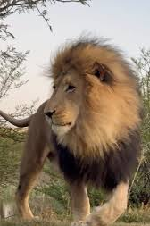
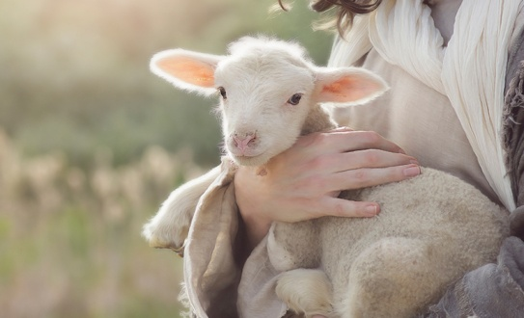

God’s Creative Redemptive
Purposes Are Written Into Creation
Light
Water
Life
Dark
Land
Death
Everything Changes
For since the creation of the world God's invisible qualities--His eternal power and Divine nature--have been clearly seen, being understood from what has been made, so that men are without excuse. Romans 1:20

Slide 11

But the Highest Level Prophetic
Picture Of What God Did in the Creation
Was To Fashion A BRIDE for Adam
Then the LORD God made a woman from the rib He had taken out of the man, and He brought her to the man. ²³ The man said, "This is now bone of my bones and flesh of my flesh; she shall be called 'woman,' for she was taken out of man." ²⁴ For this reason a man will leave his father and mother and be united to his wife, and they will become one flesh. Genesis 2:22-24 (NIV)

Slide 12
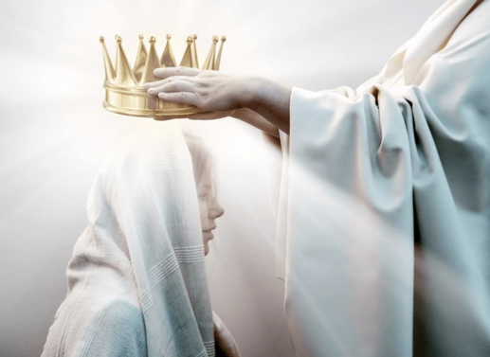
KNOWING WE ARE THE PRIZED BRIDE OF CHRIST GIVES US
GREATER CONFIDENCE BEFORE THE THRONE OF GOD TO
PRESS THROUGH THE VEIL IN RADICAL PRAYER TO
SEE GOD USE US ON ASSIGNMENTS FOR BREAKTHROUGHS
I no longer call you servants, because a servant does not know his master's business. Instead, I have called you friends (A close fond friendship), for everything that I learned from my Father I have made known to you. John 15:15 (NIV)
But you are a chosen people, a royal priesthood, a holy nation, a people belonging to God, that you may declare the praises of him who called you out of darkness into his wonderful light. 1 Peter 2:9
BIBLICAL METAPHORS
Father/ Sons
Shepherd/ Sheep
Glory/ Temple
Bridegroom/ Bride

Slide 13
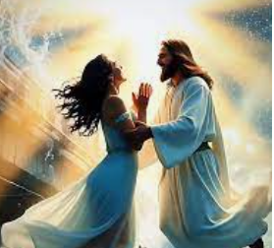
God’s Work of Grace In
DESIGNING MARRIAGE was to A/ POPULATE
The earth and make B/ GODLY FAMILY STRUCTURE through a healthy HUSBAND AND WIFE – But also
To C/ Prophetically Model God wanting to bring MANKIND to Himself as an intimate partner in His family
Husbands, love your wives, just as Christ loved the church and gave Himself up for her 26 to make her holy, cleansing her by the washing with water through the Word, 27 and to present her to Himself as a radiant Church, without stain or wrinkle or any other blemish, but holy and blameless. Ephesians 5:25-27
This Might Appear Selfish But It Is A blessing To Us And Jesus Is Pleased To Prepare us for Himself.

Slide 14
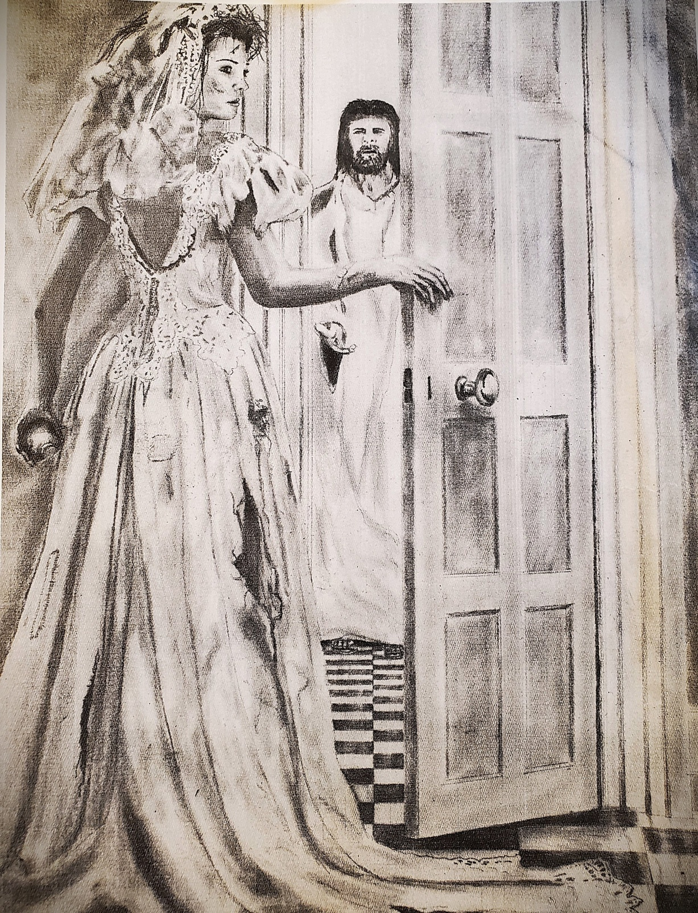
Jesus Showed Up And She
Wasn’t Ready
Wake up! Strengthen what remains and is about to die, for I have not found your deeds complete in the sight of my God. ³ Remember, therefore, what you have received and heard; obey it, and repent. But if you do not wake up, I will come like a thief, and you will not know at what time I will come to you. Revelation 3:2-3
"Behold, I come like a thief! Blessed is he who stays awake and keeps his clothes with him, so that he may not go naked and be shamefully exposed." Revelation 16:15 (NIV)

Slide 15
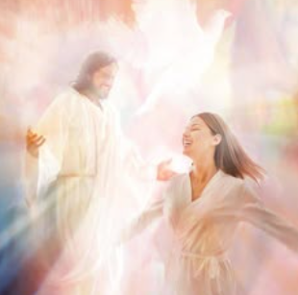
Paul re- echoes the MYSTERY – Jesus left
The Father to get a BRIDE
For this reason a man will leave his father and mother and be united to his wife, and the two will become one flesh." 32 This is a profound mystery--but I am talking about Christ and the Church. (Bride) 33 However, each one of you also must love his wife as he loves himself, and the wife must respect her husband. Ephesians 5:31-33 (NIV)
I am jealous for you with a godly jealousy. I promised you to one Husband, to Christ, so that I might present you as a pure virgin to Him. 2 Corinthians 11:2 (NIV)

Slide 16
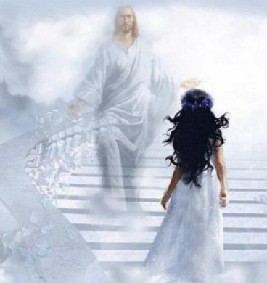
My dove in the clefts of the rock, in the hiding places on the mountainside, show me your face, let me hear your voice; for your voice is sweet, and your face is lovely. ¹⁵ Catch for us the foxes, the little foxes that ruin the vineyards. Song of Songs 2:14-15 (NIV)
How beautiful you are, my darling! Oh, how beautiful! Song of Songs 4:1 (NIV)
Psalm 45:9-11 “The King is Enthralled in Your Beauty.”
JESUS LOVES HIS BRIDE “AS SHE IS” - BUT RELEASES THIS EXTRAVAGANT GRACE TO GIVE HER ALL THE GIFTS OF THE HOLY SPIRIT AND BEAUTY TREATMENTS FROM THE WORD OF GOD TO MAKE HERSELF EVEN MORE GLORIOUS IF THAT IS POSSIBLE.

Slide 17

Now Don’t Go Weird on Me
Don’t Think of Your Insecurities
Or You will miss this Prophetic Picture
JESUS GOES LIKE – “I LOVE YOU DEARLY – YOU ARE ALREADY BEYOND BEAUTIFUL TO ME MY BRIDE – BUT GO GET YOUR HAIR DONE WHATEVER WAY YOU WANT – GO GET YOUR NAILS DONE – GET A PEDICURE – GET A NEW DRESS – I CAN’T WAIT TO SEE YOU DECK YOURSELF OUT IN WHAT I’VE PROVIDED FOR YOU!”
I Feel Insecure

Slide 18
The Bride of Christ Participates In
His Making Her Ready
JESUS SAYS – “MY BRIDE,
DRESS YOURSELF – IN MY LOVE
MY SWEETHEART, CLOTHE YOURSELF IN MY HUMILITY
MY DOVE, PURIFY YOURSELF IN MY RIGHTEOUSNESS.
MY DARLING DRESS YOURSELF IN THE FRUITS OF THE HOLY SPIRIT AND SELFLESS ACTS OF SERVICE ”
For whoever touches you touches the apple of His eye-- Zechariah 2:8 (NIV)
"Hallelujah! For our Lord God Almighty reigns. 7 Let us rejoice and be glad and give Him glory! For the wedding of the Lamb has come, and His bride has made herself ready. 8 Fine linen, bright and clean, was given her to wear." (Fine linen stands for the righteous acts of the saints.) 9 Then the angel said to me, "Write: 'Blessed are those who are invited to the wedding supper of the Lamb!'" And he added, "These are the true words of God." Revelation 19:6-9

Slide 19



Those Who “Long For His Appearing” In Everyday Life – Are Set Up To
Long For His Ultimate Appearing Very Soon
Kisses from Heaven
Interventions in Life
Divine Appointments
Personal Encounters
Healings/ Deliverance/ Miracles
Jumping off the pages of the Word
Revival/ Opened Heavens
The Passing into the Lord’s Presence
Rapture
Second Coming
Millennium
Eternal Face-to-Face Fellowship
Then we shall see face to face. Now I know in part; then I shall know fully, even as I am fully known. 1 Corinthians 13:12 (NIV)
God left nothing that is not subject to Him. Yet at present we do not see everything subject to Him. ⁹ But we see Jesus Hebrews 2:8-9 (NIV)

Slide 20
Out of This Desperate Preparation and “Glorious Fitting Us For The Marriage Supper of the Lamb” Three Passions Emerge As An Interceding Bride JOINED WITH the Chief Intercessor (1 Cor. 6:17)
A Longing (loving and welcoming) and looking (waiting with endurance) for EFFECTUAL POWER AND INTERCESSION in the Holy Spirit to get as many as possible into the Marriage Supper of the Lamb through MASSIVE REVIVAL – that will spread the BEAUTY OF JESUS EVERYWHERE. - HARVEST
A “longing and looking for the ULTIMATE Appearing” (2 Tim 4:8) of Our Spiritual Bridegroom and Lover – that through HIS GRACE we would be PLEASING to Him and found spotless in His sight – MAKING OURSELVES READY – for that day PURITY
A longing and looking (Titus 2:13) to keep the OIL of FAITH and OBEDIENCE full in our lamps in case the Bridegroom delays longer than we think – that we would FINISH OUR MISSION we are assigned. – FAITHFUL

Slide 21
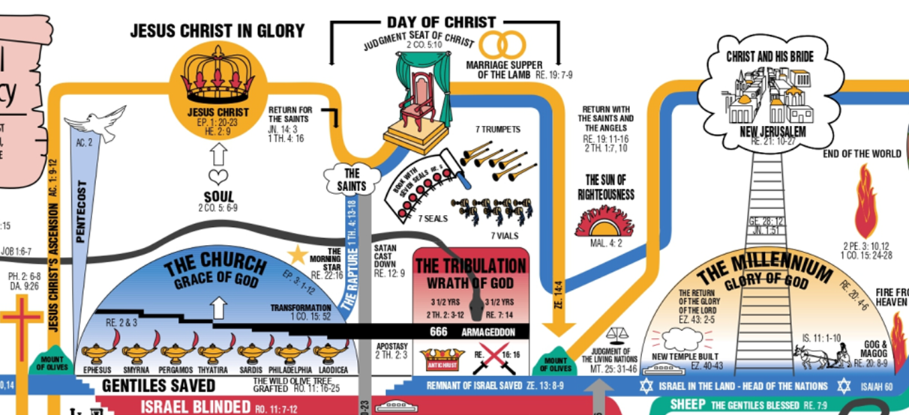
The Last Days Are Set up Around
The Jewish Wedding Model
The Great White Throne Judgment

Slide 22
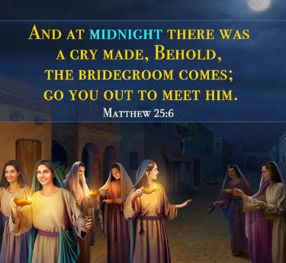
It is the Jewish Customs That Show
Us Prophetically how we are being Set up in the Last Days For The Marriage Supper of the Lamb
Jewish engagement, known as the erusin, could be a significant period before the full marriage ceremony (nissuin), sometimes lasting up to a year or even two. This extended period allowed the groom to prepare a home for his bride and establish their household.
"Do not let your hearts be troubled. Trust in God; trust also in me. ² In my Father's house are many rooms; if it were not so, I would have told you. I am going there to prepare a place for you. ³ And if I go and prepare a place for you, I will come back and take you to be with me that you also may be where I am. John 14:1-3 (NIV)

Slide 23
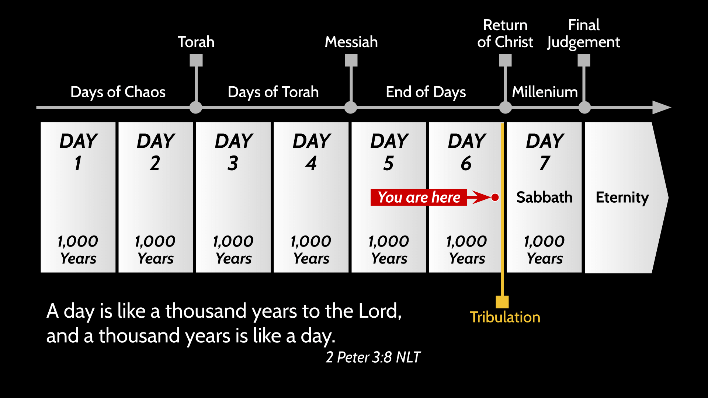




There Is A Lot Of Evidence To
Make This Case Work – Just don’t Put God in a Box
Marriage Supper of the Lamb
Great White
Throne
Judgment
Judgment
Seat of Christ
Rapture
God uses Israel
God uses The Church
From The Exodus To building of 1st Temple - 480 Years
From Solomon to destruction of 1st Temple - 480 Years
From Building of 2nd Temple To Birth of Jesus - 480 Years

Slide 24
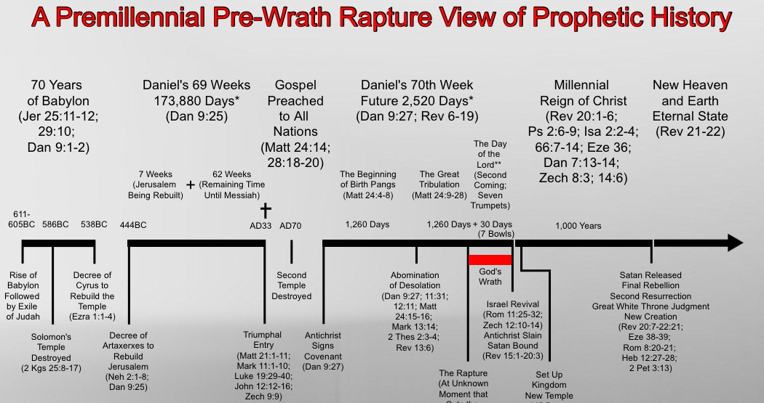
How The Book of Daniel Sets Up Revelation
²⁵ "Know and understand this: From the issuing of the decree to restore and rebuild Jerusalem until the Anointed One, the ruler, comes, there will be seven 'sevens,' and sixty-two 'sevens.' It will be rebuilt with streets and a trench, but in times of trouble. ²⁶ After the sixty-two 'sevens,' the Anointed One will be cut off and will have nothing. The people of the ruler who will come will destroy the city and the sanctuary. (ROMANS 70 AD) The end will come like a flood: War will continue until the end, and desolations have been decreed. ²⁷ He will confirm a covenant with many for one 'seven.' In the middle of the 'seven' he will put an end to sacrifice and offering. And on a wing [of the temple] he will set up an abomination that causes desolation, until the end that is decreed is poured out on him". Daniel 9:25-27 (NIV)

Slide 25
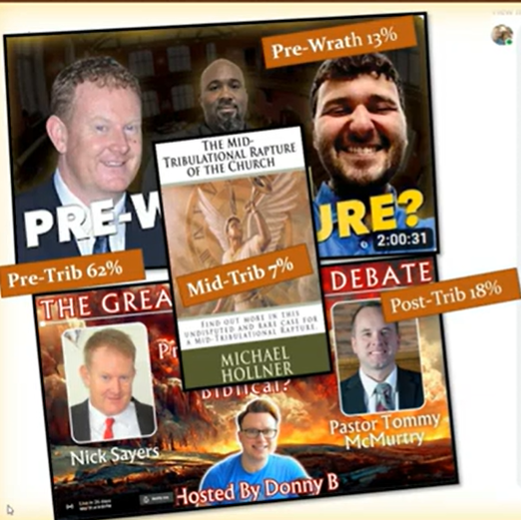

Slide 26
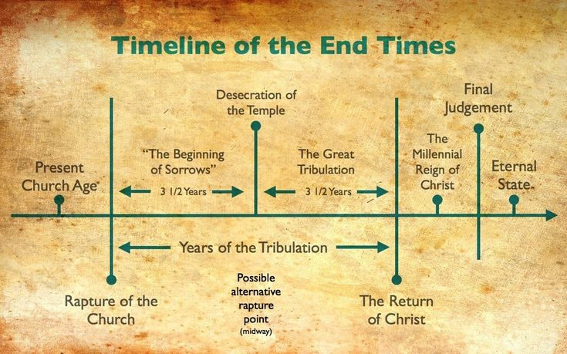


WHY THE TRIBULATION FOR MANKIND
Great White
Throne Judgment
Judgement Seat of Christ
Marriage Supper of the Lamb
Rapture
Rapture
Messianic Jews
Isaiah 30:25
Daniel 11:32
Malachi 3:2
God’s anger is poured out on those who rejected His GREATEST display of revival in human history
A great multitude that no man could number Rev. 7:9
Those days cut short for the sake of the elect Mat. 24, Mark 13

Slide 27
UNDERSTANDING - The Various Promises Of Different
Chapters of the Last Days
Church Age
Church Age/ And Millennium
"'Listen, O high priest Joshua and your associate, - I am going to bring My Servant, the Branch. ⁹ See, the stone I have set in front of Joshua! --- 'and I will remove the sin of this land in a single day. Zechariah 3:8-9 (NIV)
² In the last days the mountain of the LORD's temple will be established as chief among the mountains; it will be raised above the hills, and all nations will stream to it. ³ Many peoples will come and say, "Come, let us go up to the mountain of the LORD, to the house of the God of Jacob. He will teach us his ways, so that we may walk in his paths." The law will go out from Zion, the word of the LORD from Jerusalem. Isaiah 2:2-3 (NIV)
Ask ye of the LORD rain in the time of the latter rain; so the LORD shall make bright clouds, and give them showers of rain, to every one grass in the field. Zechariah 10:1 (KJV)
²⁰ This is what the LORD Almighty says: "Many peoples and the inhabitants of many cities will yet come, ²¹ and the inhabitants of one city will go to another and say, 'Let us go at once to entreat the LORD and seek the LORD Almighty. I myself am going.' ²² --: "In those days ten men from all languages and nations will take firm hold of one Jew by the hem of his robe and say, 'Let us go with you, because we have heard that God is with you.'" Zechariah 8:20-23 (NIV)
Millennium
The LORD will be awesome to them when He destroys all the gods of the land. The nations on every shore will worship him, every one in its own land. Zephaniah 2:11 (NIV)

Slide 28

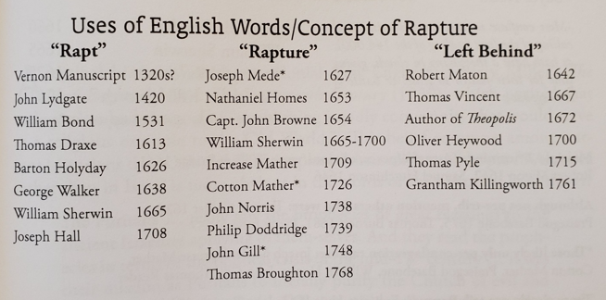
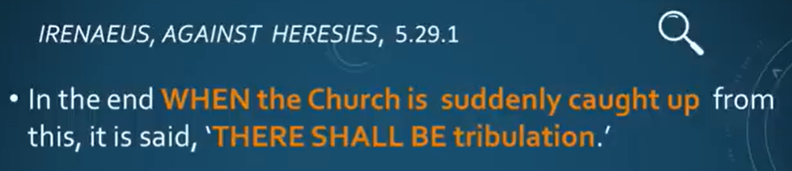
Debunking The Myth That No One Taught
About The Rapture
Until the 1840’s
180 A.D.

Slide 29
“If the Holy Spirit is hindered or suspends His powerful influence, sinners by the thousands around us, will continue in their false security, their hardness of heart, and their lack of understanding of what true faith is. Every moment they will be blindfolded and unprepared for eternity.” Samuel Buell 1765
“Every revival makes Jesus more real, the shedding of His blood more precious, and the victories of the Cross more outstanding. . . . and the DEMONSTRATION OF HIS SPIRIT more glorious. There is an urgent need for sound doctrine and a warning to those in this fresh visitation.” Ivan Spencer 1952 Elim Bible Institute President

Slide 30
LORD, FATHER WE DECREE AND DECLARE A JESUS EXALTING RADICAL REPENTANCE AND CONVERSION MOVE OF GOD
LORD, FATHER WE DECREE AND DECLARE A JESUS EXALTING RADICAL PREVAILING INTERCESSION MOVE OF THE SPIRIT
LORD, FATHER WE DECREE AND DECLARE A JESUS EXALTING RADICAL DELIVERANCE MOVE OF THE SPIRIT
LORD, FATHER WE DECREE AND DECLARE A JESUS EXALTING RADICAL HEALING/ MIRACLE MOVE OF THE SPIRIT
LORD, FATHER WE DECREE AND DECLARE A JESUS EXALTING RADICAL OBEDIENCE AND DISCIPLESHIP MOVE OF THE SPIRIT
LORD, FATHER WE DECREE AND DECLARE A JESUS EXALTING RADICAL MISSIONS MOVE OF THE SPIRIT
LORD, FATHER WE DECREE AND DECLARE A JESUS EXALTING RADICAL NATIONAL REFORMATION REVIVAL

Slide 31

God Is
For Revival/ Harvest
DIE TO YOUR TREAD MILL EXISTENCE – FIND NEW HABITS OF PRESSING THROUGH THE VEIL
JOIN WITH OTHERS IN THIS CRITICAL HOUR – PREPARE TO HELP OTHERS TO THE TABLE – GETTING READY FOR THE MARRIAGE SUPPER OF THE LAMB
FEED YOUR SOUL AND SPIRIT ON THE BLESSED HOPE – OF THE “APPEARING OF CHRIST” – IN THE DAY TO DAY AND IN THE RAPTURE.
SPREAD THE BEAUTY OF JESUS EVERYWHERE. – HARVEST
MAKE OURSELVES READY – FOR THAT DAY - PURITY
FINISH OUR MISSION WE ARE ASSIGNED – FAITHFUL

