Slide 1

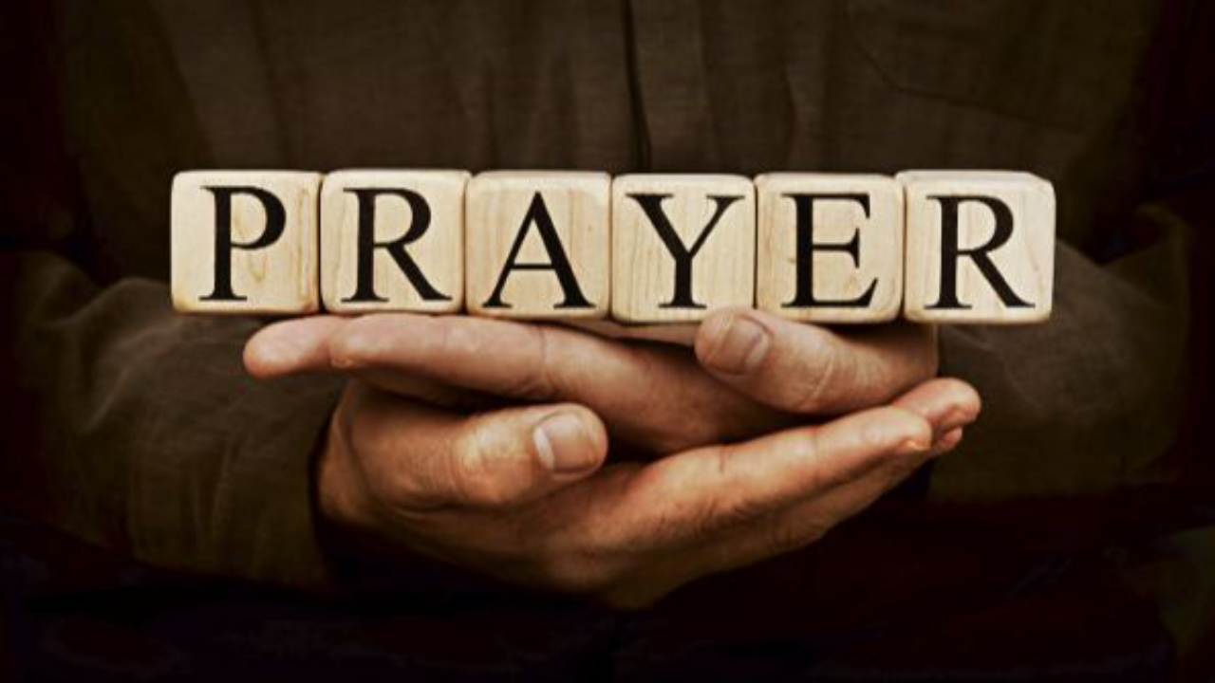
Pressing Through The Veil
By Means Of
Part 4 – Being The Bride Of Christ In The Last Days
LifeGate Sermon
August 10th, 2025

Slide 2
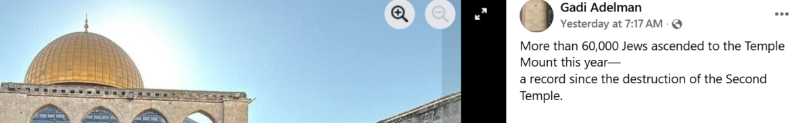
“WE ARE LIVING ON THE EDGE OF THE END WE CAN SEE THE FRONTIER OF FOREVER.”
Carol Ketchum - November 2020
"Now learn this lesson from the fig tree (Israel): As soon as its twigs get tender and its leaves come out (1948) , you know that summer is near. ³³ Even so, when you see all these things, you know that it is near, right at the door. ³⁴ I tell you the truth, this generation will certainly not pass away until all these things have happened. ³⁵ Heaven and earth will pass away, but My words will never pass away. Matthew 24:32-35
Jerusalem will be trampled on by the Gentiles until the times of the Gentiles are fulfilled. (1967) ²⁵ "There will be signs in the sun, moon and stars. (Revelation 6:13) On the earth, nations will be in anguish and perplexity at the roaring and tossing of the sea. (Tsunamis) ²⁶ Men will faint from terror, apprehensive of what is coming on the world, for the heavenly bodies will be shaken. ²⁷ At that time they will see the Son of Man coming in a cloud with power and great glory. ²⁸ When these things begin to take place, stand up and lift up your heads, because your redemption is drawing near.“ (Israel during the tribulation) Luke 21:24-28 (NIV)
I do not want you to be ignorant of this mystery, brothers, so that you may not be conceited: Israel has experienced a hardening in part until the full number of the Gentiles has come in. ²⁶ And so all Israel will be saved”. Romans 11:25-26 (NIV)

Slide 3
Solomon Said It Best
Now all has been heard; here is the conclusion of the matter: Fear God and keep his commandments, for this is the whole [duty] of man. Ecclesiastes 12:13 (NIV)
WHAT IS THE MESSAGE OF LAST DAYS TEACHING?
GOD HAS ALWAYS HAD A PLAN – AND THAT PLAN DOES HAVE PRIMARY WAYPOINTS – THEY ARE LAID OUT PROPHETICALLY IN SCRIPTURE FOR THE FUTURE –
A/ REBUILDING THE TEMPLE – B/ COMING MESSIAH – DEATH BURIAL RESURRECTION OF JESUS – C/ CHURCH AGE – D/ END OF CHURCH AGE – E/ RAPTURE –
F/ TRIBULATION AND JUDGMENT
MANKIND IS RESPONSIBLE TO FOLLOW HIS CREATOR FOR HIS LIFE TO BE BLESSED
IF WE ARE SAVED – WE WILL BE COMFORTED AND BLESSED AT THE COMING OF JESUS

Slide 4

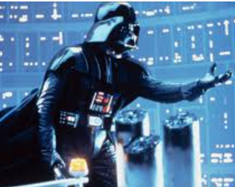
What the Millennium Teaches Us
About Satan’s Power to Deceive
Garden of Eden – Perfect fellowship with God
1000 Year
Reign With Jesus In Jerusalem
Revelation 20
Isaiah 2 ; 66
Micah 4
Zechariah 14
Genesis 3:1-7
Revelation 20:7
What Is More Dangerous – The Flesh Or Deception?
EVERY Satan
ONE World
HAS TO Flesh
FACE Death
Without Faith In Our Supernatural Jesus And the Power Of The Holy Spirit
THE THEME OF THE MILLENNIUM – IS MANKIND DOESN’T DO WELL – WHEN THERE IS SATANIC DECEPTION – TEMPTATION OF THE FLESH IS ONE LEVEL- AND MANKIND MAY POSSIBLY SURVIVE TEMPTATION – BUT DECEPTION IS AN ALTOGETHER HIGHER LEVEL – AND IT APPEARS THE DECEPTIONS OF SATAN GO AFTER THE INNER VULNERABILITIES OF MANKIND AT A DIFFERENT LEVEL – BECAUSE THEY END UP TURNING TRUTH INTO A LIE.
CONSEQUENTLY, THE WORD OF GOD IS THE ROCK THAT DOESN’T MOVE AND THE HOLY SPIRIT THROUGH JESUS IS THE LIGHT THAT WON’T MORPH INTO DARKNESS – HE WILL ALWAYS CORRECT AND CONVICT US WHEN THE ENEMY IS DECEIVING US. IF JESUS HADN’T SAVED US – AND GIVEN US THE HOLY SPIRIT – YOU AND I WOULD ALL BE DECEIVED BY THE DEVIL. GOD SHOWS US THAT WE NEED A SAVIOR – TO KEEP US IN FELLOWSHIP – AND TO CAPTURE OUR HEARTS AND LOVE THE TRUTH.

Slide 5
The “Mysteries” Of Daniel, Jesus, Paul, and Revelation
Is It Allegorical?
Is It Literal?
Jewish culture and Hebrew Writers of the Bible – did not always write CHRONOLOGICAL – (something that we value highly as inheriting the “Greek/ Roman mindset)
The word “SAINT” can be somewhat confusing as well. It does not always mean the Gentile Church - ²⁵ He will speak against the Most High and oppress his saints and try to change the set times and the laws. The saints will be handed over to him for 3 ½ years. Daniel 7:25
And it was given unto him (Anti-Christ) to make war with the saints, and to overcome them: and power was given him over all kindreds, and tongues, and nations. Revelation 13:7 (KJV)

Slide 6
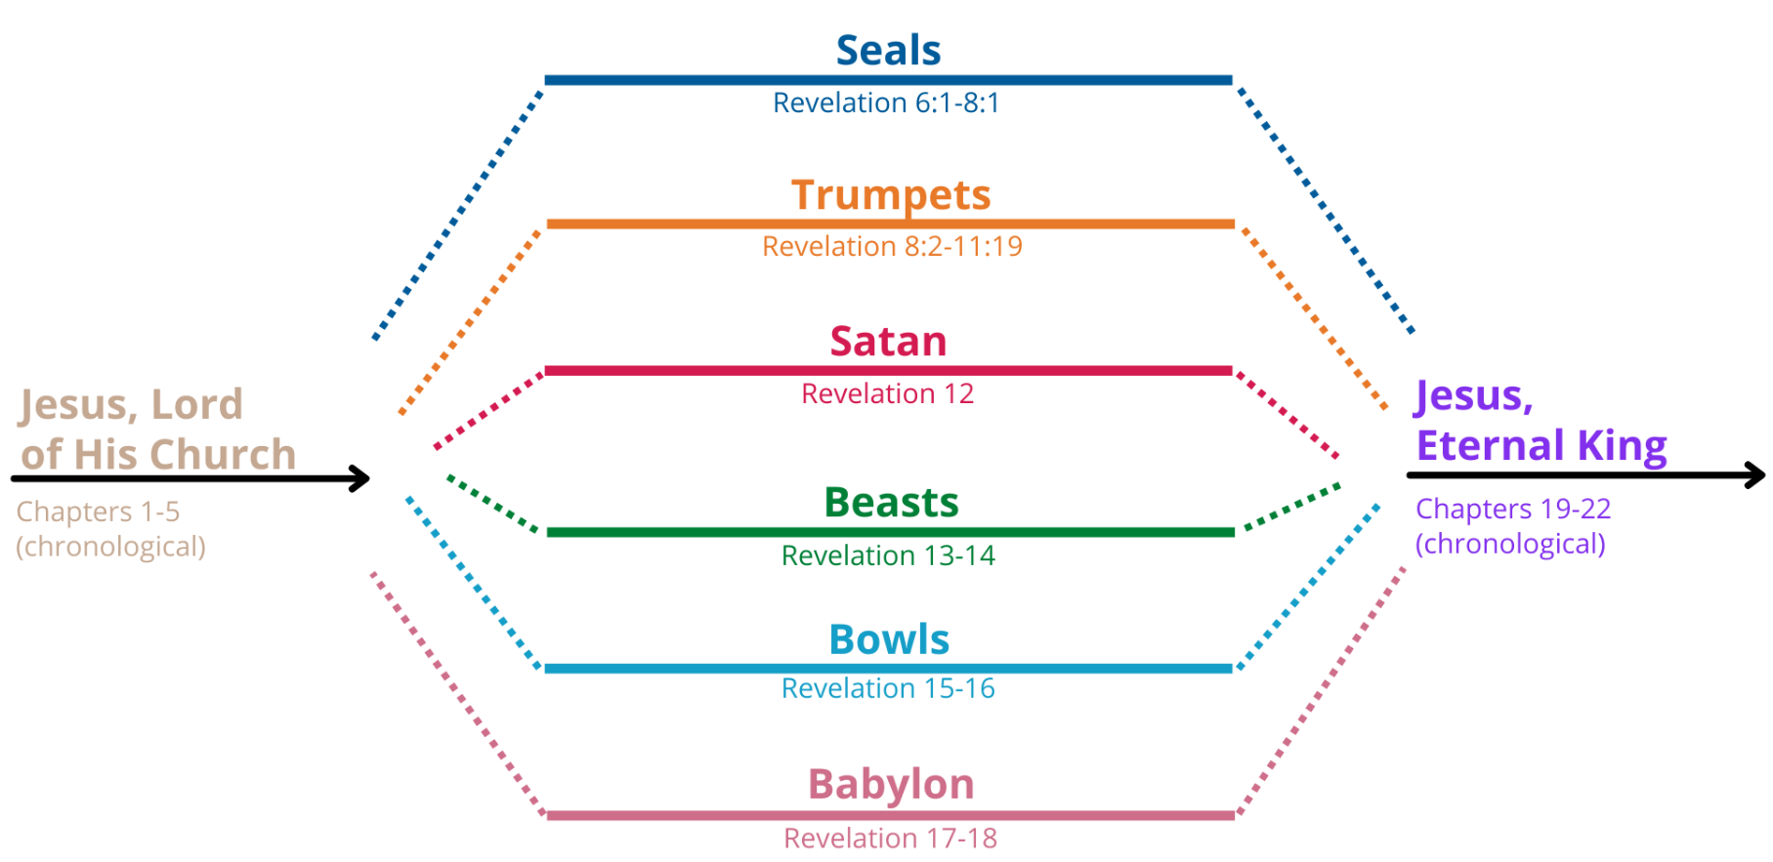
The Chronological Order of Revelation
Is Very Mysterious

Slide 7
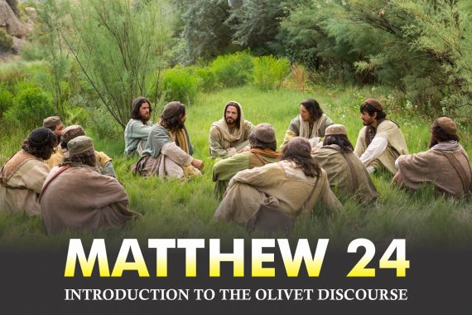

Predicting:
The destruction of Jerusalem by Rome
The rebirth – of Israel
The birth pangs and end of the Church age
The Rapture
The Tribulation
Battle of Armageddon
Let’s Learn Together As We Explore This Mansion of Revelation
Sometimes there is No Chronological Order – to entire passage – “Come Let me show you this room – Oh you got to see this other room too – and this is an amazing closet.”

Slide 8
A Fundamental Understanding Of
God’s Grace Is That He Gives Each Generation
The Anointing and Grace to Match Their Times
And such as do wickedly against the covenant shall he corrupt by flatteries: but the people that do know their God shall be strong, and do exploits (TAKE ACTION – ACCOMPLISH – ADVANCE, BRUISE). Daniel 11:32 (KJV)
The God of peace will soon crush (Bruise) Satan under your feet. The grace of our Lord Jesus be with you. Romans 16:20 (NIV)
And my God will meet (SUPPLY) all your needs according to his glorious riches in Christ Jesus. Philippians 4:19 (NIV)
His divine power has given us everything we need for life and godliness through our knowledge of Him who called us by His own glory and goodness. ⁴ Through these he has given us his very great and precious promises, so that through them you may participate in the divine nature and escape the corruption in the world caused by evil desires. 2 Peter 1:3-4 (NIV)

Slide 9
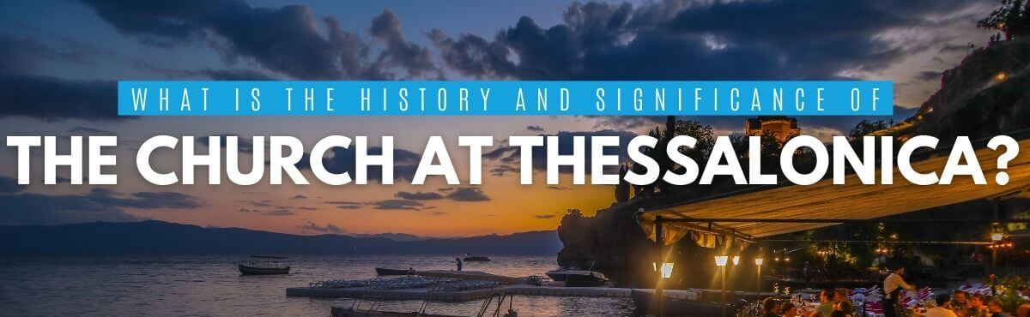
They were persecuted by the religious Jews quickly as Paul preached and revival broke out in a powerful way – Acts 17
Paul clearly told them they would have to go through trials to enter the Kingdom of God. And to comfort them he taught on the last days.
What is crazy is that false teachers rose quickly and within one to two years made a FORGERY of a letter in Paul’s name that said – “The Coming of the Lord” took place already.

Slide 10
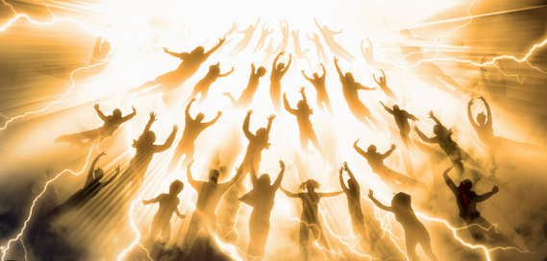
The Word of God Is Not Written For Sensationalism – But Things in it are EPIC
So we believe that God will bring with Jesus those who have fallen asleep in Him. ¹⁵ According to the Lord's own word, we tell you that we who are still alive, who are left till the coming of the Lord, will certainly not precede those who have fallen asleep. ¹⁶ For the Lord himself will come down from heaven, with a loud command, with the voice of the archangel and with the trumpet call of God, and the dead in Christ will rise first. ¹⁷ After that, we who are still alive and are left will be caught up (Harpod-zoe – to catch away – Acts 8:39 Philip) together with them in the clouds to meet the Lord in the air. And so we will be with the Lord forever. ¹⁸ Therefore encourage (comfort) each other with these words.
1 Thessalonians 4:13-18
Now, brothers, about times and dates we do not need to write to you, ² for you know very well that the day of the Lord will come like a thief in the night. ³ While people are saying, "Peace and safety," destruction will come on them suddenly, as labor pains on a pregnant woman, and they will not escape. ⁴ But you, brothers, are not in darkness so that this day should surprise you like a thief. ⁵ You are all sons of the light and sons of the day. We do not belong to the night or to the darkness. ⁶ So then, let us not be like others, who are asleep, but let us be alert and self-controlled. 1 Thessalonians 5:1-6 (NIV)

Slide 11
THE CENTRAL PASSION OF PAUL WAS ALWAYS THE GOSPEL AND THE GENTILE CHURCH - He will punish those who do not know God and do not obey the Gospel of our Lord Jesus. 2 Thessalonians 1:8 (NIV)
Concerning the coming of our Lord Jesus Christ and our being gathered to Him, we ask you, brothers, ² not to become easily unsettled or alarmed by some prophecy, report or letter supposed to have come from us, saying that the day of the Lord has already come. ³ Don't let anyone deceive you in any way, for that day will not come until the rebellion (Apostasy – falling away) occurs and the man of lawlessness (Anti- Christ) is revealed, the man doomed to destruction. ⁴ He will oppose and will exalt himself over everything that is called God or is worshiped, so that he sets himself up in God's temple, proclaiming himself to be God. ⁵ Don't you remember that when I was with you I used to tell you these things? ⁶ And now you know what is (Church) holding him back, so that he may be revealed at the proper time. ⁷ For the secret power of lawlessness (mystery of Iniquity) is already at work; (Apostate doctrines) but the one who now holds it back will continue to do so till he is taken out of the way. (RAPTURE of The Church with the PURE GOSPEL) ⁸ And then the lawless one will be revealed, whom the Lord Jesus will overthrow with the breath of His mouth and destroy by the splendor of His coming. ⁹ The coming of the lawless one will be in accordance with the work of Satan displayed in all kinds of counterfeit miracles, signs and wonders, (During the Tribulation)¹⁰ and in every sort of evil that deceives those who are perishing. They perish (they got into the tribulation) because they refused to love the truth and so be saved. 2 Thessalonians 2:1-10 (NIV)

Slide 12
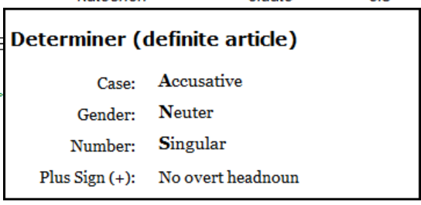
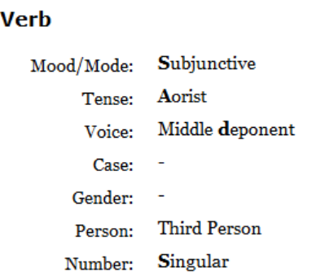
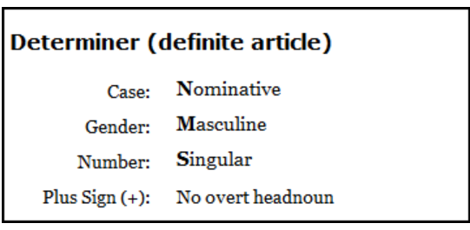
How can we know who is right (When it comes to translating early Church writings) ? By the correct methodology, candor, and elbow grease. We must approach “Irenaeus’ Against Heresies” with the same robust, consistent, impartial application of the historical-grammatical hermeneutic that we use (or should use) when we handle the word of God.
Lee Brainard
And now what withholds him until he is shown in his time - Wycliffe 1395
4 Main Views
Holy Spirit
Angel Michael
Church/ Gospel
Western Roman Empire
And now you know what is (Church) holding him back, so that he (ANTICHRIST) may be revealed at the proper time. ⁷ For the secret power of lawlessness (mystery of Iniquity) is already at work; (Apostate doctrines) but the one who now holds it back will continue to do so till he is taken out of the way.
(RAPTURE of The Church Carrying The PURE GOSPEL)
Lit. “Until out of the midst [he (it) is gone - taken]” (could be translated DONE, COME TO PASS – from the Lord’s prayer – “Thy will be DONE” or FULFILLED a form of the Greek word Gin-oe-migh) – And supper being Ended – Judas went out –
John 13:2
(Church with Pure Gospel)
Lit. – “Only now there is one holding it back” (Church with Pure Gospel)
And this gospel of the kingdom shall be preached in all the world for a witness unto all nations; and then shall the end come. Matthew 24:14

Slide 13
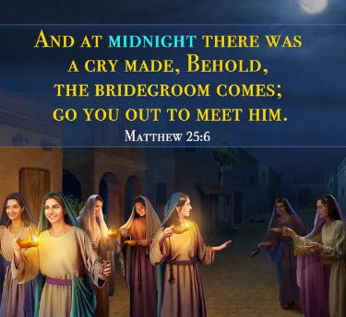
It is the Jewish Customs That Show
Us Prophetically how we are being Set up in the Last Days For The Marriage Supper of the Lamb
Jewish wedding engagement, known as the erusin, could be a significant period before the full marriage ceremony (nissuin), sometimes lasting up to a year or even two. This extended period allowed the groom to prepare a home for his bride and establish their household.
"Do not let your hearts be troubled. Trust in God; trust also in me. ² In my Father's house are many rooms; if it were not so, I would have told you. I am going there to prepare a place for you. ³ And if I go and prepare a place for you, I will come back and take you to be with me that you also may be where I am. John 14:1-3 (NIV)
a celebration known as the "Sheva Brachot" or "Seven Blessings"
The Bride and Bridegroom celebrated a Wedding
Usually for seven Days and the final night was called the Marriage Supper

Slide 14
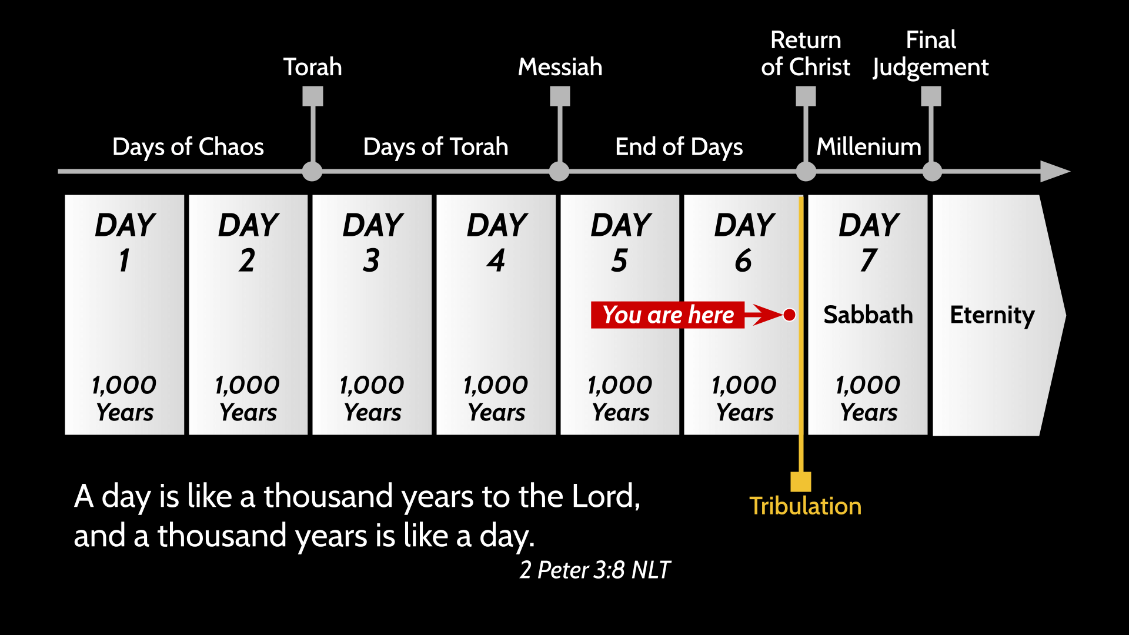



This is a traditional view of Human History
– Just don’t Put God in a Box
Great White
Throne
Judgment
Judgment
Seat of Christ
Rapture
Rapture
From The Exodus To building of 1st Temple - 480 Years
From Solomon to destruction of 1st Temple - 480 Years
From Building of 2nd Temple To Birth of Jesus - 480 Years

Slide 15
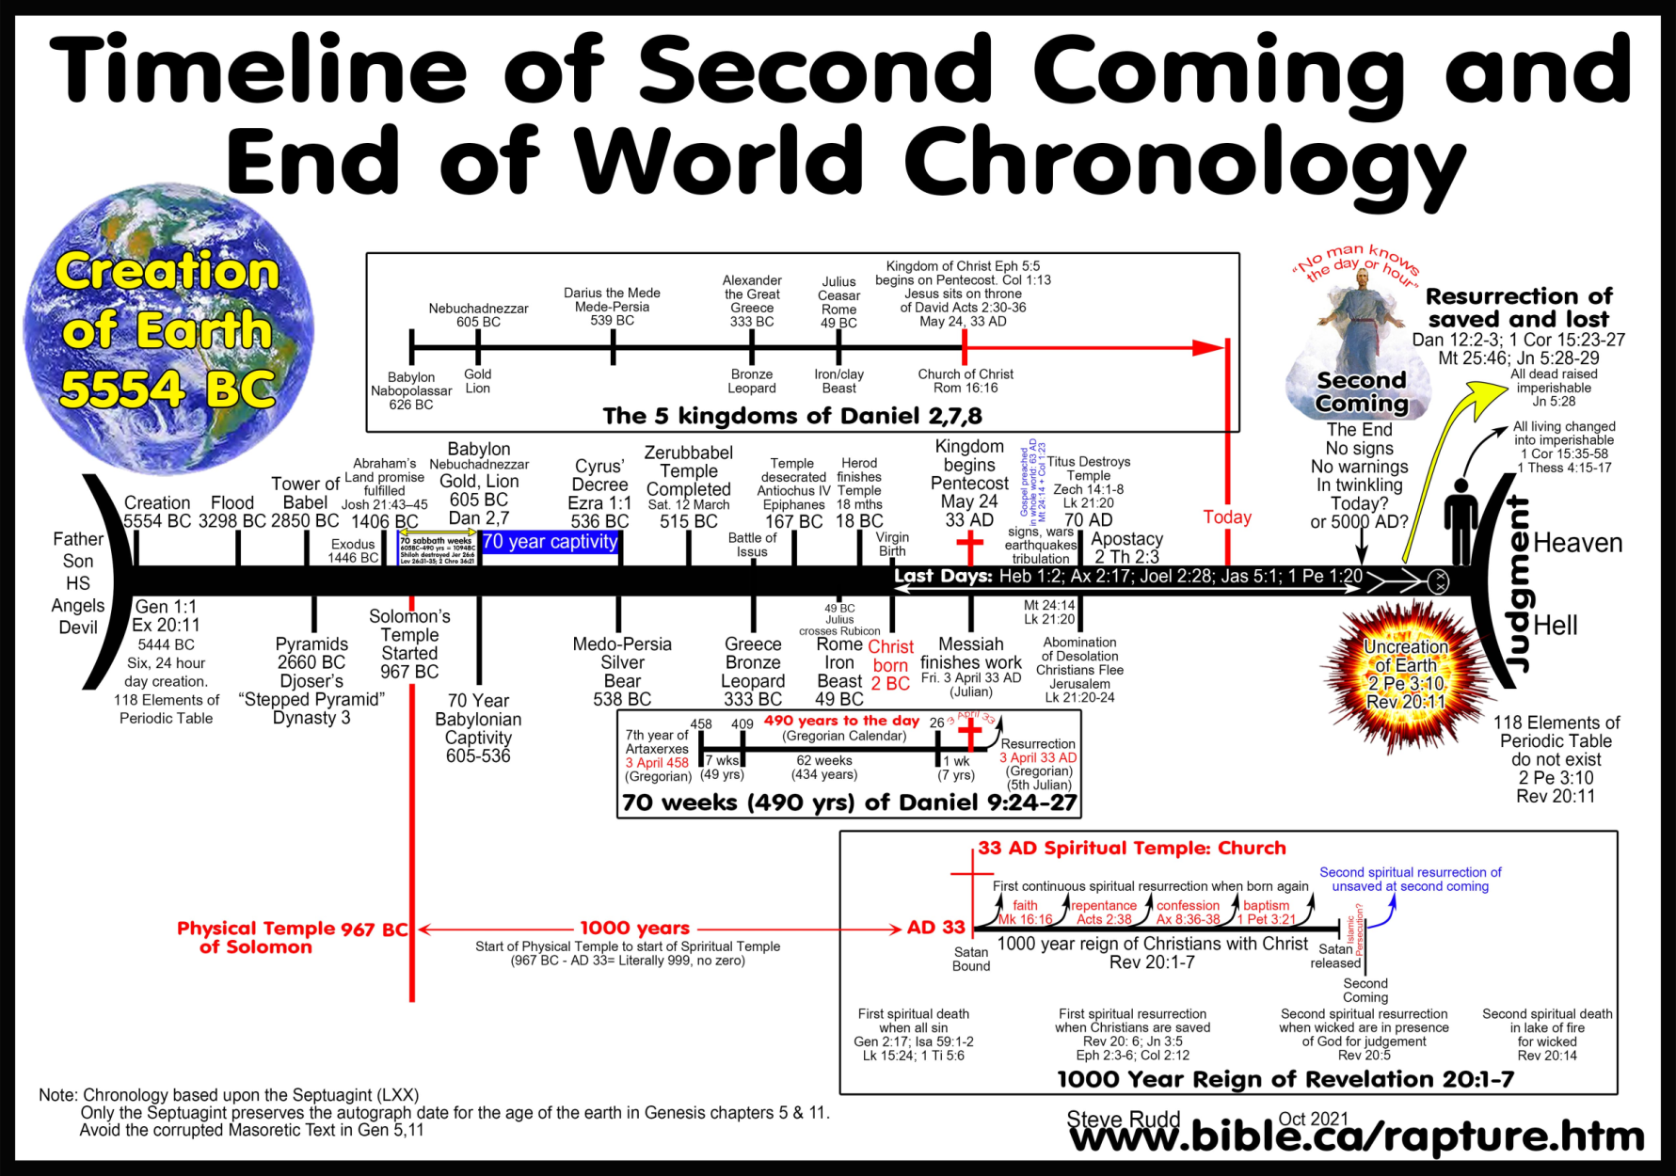
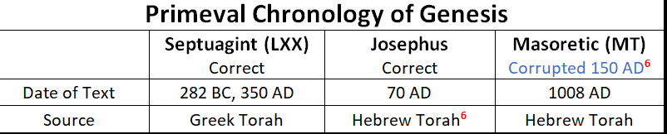
Pastor Steve Rudd

Slide 16
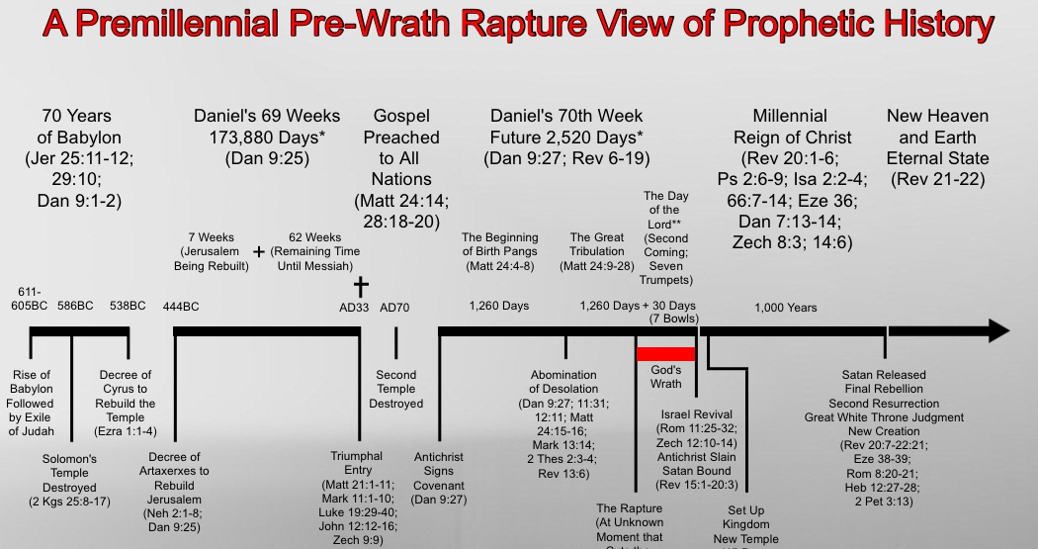
How The Book of Daniel Sets Up Revelation
²⁵ "Know and understand this: From the issuing of the decree to restore and rebuild Jerusalem until the Anointed One, the ruler, comes, (MESSIAH) there will be seven 'sevens,' and sixty-two 'sevens.' It will be rebuilt with streets and a trench, but in times of trouble. ²⁶ After the sixty-two 'sevens,' the Anointed One (Messiah) will be cut off and will have nothing. The people of the ruler who will come will destroy the city and the sanctuary. (ROMANS 70 AD) The end will come like a flood: War will continue until the end, and desolations have been decreed. ²⁷ He (ANTI-CHRIST) will confirm a covenant with many for one 'seven.' In the middle of the 'seven' he will put an end to sacrifice and offering. And on a wing [of the temple] he will set up an abomination that causes desolation, until the end that is decreed is poured out on him". Daniel 9:25-27
Rapture

Slide 17
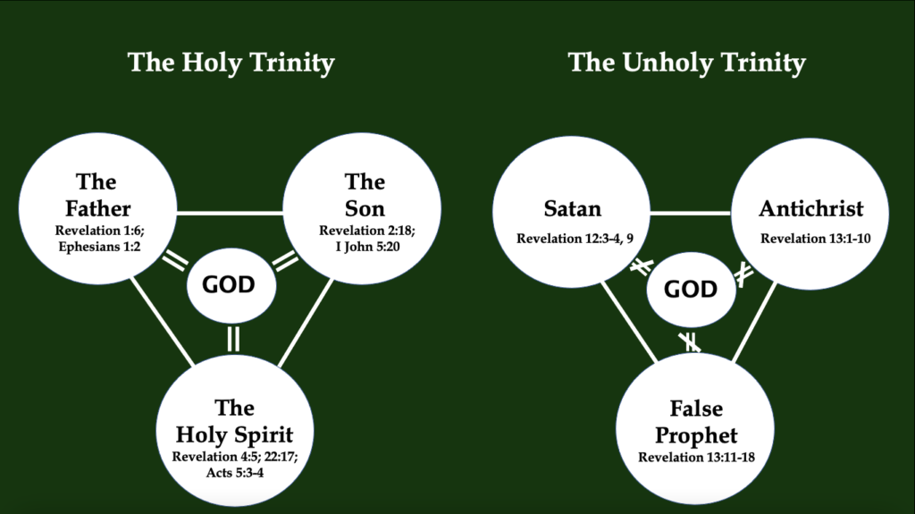
Dragon
Serpent
2nd Beast
3rd Beast

Slide 18
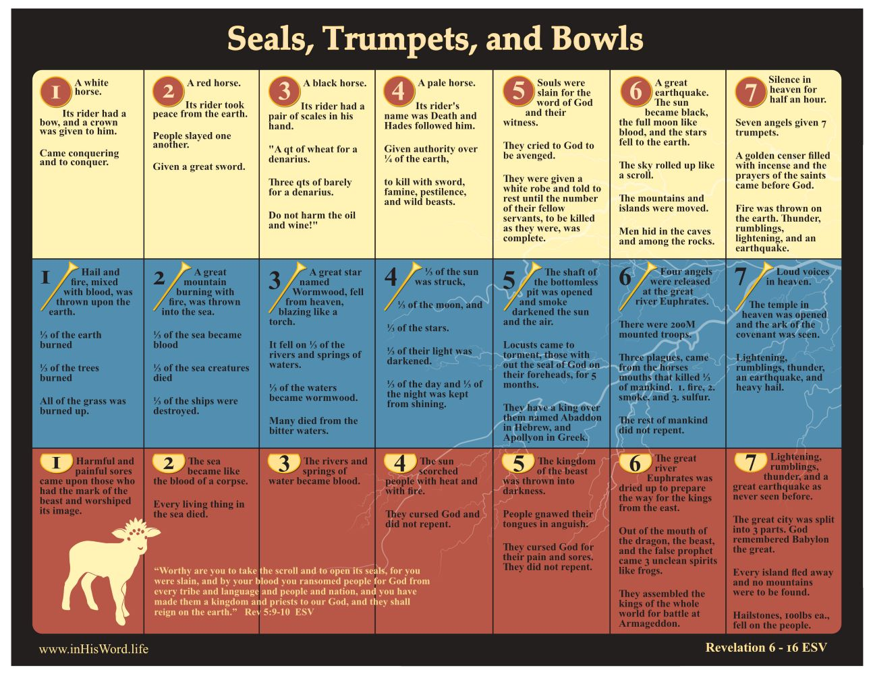

Slide 19
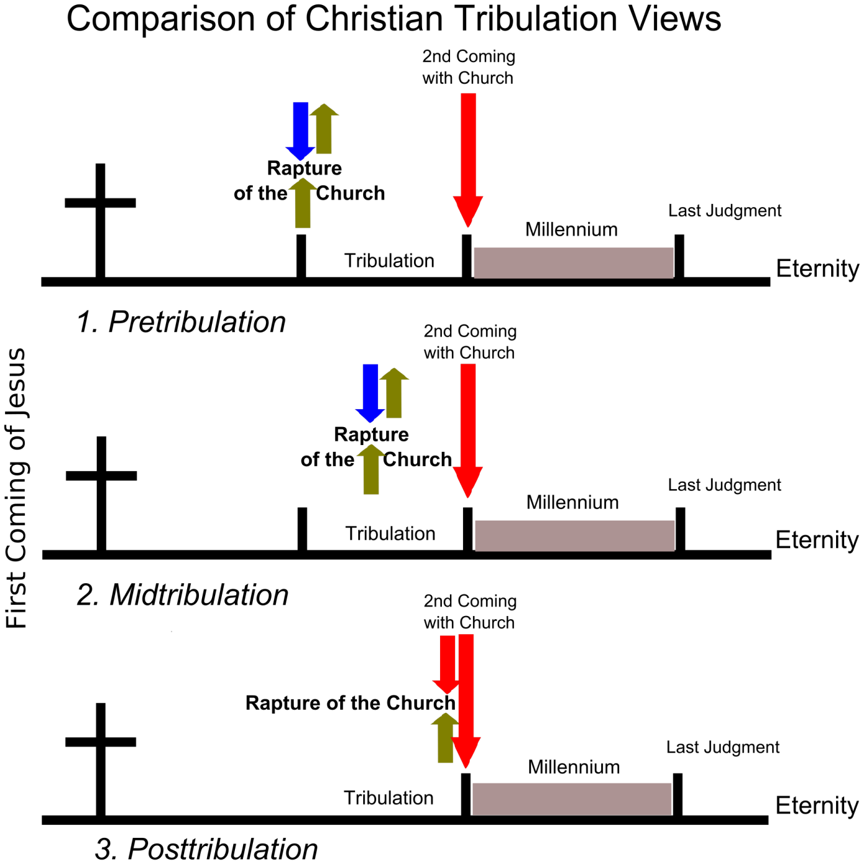
Different Views of The Rapture
⁵² in a flash, in the twinkling of an eye, at the last trumpet. For the trumpet will sound, the dead will be raised imperishable, and we will be changed. 1 Corinthians 15:52 (NIV)
²³ But each in his own turn: Christ, the firstfruits; then, when He comes, those who belong to Him. ²⁴ Then the end will come, when he hands over the kingdom to God the Father after he has destroyed all dominion, authority and power. 1 Corinthians 15:23-24 (NIV)
The predominant evidence is that the tribulation will last seven years divided up into two 3 ½ year periods. This comes from Daniel’s 70th week. But it may end up being shorter than seven years.
“I will keep you from the hour of trial - Revelation 3:10
²⁵ He will speak against the Most High and oppress his saints and try to change the set times and the laws. The saints will be handed over to him for a time, times and half a time. ²⁶ "'But the court will sit, and his power will be taken away and completely destroyed forever. Daniel 7:25-26 (NIV)
7^{th Trumpet}
There is no time
For the Marriage Supper of the Lamb – (WHEN??)

Slide 20
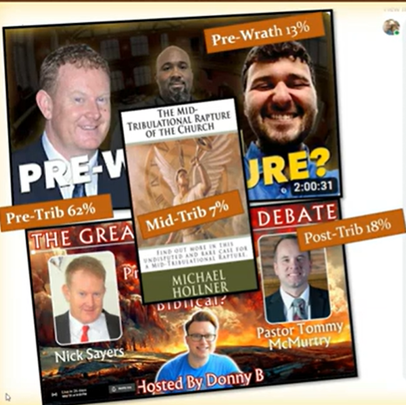
⁸ He will keep you strong to the end, so that you will be blameless on the day of our Lord Jesus Christ. ⁹ God, who has called you into fellowship with His Son Jesus Christ our Lord, is faithful. 1 Corinthians 1:8-9 (NIV)

Slide 21
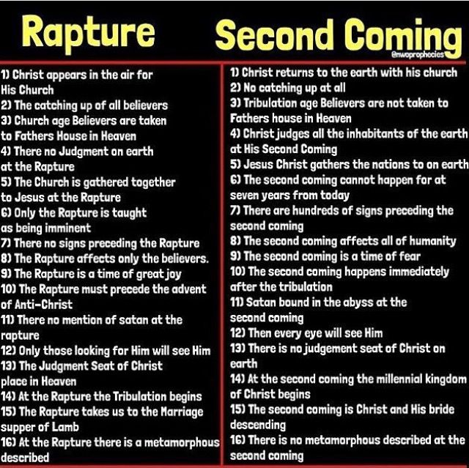
Rapture Is Different than The Second Coming (At End of Trib.)

Slide 22
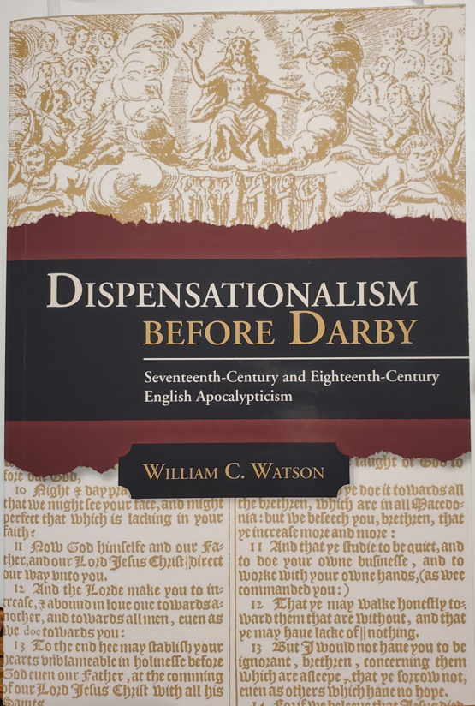
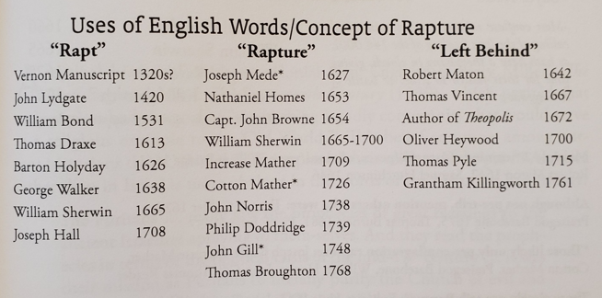
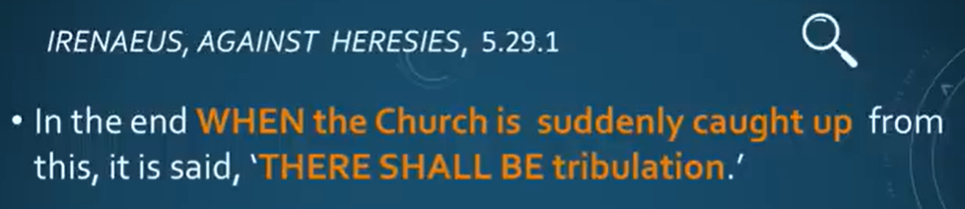
Debunking The Myth That No One Taught
About The Rapture
Until the 1840’s
EPHRAIM THE SYRIAN 350 AD
“Behold, the kingdom of heaven is at the doors [ready] to flash forth, but we don’t want to hear about these things — not ever. The signs and wonders, which the Lord said had to happen, the famines, the earthquakes, the terrors, and the nations in upheaval. These all seem to us like a dream to be told to others. The report of these things does not disturb us, nor the spectacle itself. For the elect shall be gathered prior to the tribulation, so they shall not see the confusion and the great tribulation coming upon the unrighteous world. The season for harvest has now drawn nigh, and the end of the age holds forth. Angels holding scythes are waiting for the nod. Let us fear, brethren, for it is the eleventh hour of the day. Lee Brainard
180 A.D.

Slide 23
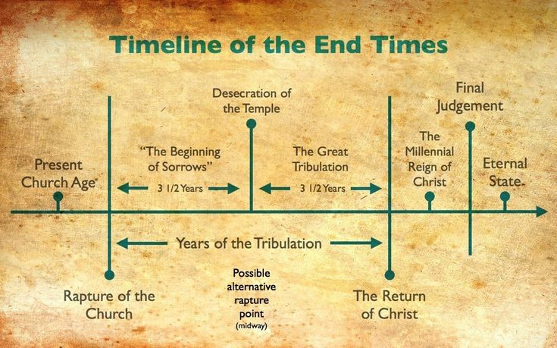


WHY THE TRIBULATION “AT THIS MOMENT” FOR MANKIND
God Judge’s those harshly who turn away from His mercy.
Jesus As Judge
Father as Judge
Great White
Throne
Judgment
Judgement
Seat of Christ
Marriage Supper of the Lamb
Second Coming
I do not want you to be ignorant of this mystery, - Israel has experienced a hardening in part until the full number of the Gentiles has come in. Romans 11:25
Go, my people, enter your rooms and shut the doors behind you; hide yourselves for a little while until his wrath has passed by. Isaiah 26:20 (NIV)
1 Corinthians
15:52
Revelation 11:15
Daniel 7:25
Battle of
Armageddon
1st and 2nd Thessalonians
Matthew
24:18
Rapture
20% Chance
80% Chance
Rapture
Resurrection
Satan
Loosed
One More
Final
Battle
Matthew
24:14
144,000 Messianic Jews
Matthew
24:15
A great multitude that no man could number Rev. 7:9
Isaiah 30:25
Daniel 11:32
Malachi 3:2
those saved in the Tribulation are resurrected and reign with Christ during the Millennium.
Revelation 20:4
God’s anger is poured out on those who rejected His GREATEST display of revival in human history
Those days cut short for the sake of the elect Mat. 24, Mark 13

Slide 24
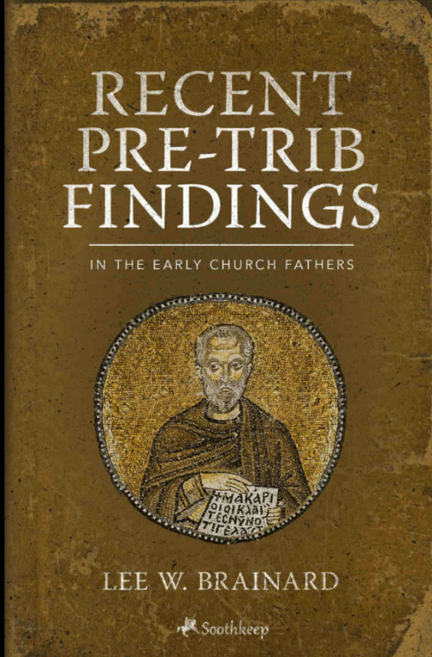
Terms:
The Day Of
The Lord –
The Great Tribulation
This is simply a matter of understanding the
day of the Lord. This prophetic day bears a
strong analogy to a normal day.
The normal day has four aspects:
the morning star,
the dawning,
the sunrise,
and the day time itself.
So with the coming day of the Lord. The rapture is the morning star of the day of the Lord (Rev. 2:28, Rev. 22:16, 2 Pe 1:19). The tribulation is the dawning of the day (1 Thess. 5:1-5). The second coming is the sunrise of the day (Mal. 4:1-3). The kingdom (MILLENNIUM) is the FULL day of the Lord in contrast to man’s day. Lee Brainard,

Slide 25
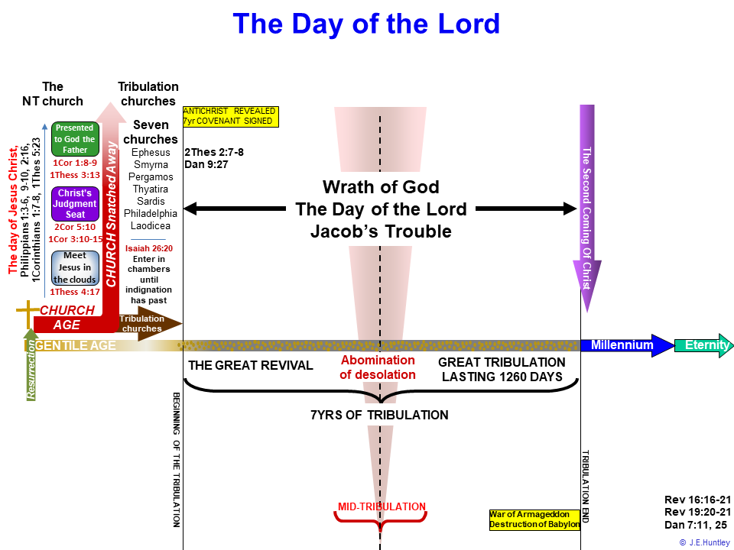
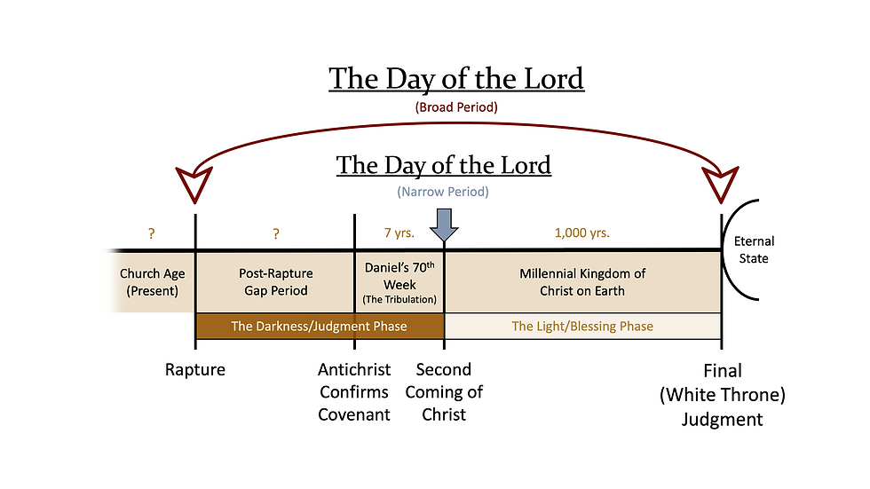
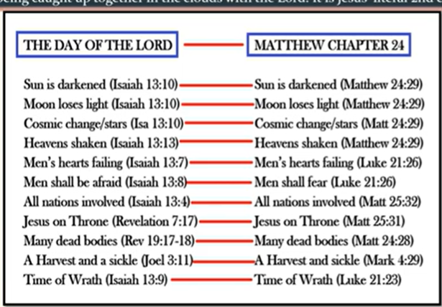
Marriage Supper Of The Lamb
⁷ But in the days when the seventh angel is about to sound his trumpet, the mystery of God will be accomplished, just as He announced to His servants the prophets." Revelation 10:7 (NIV)

Slide 26
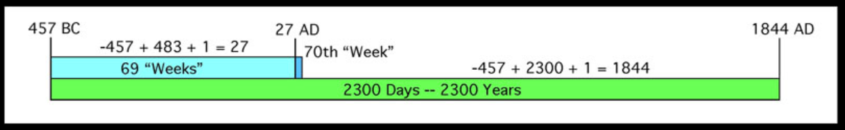
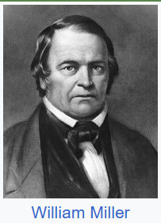
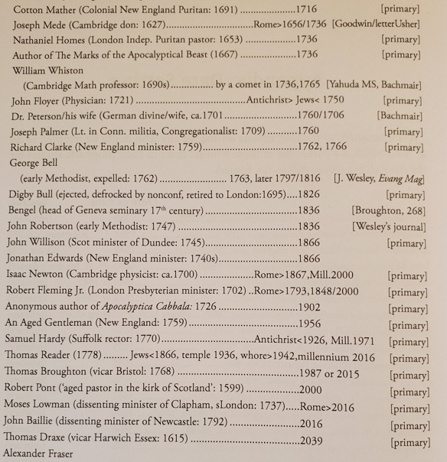
Be Warned
Of Setting Dates
Everyone
Has Been Wrong

Slide 27
Out of This Desperate Preparation and “Glorious Fitting Us For The Marriage Supper of the Lamb” Three Passions Emerge As An Interceding Bride JOINED WITH the Chief Intercessor (1 Cor. 6:17)
A Longing (loving and welcoming) and looking (waiting with endurance) for EFFECTUAL POWER AND INTERCESSION in the Holy Spirit to get as many as possible into the Marriage Supper of the Lamb through MASSIVE REVIVAL – that will spread the BEAUTY OF JESUS EVERYWHERE. - HARVEST
A “longing and looking for the ULTIMATE Appearing” (2 Tim 4:8) of Our Spiritual Bridegroom and Lover – that through HIS GRACE we would be PLEASING to Him and found spotless in His sight – MAKING OURSELVES READY – for that day PURITY
A longing and looking (Titus 2:13) to keep the OIL of FAITH and OBEDIENCE full in our lamps in case the Bridegroom delays longer than we think – that we would FINISH OUR MISSION we are assigned. – FAITHFUL

Slide 28

Guarding Against
There’s a huge difference between “LONGING TO BE WITH JESUS” – and wanting to “CHECK OUT.”
⁴ Yet I hold this against you: You have forsaken your first love. ⁵ Remember the height from which you have fallen! Repent and do the things you did at first. If you do not repent, I will come to you and remove your lampstand from its place. Revelation 2:4-5 (NIV)

Slide 29
Questions From LifeGate
What is the Day of the Lord? – Is it different from the “Great and Terrible Day of the Lord? (Joel 2)
How can the Tribulation be 7 years if it is cut short? (70th week from Daniel 9:24)
Is there going to be a literal Anti-Christ – or is it just the spirit of Anti-Christ? (1 John 2:18)
Is the current Gaza conflict fulfilling Zephaniah 2:4)?
When is Jesus Going to separate the Sheep and the Goats – What should a GENUINE Christian look like in this hour?
How does AI figure into the Last Days and the Beast System?

Slide 30
Solomon Said It Best
Now all has been heard; here is the conclusion of the matter: Fear God and keep his commandments, for this is the whole [duty] of man. Ecclesiastes 12:13 (NIV)
WHAT IS THE MESSAGE OF LAST DAYS TEACHING?
GOD HAS ALWAYS HAD A PLAN – AND THAT PLAN DOES HAVE PRIMARY WAYPOINTS – THEY ARE LAID OUT PROPHETICALLY IN SCRIPTURE FOR THE FUTURE –
A/ REBUILDING THE TEMPLE – B/ COMING MESSIAH – DEATH BURIAL RESURRECTION OF JESUS – C/ CHURCH AGE – D/ END OF CHURCH AGE – E/ RAPTURE –
F/ TRIBULATION AND JUDGMENT
MANKIND IS RESPONSIBLE TO FOLLOW HIS CREATOR FOR HIS LIFE TO BE BLESSED
IF WE ARE SAVED – WE WILL BE COMFORTED AND BLESSED AT THE COMING OF JESUS

Slide 31

God Is
For Revival/ Harvest
Listen, if you forget everything else we’ve studied over these last weeks – if you forget the details:
You still can’t defend whether you’re pretrib, or mid-trib, or post-trib;
You don’t know if your pre-millennial, or post-millennial, or maybe you don’t even like millennials . . . Let me tell you, you must know that you are saved – (THAT YOU HAVE GIVEN JESUS YOUR FULL YES) that you’ve been redeemed by the Savior and then remember this – this is the overriding summation of prophetic scripture – here it is. It might be too simple for you:
Jesus wins. (HE RE-ESTABLISHES HIS ORIGINAL PLAN TO DWELL WITH MEN)
Jesus Christ will reign on earth.
Jesus Christ will rule the nations. (With the Saints)
Jesus Christ is the King of Kings and Lord of Lords. (Steven Davey)
Jesus Christ CALLS US TO BE HIS BRIDE – AND WE WIN .

Slide 32
APPLICATION
Give the Lord YOUR FULL YES and live your life knowing the DAILY and ETERNAL flow together and you’re going to need DEEP FILLING’S of the Holy Spirit to stay focused and live above the drama.
Pray for LifeGate to Continue to Pioneer with other churches to OCCUPY until He comes and STAY spiritually aligned with God’s purposes to see last days revival and use all the GIFTS AND FRUITS AND POWER OF THE HOLY SPIRIT for inviting everyone to the Marriage Supper of the Lamb.

