Slide 1

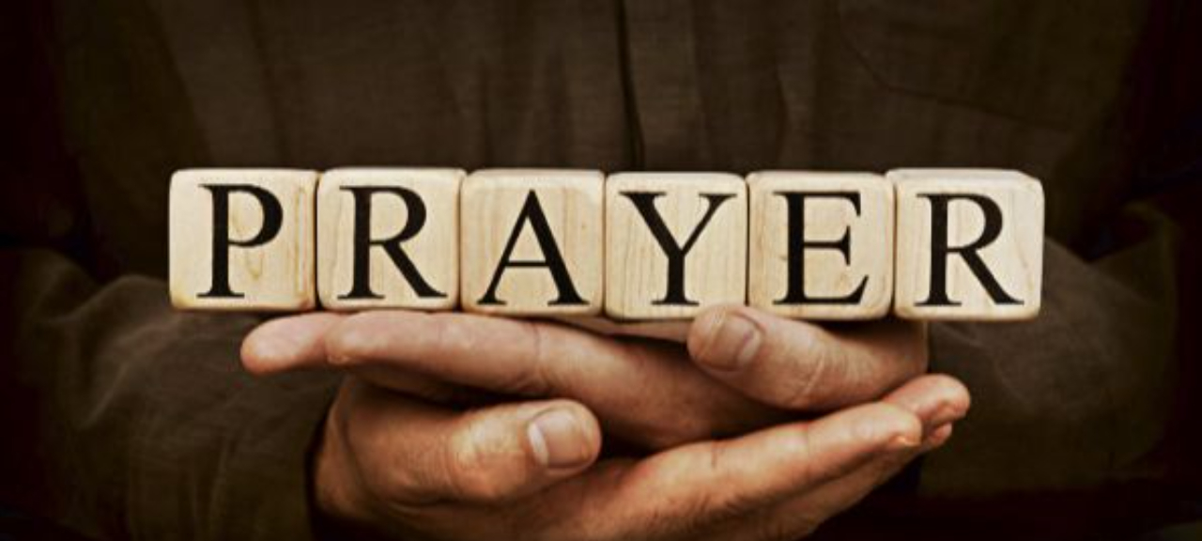
Pressing Through The Veil
By Means Of
Part 5 – Skeletons In The Closet
Praying Through And
Not Losing Your Peace
LifeGate Sermon
September 7th, 2025

Slide 2

The sermon you’re about to hear, is for all of us. It is about real people, it is not directed to any one person. It is for all of us. Many of those who hear this word today are on a journey – many in America are awakening to REALITY IN CHRIST – they are coming to the Lord with all their challenges, baggage, and back-stories. Jesus is faithful to continue His work in them. This is not a word of CONDEMNATION OR JUDGMENT – but of exhortation to not quit or give up and to be accountable and allow God to finish the change process in you: To unwrap your grave clothes and let you go free.

Slide 3

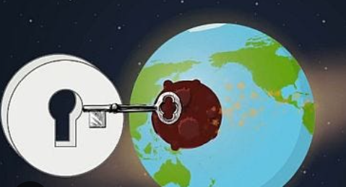
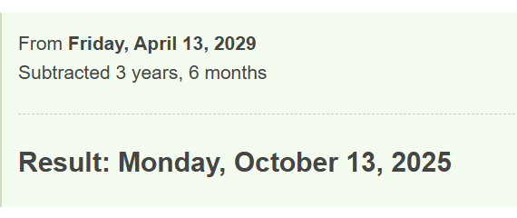
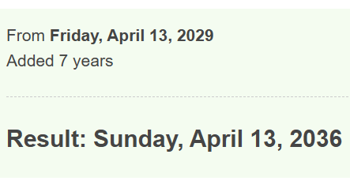
IS THE RAPTURE THIS September?
COINCIDES WITH JEWISH FEAST OF THE TABERNACLES

Slide 4
It Is Our CONTINUOUS Passion To See
These Promises Fulfilled
For the earth will be full of the knowledge of the LORD as the waters cover the sea. 10 In that day the Root of Jesse will stand as a banner for the peoples; the nations will rally to Him, and His place of rest will be glorious. Isaiah 11:9-10 (NIV) (Repeated – Habakkuk 2:14)
In the day of great slaughter, (1914-45 – World War 1 and 2 – 100 Million casualties) - when the towers fall (September 11), streams of water will flow on every high mountain and every lofty hill. 26 The moon (CHURCH) will shine like the sun (JESUS), and the sunlight (JESUS) will be seven times brighter, like the light of seven full days.
Isaiah 30:25-26 (NIV)
Behold, the days come, says the LORD, that the plowman shall overtake the reaper, and the treader of grapes him that sows seed; and the mountains shall drop sweet wine, and all the hills shall melt. Amos 9:13
I will shake all nations, and the desired of all nations will come, and I will fill this house with glory,' says the LORD Almighty. 'The glory of this present house will be greater than the glory of the former house,' says the LORD Almighty. 'And in this place I will grant peace,' declares the LORD Almighty." Haggai 2:7-9 (NIV)

Slide 5

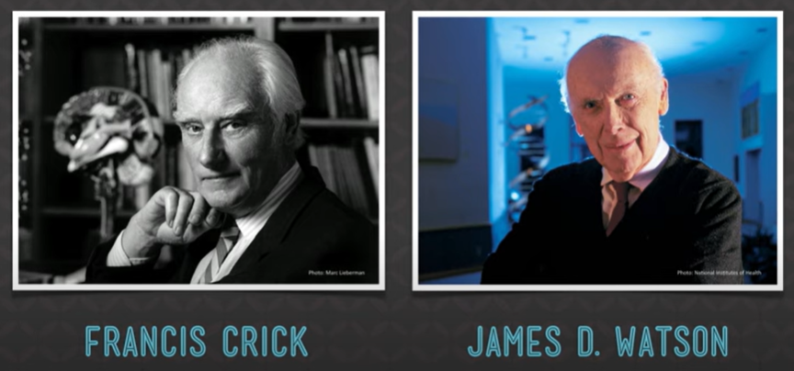
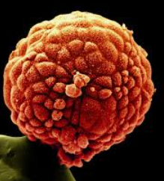
The Glory of God in Our Intricate Design
DNA
250 red blood cells
Head of a Pin

Slide 6
We Are Each Fearfully And Wonderfully Made
Christianity and Science / Apologetics
I praise you because I am fearfully and wonderfully (Marvelous – set apart) made; your works are wonderful, I know that full well. ¹⁵ My frame was not hidden from you when I was made in the secret place. When I was woven together (literal – needlework- embroidered) in the depths of the earth, ¹⁶ your eyes saw my unformed body. All the days ordained (fashioned) for me were written in your book before one of them came to be. ¹⁷ How precious to me are your thoughts, O God! How vast is the sum of them! ¹⁸ Were I to count them, they would outnumber the grains of sand. When I awake, I am still with you. Psalm 139:14-18
All things were created by Him and for Him. 17 He is before all things, and in Him all things hold together.
Colossians 1:16,17 (Literal – HAVE BEEN HELD TOGETHER)

Slide 7
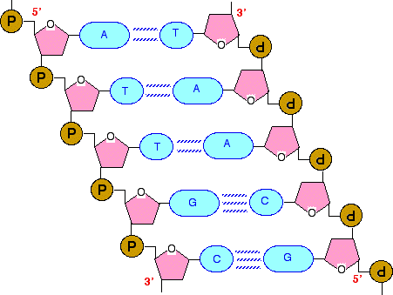
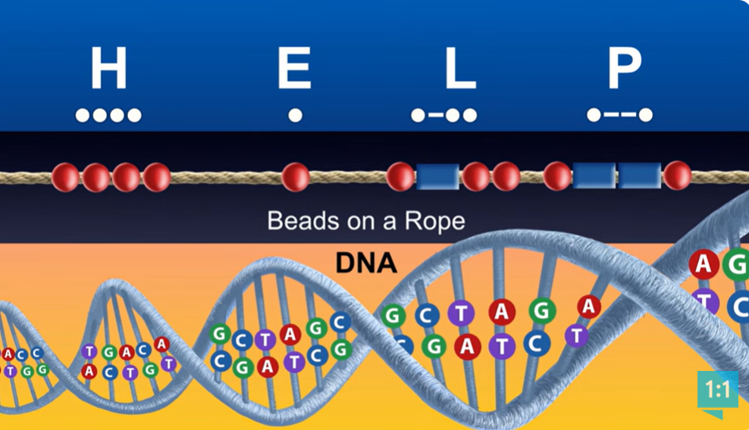
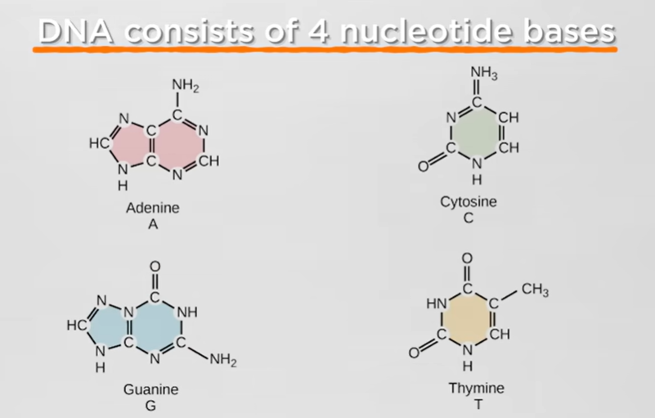

Slide 8
DNA
TRIVIA
How Many Cells Are In The Average Adult Human?
30 Trillion
How long is the DNA strand in a single cell?
6 Feet
How many Miles of DNA
Are in an adult human
34 Billion Miles
How Many Nucleotide Base Pairs are in the Human Gnome?
3 Billion
How much data is stored in the Human Gnome
850 Bibles
How Many Nucleotide Base Pairs are in Mosquito?
260 Million

Slide 9
James Five - Shows Us Our Privileges
of Faith If We Operate With Intentionality
¹³ Is any one of you in trouble? He should pray. Is anyone happy? Let him sing songs of praise. ¹⁴ Is any one of you sick? He should call the elders of the church to pray over him and anoint him with oil in the Name of the Lord. ¹⁵ And the prayer offered in faith will make the sick person well; the Lord will raise him up. If he has sinned, he will be forgiven. ¹⁶ Therefore confess your sins to each other and pray for each other so that you may be healed. The prayer of a righteous man is powerful and effective. ¹⁷ Elijah (Elisha) was a man just like us. He prayed earnestly that it would not rain, and it did not rain on the land for three and a half years. ¹⁸ Again he prayed, and the heavens gave rain, and the earth produced its crops. ¹⁹ My brothers, if one of you should wander from the truth and someone should bring him back, ²⁰ remember this: Whoever turns a sinner from the error of his way will save him from death and cover over a multitude of sins. James 5:11-20 (NIV)
GOD IS NOT A RESPECTER OF PERSONS – Act 10;Rom. 2: Eph. 6; Col. 3

Slide 10
My Thoughts On James Five
The thing that challenges me out of James chapter 5 is when James says Elijah was a man just like us and he prayed and it did not rain and then he prayed again and it did rain - This absolutely reveals that God shows no favoritism; God does not give somebody a leg up for breakthrough and we are called the starve spiritually and be strung along. James is basically saying if Old Testament Saints like Elijah and Elisha and David and Daniel and Moses could maintain a high level of intimacy and prevail in faith for breakthroughs under Old Testament Grace and ordinances how much more should New Testament Saints be able to maintain a level of intimacy and be prepared for good works in Christ! So if we need to pray that it doesn't rain we'll pray that it doesn't rain - if we need to pray that it does rain we can pray that it will rain if we need to restrain (by prayer and supplication) principalities that are wreaking havoc in our community then we pray those warfare prayers - if we need wisdom for decisions and outcomes that we believe will honor and glorify God then we pray for that wisdom and for those outcomes - if we need healing then we pray for that healing - if we need character change and greater fillings of the Spirit then we pray and expect for them - All those types of encounters occurred under Elijah and Elisha how much more should they occur under a New Testament Church humbly submitted to the Lordship of Jesus Christ.

Slide 11
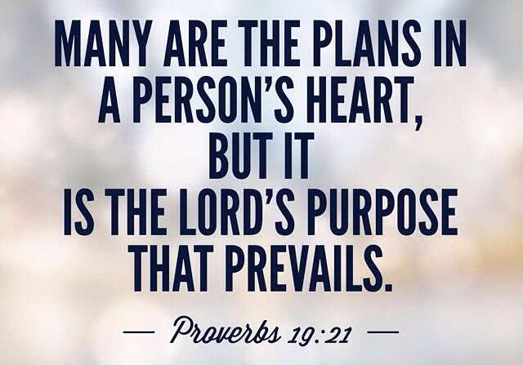


Detours – Cul-de-sacs – turn-arounds – Exit Ramps
“Prepare the way for the LORD; make straight in the wilderness a highway for our God. Isaiah 40:3 (NIV)
Primary purpose
In LIFE or a given season
Options
Primary Plan of God
For the gifts and calling of God are without repentance.
Romans 11:29 (KJV)

Slide 12

King Joram – Elisha And Skeletons
In The Closet (2 Kings chapters 3-7)
Joram son of Ahab became king of Israel in Samaria --, and he reigned twelve years. 2 He did evil in the eyes of the LORD, but not as his father and mother had done. He got rid of the sacred stone of Baal that his father had made. 3 Nevertheless he clung to the sins of Jeroboam son of Nebat, which he had caused Israel to commit; he did not turn away from them. 2 Kings 3:1-3 (NIV)
Exposes a ghastly human trait that many of God’s people do not overcome -

Slide 13
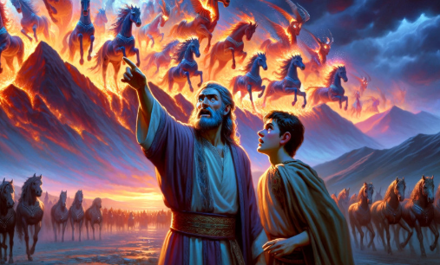
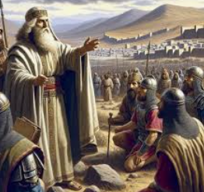
King Joram - From Supernatural Interventions
To Depression (2 Kings 6,7)
Elisha was given deep Intel about the King of Aram
Elisha Surrounded at Dothan by a large Battalion – Angel Armies show up and
"Oh, my lord, what shall we do?" the servant asked. 16 "Don't be afraid," the prophet answered. "Those who are with us are more than those who are with them."
As the enemy came down toward him, Elisha prayed to the LORD, "Strike these people with blindness." So He struck them with blindness, as Elisha had asked. 19 Elisha told them, "This is not the road and this is not the city. Follow me, and I will lead you to the man you are looking for." And he led them to Samaria.

Slide 14
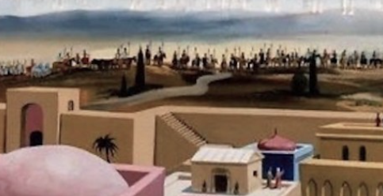
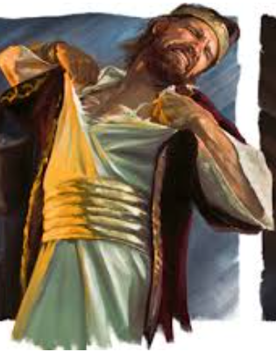
Frustrations Along the Way – Loses His Peace
The Army of the King of Aram that he left go five years ago is back laying siege to Samaria.
Some time later, Ben-Hadad king of Aram mobilized his entire army and marched up and laid siege to Samaria.
Famine lasts over two years and is so bad a donkey’s head cost over $100 and people resort to cannibalism
King Joram tore his robes when he heard about the cannibalism – and underneath was sack-cloth
Joram was praying for breakthrough – but he hits his breaking point - he let’s go of any agreement in faith with praying Elisha – and vows to kill him – hinting that he is responsible for the famine.

Slide 15
On The Verge of Victory
Joram Caves to Unbelief and Fear
(Joram) said, "May God deal with me, be it ever so severely, if the head of Elisha son of Shaphat remains on his shoulders today! And [the king] said, "This disaster is from the LORD. Why should I wait for the LORD any longer?" 2 Kings 6:31,33
Elisha said, "Hear the word of the LORD. This is what the LORD says: About this time tomorrow, a seah (seven quarts) of flour will sell for a shekel (1 dollar) and two seahs of barley for a shekel at the gate of Samaria." 2 The officer on whose arm the king was leaning said to the man of God, "Look, even if the LORD should open the floodgates of the heavens, could this happen?" "You will see it with your own eyes," answered Elisha, "but you will not eat any of it!" 2 Kings 7:1-2 (NIV)

Slide 16
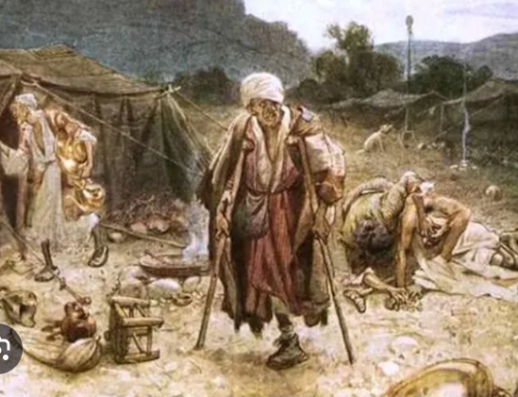
Intervention Comes
For The Remnant That Prayed Through
At dusk they got up and went to the camp of the Arameans. When they reached the edge of the camp, not a man was there, ⁶ for the Lord had caused the Arameans to hear the sound of chariots and horses and a great army, so that they said to one another, "Look, the king of Israel has hired the Hittite and Egyptian kings to attack us!" ⁷ So they got up and fled in the dusk and abandoned their tents and their horses and donkeys. They left the camp as it was and ran for their lives.
2 Kings 7:5-7 (NIV)
¹⁷ Now the king had put the officer on whose arm he leaned in charge of the gate, and the people trampled him in the gateway, and he died, just as the man of God had foretold when the king came down to his house. ¹⁸ It happened as the man of God had said to the king: "About this time tomorrow, a seah of flour will sell for a shekel and two seahs of barley for a shekel at the gate of Samaria." 2 Kings 7:17-18 (NIV)

Slide 17
Detours – Cul-de-sacs – turn-arounds – Exit Ramps
“Prepare the way for the LORD; make straight in the wilderness a highway for our God. Isaiah 40:3 (NIV)
Primary purpose
In LIFE or a given season
Options
Primary Plan of God
For the gifts and calling of God are without repentance.
Romans 11:29 (KJV)

Slide 18
King Joram Was Overcome
By These Three Detours
SPIRITUAL/ RELIGIOUS DETOUR– He compromised with his ungodly heritage – He never dealt with all the skeletons in his closets – God could not fully bless him the way He wanted
CULTURAL DETOUR– He adopted the ways of the worldly kings ahead of him – He could go through the motions – but he had no deep prayer life.
PERSONALITY DETOUR – He left his emotions and anger flair up because God was not coming through – HE LOST HIS PEACE - He had to perform for others – HE WAS LETTING THEM DOWN.

Slide 19
The Search Light Of The Holy Spirit
THE SKIMPING ON OBEDIENCE – BECAUSE WE SEE NO “RETURN ON INVESTMENT.”
(They are) saying, "When will the New Moon (TIME OF SPECIAL SEEKING) be over that we may sell grain, and the Sabbath be ended that we may market wheat?“ (GET BACK TO NORMAL) -- skimping the measure, boosting the price and cheating with dishonest scales, Amos 8:5 (NIV)
SEARCH ME OH GOD IN THIS HOUR – I NEED TO BE COMPLETELY ALIGNED WITH YOU – FORGIVE ME FOR “PINCHING HERE AND THERE” SKIMPING ON MY OBEDIENCE – BECAUSE I GET DISTRACTED AND LAZY AND WEARY IN WELL DOING. YOU DESERVE A FULLY ENGAGED BRIDE – NOT ONE THAT HAS OTHER INTERESTS.

Slide 20
The Highway That God Bulldozes
Through These Detours
And we know that in all things God works for the good of those who love Him, who have been called according to His purpose. Romans 8:28
Therefore, if anyone is in Christ, he is a new creation; the old has gone, the new has come! 2 Corinthians 5:17 (NIV)
Do not be anxious about anything, but in everything, by prayer and petition, with thanksgiving, present your requests to God. ⁷ And the peace of God, which transcends all understanding, will guard (garrison – fortify) your hearts and your minds in Christ Jesus. Philippians 4:6-7 (NIV)

Slide 21
Personality Detours - Why is It That?
Pioneers/ Mavericks are good strong leaders – but often become fiercely independent – as visionaries and usually don’t finish what they started
Survivors – look to protect themselves and others – but can over control everything in their life
Loners – are sensitive and aware of things others miss – but don’t share their gifts easily and are quick to sabotage relationships through insecurity.
Fighters – will risk more than anyone – but tend to have something to prove – and it is very difficult to build consensus because they wear others out.
Wounded warriors – are deeply empathetic towards others but are susceptible to enable others to keep their skeletons in their closets.
Builder/ Fixers/ Healers – are kind-hearted and practical but can be too mission focused instead people focused

Slide 22

God Is
For Revival/ Harvest
APPLICATION
It comes down to CHOICES to PARTNER with a supernatural God – ask HIM – TO MAKE A HIGHWAY through your detours and cul-de-sacs.
LET HIM OPEN THE CLOSETS OF YOUR HEART and get rid of the SKELETONS – i.e. hurt – wounds – addictions – fear – anxiety – worry – control – anger – that hinder the FULL BLESSING of God.
PRAY THROUGH – don’t quit on the edge of victory – because you’re frustrated with God – or your fellow intercessors
DON’T LOSE YOUR PEACE – cry out for Philippians chapter four to unfold the moment you start down that path.

