Slide 1

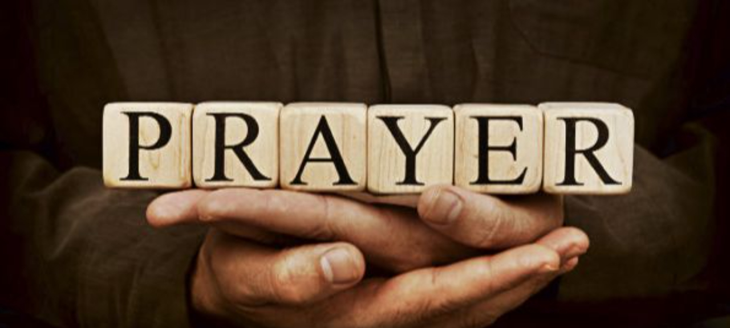
Pressing Through The Veil
By Means Of
Part 6 – Overcoming
Wounds And Personality Detours
LifeGate Sermon
September 14th, 2025

Slide 2
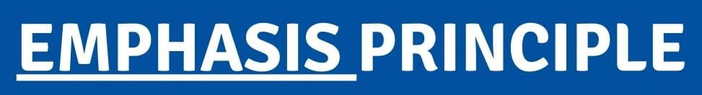
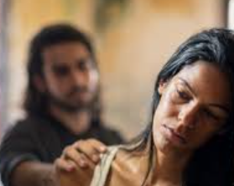

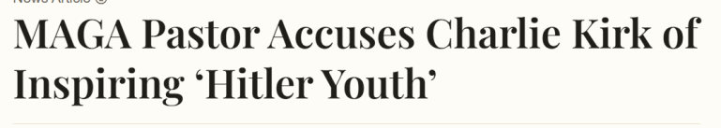

In situations – in Challenging Conversations – In Moments of crisis – in Watershed events
Balance can hinder us from learning
or become something to hide behind so we don’t take responsibility for what God is trying to change in us. (Ultimately we do want balance)
You need to be
Conciliatory
The Opponents of Judeo-Christian Values concerning:
VALUE AND ORIGIN OF LIFE
SEXUALITY
GOVERNMENT
IMMIGRATION/ INTER-CULTURAL (RACISM)
FINANCES/ TAXATION
No you need to Repent for creating demonic caricatures

Slide 3


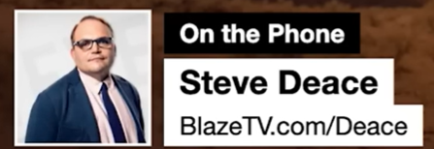
Hearts need to change
Strongholds need exposed
Tenderized – Sensitized and Softened - Emboldened
- Church - Godly men buried Stephen and mourned deeply for him.
The ungodly - But Saul began to destroy the church. Going from house to house, he dragged off men and women and put them in prison. ⁴ Those who had been scattered preached the word wherever they went. ⁵
God is Looking For An Apostolic People – Not Revengeful Servants

Slide 4
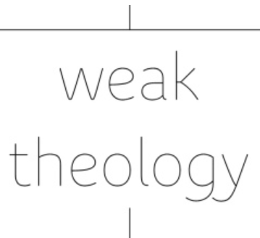
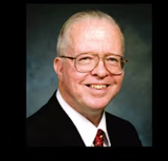
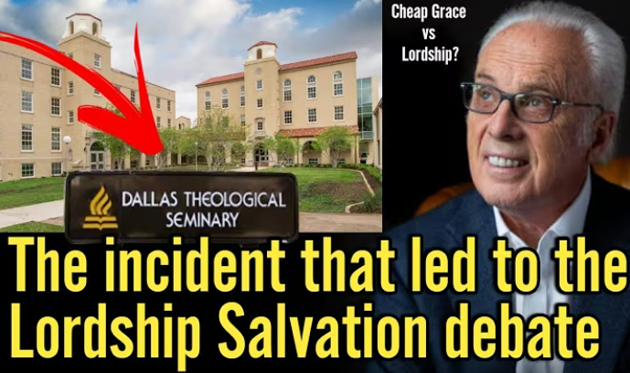

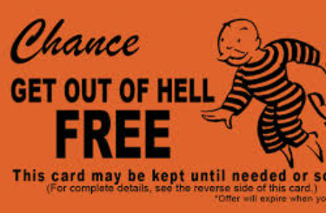
WHY ARE THERE SO MANY LITTLE FOXES IN THE VINEYARD TRYING TO RUIN THE HARVEST?
Zane Hodges
Missionary to
Mexico
Theology
John MacArthur
Passed Away July 14, 2025
And He said to them all, If any man will come after Me, let him deny himself, and take up his cross daily, and follow Me. ⁻⁻⁻⁻ . Luke 9:23 (KJV)
Salvation is More Than A One-Time Prayer
⁹ Because if you acknowledge and confess with your lips that Jesus is Lord and in your heart believe (adhere to, trust in, and rely on) that God raised Him from the dead, you will be saved. 10 For with the heart a person believes (adheres to, trusts in, and relies on Christ) and so is justified, and with the mouth he confesses (declares openly and speaks out freely about his faith) and confirms [his] salvation. Romans 10:9-10 (AMP)
Believe / Trust In Part Faith
Confessional/ Fruit Part Faith

Slide 5
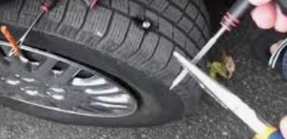
Why Is The Bride of Christ Being So Challenged
And Refined and Being Made to Grow Up?
Because The Father Wants A Bride For His Son That Lives Like His Son Did (1 John 2:6)
Therefore, if anyone is in Christ, he is a new creation; the old has gone, the new has come! 2 Corinthians 5:17
What Most Believers Don’t understand about this amazing promise - is that this promise is a SEED PROMISE that must grow.
How God anointed Jesus of Nazareth with the Holy Spirit and with power: Who went about doing good, and healing (to cure and make whole) all that were oppressed (to exercise power against) of the devil. Acts 10:38 (KJV)

Slide 6
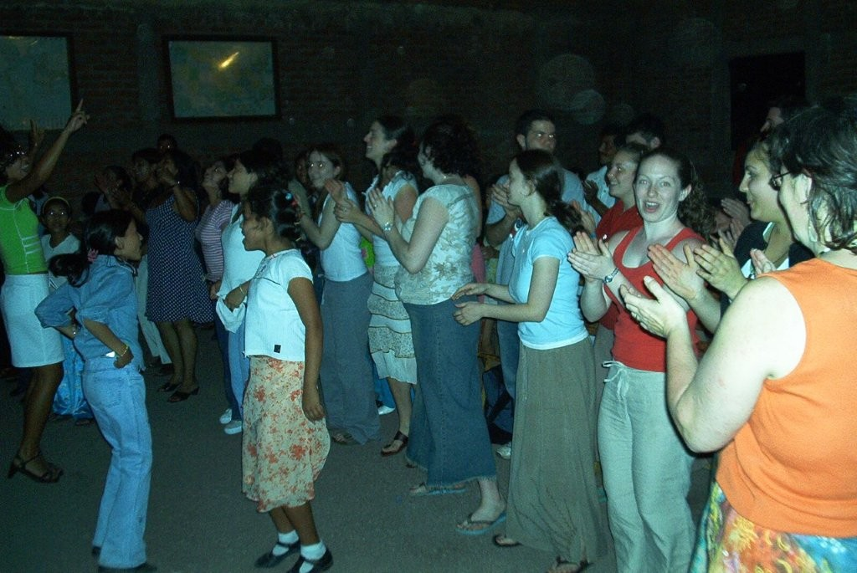
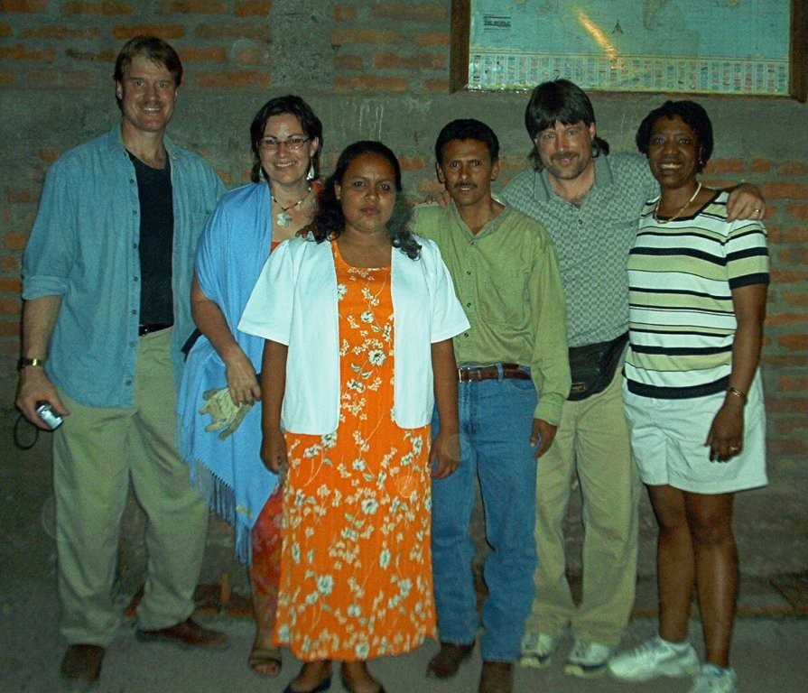

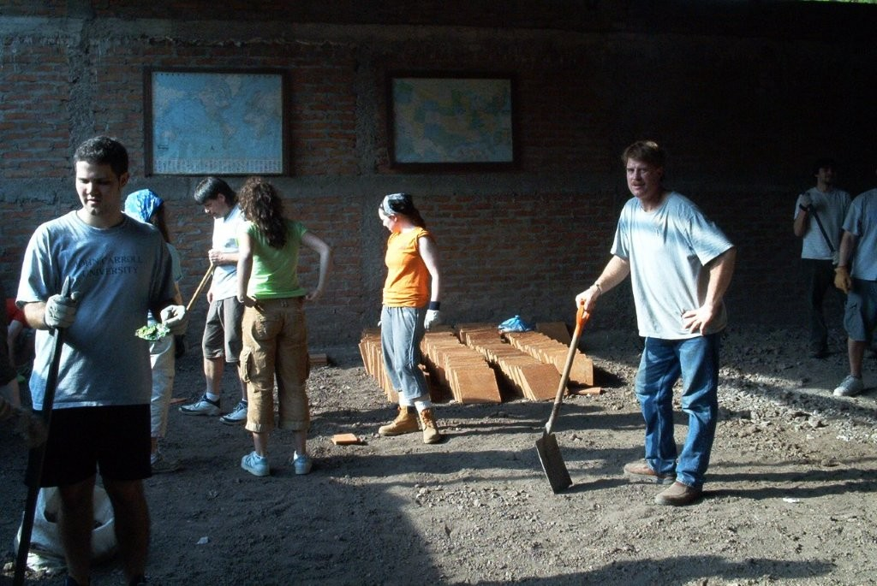
Remembering an Account Of God Stirring
20 Years Ago In Nicaragua In 2005

Slide 7


May the God of peace,
Who through the blood of the eternal covenant brought back from the dead our Lord Jesus, that great Shepherd of the sheep, ²¹
equip (thoroughly repair – adjust - complete – perfect) you with everything good (every grace you may need) for doing His will,
and may He work (cause and perform) in us what is pleasing (fully agreeable) to Him, through Jesus Christ,
to Whom be glory for ever and ever. Amen.
Hebrews 13:20-21 (NIV)

Slide 8

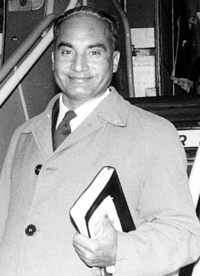
God is Bringing Us To A Place Where He Can – Return His Greater Glory In The Church
He was aware something was missing – He felt the futility of ministry – the Glory was not among the people.
Now to Him who is able to do immeasurably more than all we ask or imagine, according to His power that is at work within us, ²¹ to Him be glory in the church and in Christ Jesus throughout all generations, for ever and ever! Amen. Ephesians 3:20-21 (NIV)

Slide 9

We Have Authority As God Changes
Our Hearts and Heals Our Wounds
And Fills Us More and More with His Spirit of Glory
To Change The Atmosphere
“Victory is here – Be aware in your coming in and your going out – you have been given authority to change the atmosphere.” Shane Sheets

Slide 10

King Joram – Elisha And Skeletons
In The Closet (2 Kings chapters 3-7)
Joram son of Ahab became king of Israel in Samaria in the eighteenth year of Jehoshaphat king of Judah, and he reigned twelve years. ² He did evil in the eyes of the LORD, but not as his father and mother had done. He got rid of the sacred stone of Baal that his father had made. ³ Nevertheless he clung to the sins of Jeroboam son of Nebat, which he had caused Israel to commit; he did not turn away from them.
2 Kings 3:1-3 (NIV)

Slide 11


You Can’t Control Your
But because of the Gospel – Because of Jesus Christ – You can respond to HIM and allow HIM to repair – to restore and make whole what is broken – and REESTABLISH HIS ORIGINAL DESTINY FOR YOUR LIFE.

Slide 12
King Joram Was Overcome
By These Three Detours
SPIRITUAL/ RELIGIOUS DETOUR– He compromised with his ungodly heritage – He never dealt with all the skeletons in his closets – God could not fully bless him the way He wanted
CULTURAL DETOUR– He adopted the ways of the worldly kings ahead of him – He could go through the motions – but he had no deep prayer life.
PERSONALITY DETOUR – He left his emotions and anger flair up because God was not coming through – HE LOST HIS PEACE - He had to perform for others – HE WAS LETTING THEM DOWN.

Slide 13



Most People Don’t Realize They Still Carry
Insecurities and Wounds That Are Not Healed
Generational
Baggage
“It’s easier to raise strong Children than to fix broken men.” Frederick Douglass

Slide 14

Don’t Make This Into A Cookie Cutter
You Have To Discern Where Your
Wounding or Brokenness Came From
Did Adam have any Daddy Wounds?
But he became broken by a LIE he believed and acted upon.

Slide 15
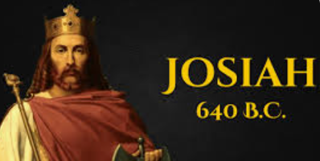
Transformative Nurturing By God Can Break The Daddy Wounds And Generational Baggage
Amon (Son of Manasseh) was twenty-two years old when he became king, and he reigned in Jerusalem two years. - ²⁰ He did evil in the eyes of the LORD, as his father Manasseh had done. ²¹ He walked in all the ways of his father; he worshiped the idols his father had worshiped, and bowed down to them. ²² He forsook the LORD, the God of his fathers, and did not walk in the way of the LORD. ²³ Amon's officials conspired against him and assassinated the king in his palace. ²⁴ Then the people of the land killed all who had plotted against King Amon, and they made Josiah his son king in his place. 2 Kings 21:19-24 (NIV)
YOU MAY HAVE GENERATIONAL BAGGAGE BUT YOU DON’T HAVE TO BE DEFINED BY IT
¹¹ When the king heard the words of the Book of the Law, he tore his robes. 2 Kings 22:11 (NIV)

Slide 16



Your
Examine (scrutinize) yourselves 2 Corinthians 13:5 (NIV)

Slide 17
Personality Detours -
Pioneers/ Mavericks are good strong leaders – but often become fiercely independent – are visionaries but usually don’t finish what they start
Survivors/ Protectors – are good at protecting themselves and others – but can over control everything in their life and those around them.
Loners/ Perfectionists – are sensitive and aware of things others miss – but don’t share their gifts easily and are quick to sabotage relationships through insecurity.
Fighters – will risk more than anyone else – but tend to have something to prove – and it is very difficult to build consensus because they wear others out.
Empathetic warriors – are deeply compassionate towards others but are susceptible to enable others to keep their skeletons in their closets.
Builder/ Fixers/ Healers – are kind-hearted and practical but can be too mission focused instead people focused

Slide 18
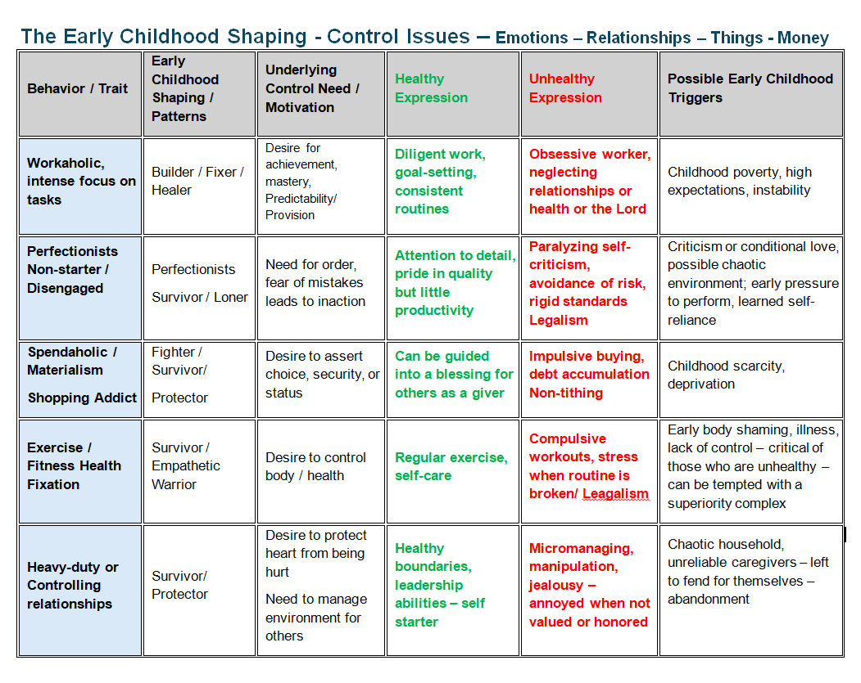

Slide 19
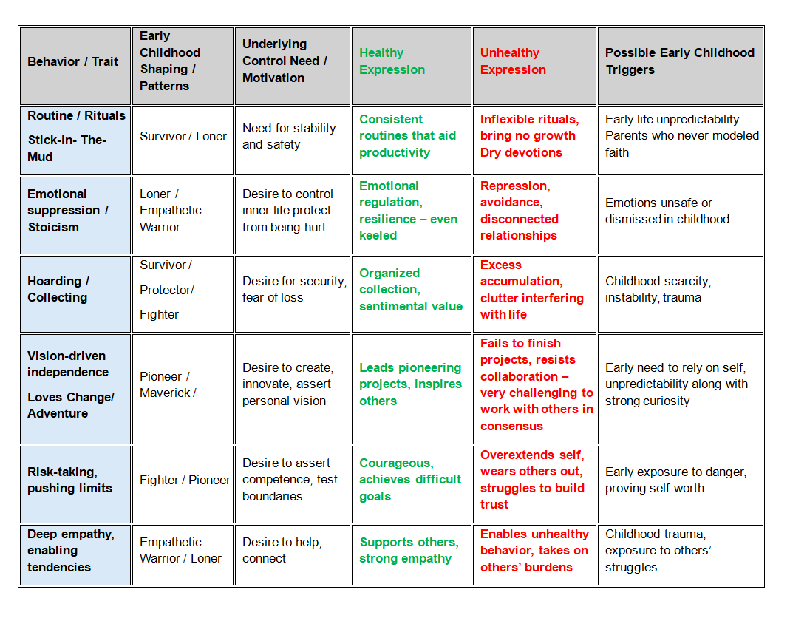

Slide 20

God Is Changing Us At The Deepest Levels
Iron sharpens iron; so a man sharpens the countenance of his friend.
Proverbs 27:17 (KJV)
God doesn’t want to just plug a couple holes in your heart – He wants to make you WHOLE!!!!
And the very God of peace sanctify you wholly (complete + uttermost) ; and I pray God your whole spirit and soul and body be preserved blameless unto the coming of our Lord Jesus Christ. ²⁴ Faithful is he that calls you, who also will do it. 1 Thessalonians 5:23-24 (KJV)
We are not teaching a works oriented life of RELIGION – we are teaching that every area in your life at salvation there is the SEED OF NEW CREATION IN YOU

Slide 21
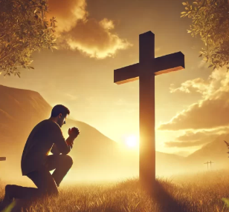
Humbling Ourselves Under God’s Mighty
Hand – Is Coming to the Foot of the Cross
This is where we get FORGIVENESS This is where we get PURIFIED/ and ALIGNED/ and HEALED
"God opposes the proud but gives grace to the humble." ⁶ Humble yourselves, therefore, under God's mighty hand, that he may lift you up in due time. ⁷ Cast all your anxiety on him because he cares for you. ⁸ Be self-controlled and alert. Your enemy the devil prowls around like a roaring lion looking for someone to devour. ⁹ Resist him, standing firm in the faith, because you know that your brothers throughout the world are undergoing the same kind of sufferings. 1 Peter 5:5-9 (NIV)

Slide 22

God Is
For Revival/ Harvest
APPLICATION
Humble yourself under God – to make you whole – to fix your leaks – to heal your wounds – to MAKE YOU LIKE JESUS
LET HIM OPEN THE CLOSETS OF YOUR HEART and get rid of the SKELETONS – i.e. hurt – wounds – addictions – fear – anxiety – worry – control – anger – that hinder the FULL BLESSING of God.
BE ACCOUNTABLE TO A CLOSE FRIEND– allow the Lord to link you with someone who will walk through your PERSONALITY TRANSPLANT

Slide 23


