Slide 1

Part 3 –
“Living A Life Of Praise And Thanksgiving”
LifeGate Sermon
November 23nd, 2025

Slide 2
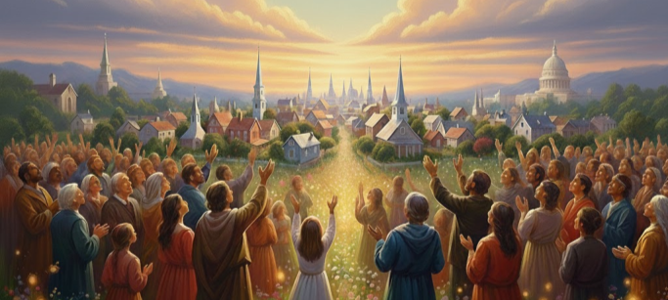
God Is Answering – But Sometimes We
Are Not Satisfied with the Margins He Gives
GOD IS SAYING – “I’VE BROUGHT YOU THIS FAR – WHY DON’T YOU TRUST ME THAT I WILL BRING YOU THROUGH.”

Slide 3
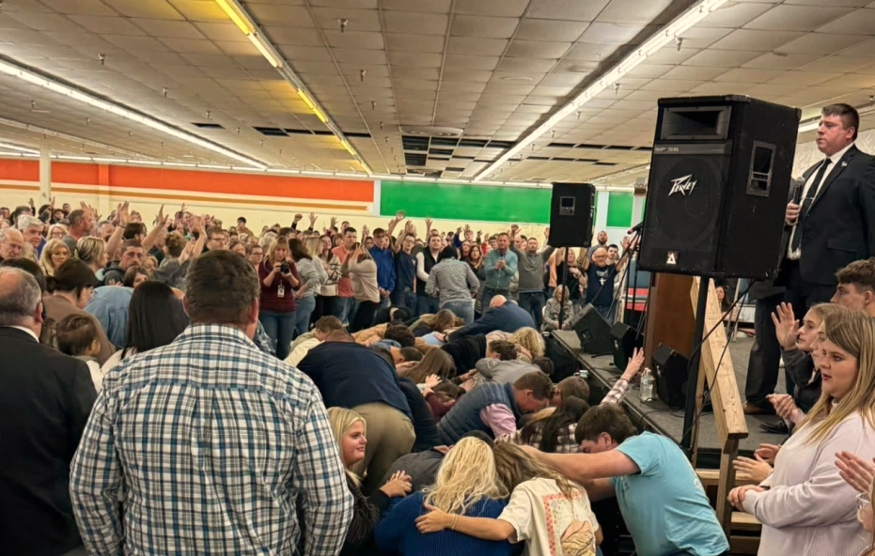
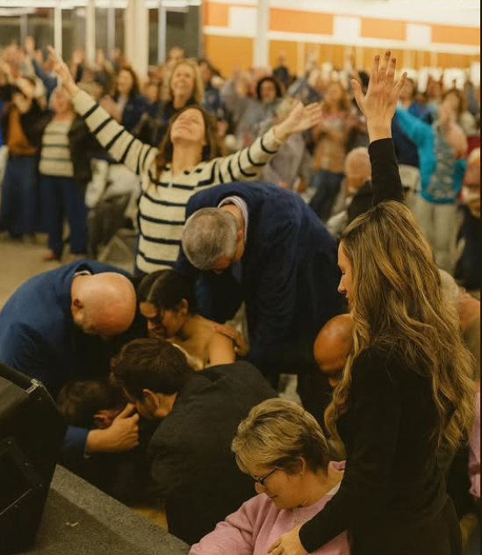
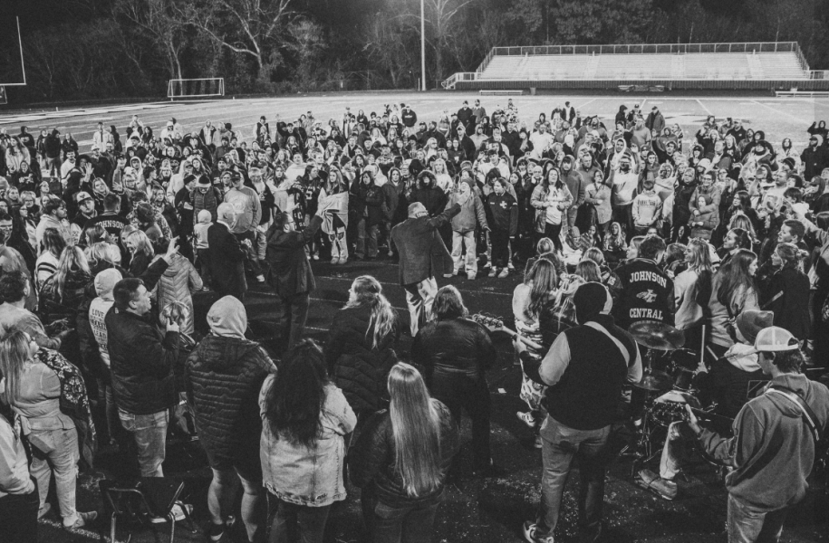
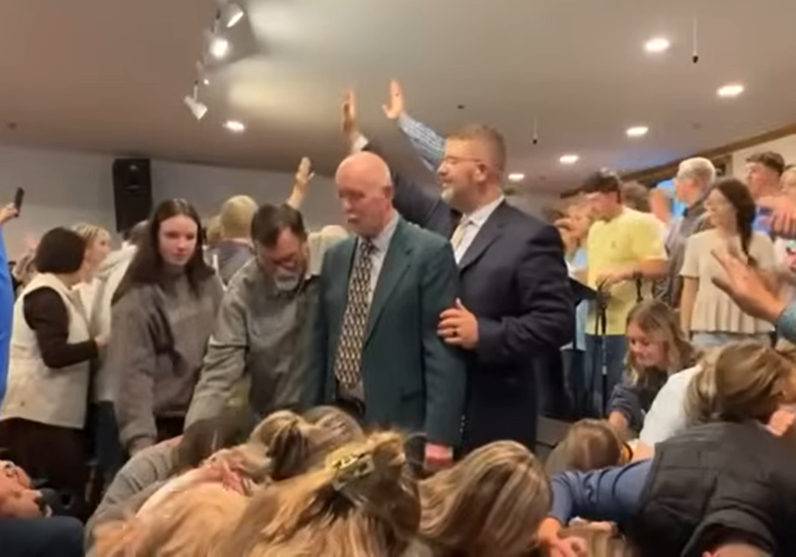
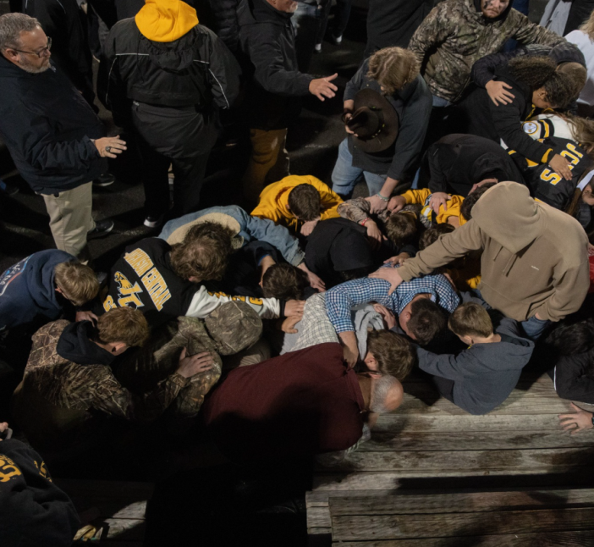

Slide 4
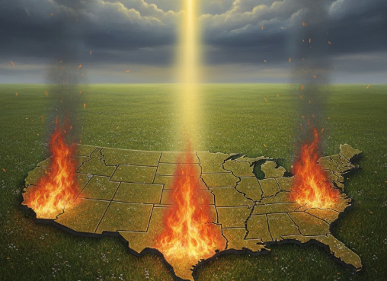
We Are So Grateful For God’s Mercy
On Our Undeserving Nation

Slide 5
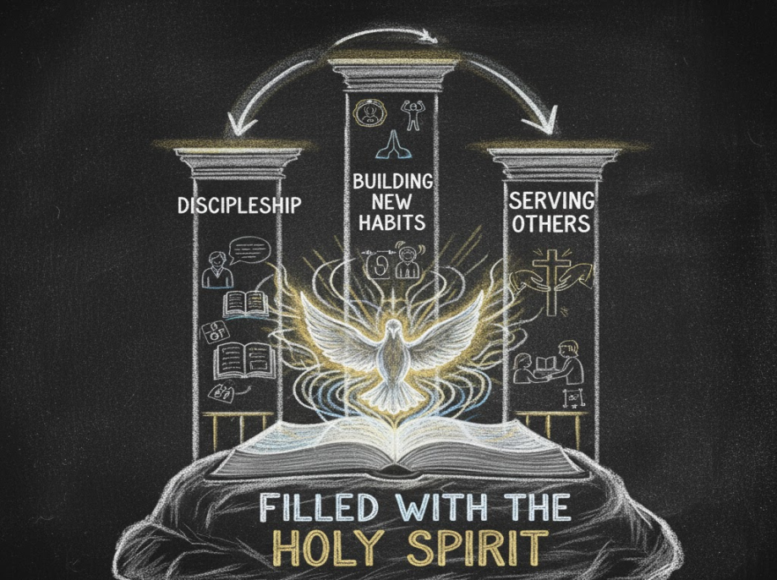
Teaching Series Themes
Hebrews 10:25
Therefore go and make disciples of all nations, baptizing them in the name of the Father and of the Son and of the Holy Spirit, Matthew 28:19 (NIV)
Serve wholeheartedly, as if you were serving the Lord, not men, Ephesians 6:7 (NIV)
Basics
Ephesians 5:18

Slide 6

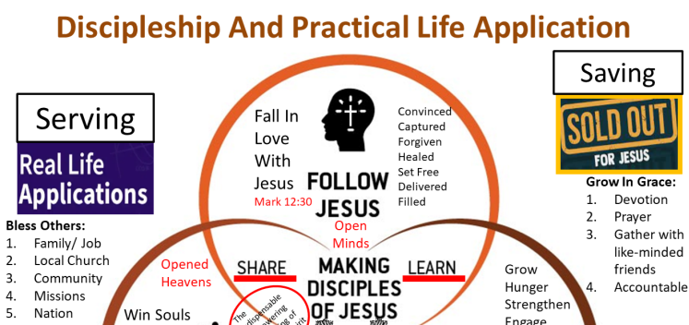
GRAPHIC ON DIFFERENT PRACTICAL
APPLICATIONS OF THE GOSPEL
Thankful

Slide 7
How Would You Rank America’s
Least Exercised Virtues?
(What Are We Weakest At?)
5
Stewardship – Taking care of what we have
6
Hard work – Being disciplined to be fruitful in labor
3
Servanthood – Wanting to bless others first
4
Thankfulness – Being grateful/ not complaining
7
Honesty – Telling the truth even when it hurts
2
Self-Control – Delaying gratification for God’s will
1
Loving God and others – “Golden rule”

Slide 8

LifeGate Wants To Focus
Through Revival and Prayer
On These Three Strategic Virtues

Slide 9


LifeGate Promotes A Family-Friendly
Environment – But The LifeGate
Church is Not Your Own Kitchen

Slide 10
I’ve Always Struggled with How To Be
Thankful in all Circumstances
Do not be anxious about anything, but in everything, by prayer and petition, with thanksgiving, present your requests to God. ⁷ And the peace of God, which transcends all understanding, will guard your hearts and your minds in Christ Jesus. Philippians 4:6-7 (NIV)
Speak to one another with psalms, hymns and spiritual songs. Sing and make music in your heart to the Lord, ²⁰ always giving thanks to God the Father for everything, in the name of our Lord Jesus Christ. Ephesians 5:19-20 (NIV)
⁷ Rooted and built up in Him, and stablished in the faith, as ye have been taught, abounding therein with thanksgiving. Colossians 2:7 (KJV)
Be joyful always; ¹⁷ pray continually; ¹⁸ give thanks (EUCHARISTEO – to express gratitude and be grateful) in all circumstances, for this is God's will for you in Christ Jesus. 1 Thessalonians 5:16-18 (NIV)

Slide 11
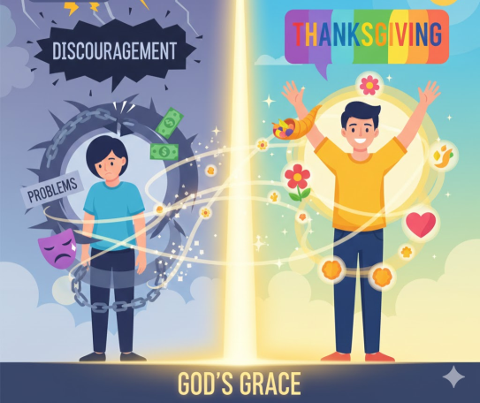

Then I Realized That Pre-emptive Praise (For Knowing God Has Heard My Prayers) And Is ALREADY WORKING on My Behalf- Sets me free from frustration and anxiety
After consulting the people, Jehoshaphat appointed men to sing to the LORD and to praise Him for the splendor of His holiness as they went out at the head of the army, saying: "Give thanks to the LORD, for his love endures forever." ²² As they began to sing and praise, the LORD set ambushes against the men of Ammon and Moab and Mount Seir who were invading Judah, and they were defeated. 2 Chronicles 20:21-22 (NIV)

Slide 12

Thanksgiving

Slide 13
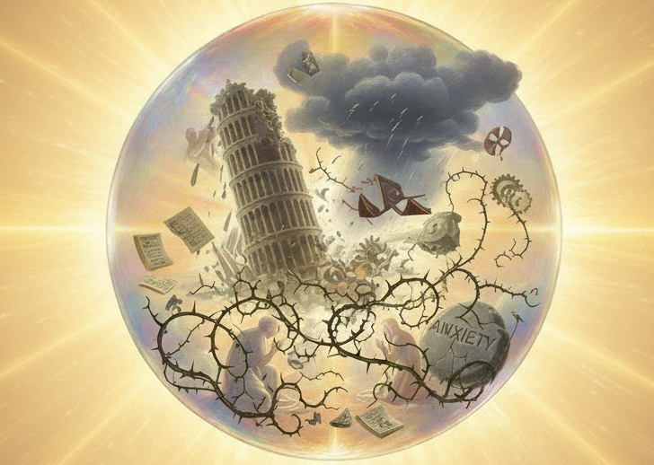
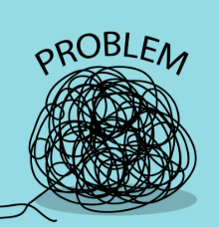
Praise For His working Things Out
Faith In The Lord
To Overcome
Thanksgiving
Praise For His working Things Out
Faith In The Lord
To Overcome
Do not be anxious about anything, but in everything, by prayer and petition, with thanksgiving, present your requests to God. ⁷ And the peace of God, which transcends all understanding, will guard your hearts and your minds in Christ Jesus. Philippians 4:6-7 (NIV)

Slide 14
THIS IS MY STRATEGY
TO TAKE BURDENS
PROBLEMS AND TURN THEM
INTO PRAISE
“LORD FATHER I PRAISE YOU - YOU ARE WORKING IN THIS IMPOSSIBILITY WITH MAN AND THAT YOU ARE ABOVE THIS MOUNTAIN AND PROBLEM - THAT BY FAITH, IN THE NAME OF JESUS - I CAST DOWN ALL THE GIANTS OF HINDRANCE – RESISTANCE AND INTIMIDATION AND FEAR – AND SPIRITUAL AND EARTHLY NEEDS CONCERNING PREVAILING FOR – “ fill in the blank”

Slide 15
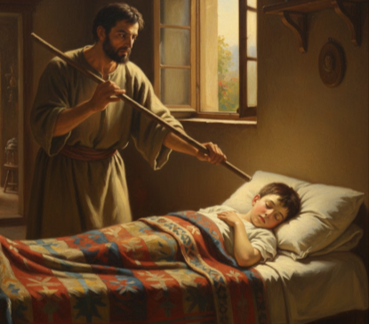
2 Kings Chapter 4 Miracle
Then he (Elisha) said to Gehazi, Gird up your loins, and take my staff in your hand, and go your way: if thou meet any man, greet him not; and if any greets you, answer him not again: and lay my staff upon the face of the child.
2 Kings 4:29

Slide 16
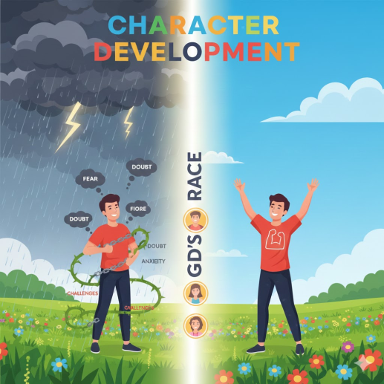
“SO LORD HOW ARE YOU USING THIS TO MAKE ME MORE LIKE YOU – OR TO BRING YOURSELF GLORY?”
God’s Grace In The Trial
Sing joyfully to the LORD, you righteous; it is fitting for the upright to praise Him. Psalm 33:1 (NIV)

Slide 17
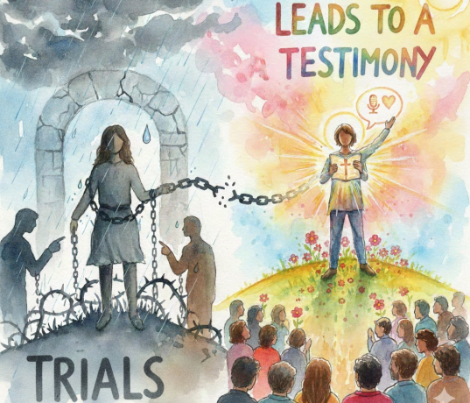
THE COUNTER-INTUITIVE KINGDOM OF GOD
“You will be brought before kings and governors, and all on account of My name. 13 This will result in your being witnesses to them.
Luke 21:12-13 (NIV)

Slide 18
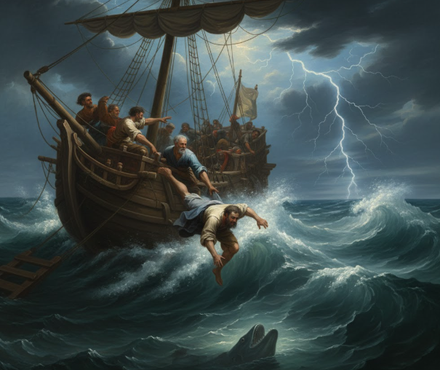
Jonah Is One of the Hardest Character
Studies in all of Scripture

Slide 19
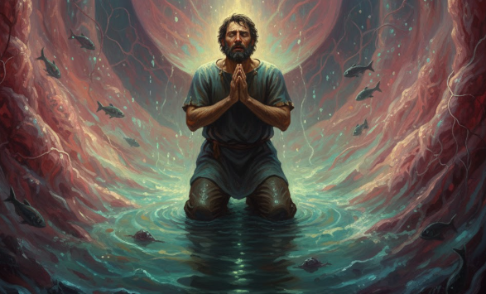
Jonah Was Not Thankful For
The Value of His Salvation – until
But I, with a song of thanksgiving, will sacrifice to You. What I have vowed I will make good. Salvation comes from the LORD." Jonah 2:9 (NIV)

Slide 20
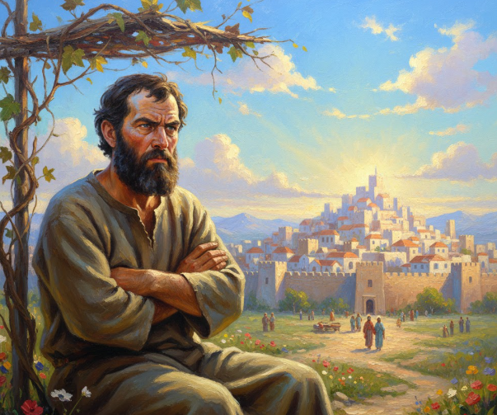
But He Remained Annoyed At
The Pagans Outside of God’s Kingdom

Slide 21
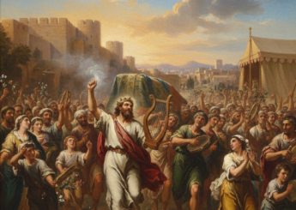
David Taught Israel To Praise And Give Thanks
Give thanks to the LORD, for He is good; His love endures forever. 35 Cry out, "Save us, O God our Savior; gather us and deliver us from the nations, that we may give thanks to Your holy Name, that we may glory in Your praise." 36 Praise be to the LORD, the God of Israel, from everlasting to everlasting. Then all the people said "Amen" and "Praise the LORD." 1 Chronicles 16:34-36 (NIV)

Slide 22
BEING THANKFUL FOR OUR SALVATION
Being THANKFUL for being saved from a Christ-less eternity – from separation in hell
Being THANKFUL for being saved from a life of endless sorrows and bondage and LONELINESS
Being THANKFUL for being saved from the GRIP OF SIN – SATAN and the WORLD
Being THANKFUL for being FORGIVEN – CLEANSED – FREED - by the blood of Jesus Christ – brought into SALVATION through God
Being THANKFUL for being ADOPTED into the BELOVED – brought into FELLOWSHIP with God.
Being THANKFUL for being PROVIDED FOR by the RICHES THAT ARE IN CHRIST JESUS – Brought into FULLNESS in God.

Slide 23
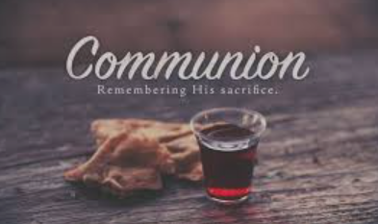
Lay down our Sins- Fears – Anxieties – Worries – Challenges - Sickness - at the cross – HE PAID FOR IT ALL – (Why carry something He already broke off of you or is working out for you?)
Take the “cup of thanksgiving”

Slide 24
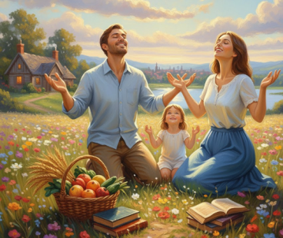
God Bringing Us Through And Supplying
Our Needs So We can Be Generous Leads To Us
and Others We Bless Being Thankful to God
Now He who supplies seed to the sower and bread for food will also supply and increase your store of seed and will enlarge the harvest of your righteousness. ¹¹ You will be made rich in every way so that you can be generous on every occasion, and through us your generosity will result in thanksgiving to God. 2 Corinthians 9:10-11 (NIV)

Slide 25
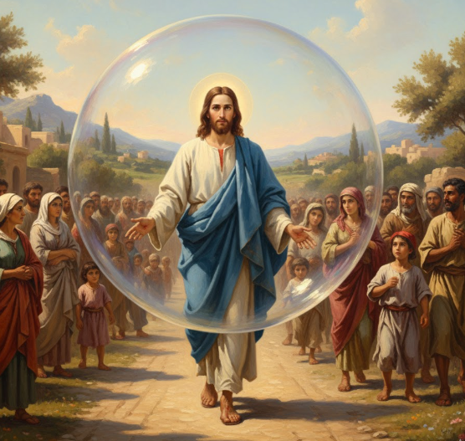
What If Jesus Came To Earth –
But Not The “Whole Way”
For we do not have a high priest who is unable to sympathize with our weaknesses, but we have one who has been tempted in every way, just as we are--yet was without sin. Hebrews 4:15 (NIV)

