Slide 1

Part 4 –
“Living A Life Of Contentment
and Repenting For Giving In
To The Idolatrous Culture of America”
LifeGate Sermon
December 7, 2025

Slide 2





Slide 3

How Do We Model and Teach
Contentedness During The Consumer Craziness of Christmas?
And be not conformed (TO BE FASHIONED IN IDENTICAL RESEMBLANCE) to this world: but be ye transformed by the renewing of your mind, that you may prove what is that good, and acceptable, and perfect, will of God. Romans 12:2 (KJV)

Slide 4



This Sermon is About Biblical Counsel
Not
Some of you have made large financial decisions and are attempting to let God lead in your finances
THIS SERMON IS ABOUT
CHANGING OUR
CONSUMER HABITS BUILT THROUGH A FALLEN
CULTURE AND POOR MODELING
FROM OUR CHILDHOODS

Slide 5


LifeGate Will Disciple Others
Through Revival and Prayer
These Three Strategic Virtues
Through Overcoming Our Idolatrous Culture

Slide 6



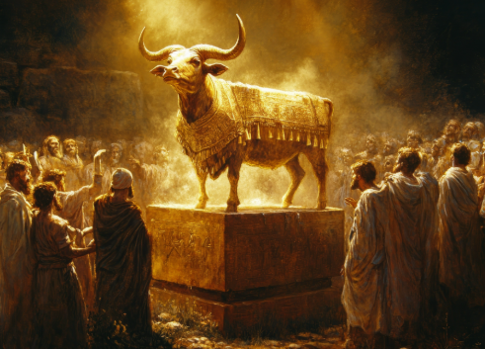
Three Particular Realms
Get Dicey Regarding Discipleship
1
Finances
2
3
Parenting
Idolatrous Culture

Slide 7

Teaching Series Themes
Hebrews 10:25
Therefore go and make disciples of all nations, baptizing them in the name of the Father and of the Son and of the Holy Spirit, Matthew 28:19 (NIV)
Serve wholeheartedly, as if you were serving the Lord, not men, Ephesians 6:7 (NIV)
Basics
Ephesians 5:18

Slide 8

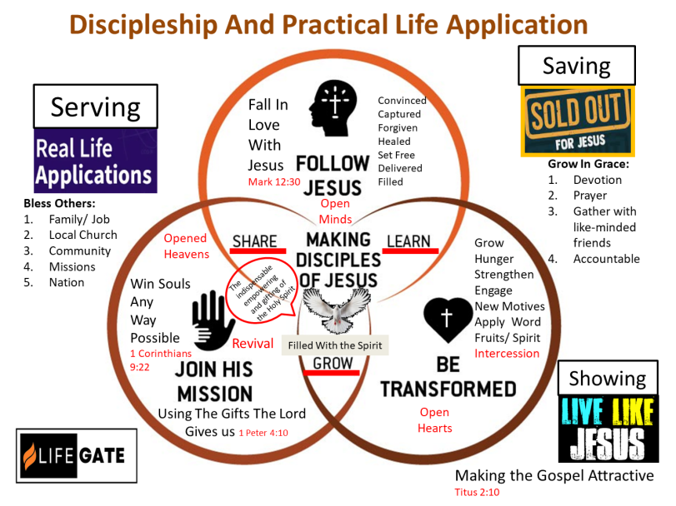
GRAPHIC ON DIFFERENT PRACTICAL
APPLICATIONS OF THE GOSPEL

Slide 9
Jesus Taught Us Not to Worry
And Run After the Things of the World.
²⁵ "Therefore I tell you, do not worry about your life, what you will eat or drink; or about your body, what you will wear. Is not life more important than food, and the body more important than clothes? ²⁶ Look at the birds of the air; they do not sow or reap or store away in barns, and yet your heavenly Father feeds them. Are you not much more valuable than they? ²⁷ Who of you by worrying can add a single hour to his life? ²⁸ "And why do you worry about clothes? See how the lilies of the field grow. They do not labor or spin. ²⁹ Yet I tell you that not even Solomon in all his splendor was dressed like one of these. ³⁰ If that is how God clothes the grass of the field, which is here today and tomorrow is thrown into the fire, will He not much more clothe you, O you of little faith? ³¹ So do not worry, saying, 'What shall we eat?' or 'What shall we drink?' or 'What shall we wear?' ³² For the pagans run after (demand, crave, seek after) all these things, and your heavenly Father knows that you need them. ³³ But seek first His kingdom and his righteousness, and all these things will be given to you as well. ³⁴ Therefore do not worry about tomorrow, for tomorrow will worry about itself. Each day has enough trouble of its own. Matthew 6:25-34 (NIV)
"Be careful, or your hearts will be weighed down with dissipation, drunkenness and the anxieties of life, and that day will close on you unexpectedly like a trap. Luke 21:34 (NIV)

Slide 10
We Are So Grateful For God’s Blessings
He Calls For Us To Be Content
I know what it is to be in need, and I know what it is to have plenty. I have learned the secret of being content in any and every situation, whether well fed or hungry, whether living in plenty or in want. 13 I can do everything through him who gives me strength. Philippians 4:12-13 (NIV)
But if we have food and clothing, we will be content with that. 1 Timothy 6:8 (NIV)
Keep your lives free from the love of money and be content with what you have, because God has said, "Never will I leave you; never will I forsake you." Hebrews 13:5 (NIV)

Slide 11








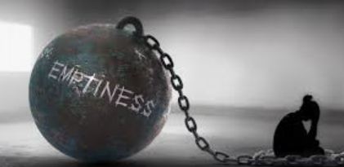

A Powerful Word Picture
CONTENT – comes from ARK- EH- OE - through the idea of raising a barrier - hedge; properly to ward off, i.e. - to avail:-to be content, to have enough

Slide 12
What Is The Idolatrous Culture
That We Live In – And Why Is It Addictive?
After this I saw another angel coming down from heaven. He had great authority, and the earth was illuminated by his splendor. ² With a mighty voice he shouted: "Fallen! Fallen is Babylon the Great! She has become a home for demons and a haunt for every evil spirit, a haunt for every unclean and detestable bird. ³ For all the nations have drunk the maddening wine of her adulteries. The kings of the earth committed adultery with her, and the merchants of the earth grew rich from her excessive luxuries." ⁴ Then I heard another voice from heaven say: "Come out of her, my people, so that you will not share in her sins, so that you will not receive any of her plagues; Revelation 18:1-4 (NIV)
1. Culture is a huge FAMILIAR vector for demonic deception and addiction – you GROW UP IN IT – it inoculates you.
2. Culture is going to allure through most intense PLEASURES and passions/ mainly sexual, chemical, and financial.
3. Culture is based on CONSUMING MORE AND MORE – never enough – the merchants will always lure you in for more.

Slide 13

“I set a trap for you, O Babylon, and you were caught before you knew it; you were found and captured because you opposed the LORD. ²⁵ The LORD has opened His arsenal and brought out the weapons of His wrath, for the Sovereign LORD Almighty has work to do in the land of (Babylon).” Jeremiah 50:24-25 (NIV)

Slide 14

How Does God Set A Trap?

Slide 15
THERE IS THIS TARRYING - AN INVITATIONAL GLORY IN THE EARTH RIGHT NOW - WHERE THE LORD IS DRAWING US PAST THIS COLOSSAL DISTRACTION CALLED THE “MISTRESS OF IDOLATROUS CULTURE” – THE ENDLESS RABBIT TRAILS OF DISTRACTION AND PLEASURE THAT DAILY SEEK YOUR AFFECTIONS.
"Everything is permissible for me"--but not everything is beneficial (EXPEDIENT – GIVES THE ADVANTAGE) . "Everything is permissible for me"--but I will not be mastered (BROUGHT UNDER THE POWER) by anything. 1 Corinthians 6:12 (NIV)
People who want to get rich fall into temptation and a trap and into many foolish and harmful desires that plunge men into ruin and destruction. ¹⁰ For the love of money is a root of all kinds of evil. Some people, eager for money, have wandered from the faith and pierced themselves with many griefs.
1 Timothy 6:9-10 (NIV)

Slide 16
Biblical Perspective To Overcome
The Pull Of The Idolatrous Culture
What I mean, brothers, is that the time is short. From now --- those who buy something, as if it were not theirs to keep; ³¹ those who use the things of the world, as if not engrossed in them. For this world in its present form is passing away.
1 Corinthians 7:29-31 (NIV)
I am saying this for your own good, not to restrict you, but that you may live in a right way in undivided devotion to the Lord. 1 Corinthians 7:35 (NIV)
Do not love the world or anything in the world. If anyone loves the world, the love of the Father is not in him. ¹⁶ For everything in the world--the cravings of sinful man, the lust of his eyes and the boasting of what he has and does--comes not from the Father but from the world. ¹⁷ The world and its desires pass away, but the man who does the will of God lives forever.
1 John 2:15-17 (NIV)

Slide 17
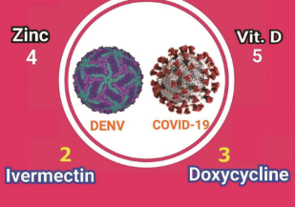


A Powerful Medical Analogy
Zinc is the “kill shot – that attacks the Virus
And my God will meet all your needs according to his glorious riches in Christ Jesus. Philippians 4:19 (NIV)
Ivermectin
Opens The
The vectors
To Attack the Virus
Thanksgiving
Opens The
vectors
CONTENTMENT
Kills the Virus

Slide 18
So How Do We Model
To Our Children And This Generation
A Life of Contentment?
We need to START THINKING BIBLICALLY ABOUT FINANCES AND RESOURCES AND POSSESSIONS– and how you teach yourself to STEWARD – TO SAVE - TO WAIT- TO MAXIMIZE SAVINGS - to overcome the pull of endless pursuits of MORE STUFF
LIVE WITH GRATITUDE – LIVE WITH CONTENTMENT.
Recognize your tendencies – WHY AM I A CONTINUOUS SPENDER - - is it a stronghold – even from your childhood - BECOME ACCOUNTABLE.
Be able to SAVE AND DELAY a purchases –
SIMPLIFY = live with less – look for ways to bless others

Slide 19
WHAT ABOUT BEING
CONTENT AND HAVING
YOUR FAMILY BE CONTENT
We take care of the things we have
You don’t need more to be happy
We are blessed with what we have
Take on a missionary or local ministry and make them a gift for the kids to give toward.

Slide 20
THE COUNTER-CULTURE KINGDOM OF GOD
FOR WHAT SHOULD MEN AND WOMEN LIVE?
WHAT IS OUR MAIN MISSION?
IS IT OUR ONLY PURPOSE TO SPEND AND BE SPENT?
THE FALLEN IDOLATROUS SYSTEM WANTS MECHANICAL CLUELESS PEOPLE WHO SERVE ITS INTEREST
IT HAS NO CONCERN FOR ANYTHING INVISIBLE AND ETERNAL OR HOLY
THIS LIFE IS VERY TEMPORARY – ONLY WHAT WE DO FOR THE LORD COUNTS
GOD IS LOOKING FOR A PEOPLE THAT ARE “IN THE WORLD AND NOT OF IT ” (John 15:19)

Slide 21
There’s A Phrase We Don’t
Allow To Hold Us In Limitation
“Oh, I’ve already done that – I don’t need to do that again.”
Being Filled With the Holy Spirit
Confession, Repentance
Breaking Soul-Ties

Slide 22
Breaking Soul-ties And
Our Affinity With Constant Consumeristic Living
Do you not know that he who unites himself with a prostitute (Idolatrous culture) is one with her in body? For it is said, "The two will become one flesh." ¹⁷ But he who unites himself with the Lord is one with Him in spirit 1 Corinthians 6:16, 17
LORD I REPENT OF - AND ASK YOU TO CUT OFF THE ROOTS OF:
LOVE OF MONEY AND POSSESSIONS/ HOARDING/ LACK OF STEWARDSHIP AND TITHING/ SHOPLIFTING/ PETTY THEFT/ UNTHANKFULNESS
LOVE OF COMFORT/ PLEASURE-SEEKING/ LOVE OF ENTERTAINMENT/ OVER EATING/ LACK OF FASTING

Slide 23

Close In Prayer
And Further Ministry

