Slide 1

Part 5 –
“Hidden In Plain Sight”
LifeGate Christmas Sermon
December 21, 2025

Slide 2
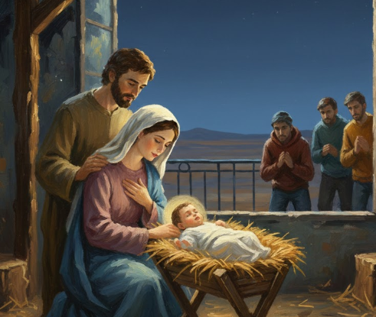
READING OF
CHRISTMAS STORY

Slide 3
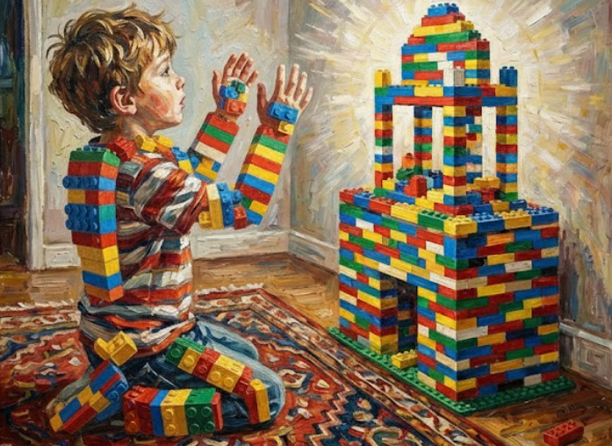
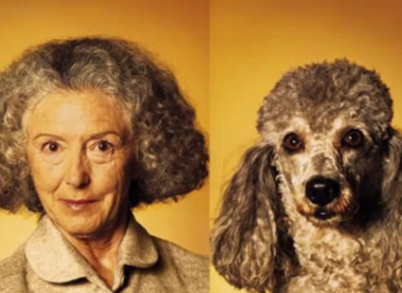
The idols of the pagan nations are silver and gold, made by the hands of men. ¹⁶ They have mouths, but cannot speak, eyes, but they cannot see; ¹⁷ they have ears, but cannot hear, nor is there breath in their mouths. ¹⁸ Those who make them will be like them, Psalm 115:15-18

Slide 4
Memory Verse
So then faith comes by hearing, and hearing by the Word of God. Romans 10:17 (KJV)DL

Slide 5

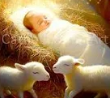
Thanks be unto God for His unspeakable (INDESCRIBABLE) Gift. 2 Corinthians 9:15
Yet to all who received Him, to those who believed (IN HIM RELATIONALLY) in His name, He gave the right to become children of God-- 13 children born not of natural descent, nor of human decision or a husband's will, but born of God. John 1:12-13 (NIV)

Slide 6

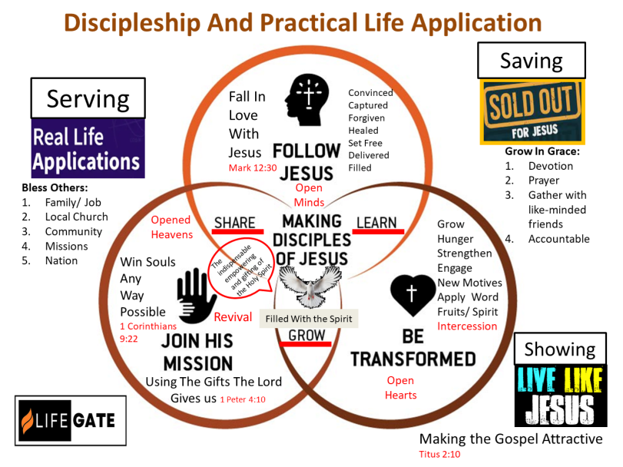
GRAPHIC ON DIFFERENT PRACTICAL
APPLICATIONS OF THE GOSPEL

Slide 7

A Little Illustration – Stirring To Set Up The Awe Of God In Our Lives
LifeGate Is a
Pro-Science –
Pro – Intelligent Design Church.
Pro-Life
God made all the laws of physics, laws of biology, and every universal constant from gravity to the speed of light.

Slide 8
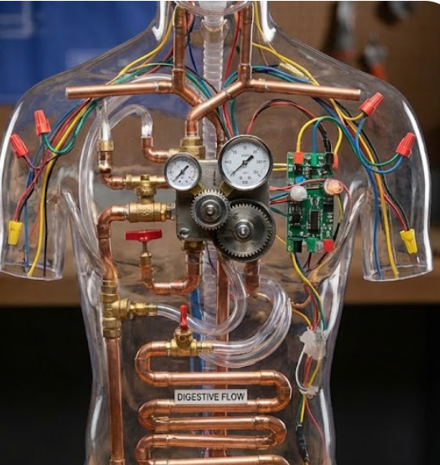
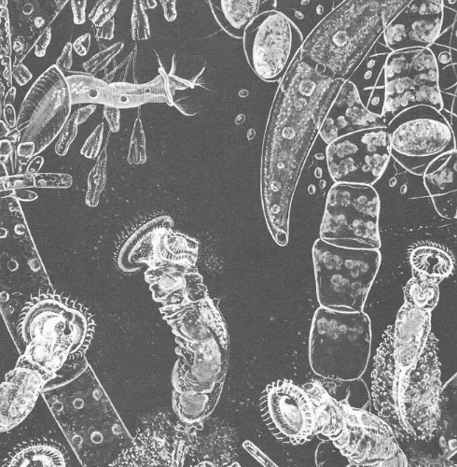
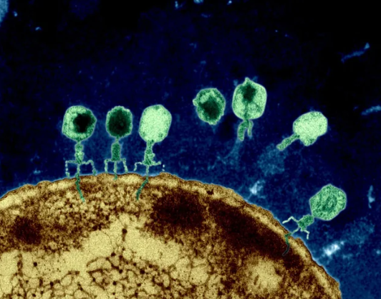
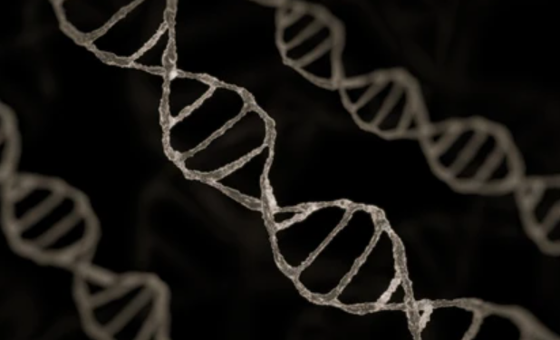
God Could Have Made Things Very Simple
JUST THINK GOD MADE ALL OF THIS
COMPLEXITY – AND I THINK IT
IS TO HUMBLE THIS GENERATION
MARINE PLANKTON
1885

Slide 9
Think About God Creating
Measurements – Math
Miles
Seconds
Days – Years
Numbers – Calculus – Trigonometry
How Long is 1 million Seconds
1 with six zeros
11 Days
How Long is 1 Billion Seconds
1 with nine zeros
32 Years
How Long is 1 Trillion Seconds
1 with 12 zeros
31 thousand years
How Long is 1 Quintillion Seconds
1 with 20 zeros
3 Trillion Years

Slide 10
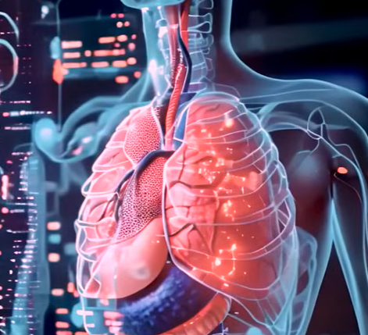
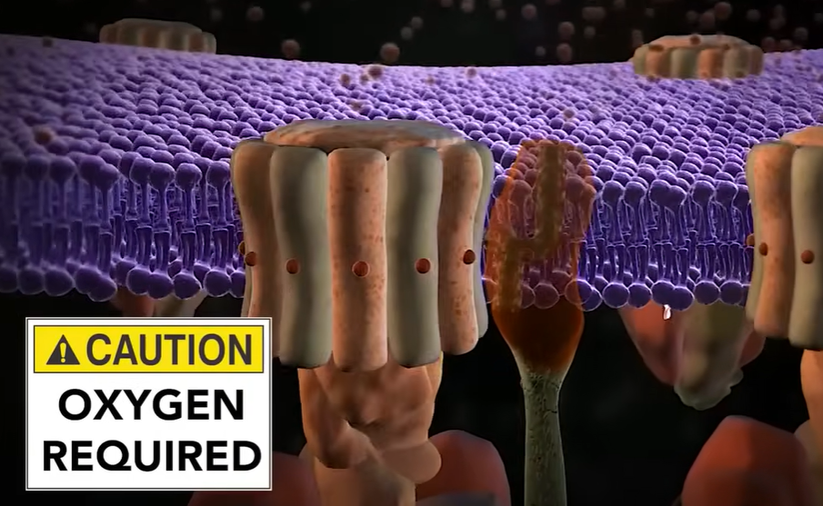
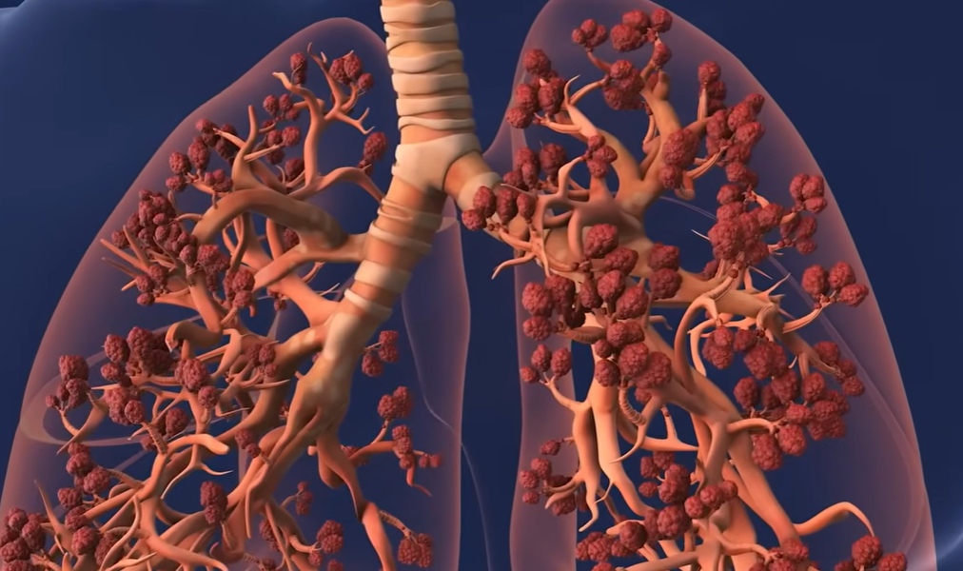
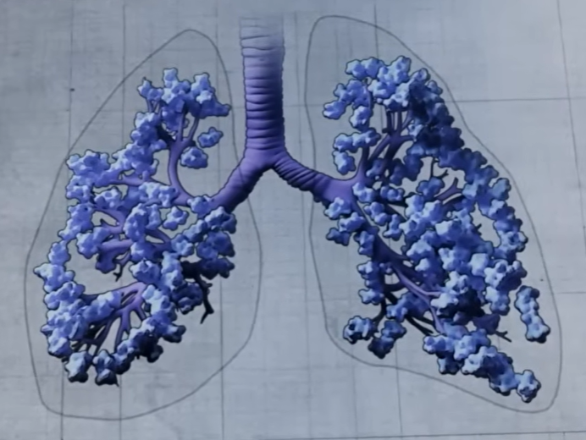
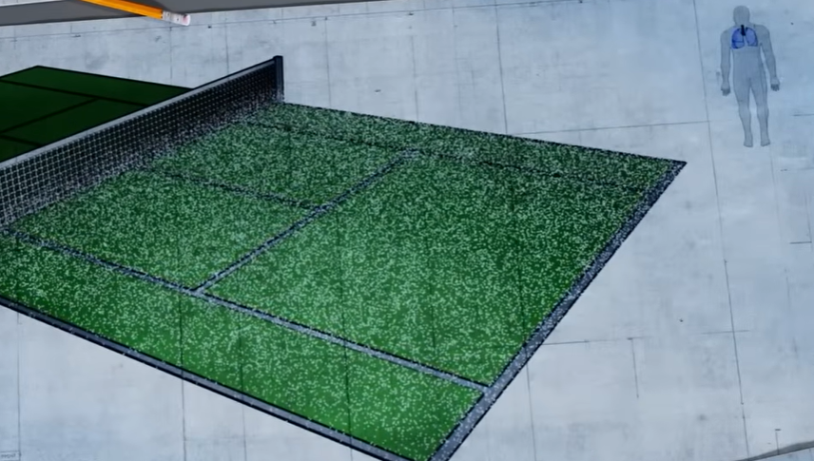
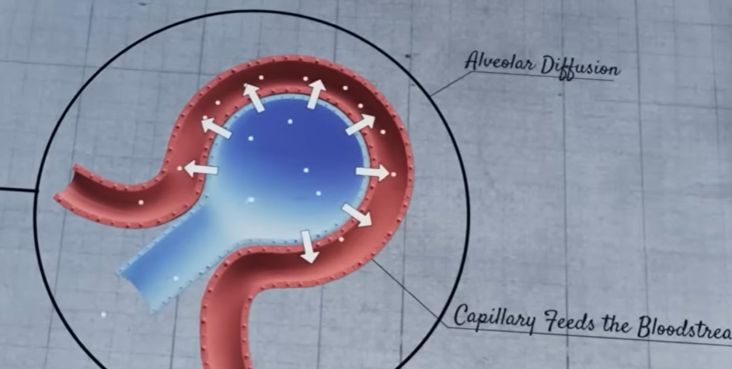
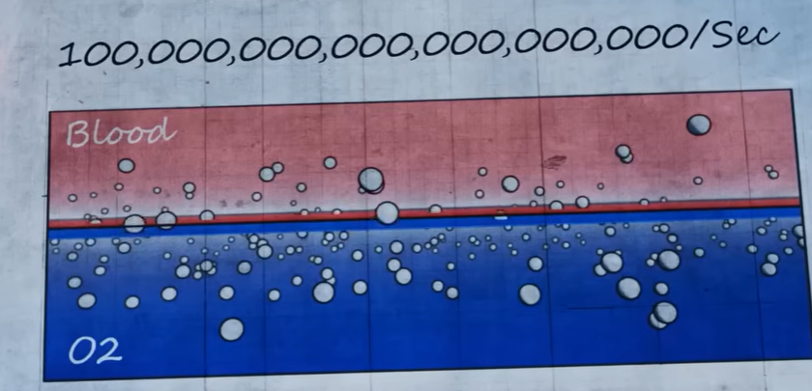
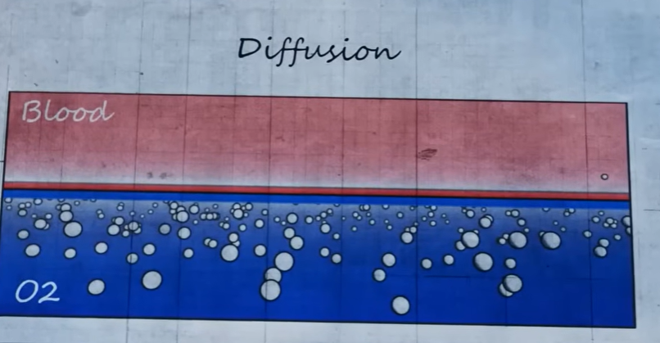
How God Designed The Human Lungs
To Feed The Need For Oxygen
ONE RED BLOOD CELL CARRIES ENOUGH HEMOGLOBIN TO CARRY ONE BILLION
OXYGEN MOLECULES BECAUSE BLOOD ITSELF
CANNOT TRANSPORT OXYGEN
THESE RED BLOOD CELLS FLOW THROUGH
60,000 MILES OF BLOOD VESSELS AND ARTERIES
TO GET HEMOGLOBIN IN YOUR RED BLOOD CELLS REQUIRES IRON – AND IRON IS TOXIC AND NEEDS REGULATED AND THAT’S WHAT YOUR LIVER DOES
Every Cell In Your Body Is A Factory That Requires Oxygen To Run
300 Million Alveoli Air Sacks Per Lung

Slide 11

Let’s Get This Revelation Of “Messiah” Clear
For unto us a child is born, unto us a Son is given: and the government shall be upon His shoulder: and His Name shall be called Wonderful, Counsellor, The Mighty God, The everlasting Father, The Prince of Peace. Isaiah 9:6 (KJV)
The Jews didn’t think the
Messiah Was God
Know and understand this: From the issuing of the decree to restore and rebuild Jerusalem until Messiah (Strong’s Hebrew 4899 – 7Xs) the Prince will be seven weeks and 62 weeks. (483 years). Daniel 9:25 (HCSB)
"And you shall know and understand, that from the going forth of the command for the answer and for the building of Jerusalem until Christ the (Anointed One) prince seven weeks, and sixty-two weeks; (Septuagint – written 200 years before Christ)
“For some of them, their expectations for the ‘Deliverer Who shall come forth from Jacob' was intense, theologically-charged, and surprisingly detailed.” Glenn Miller

Slide 12
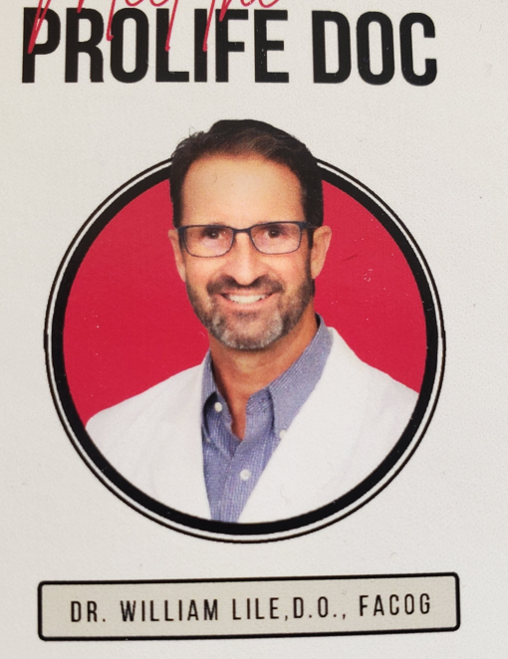
This Brother
Made A Power
Observation
Of Two
Unborn Babies
Responding
To God and each
Other

Slide 13
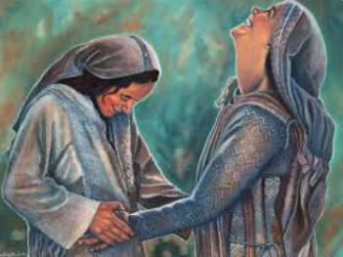
Elizabeth
Already Acknowledged
Jesus As Her Lord
And He was an unborn
Fetus 6 months old
At that time Mary got ready and hurried to a town in the hill country of Judea, ⁴⁰ where she entered Zechariah's home and greeted Elizabeth. ⁴¹ When Elizabeth heard Mary's greeting, the baby leaped in her womb, and Elizabeth was filled with the Holy Spirit. ⁴² In a loud voice she exclaimed: "Blessed are you among women, and blessed is the Child you will bear! ⁴³ But why am I so favored, that the mother of my Lord should come to me? ⁴⁴ As soon as the sound of your greeting reached my ears, the baby in my womb leaped for joy. Luke 1:39-44 (NIV)

Slide 14
Let’s Get Back To The “GIFT” That
God was Bringing To the Earth
Then an angel of the Lord stood before them, and the glory of the Lord shone around them, and they were terrified. ¹⁰ But the angel said to them, “Don’t be afraid, for look, I proclaim to you good news of great joy that will be for all (Greek - PAS - whosoever, everyone, all men) the people: ¹¹ Today a Savior, who is Messiah the Lord, was born for you in the city of David. Luke 2:9-11 (HCSB)

Slide 15
GOD NOT ONLY PROVIDES THE PRICELESS GIFT
OF CHRIST TO ALL MEN – BUT HE GIVES US THE CAPACITY TO RECEIVE AND TAKE HOLD OF THAT GIFT BY GRACE THROUGH FAITH
Fight the good fight of the faith. Take hold of the (GIFT – Christ Who is your Life Col. 3) eternal life to which you were called when you made your good confession in the presence of many witnesses.
1 Timothy 6:12 (NIV)
In this way they will lay up treasure for themselves as a firm foundation for the coming age, so that they may take hold of the (GIFT) life that is truly life. 1 Timothy 6:19 (NIV)

Slide 16

SO YOU CANNOT RECEIVE A GIFT UNLESS
YOU CAN GRASP IT – GRAB IT
RECEIVE IT – EMBRACE IT – TAKE IT – REACH OUT FOR IT AND HOLD IT
There is no NORMAL way of receiving a gift
except through your HAND

Slide 17
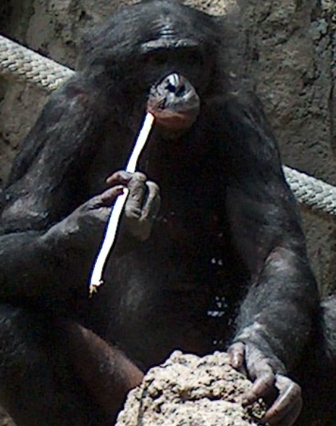
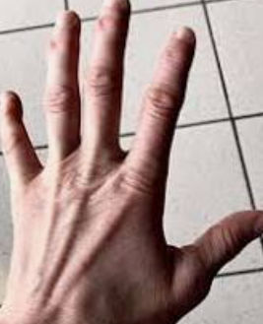
The Miracle
Of The Human
HAND
The human hand is amazing due to its unparalleled dexterity, combining strength and precision through an opposable thumb, flexible fingers, and complex muscle/nerve system, allowing for tool use, intricate tasks

Slide 18


SO GOD DOES NOT OFFER A GIFT
AND NOT GIVE US THE MEANS
TO GRASP AND RECEIVE THAT GIFT
Praise be to the LORD my Rock, who trains my hands for war, my fingers for battle. Psalm 144:1

Slide 19
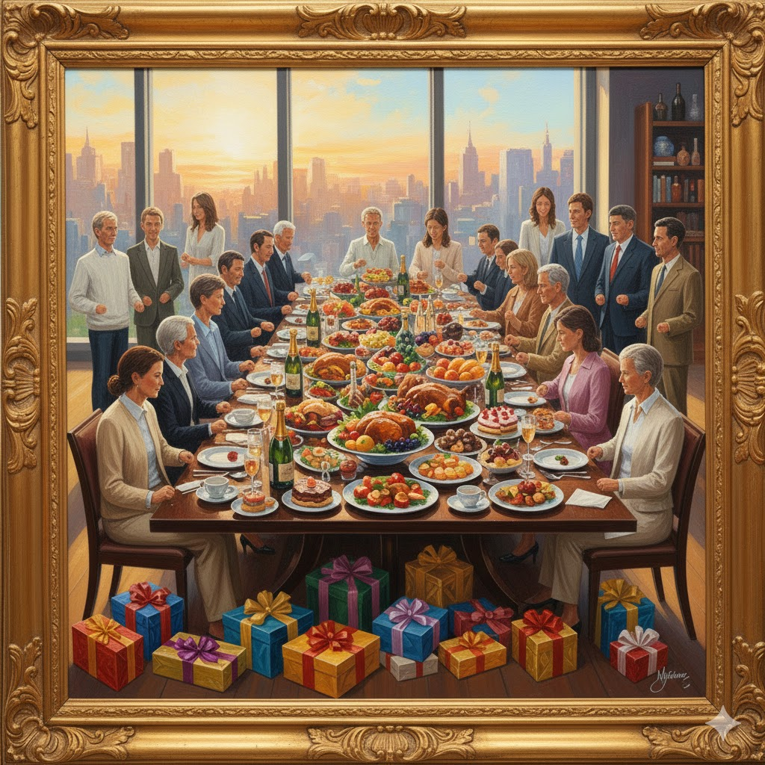
WHAT IF WE HAD NO HANDS OR FINGERS TO RECEIVE?

Slide 20

God Doesn’t Offer Something And
Then Make it Impossible To Receive
1
God doesn’t handicap anyone in Mankind so they are
not be able to RECEIVE THE GIFT of CHRIST.
2
God doesn’t lure us in with a GOOD STORY and then
Reveal to us that it wasn’t true - THE GOSPEL IS REAL!
3
God doesn’t TELL US ALL ABOUT THE GIFT of salvation and then BOX it in – nail it down – keep it locked away
4
God DELIGHTS to SHOW OFF HIS GIFT – of JESUS – and have EVERYONE POSSIBLE RECEIVE HIM.
I will be found by you," declares the LORD, "and will bring you back from captivity. I will gather." Jeremiah 29:14

Slide 21
Here is the “Glory” Of This Whole Gift of God Through Reality In Christ
1
God offers an astounding Gift to ALL MEN – Jews and Gentiles alike – EVERYONE – Jesus as SAVIOR
2
Then God gives them the GRACE to RECEIVE this gift of salvation through Christ – GOSPEL – THE HAND OF GRACE (Titus 2:11 – The Grace of God has appeared to ALL men.)
3
This WORD and GRACE (Acts 20:32) - has the power to PRODUCE SAVING FAITH for everyone – it is given to ALL (FAITH COMES BY HEARING THE WORD)
So when we share the Gospel to others we are releasing the POTENTIAL of them taking the GRACE given in the GIFT OF JESUS CHRIST – and exercising their FAITH.
4

Slide 22
THE RESULT IS THAT WE ARE BLESSED TO SHARE THIS GIFT WITH OTHERS
GOD GIVES US THE EXTRAORDINARY GIFT OF HIMSELF – AND THE HONOR OF SHARING HIM WITH EVERYONE – AND WE WILL BE HELD ACCOUNTABLE HOW WELL WE DO IN SHARING HIM AS THE
PRICELESS GIFT
For we must all appear before the judgment seat of Christ, that each one may receive what is due him for the things done while in the body, whether good or bad. ¹¹ Since, then, we know what it is to fear the Lord, we try to persuade men. What we are is plain to God, and I hope it is also plain to your conscience. 2 Corinthians 5:10-11 (NIV)

Slide 23
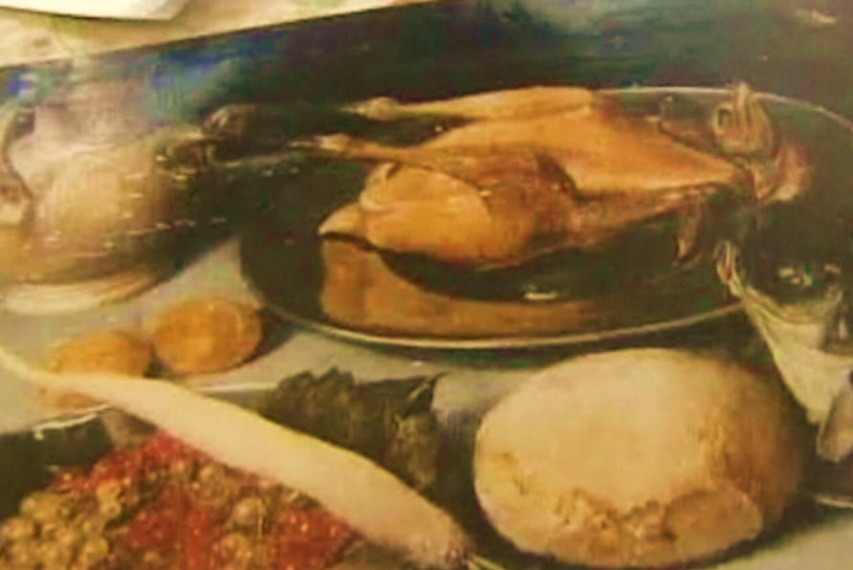
Some Things Are Hidden In Plain Sight
2012 – Good will Store – Oil Painting Sold for $3
It was a Flemish -painting from 1650 – In America for 300 years - Sold at Auction for $190,000

Slide 24
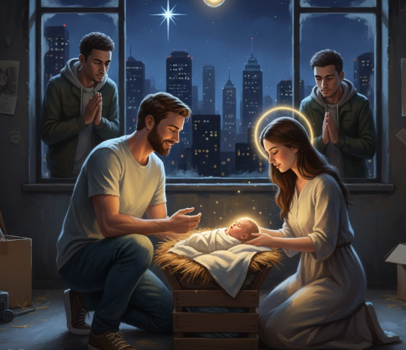
If Jesus Came In A Manger Today
He Would Still Be The Greatest Gift Ever
Given By God and Yet Hidden In Plain Sight

Slide 25
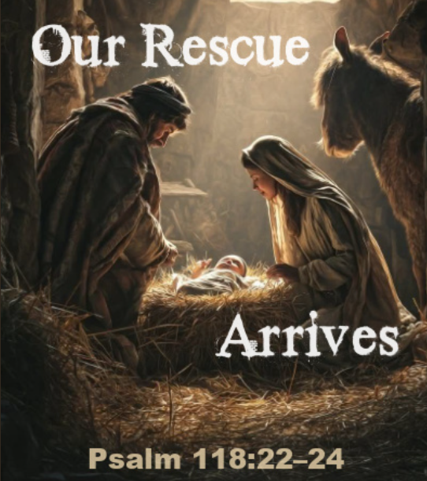
He who did not spare His own Son, but gave Him up for us all--how will He not also, along with Him, graciously give us all things? Romans 8:32 (NIV)

Slide 26
OBVIOUSLY THE OMNIPOTENT – AND OMNISCIENCE GOD OF THE UNIVERSE KNEW – WE WOULD HAVE TO PUSH THROUGH OUR CHILDISH FLESHLY ADDICTIONS – OUR IDOLATROUS CULTURE – OUR PRIDE AND EGO – AND THE DISTRACTIONS AND BATTLE OF LIVING IN A FALLEN WORLD – AND ALL THE DRAMA – TRAUMA AND WOUNDING THAT WOULD HAPPEN FROM OTHERS SINNING AGAINST US AND OUR SINS AGAINST GOD AND OTHERS –
AND SOMEHOW – IT WAS POSSIBLE FOR EVERYONE TO HAVE THE GRACE TO RESPOND TO THE GOSPEL – THERE WAS A GRACE GIVEN EVERYONE TO RESPOND TO THE CALL TO FOLLOW JESUS CHRIST – TO REPENT – TO PLACE FAITH IN THE INVISIBLE GOD AND FOLLOW HIS SPIRIT AND WORD
– AND AFTER ALL OF THIS – GOD IS TICKLED WHEN PEOPLE YIELD TO HIM – ALLOW HIM TO RESTORE THEM – SAVE THEM – REFORM THEM – BRING THEM BACK INTO HIS ORIGINAL INTENTIONS.

Slide 27
Memory Verse
So then faith comes by hearing, and hearing by the Word of God. Romans 10:17 (KJV)DL

Slide 28
Application
Have you responded yet to this GOOD NEWS - HAVE YOU TAKEN HOLD OF JESUS THE GIFT– His Name is Jesus – have turned your life over to Him to save you from a heart of sin and from the world of darkness around you?
Are you willing to SHARE THE GIFT OF JESUS with others? – Remember God has given each person the GRACE to receive this gift – pray that they would ACTIVATE the faith that comes from the Gospel and the revelation of Christ.

