Slide 1
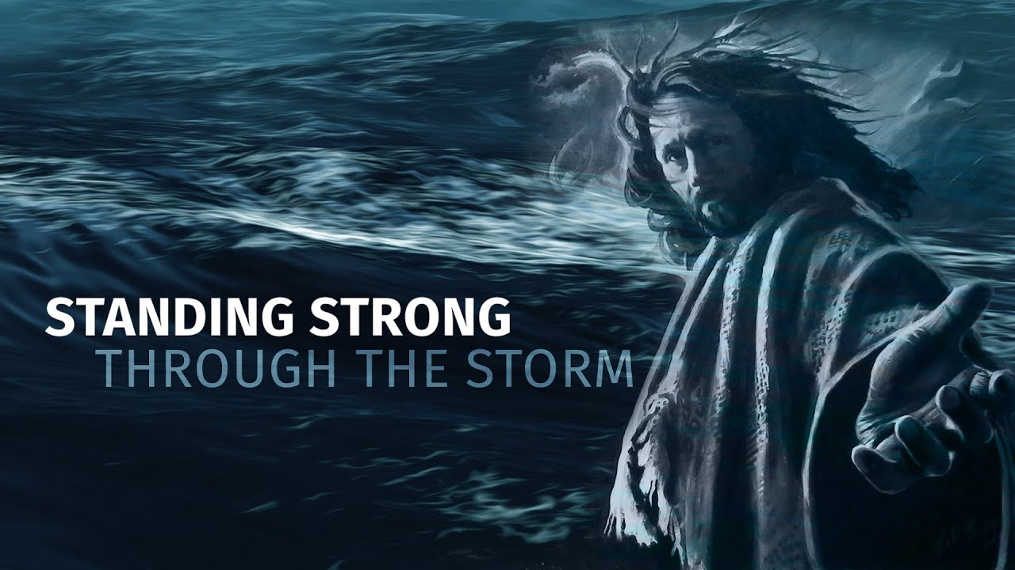
A Stronger Faith in the Midst of a Chaotic Life
Growing stronger in our relationship with Christ and
one another - helping us weather the storms of Life.
Be strong in the Mighty Power of the Lord. Eph. 6: 10

Slide 2
INTRODUCTION
- The idea of discipleship, means that we need to equip and train new believers to become strong and ready to grow in the hostile environment they are living in.
- Training, teaching, mentoring, modeling, supporting and empowering new believers is an Essential & Intentional task.
- While the power of the Holy Spirit is present, and the word of God is actively opening their hearts, the daily and weekly role of other Christians connecting with young Christians is vital.
- There is a mystery to Discipleship – some are powerfully converted and the strongholds and past entanglements fall off quickly and spiritual growth seems instantaneous.
- While other’s experience is slower transformation and seems to take longer. Embedded mindsets and habits are much harder to break. The journey is one of gradual change and sometimes feels like there is lack of devotion.
Each of our journeys are unique and personal. We can not judge others who are at a different places. Yet, everyone of us has to be ready to be challenged and called upon to go deeper in our Discipleship Journey.
One of the most helpful attributes to have in being discipled….teachable heart!

Slide 3
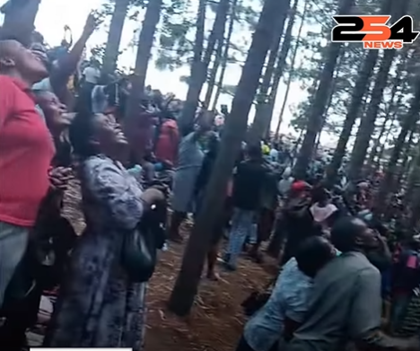
Two more things:
1) Time is running out! Jesus is coming back.
- Living in the balance between the Longing and Hunger to see the Lord Jesus coming back for His bride/ Staying committed to being a bold example of what it means to be a true follower of Christ.
Longing for Heaven, while living in a way to stir others to become Christ Followers.

Slide 4
2) Secular vrs, building God’s Kingdom.
- Living in the balance with most of our time taken up with family, work, school, personal responsibility and / Still feeling like we want to be helping more with ministry and spreading of the gospel. We can begin to feel like a failure.
God’s Kingdom needs everyone one of us!
- Every vocation, job, task and assignment you take on as a believer
…..makes you a missionary!!
- Some of the hardest missions fields are………..
- Our homes/ families
- Public service on school boards and community organizations
- Standing up for Christ in public School
- Doing the right thing at your job
- Helping a neighbor when they are sick
- Caring for an aging parent
- Supporting a young family with handicap child

Slide 5
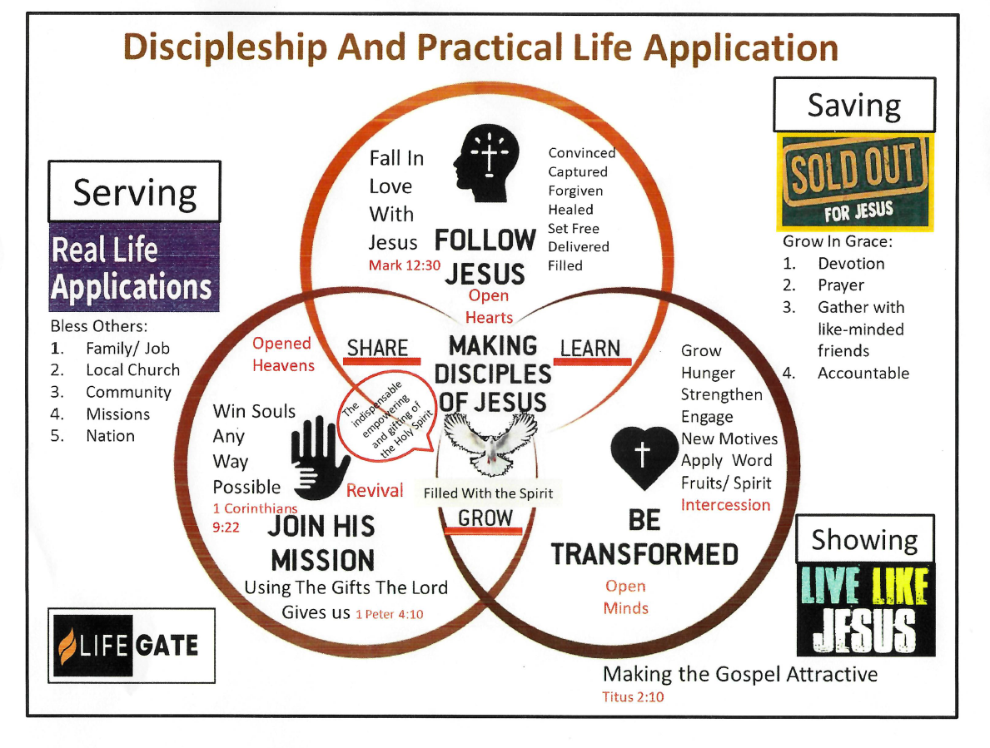
LifeGate’s Fall Theme - Discipleship

Slide 6


Not sure if the two are connected?

Slide 7
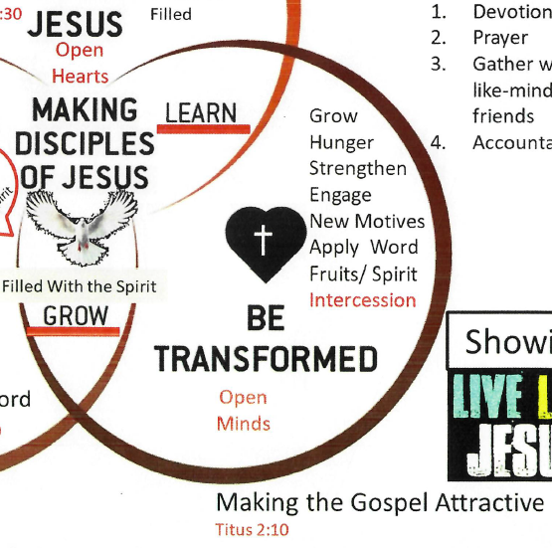
Focus will be on the third circle – Be transformed

Slide 8
Three parts:
1) Look at the instructions Paul gave Titus as he mentored the early church in Crete.
2) Review the Character traits of real disciples and what we need to be like.
3) Look at the gifts and see where do I find myself being used to help other Christians grow and become stronger.

Slide 9
Book of Titus: AD 65
1. Background - Titus and Paul worked together as missionaries and Crete might have been one of Paul’s last mission outreaches. AD 62- 64
2. Titus 1: 1- 4 Misson statement – wanted new believers to be strong in their faith ad live godly lives.
3. Titus 1: 10 -14 What was the social environment like on Crete for these early Christians?
4. Titus 1: 5- 9 Establish leaders for the church who demonstrate personal integrity and leadership skills.

Slide 10
What Qualities that make for a strong Christian?
Honesty - Trustworthy - Financially successful
Kindness - No beard/ clean shaven - Compassion
Dresses sharply - Willing to forgive - Gentle
Humility - No tattoos - Purity
Uses a King James Bible - Faithful worker - Servant heart
Never works on Sunday - Listens to decent music - Give generously
Overcomer - Better then every - Has it together
Car is washed regularly - Doesn’t mow grass Sunday - Teachable
Obedient to leadership - Integrity - Self Control
Spot a fake believer - Slow to anger - Has wisdom
Doesn’t wear makeup - Doesn’t get sick often - Doesn’t swear
Admits when their wrong - Loves the lost - Worshiper
Reads the word of God - Intercessor - Takes time listen

Slide 11
Titus
5. Look out for phony Christians – coming into the flock. Titus 1: 15 -1 6
6. Titus 2: 1 -5 Build healthy Church family with equipping the older men and women to lead by example younger Christians.
7. Titus 2: 9 – 13 Instruct employees to be the best representation of Christ they can be at the workplace.
8. Titus 3:1 -2 Respect and obey government regulations
9. Stand up against controversial debates with legalism or unnecessary arguments. Titus 3: 9 – 11
10. Get involved in practical needs. Titus 3: 14

Slide 12
New Testament gives several lists of Gifts or Talents we need to use to build up the Church:
1 Cor. 12 / Romans 12/ 1 Peter 4
1 Cor. 12: 8 – 10
Wisdom
Word of knowledge
Faith
Healing
Working of miracles
Discernment
Speaking in tongues
Translation of tongues
Rom. 12: 3-8
Prophesying
Service
Teaching
Encouraging / exhort
Giving/ practical
Leadership/ administration
Mercy/ compassion
1 Peter 4: 9 – 11
Serving others/ sharing practical help
Teaching/ preaching
Reaching the lost
Repairing cars, computers, washers - Van driver - Drama/ plays
Raking leaves, taking out trash - Dancing/ flagging - Painting/ arts
Worship, music - decorating - Financial advise - Counseling
Sound technician - Web design - Promotion - Video/ Podd Cast
Every Christian has gifts and talents to use to build up the Church.

Slide 13
Application:
1) Look for ways to build one another up.
Text/ encourage/ prayer for one another throughout the week
Resist the idea that I don’t have anything worth while to offer.
Invite people into you space and ask for prayer. (Vulnerable)
2) Invite the Holy Spirit to increase your spiritual appetite to grow and become stronger. “Lord is there something you are asking of me and I’m not seeing it?”
3) Resist the idea that my life is being wasted on earthly things and I’m not being a good follower because I’m bogged down in the day to day life of family, work and community.

