Slide 1
God really on Your side!!
Spiritual warfare is at work to take you out spiritually or disqualify your message from being heard

Slide 2
Introduction: Another Year of great change and Challenge
1 Peter 4: 12 – 14
Romans 8: 17 – 18
Phil 1:29
God’s Word always tells us the truth and doesn’t sugar coat the Christian journey so we are caught off guard.

Slide 3
The Gospel needs to be clearly presented
Our relationship with Jesus is going to cost us…..
friends, time, money, reputations……
Self denial is paramount and will be a daily choice
Jesus never made it sound easy to follow him
It’s a Lifetime commitment

Slide 4

Discipleship is not Brainwashing – Invitation to Follow the greatsest person who exists.

Slide 5
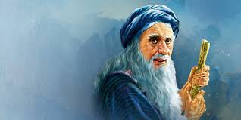
Old Testament Exampls of Spiritual warfare
Samuel leads the People of Israel to repent.
1 Samuel 7

Slide 6
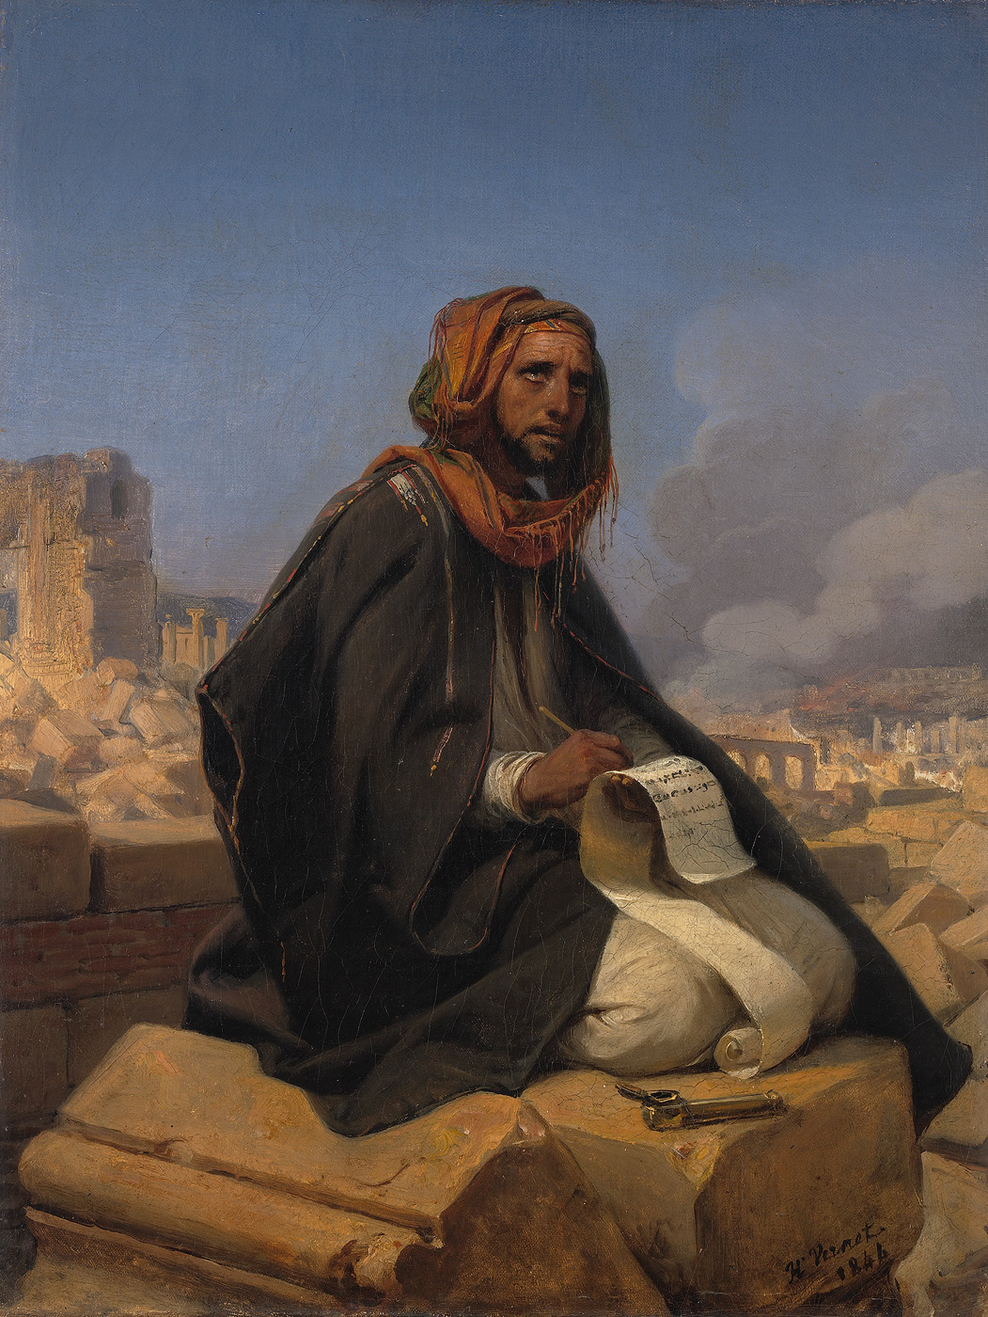
Jeremiah 44
Jeremiah is with the exiles in Egypt and has a message for them about loyalty and worship of God. Idolatry isn’t worth it.

Slide 7

2 Thess. 2: 9 - 13
Deception is coming in the last days! Church needs to be digging into the truth and disciples to keep from falling away!

Slide 8

Personal Stories of poor discipleship:
Nicaragua
Kenya
Scottland

Slide 9

Eleanor Issacson

Slide 10
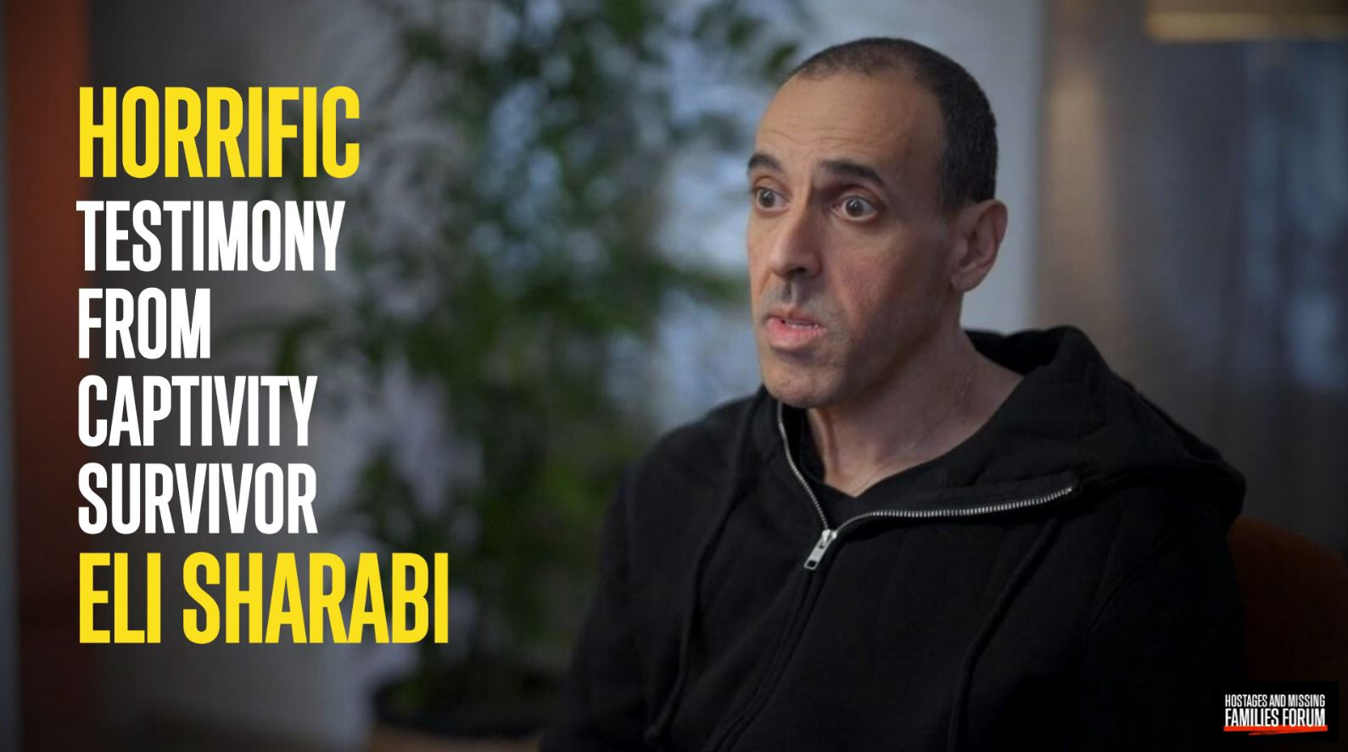
Eli Sharabi

Slide 11

Melanie Clift -

Slide 12

Battle Ground in America

Slide 13
Conclusions
Don’t let your circumstances determine if you are in God’s will
Invite the Holy Spirit to highlight potential tripping Hazards - Enemy is trying to set you up.
Invite someone into your journey to speak truth and support you when your weak.

