Slide 1

Part 2 –
“Truly Knowing The Love of God
And Coming Into The Spirit of Adoption”
LifeGate Sermon
November 2nd, 2025

Slide 2




Slide 3

Teaching Series Themes
Hebrews 10:25
Therefore go and make disciples of all nations, baptizing them in the name of the Father and of the Son and of the Holy Spirit, Matthew 28:19 (NIV)
Serve wholeheartedly, as if you were serving the Lord, not men, Ephesians 6:7 (NIV)
Basics
Ephesians 5:18

Slide 4
Love the Lord your God with all your heart and with all your soul and with all your mind and with all your strength.' ³¹ The second is this: 'Love your neighbor as yourself.' There is no commandment greater than these." Mark 12:30-31 (NIV)
This is love: not that we loved God, but that He loved us and sent His Son as an atoning sacrifice for our sins. ¹¹ Dear friends, since God so loved us, we also ought to love one another. 1 John 4:10-11 (NIV)
“I came into your house. You did not give me any water for my feet, but she wet my feet with her tears and wiped them with her hair. ⁴⁵ You did not give me a kiss, but this woman, from the time I entered, has not stopped kissing my feet. ⁴⁶ You did not put oil on my head, but she has poured perfume on my feet. ⁴⁷ Therefore, I tell you, her many sins have been forgiven--for she loved much. But he who has been forgiven little loves little." Luke 7:44-47 (NIV)

Slide 5

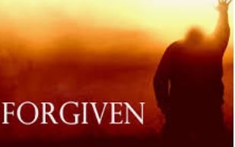
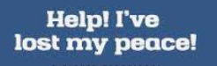


Her many sins have been forgiven--for she loved much. But he who has been forgiven little loves little."
Luke 7:47
He restores my soul: he leads me in the paths of righteousness for his name's sake. Psalm 23:3 (KJV)

Slide 6

WHEN WE TALK ABOUT THE “LOVE OF GOD” – HIS GRACE IS RIGHT THERE – THEY ARE LINKED TOGETHER THROUGH BONDS THAT CAN’T BE BROKEN
The grace of the Lord Jesus Christ, and the love of God, and the communion of the Holy Spirit, be with you all. Amen. 2 Corinthians 13:14 (KJV)
The grace of our Lord was poured out on me abundantly, along with the faith and love that are in Christ Jesus. 1 Timothy 1:14 (NIV)

Slide 7

THE PERFECT BIBLICAL DEFINITION OF LOVE
Love is patient and kind. Love knows neither envy nor jealousy. Love is not forward and self-assertive, nor boastful and conceited. ⁵ She does not behave unbecomingly, nor seek to aggrandize herself, nor blaze out in passionate anger, nor brood over wrongs. ⁶ She finds no pleasure in injustice done to others, but joyfully sides with the truth. ⁷ She knows how to be silent. She is full of trust, full of hope, full of patient endurance. ⁸ Love never fails
1 Corinthians 13:4-8 (WEY)
“The Perverting Perfect Love”
So
Is a Movement of Empathy Hi-jacked by perverted definition of Holy Biblical Love

Slide 8

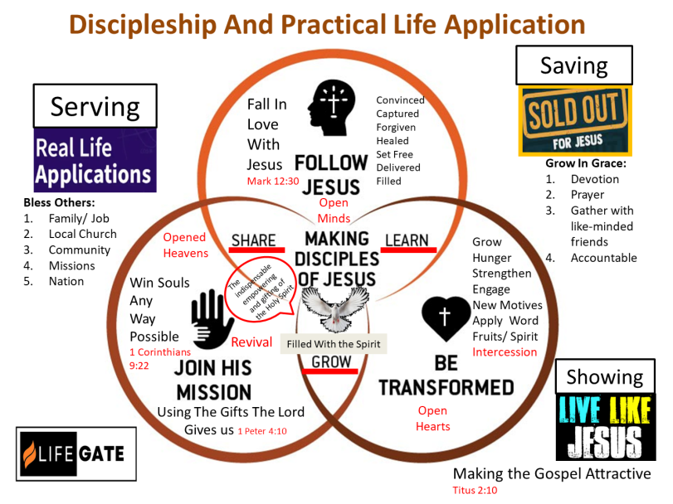
GRAPHIC ON DIFFERENT PRACTICAL
APPLICATIONS OF THE GOSPEL

Slide 9
Breaking Down Discipleship Graphic
Into Its Practical Elements
SAVING Sold Out For Jesus | SHOWING Living Like Jesus | SERVING In Real Life Applications
FAITH/ Confidence | FRUIT/ Character | FUNCTION/ Contribute
LEARN | GROW | SHARE
Follow Jesus | Be Transformed | Join His Mission/ ACTIVATION
Head | Heart | Hands
Open Minds | Open Hearts | Open Hands Open Heavens
Growing in Grace Activate Faith | Apply the Word and Spirit – Being Accountable | Actions - Being a blessing to your family and others
Fall in Love with Jesus | Make The Gospel Attractive | Win Souls Any Way Possible
Living a life of Intimacy and Identity in Christ | Living a life of Faith-filled Intercession that releases the supernatural | Using the gifts and talents the Lord has given you to steward the community you live in

Slide 10

Today’s Focus
SAVING –us from an Orphaned – detached Spirit
1 John 4:16
John 3:16
Romans 5: 8
We are going to explore the foundational revelation that “GOD IS LOVE” and that “GOD SO LOVED THE WORLD THAT HE GAVE HIS ONLY BEGOTTEN SON.” Even more extravagantly – GOD DEMONSTRATES HIS OWN LOVE FOR US IN THIS: WHILE WE WERE STILL SINNERS, CHRIST DIED FOR US.- This revelation of God’s love underpins the universe – our existence and our redemption and is the POWER that changes our motives and heart.

Slide 11
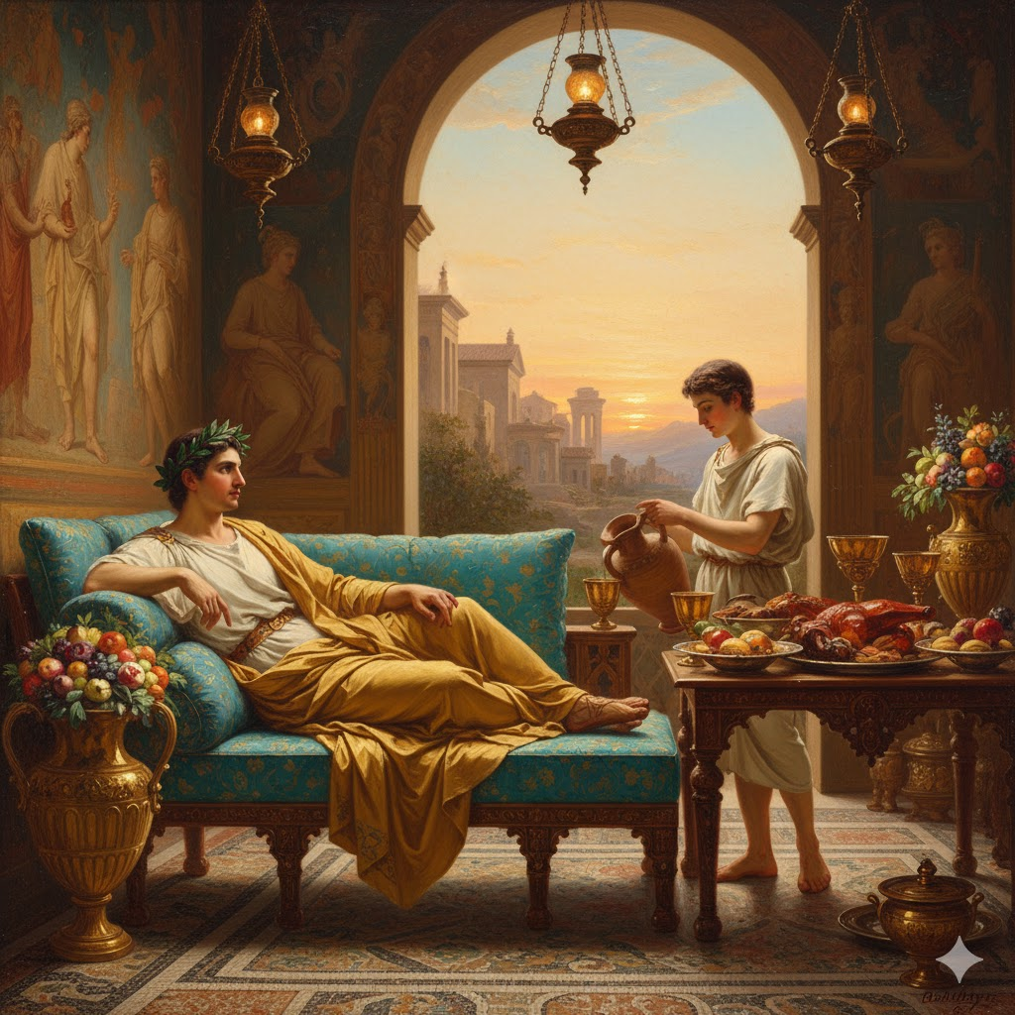
UNDERSTANDING THE CULTURAL BACKGROUND
OF PAUL’S TEACHING ON ADOPTION – SONSHIP
COMING OUT OF SLAVERY
Slavery unfortunately continues to exist in almost every part of the earth. It was Governmentally banned in 1865 in America but slavery still exists in corners of every nation.
1 - Royalty – Monarchs/ Kings/ Queens - Nobles – Generals - Lords - Princes
2 - Son’s and Daughters of Nobles
In Paul’s day slavery was approximately 25% of the total population – some nations ran as high as 40%
3 - Commoners the labor force
4 - Slave/ Servant – indentured

Slide 12
CRUCIAL UNDERSTANDING OF GOD’S LOVE
In the Greco-Roman world, a slave was not allowed to call their master "father". To do so would have blurred the strict, hierarchical lines of authority that defined both Roman and Greek households. The master-slave dynamic was one of ownership and control, not of deep caring family relationship.
God Chose You
Through Creating You
Providing Salvation For You
Illuminating You Through The Gospel
⁴ For he chose us in Him (JESUS) before the creation of the world to be holy and blameless in His sight. In love ⁵ He (FATHER) predestined us to be adopted as His sons through Jesus Christ, in accordance with His pleasure and will-- Ephesians 1:4-5 (NIV)
This all had to take place because Adam and Eve
had become ORPHANS – DETACHED - SLAVES

Slide 13
PAUL AND PETER TAUGHT THAT WE WERE SLAVES AND PEOPLE ARE MASTERED BY
WHAT EVER ENSLAVES THEM
GOD IS THE “ONLY” BONDAGE BREAKER
For we know that our old self was crucified with Him so that the body of sin might be done away with(overcome) , that we should no longer be slaves to sin-- Romans 6:6 (NIV)
They promise them freedom, while they themselves are slaves of depravity--for a man is a slave to whatever has mastered him. 2 Peter 2:19 (NIV)
You are my friends if you do what I command. ¹⁵ I no longer call you servants (1401 – Doolos – Slave) , because a servant does not know his master's business. Instead, I have called you friends, (Philos – Dear Friend) for everything that I learned from my Father I have made known to you. ¹⁶ You did not choose me, but I chose you and appointed you to go and bear fruit--fruit that will last. Then the Father will give you whatever you ask in my name. ¹⁷ This is my command: Love each other. John 15:14-17

Slide 14
THE SOURCE OF OUR SALVATION IS GOD’S LOVE
The LORD appeared to us in the past, saying: "I have loved you with an everlasting love; I have drawn you with loving-kindness. Jeremiah 31:3 (NIV)
God’s Love is Holy – without a single flaw – James 5:17
God’s Love is unconditional – without invitation – It came to you without your deserving it or earning it Ephesians 2:1-5
God’s Love is Universal – For the grace (Love) of God that brings salvation has appeared to all men. Titus 2:11 (NIV)
God’s Love is the MOST POWERFUL virtue for Motivating change in our lives – 2 Corinthians 5: 14-17
God’s Love (Grace) can be refused and of “none effect” - 2 Corinthians 6:6 - If anyone does not love the Lord--a curse be on him. Come, O Lord! 1 Corinthians 16:22 (NIV)

Slide 15
CRUCIAL UNDERSTANDING OF GOD’S LOVE
BRINGING US IN AS SONS AND DAUGHTERS
THROUGH THE SPIRIT OF ADOPTION
Fight against the FLESH
For you have not received the spirit of bondage again to fear; but you have received the Spirit of adoption, whereby we cry, Abba, Father. 16 The Spirit itself bears witness with our spirit, that we are the children of God: Romans 8:11-16 (KJV)
Fight against dead religiosity/ spirit of religion
But when the time had fully come, God sent his Son, born of a woman, born under law, 5 to redeem those under law, that we might receive the full rights of sons. 6 Because you are sons, God sent the Spirit of his Son into our hearts, the Spirit who calls out, "Abba, Father." 7 So you are no longer a slave, but a son; and since you are a son, God has made you also an heir. Galatians 4:3-7 (NIV)

Slide 16
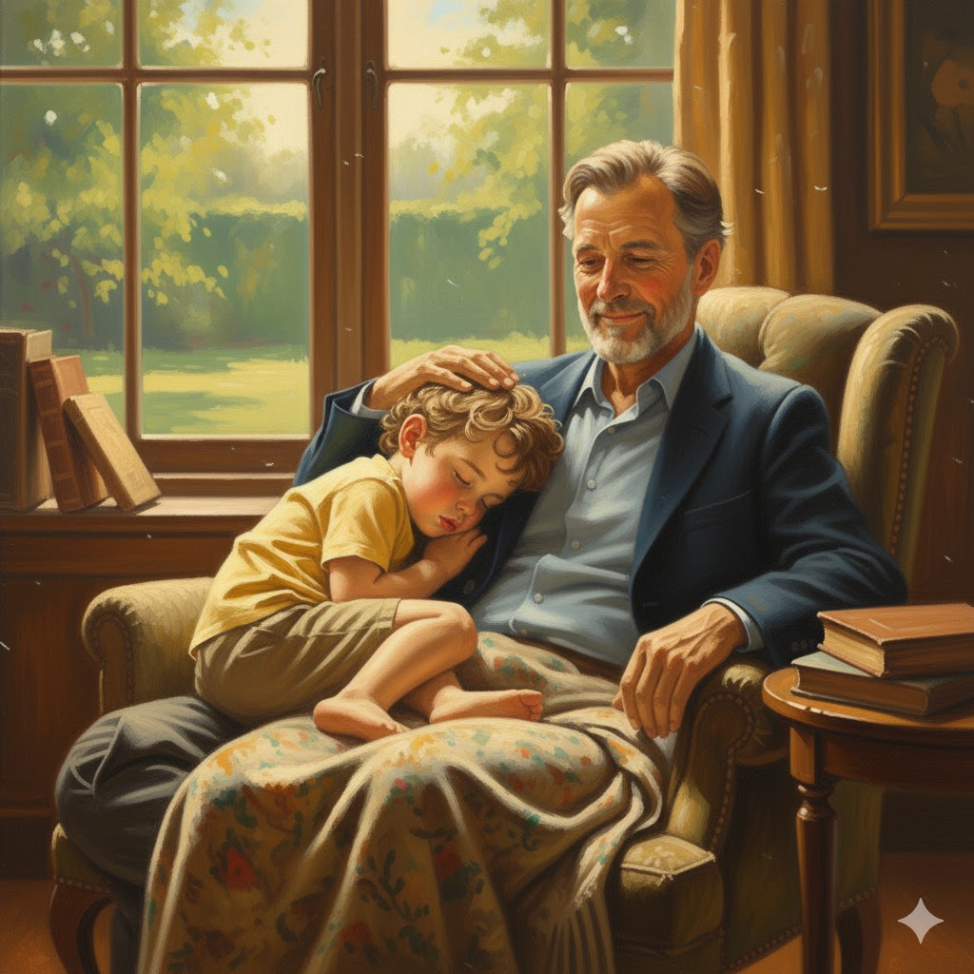
THIS WORD – CRY – IS
A POWERFUL LAYING HOLD –
IT IS “Daddy I Desperately Need you.”
KRADZOE
properly to “croak” (as a raven) or scream, i.e. (genitive) to call aloud (shriek, exclaim, intreat) :- cry (out).

Slide 17

“Dad – I need you right now – the FLESH is chasing me – and I need to be next to you to defend me and motivate me to stay close to you.”
SO THERE IS AN INTIMATE – “LAYING BACK AGAINST THE HEART OF DADDY FATHER” – BUT THERE IS THIS CRY OF ADOPTION – DAD – I NEED YOU NOW

Slide 18
RADICAL VERSES ON THE LOVE OF GOD
And we have seen and testify that the Father has sent His Son to be the Savior of the world. 15 If anyone acknowledges that Jesus is the Son of God, God lives in Him (by faith) and he in God. 16 And so we know and rely (faith) on the love God has for us. God is love. Whoever lives in love (through faith in Christ producing the actions of Christ) lives in God, and God in him. 17 In this way, love is made complete among us so that we will have confidence on the day of judgment, because in this world we are like Him. 18 There is no fear in love. But perfect (complete – full growth – mature – finished - accomplished) love drives out fear, because fear has to do with punishment. The one who fears is not made perfect in love. 19 We love because He first loved us. 20 If anyone says, "I love God," yet hates his brother, he is a liar. For anyone who does not love his brother, whom he has seen, cannot love God, whom he has not seen. 21 And He has given us this command: Whoever loves God must also love his brother. 1 John 4:14-21

Slide 19
The One Who Fears Is Not Made
Perfect In Love – It Doesn’t Say
“Is Not a Child of God”
The one who keeps going back to the world is “not made perfect in love”
The one who keeps walking in anxiety and worry is “not made perfect in love”
The one who keeps blaming God for all their troubles “not made perfect in love”

Slide 20

THREE ENEMIES OF INTENSIFIED
CONNECTIVITY AND REVELATION
OF EXPERIENCING GOD’S LOVE
Contentedness
Carnality
Conflicted devotion
¹² At that time I will search Jerusalem with lamps and punish those who are complacent, who are like wine left on its dregs, who think, 'The LORD will do nothing, either good or bad.' Zephaniah 1:12 (NIV)

Slide 21
APPLICATION
Walk in LOVE and forgiveness – His and then forgiving others
Call on the Lord out of the “Spirit of Adoption” – you are loved – acknowledge His love – respond to His love and be BOLD to love others
Repent quickly when you lose you peace because you lost sight of HIM

