Slide 1
Message: Steady growth and breaking off old habits
Being Transformed –
Overcoming the past
Living in Victory

Slide 2
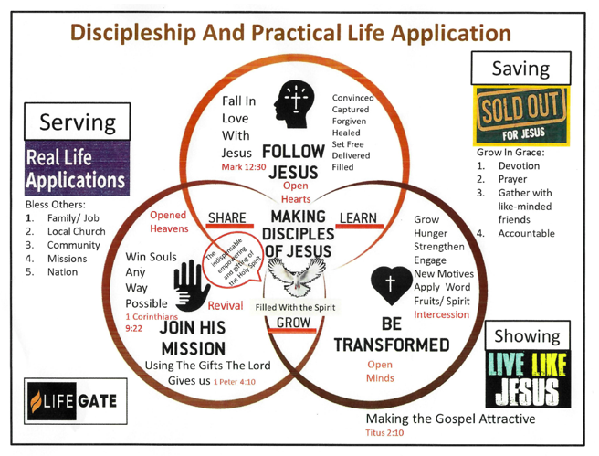

Slide 3
Therefore I, a prisoner for serving the Lord, beg you to lead a life worthy of your calling, for you have been called by God. ² Always be humble and gentle. Be patient with each other, making allowance for each other’s faults because of your love. ³ Make every effort to keep yourselves united in the Spirit, binding yourselves together with peace. Eph. 4: 1-3
¹⁴ Then we will no longer be immature like children. We won’t be tossed and blown about by every wind of new teaching. We will not be influenced when people try to trick us with lies so clever they sound like the truth. ¹⁵ Instead, we will speak the truth in love, growing in every way more and more like Christ, who is the head of his body, the church. Eph. 4:15-15

Slide 4
Rom. 15: 1-3, 5,7
We who are strong must be considerate of those who are sensitive about things like this. We must not just please ourselves. ² We should help others do what is right and build them up in the Lord. ³ For even Christ didn’t live to please himself.
⁵ May God, who gives this patience and encouragement, help you live in complete harmony with each other, as is fitting for followers of Christ Jesus.
⁷ Therefore, accept each other just as Christ has accepted you so that God will be given glory.

Slide 5
We need community. When we don’t have it, we’ll feel an emptiness, a longing, a craving, one that isn’t rooted in discontentment but in our very design. Just like God created us to require oxygen and water and food to live, he’s created us to need one another. However, well-intentioned efforts to emphasize the importance of a personal relationship with God have inadvertently diminished the importance of our corporate relationship. When we come to faith in Christ, we obtain citizenship in God’s kingdom. We aren’t lone rangers; we are indelibly linked to God’s people.
We carry out the mission together, inviting others to join the kingdom that will not be shaken. When enemies are in our midst—seeking to deceive and dismantle the kingdom—we drive them out. And when the battle seems bleak and our hope wavers, we remind each other that God has already won.
“Amy Dimarcangelo”

Slide 6
² Dear friends, you always followed my instructions when I was with you. And now that I am away, it is even more important. Work hard to show the results of your salvation, obeying God with deep reverence and fear. ¹³ For God is working in you, giving you the desire and the power to do what pleases him. Phil. 2: 12 – 13

Slide 7
¹¹ “This is the meaning of the parable: The seed is God’s word. ¹² The seeds that fell on the footpath represent those who hear the message, only to have the devil come and take it away from their hearts and prevent them from believing and being saved. ¹³ The seeds on the rocky soil represent those who hear the message and receive it with joy. But since they don’t have deep roots, they believe for a while, then they fall away when they face temptation. ¹⁴ The seeds that fell among the thorns represent those who hear the message, but all too quickly the message is crowded out by the cares and riches and pleasures of this life. And so they never grow into maturity. ¹⁵ And the seeds that fell on the good soil represent honest, good-hearted people who hear God’s word, cling to it, and patiently produce a huge harvest.
Luke 8: 11- 15

Slide 8
ou are my friends if you do what I command. ¹⁵ I no longer call you slaves, because a master doesn’t confide in his slaves. Now you are my friends,(Servant King Posture) since I have told you everything the Father told me. ¹⁶ You didn’t choose me. I chose you. I appointed you to go and produce lasting fruit, so that the Father will give you whatever you ask for, using my name. ¹⁷ This is my command: Love each other.
John 15: 14-17

Slide 9
But in fact, it is best for you that I go away, because if I don’t, the Advocate^{[a]} won’t come. If I do go away, then I will send him to you. ⁸ And when he comes, he will convict the world of its sin, and of God’s righteousness, and of the coming judgment.
¹³ When the Spirit of truth comes, he will guide you into all truth. He will not speak on his own but will tell you what he has heard. He will tell you about the future. ¹⁴ He will bring me glory by telling you whatever he receives from me.
John 16; 7- 8

Slide 10
Rom. 7: 15 – 19
¹⁵ I don’t really understand myself, for I want to do what is right, but I don’t do it. Instead, I do what I hate. ¹⁶ But if I know that what I am doing is wrong, this shows that I agree that the law is good. ¹⁷ So I am not the one doing wrong; it is sin living in me that does it.
¹⁸ And I know that nothing good lives in me, that is, in my sinful nature.^{[d]} I want to do what is right, but I can’t. ¹⁹ I want to do what is good, but I don’t. I don’t want to do what is wrong, but I do it anyway.

Slide 11
Rom. 8: 5 – 11
⁵ Those who are dominated by the sinful nature think about sinful things, but those who are controlled by the Holy Spirit think about things that please the Spirit. ⁶ So letting your sinful nature control your mind leads to death. But letting the Spirit control your mind leads to life and peace. ⁷ For the sinful nature is always hostile to God. It never did obey God’s laws, and it never will. ⁸ That’s why those who are still under the control of their sinful nature can never please God.
⁹ But you are not controlled by your sinful nature. You are controlled by the Spirit if you have the Spirit of God living in you. (And remember that those who do not have the Spirit of Christ living in them do not belong to him at all.) ¹⁰ And Christ lives within you, so even though your body will die because of sin, the Spirit gives you life^{[d]} because you have been made right with God. ¹¹ The Spirit of God, who raised Jesus from the dead, lives in you.

Slide 12
Rom. 7: 24 – 25
²⁴ Oh, what a miserable person I am! Who will free me from this life that is dominated by sin and death? ²⁵ Thank God! The answer is in Jesus Christ our Lord. So you see how it is: In my mind I really want to obey God’s law, but because of my sinful nature I am a slave to sin.

Slide 13
1 Cor. 6: 15- 20

Slide 14
Col 3:12 – 14, 16
¹² Since God chose you to be the holy people he loves, you must clothe yourselves with tenderhearted mercy, kindness, humility, gentleness, and patience. ¹³ Make allowance for each other’s faults, and forgive anyone who offends you. Remember, the Lord forgave you, so you must forgive others. ¹⁴ Above all, clothe yourselves with love, which binds us all together in perfect harmony.
¹⁶ Let the message about Christ, in all its richness, fill your lives. Teach and counsel each other with all the wisdom he gives.

Slide 15
Titus 2:1-2, 6- 8
As for you, Titus, promote the kind of living that reflects wholesome teaching. ² Teach the older men to exercise self-control, to be worthy of respect, and to live wisely. They must have sound faith and be filled with love and patience.
⁶ In the same way, encourage the young men to live wisely. ⁷ And you yourself must be an example to them by doing good works of every kind. Let everything you do reflect the integrity and seriousness of your teaching. ⁸ Teach the truth so that your teaching can’t be criticized.

Slide 16
Plasm 19: 7 -14 Statement & a prayer
The instructions of the Lord are perfect, reviving the soul. The decrees of the Lord are trustworthy, making wise the simple. ⁸ The commandments of the Lord are right, bringing joy to the heart. The commands of the Lord are clear, giving insight for living. ⁹ Reverence for the Lord is pure, lasting forever. The laws of the Lord are true; each one is fair.

Slide 17
They are more desirable than gold, even the finest gold. They are sweeter than honey, even honey dripping from the comb. ¹¹ They are a warning to your servant, a great reward for those who obey them.
¹² How can I know all the sins lurking in my heart? Cleanse me from these hidden faults.

Slide 18
Keep your servant from deliberate sins! Don’t let them control me. Then I will be free of guilt and innocent of great sin.
¹⁴ May the words of my mouth and the meditation of my heart be pleasing to you, O Lord, my rock and my redeemer.

