Slide 1
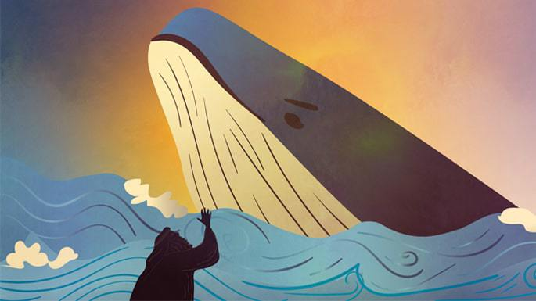
The God Who Revives Sinners
Jonah 2

Slide 2
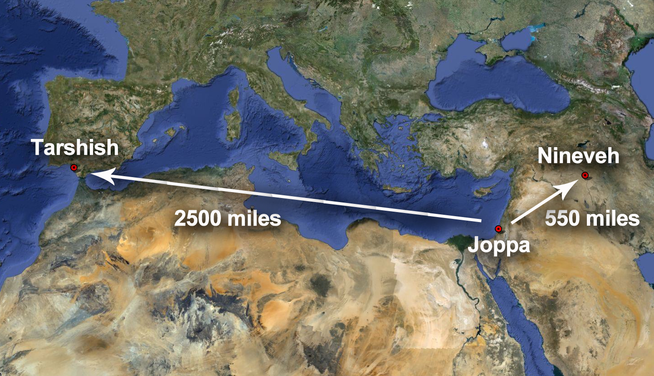

Slide 3
I. Even in your darkest and lowest moment, there is still hope given by God’s mercy.

Slide 4
II. Although deliverance from God might not be immediate, it is still certain.

