Slide 1

Bringing It Together
The Intersections of Faith and Mental Health
Notes:
First, I want to thank you for the privilege of speaking to you about two area that I feel very passionately about: my faith and mental health.
If we were spending 45 minutes together in a therapy session, I would want you to leave with something to reflect on later. This could be a new insight about yourself, a new skill to employ, or a homework assignment for later. My experience has been that if nothing is written down, then the person leaves with just a feeling about the session, whether it was difficult, cathartic, or encouraging. My goal for when you leave today is that you have more than just a sense of the emotion of this session. Everyone should have received a note pad and pen, which I hope that you will utilize. This may be to write down a feeling or thought that you want to explore later. It could be your own resistance that you observe and take note about. When we observe ourselves resisting an emotion, thought, or perspective, this is important to evaluate further. Why am I resisting this? It could be that this emotion feels too vulnerable or that the perspective being presented challenges our previously held beliefs or biases. We improve our reflective function and our self-understanding when we first notice, then name, then consider the origin of our emotions, thoughts, and feelings. So to demonstrate how this works, let’s start with a “mental health check-in.”

Slide 2

Mental Health Check-in
1) What emotion(s) am I feeling right now?
2) What do I notice in my body?
3) What thoughts are predominant?
4) Is there anything that I need right now?
5) What is something for which I am grateful?
Notes:
Here is an example of a mental health check-in. I want you to take a moment to really notice and name the emotion that you are feeling right now. Do you feel tired? Annoyed? Curious? Content? Skeptical?
Now notice what you are feeling in your body…are there any areas where you notice tension? Is your heart beating slow and steady or rapidly? Notice your breath…what does the air feel like to breathe in deeply through your nose…to hold the tension in your chest as your lungs are being filled with air, then to exhale and notice the feeling of air moving out of your chest and releasing tension. To let your shoulders relax.
Now what thoughts are predominant? You may notice during our time together this morning that your mind periodically wanders. This is normal. The average person spends at least 30% of their day in “mind wandering.” Just make a note of what distracted you and then shift your thoughts back to the topic at hand.
Is there anything that you need right now? Sometimes our irritability is fueled by fatigue or hunger, and we may not make connections between our emotions and needs unless we take an inventory. I also realize that today’s topics may weigh heavy, so please take care of yourself and take a break if needed.
Now, I want you to write down at least one thing for which you are genuinely grateful. We will talk a little more about the elements of this check-in later. This exercise is brief, but important for understanding yourself. Try this periodically during the week.

Slide 3

”Do not despise these small beginnings, for the Lord rejoices to see the work begin.”
Zechariah 4:10 NLT
Notes:
So maybe the idea of checking in with yourself, or doing progressive muscle relaxation, or having self-care activities seems insignificant. However, the small things really do matter. A study done by a neurologist, Dr. Sen, recently found that daily flossing could decrease stroke risk. The daily health disciplines, including spiritual, physical and emotional health practices, may seem small but have a great impact.

Slide 4
Mental Health is the intersection of your biology, environment, mind, emotions, and soul.
SOCIAL
BIOLOGICAL
PSYCHOLOGICAL
SPIRITUAL
Notes:
Your mental health is the intersection of your biology, environment, mind, emotions, and soul. In psychiatry, we look at health, illness, and treatment planning from a biological, psychological, social, and spiritual context.
Examples of the Biological components include things such as what conditions are present in your family, your co-occurring medical conditions, what medications you are taking, and how often you use alcohol or other substances, which can worsen psychiatric conditions.
Psychological components include things such as your view of others, your view of yourself, and any past Traumas that you have experienced.
Social components include your Family, Friends, Pets, Employment, Hobbies, and things that you do to take care of yourself.
Spiritual components include your involvement in a Faith community and spiritual practices like scripture reading, prayer, and meditation.
In order to have true health, each of these components should be whole and balanced.

Slide 5

Isaiah 59:1
Behold, the Lord’s hand is not shortened, That it cannot save;
Nor His ear heavy, That it cannot hear.
Jeremiah 32:27
“Behold, I am the Lord, the God of all flesh. Is there anything too hard for Me?
Ephesians 3:20-21
Now to Him who is able to do exceedingly abundantly above all that we ask or think, according to the power that works in us, to Him be glory in the church by Christ Jesus to all generations, forever and ever. Amen.
Notes:
Isaiah 59:1
Behold, the Lord’s hand is not shortened, That it cannot save; Nor His ear heavy, That it cannot hear.
Jeremiah 32:27
“Behold, I am the Lord, the God of all flesh. Is there anything too hard for Me?
Ephesians 3:20-21
Now to Him who is able to do exceedingly abundantly above all that we ask or think, according to the power that works in us, to Him be glory in the church by Christ Jesus to all generations, forever and ever. Amen.
I have seen God do the impossible, and there is nothing too hard for Him. However, God often brings the healing that we pray for through the gifting of those who have dedicated their lives to the art of medicine. The answer to our prayers may be aligning us with a physician with discernment, finding the right medication for our biology, or the right therapist who is empathetic but still pushes us to do the hard things. God works through providing us the people and resources to achieve healing through a process more often that he gives instantaneous healing, but both are miraculous.

Slide 6
Treating Illness from a Biological Perspective
High Blood Pressure
Depression
Medication
Home Blood Pressure Monitoring
Adequate Sleep
Exercise
Stress Reduction/Self-care
Medication
Mood Logs
Adequate Sleep
Exercise
Stress Reduction/Self-care
Notes:
So the ways that we approach mental illness are similar to how we view other medical conditions. Sometimes it takes multiple medication trials for us to discover the right medication or combination of medications that manages an illness. One of my frustrations is when someone who has been very stable discontinues their medications and decompensates because they are getting negative messages from family, friends, or their faith community. We would never tell someone with high blood pressure that they should just “get over” their symptoms or that their medical condition wasn’t real. We wouldn’t tell them to just pray harder or be more spiritual to make their high blood pressure resolve. So why would we treat biological illness related to mental health any differently? We need to make sure that we speak about mental illness in an informed way that supports those who are seeking help. Now that we have talked about the biological aspects of mental health, lets talk about the psychological aspects.

Slide 7
Mark
12:29-30
²⁹ Jesus answered him, “The first of all the commandments is: ‘Hear, O Israel, the Lord our God, the Lord is one.
‘ekad or one: unity made up of several parts
³⁰ And you shall love the Lord your God with all your heart, with all your soul, with all your mind, and with all your strength.’ This is the first commandment.
Notes:
Mark 12:29 says, Jesus answered him, “The first of all the commandments is: ‘Hear, O Israel, the Lord our God, the Lord is one.
The Hebrew word ‘ekad, which is translated as “one,” means unity made up of several parts. This is the mystery of the Trinity.
And you shall love the Lord your God with all your heart, with all your soul, with all your mind, and with all your strength.’ This is the first commandment. Verse 30 addresses the we, being made in the image of God, are also one being with many parts. Your physical body, soul, emotions, and mind are all parts of you, and true health and wellness addresses each of these aspects.

Slide 8

Isaiah 53:3
He is despised and rejected by men,
A Man of sorrows and acquainted with grief.
John 11:33-35
³³ Therefore, when Jesus saw her weeping, and the Jews who came with her weeping, He groaned in the spirit and was troubled. ³⁴ And He said, “Where have you laid him?”
They said to Him, “Lord, come and see.”
³⁵ Jesus wept.
Notes:
Perhaps there is some resistance to acknowledging the importance of emotional health, while easily embracing the role of the mind and logic. Yet Jesus is often portrayed demonstrating deep emotions. Isaiah 53:3 speaks of Jesus when it says that “He is despised and rejected by men,
A Man of sorrows and acquainted with grief.”
In John 11, When Jesus came upon Mary weeping at Lazarus’ tomb, Jesus “groaned in the spirit and was troubled. ³⁴ And He said, “Where have you laid him?” They said to Him, “Lord, come and see.” ³⁵ Jesus wept.”
Jesus intended to raise Lazarus from the grave moments later, YET he still WEPT.

Slide 9
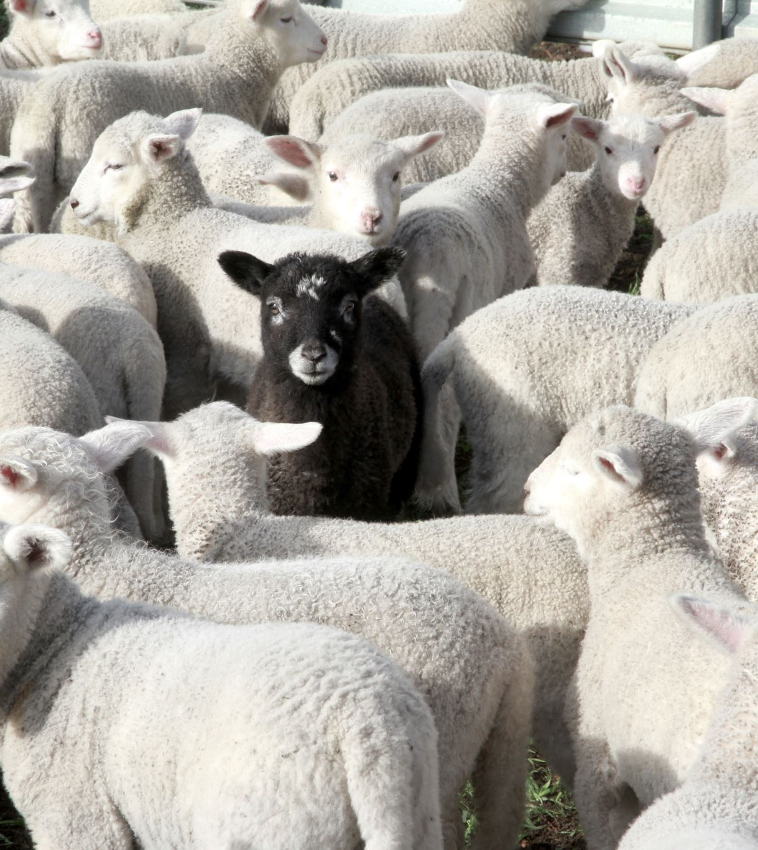
Matthew 9:36
But when He saw the multitudes, He was moved with compassion for them, because they were weary and scattered, like sheep having no shepherd.
Matthew 14:14
And when Jesus went out He saw a great multitude; and He was moved with compassion for them, and healed their sick.
Notes:
Matthew 9:36
But when He saw the multitudes, He was moved with compassion for them, because they were weary and scattered, like sheep having no shepherd.
Matthew 14:14
And when Jesus went out He saw a great multitude; and He was moved with compassion for them, and healed their sick.
Many times in the New Testament, Jesus is described as being “moved with compassion,” which then motivates his behaviors, such as healing the sick, feeding the multitudes, or raising the widow’s son from the dead.

Slide 10
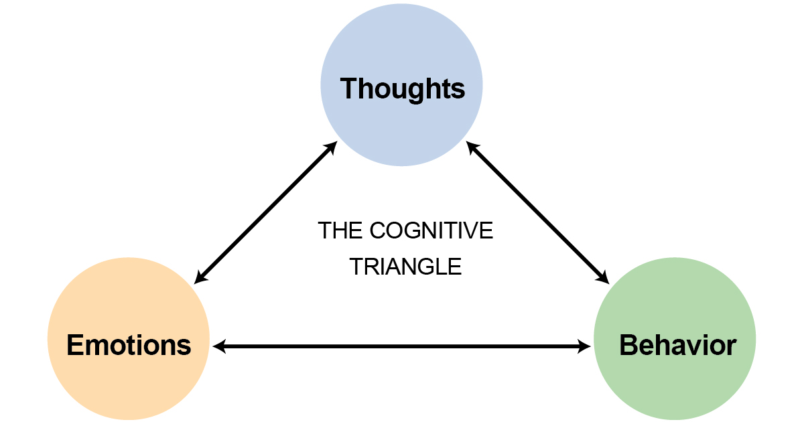
Notes:
This idea that our emotions, thoughts, and behaviors all influence each other is the basis of Cognitive Behavioral Therapy. If you can change your ways of thinking, you can also influence your emotions and behaviors.

Slide 11

^{Philippians 4}
⁴ Rejoice in the Lord always. Again I will say, rejoice!
⁵ Let your gentleness be known to all men. The Lord is at hand.
⁶ Be anxious for nothing, but in everything by prayer and supplication, with thanksgiving, let your requests be made known to God; ⁷ and the peace of God, which surpasses all understanding, will guard your hearts and minds through Christ Jesus.
⁸ Finally, brethren, whatever things are true, whatever things are noble, whatever things are just, whatever things are pure, whatever things are lovely, whatever things are of good report, if there is any virtue and if there is anything praiseworthy—meditate on these things.
Notes:
Now let’s see how similar this is to Philippians 4.
⁴ Rejoice in the Lord always. Again I will say, rejoice!
⁵ Let your gentleness be known to all men. The Lord is at hand.
⁶ Be anxious for nothing, but in everything by prayer and supplication, with thanksgiving, let your requests be made known to God; ⁷ and the peace of God, which surpasses all understanding, will guard your hearts and minds through Christ Jesus.
⁸ Finally, brethren, whatever things are true, whatever things are noble, whatever things are just, whatever things are pure, whatever things are lovely, whatever things are of good report, if there is any virtue and if there is anything praiseworthy—meditate on these things.
Remember how we mentioned the cognitive model? Here in Philippians 4, we are given a list of things on which to meditate, which will influence our emotions and behaviors.

Slide 12
A 2023 meta-analysis (Diniz et al.) showed that gratitude led to “better mental health, and fewer symptoms of anxiety and depression. Furthermore, qualitative analysis demonstrated other benefits such as more positive emotions and moods, greater appreciation and optimism, more prosocial behavior, less worry, and less psychological pain.”
Notes:
Remember the fifth element of our mental health check-in was to identify something for which you were grateful. Scientists are beginning to research what Christians have always known to be true. A meta-analysis by Diniz et al. in 2023 showed that gratitude led to “better mental health, and fewer symptoms of anxiety and depression. Furthermore, qualitative analysis demonstrated other benefits such as more positive emotions and moods, greater appreciation and optimism, more prosocial behavior, less worry, and less psychological pain.”
Diniz G, Korkes L, Tristão LS, Pelegrini R, Bellodi PL, Bernardo WM. The effects of gratitude interventions: a systematic review and meta-analysis. Einstein (Sao Paulo). 2023 Aug 11;21:eRW0371. doi: 10.31744/einstein_journal/2023RW0371. PMID: 37585888; PMCID: PMC10393216.

Slide 13

The World Health Organization (WHO) defines health as "a state of complete physical, mental, and social well-being and not merely the absence of disease or infirmity."
Notes:
The World Health Organization (WHO) defines health as "a state of complete physical, mental, and social well-being and not merely the absence of disease or infirmity."

Slide 14

Romans 12:4-6
⁴ For as we have many members in one body, but all the members do not have the same function, ⁵ so we, being many, are one body in Christ, and individually members of one another. ⁶ Having then gifts differing according to the grace that is given to us, let us use them
Notes:
Just as the World Health Organization and Psychiatry acknowledge social well-being as part of health, community is also foundational to Christianity.
Romans 12:4-6
⁴ For as we have many members in one body, but all the members do not have the same function, ⁵ so we, being many, are one body in Christ, and individually members of one another. ⁶ Having then gifts differing according to the grace that is given to us, let us use them
This also brings us back to the idea of unity from many parts. In the same way that you are made up of body, mind, emotions, and soul, the church is also a body made up of many parts. Each Christian brings a unique gifting and function to the church. If you consider your own body, what system is unimportant? Your cardiovascular system provides oxygen delivery and removes waste, but it can’t function without your lungs and kidneys. Your immune system is often not considered until you are sick. In the same ways, each member of the church brings a needed function to the body, so use your gifts. You are made for community and isolation is concerning.

Slide 15

Isaiah 61:1-3.
“The Spirit of the Lord God is upon Me,
Because the Lord has anointed Me
To preach good tidings to the poor;
He has sent Me to heal the brokenhearted,
To proclaim liberty to the captives,
And the opening of the prison to those who are bound;
² To proclaim the acceptable year of the Lord,
And the day of vengeance of our God;
To comfort all who mourn,
³ To console those who mourn in Zion,
To give them beauty for ashes,
The oil of joy for mourning,
The garment of praise for the spirit of heaviness;
That they may be called trees of righteousness,
The planting of the Lord, that He may be glorified.”
Notes:
Isaiah 61:1-3.
“The Spirit of the Lord God is upon Me,
Because the Lord has anointed Me
To preach good tidings to the poor;
He has sent Me to heal the brokenhearted,
To proclaim liberty to the captives,
And the opening of the prison to those who are bound;
² To proclaim the acceptable year of the Lord,
And the day of vengeance of our God;
To comfort all who mourn,
³ To console those who mourn in Zion,
To give them beauty for ashes,
The oil of joy for mourning,
The garment of praise for the spirit of heaviness;
That they may be called trees of righteousness,
The planting of the Lord, that He may be glorified.”
Luke 4:17 records that Jesus read this passage in Isaiah, then said “today this Scripture is fulfilled in your hearing.” So if this is the mission of Jesus, how often does the church join Him in doing these things? Notice that many of these persons are the marginalized people that society would prefer to ignore. The poor, the brokenhearted, and the captives. Captivity can include physical imprisonment, but may also refer to those who are held captive by addiction, mental illness, or unresolved grief. During his ministry, Jesus served many of the social outcasts of his day: the tax collectors, the unclean, the poor, and the unseen. How often do our own actions and intentions align with the mission and heart of Jesus?

Slide 16

According to NAMI, in the United States each year, mental illness is experienced by
1 in 5 adults
1 in 6 youth aged 6-17
50% of all lifetime mental illness begins by age 14, and 75% by age 24
Notes:
One of the stigmatized and marginalized groups in our society today are those who struggle with mental illness. The National Alliance on Mental Illness (NAMI) reports that each year, mental illness is experienced by 1 in 5 adults and 1 in 6 youth aged 6-17.
Half of all mental illness begins by age 14 and 75% by age 24.

Slide 17

John 9
² And His disciples asked Him, saying, “Rabbi, who sinned, this man or his parents, that he was born blind?”
³ Jesus answered, “Neither this man nor his parents sinned, but that the works of God should be revealed in him.
Notes:
John 9
² And His disciples asked Him, saying, “Rabbi, who sinned, this man or his parents, that he was born blind?”
³ Jesus answered, “Neither this man nor his parents sinned, but that the works of God should be revealed in him.
There is already so much stigma surrounding mental health. We have to make sure the church is an affirming place that supports and facilitates healing. The Health and Prosperity philosophy attributes success or failure to the actions of the individual. This theory is idolatry, making the individual their own god, manifesting blessing or cursing based on their own action. Jesus highlighted that biological illness is not necessarily the result of a sin or failure on the part of the person who is suffering.

Slide 18

“Mental illness is not the result of a personal weakness, lack of character or poor upbringing. Likewise, it isn’t about “getting over it” through willpower. Without meaning to, we may…add to the stigma that many living with a mental health condition experience.” -NAMI
Notes:
According to NAMI, “Mental illness is not the result of a personal weakness, lack of character or poor upbringing. Likewise, it isn’t about “getting over it” through willpower. Without meaning to, we may…add to the stigma that many living with a mental health condition experience.”
It’s important that we examine our own biases regarding mental health and are thoughtful in how we speak about it to others.

Slide 19
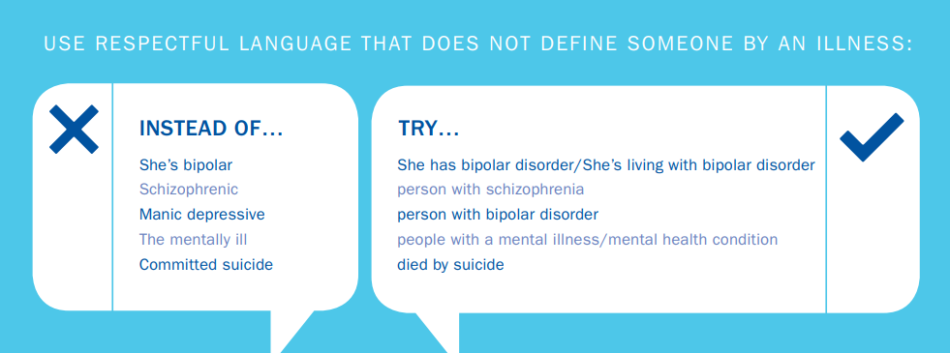
Person-Centered, Respectful Language
Matthew 12:34
For out of the abundance of the heart the mouth speaks.
Notes:
Matthew 12:34
For out of the abundance of the heart the mouth speaks.
How we speak about mental illness says a lot about the attitude of our hearts towards those who are suffering.
If we use respectful, person-centered language, we will not define people by their illness. Some examples include “She’s living with bipolar disorder.” “He’s a person with schizophrenia.” or referencing “People with a mental illness or mental health condition.”
It’s also important that we use non-stigmatizing language when discussing suicide. We do not use the language “committed suicide,” as this has negative connotations, like committed a crime or committed a sin. Instead we say “died from suicide” in the same way that we would say someone “died from a heart attack” or “died from cancer.”

Slide 20

God described Job by saying “there is none like him on the earth, a blameless and upright man, one who fears God and shuns evil” Job 1:8
Job 7:16
I loathe my life; I would not live forever. Let me alone, For my days are but a breath.
Notes:
God described Job by saying “there is none like him on the earth, a blameless and upright man, one who fears God and shuns evil?” When disasters have taken everything except his wife, Job’s friends do well when they just sit with him in his grief.
However, despite God’s endorsement of Job as a blameless and upright man, Job’s friends eventually state that this series of calamities must be in some way Job’s fault. As Job begins to despair, He says “I loathe my life; I would not live forever. Let me alone, For my days are but a breath.” Job felt that his life was lacking meaning and purpose, which led him to lose his desire for life.

Slide 21

Psalm 6:6
I am weary with my groaning;
All night I make my bed swim;
I drench my couch with my tears.
Psalm 13: 1-2
How long, O Lord? Will You forget me forever?
How long will You hide Your face from me?
² How long shall I take counsel in my soul,
Having sorrow in my heart daily?
Notes:
When we read the Psalms, David often expresses deep sorrow, from being weary with his groaning, to swimming in his tears, to having sorrow in his heart daily. He also expresses feeling forgotten by God, as if God is hidden from him.

Slide 22

I Kings 19:4
But he himself went a day’s journey into the wilderness, and came and sat down under a broom tree. And he prayed that he might die, and said, “It is enough! Now, Lord, take my life”
Notes:
I Kings 19:4
But he himself went a day’s journey into the wilderness, and came and sat down under a broom tree. And he prayed that he might die, and said, “It is enough! Now, Lord, take my life”
Elijah had just experienced God demonstrating his supremacy by working a miracle in front of the prophets of Baal on Mount Caramel. Elijah was a man of great faith, but still struggled with thoughts of wanting to die. Jezebel was seeking to kill him, and he felt alone. One warning sign is that Elijah left behind his servant and went into the wilderness alone. God provided food, and Elijah walked for 40 days until he reached Horeb, the mountain of God. God spoke to Elijah, not in the wind that broke the rocks, or the earthquake, or in the fire, but in a “still small voice.” In verse 10, Elijah speaks with God and says, “I alone am left; and they seek to take my life.” Isolation and hopelessness fueled Elijah’s desire to die. God revealed that there were still 7,000 faithful servants in Israel and provided Elisha as an intern.
Job was blameless and upright, David was a man after God’s own heart, and Elijah was a prophet. Their examples of depression and thoughts of death demonstrate that no person, no matter how spiritual, is exempt from struggling with their mental health.

Slide 23

The actual ratio of attempts to completed suicides is probably at least 10 to 1. This somewhat backs up the theory that many of those who attempt suicide want their pain to end, not their life.
Eight out of ten people considering suicide give some sign of their intentions. This emphasizes that learning the warning signs is essential to recognizing the people who may be at risk. Some of the major warning signs include:
talking about death or suicide
looking for the means to kill oneself
hopelessness and anger/irritability
dramatic changes in mood, appetite or sleep patterns
Don’t be afraid to ask your loved one: “Are you having thoughts of suicide?” If the answer is yes, stay with them and call 988.
Notes:
The actual ratio of attempts to completed suicides is probably at least 10 to 1. This somewhat backs up the theory that many of those who attempt suicide want their pain to end, not their life.
Eight out of ten people considering suicide give some sign of their intentions. This emphasizes that learning the warning signs is essential to recognizing the people who may be at risk. Some of the major warning signs include:
talking about death or suicide
looking for the means to kill oneself
hopelessness and anger/irritability
dramatic changes in mood, appetite or sleep patterns
Don’t be afraid to ask your loved one: “Are you having thoughts of suicide?” If the answer is yes, stay with them and call 988.
Promote Hope, Healing and Help to Prevent Suicide | NAMI: National Alliance on Mental Illness

Slide 24
Get comfortable feeling uncomfortable. Your physical and emotional presence will have a big impact on how the conversation goes.
Create a safe space. Find a place for privacy and comfort.
Start with, “I’ve noticed….”Thank them for taking time to speak with you, and list the observations you’ve made that led you to be concerned.
Ask open-ended questions. “I’d like to understand more about what you’re going through. Can you tell me more?”
Practice active listening. Refrain from problem-solving and advice-giving. Instead, show them that they are being heard. Use minimal encouragers like nodding your head, and saying, “and then what happened” to keep the conversation going.
Notes:
Get comfortable feeling uncomfortable. Your physical and emotional presence will have a big impact on how the conversation goes.
Create a safe space. Find a place for privacy and comfort.
Start with, “I’ve noticed….”Thank them for taking time to speak with you, and list the observations you’ve made that led you to be concerned.
Ask open-ended questions. “I’d like to understand more about what you’re going through. Can you tell me more?”
Practice active listening. Refrain from problem-solving and advice-giving. Instead, show them that they are being heard. Use minimal encouragers like nodding your head, and saying, “and then what happened” to keep the conversation going.
How to Ask Someone About Suicide | NAMI: National Alliance on Mental Illness

Slide 25
Frame the question in empathy and compassion. “You know, sometimes when people are going through what you’re going through, they find themselves in unimaginable pain. Thoughts like, ‘I wish I could go to bed and not wake up in the morning’ enter their mind because their pain has exceeded their ability to cope.”
Assume that suicide is “on the menu.” Because suicidal thoughts are common for people who feel overwhelmed, you can say something like, “Sometimes when emotional pain is so intense, people think about suicide. I’m wondering how many times suicide might have crossed your mind, even if just fleeting in nature.”
Use direct language. Using the word “suicide” in a direct way says, “We can talk about this here.” It’s important to use the direct language of “suicide” rather than “hurting yourself,” because these are different questions.
Notes:
Frame the question in empathy and compassion. “You know, sometimes when people are going through what you’re going through, they find themselves in unimaginable pain. Thoughts like, ‘I wish I could go to bed and not wake up in the morning’ enter their mind because their pain has exceeded their ability to cope.”
Assume that suicide is “on the menu.” Because suicidal thoughts are common for people who feel overwhelmed, you can say something like, “Sometimes when emotional pain is so intense, people think about suicide. I’m wondering how many times suicide might have crossed your mind, even if just fleeting in nature.”
Use direct language. Using the word “suicide” in a direct way says, “We can talk about this here.” It’s important to use the direct language of “suicide” rather than “hurting yourself,” because these are different questions.
How to Ask Someone About Suicide | NAMI: National Alliance on Mental Illness

Slide 26

Ephesians 4:1-3
I, therefore, the prisoner of the Lord, beseech you to walk worthy of the calling with which you were called, ² with all lowliness and gentleness, with longsuffering, bearing with one another in love, ³ endeavoring to keep the unity of the Spirit in the bond of peace.
Notes:
Ephesians 4:1-3
I, therefore, the prisoner of the Lord, beseech you to walk worthy of the calling with which you were called, ² with all lowliness and gentleness, with longsuffering, bearing with one another in love, ³ endeavoring to keep the unity of the Spirit in the bond of peace.

Slide 27

Responding to Others in a Storm
Romans 12:15
Rejoice with those who rejoice, and weep with those who weep.
II Corinthians 1:3-4
³ Blessed be the God and Father of our Lord Jesus Christ, the Father of mercies and God of all comfort, ⁴ who comforts us in all our tribulation, that we may be able to comfort those who are in any trouble, with the comfort with which we ourselves are comforted by God.
Notes:
Romans 12:15
Rejoice with those who rejoice, and weep with those who weep.
It is easy for us to share in rejoicing, but how often do we allow ourselves to sit with the hard emotions of others? Job’s friends did their best when they sat with Job in silence. There is a ministry of presence that we can provide to those who are hurting.
II Corinthians 1:3-4 ³ Blessed be the God and Father of our Lord Jesus Christ, the Father of mercies and God of all comfort, ⁴ who comforts us in all our tribulation, that we may be able to comfort those who are in any trouble, with the comfort with which we ourselves are comforted by God.
God comforts us in our tribulations, so that we can in turn share that comfort with others who are suffering. Your greatest pain and struggles may one day be the source of your greatest ministry.

Slide 28

Romans 15:13
Now may the God of hope fill you with all joy and peace in believing, that you may abound in hope by the power of the Holy Spirit.
Hebrews 19:20-21
This hope we have as an anchor of the soul, both sure and steadfast, and which enters the Presence behind the veil, ²⁰ where the forerunner has entered for us, even Jesus, having become High Priest forever according to the order of Melchizedek.
Notes:
Romans 15:13
Now may the God of hope fill you with all joy and peace in believing, that you may abound in hope by the power of the Holy Spirit.
Hebrews 19:20-21
This hope we have as an anchor of the soul, both sure and steadfast, and which enters the Presence behind the veil, ²⁰ where the forerunner has entered for us, even Jesus, having become High Priest forever according to the order of Melchizedek.
One of the modifiable risk factors for suicide is hopelessness. As believers, we have hope for today, the future, and eternity, and sharing this hope can save lives. We have Jesus as an anchor for our souls, and even when everything else falls apart, He is sure and steadfast.

Slide 29

Lamentations 3:21-26
²¹ This I recall to my mind,
Therefore I have hope.
²² Through the Lord’s mercies we are not consumed,
Because His compassions fail not.
²³ They are new every morning;
Great is Your faithfulness.
²⁴ “The Lord is my portion,” says my soul,
“Therefore I hope in Him!”
²⁵ The Lord is good to those who wait for Him,
To the soul who seeks Him.
²⁶ It is good that one should hope and wait quietly
For the salvation of the Lord.
Notes:
Lamentations 3:21-26
²¹ This I recall to my mind,
Therefore I have hope.
²² Through the Lord’s mercies we are not consumed,
Because His compassions fail not.
²³ They are new every morning;
Great is Your faithfulness.
²⁴ “The Lord is my portion,” says my soul,
“Therefore I hope in Him!”
²⁵ The Lord is good to those who wait for Him,
To the soul who seeks Him.
²⁶ It is good that one should hope and wait quietly
For the salvation of the Lord.
When we find ourselves in a storm, we can find hope by recalling to our mind (intentionally changing our thoughts if you recall the CBT model) and meditating on the Lord’s mercy and faithfulness, which brings us to hope.

Slide 30

Notes:
We are all born with a congenital disease called sin. Romans 5:12 Wherefore, as by one man sin entered into the world, and death by sin; and so death passed upon all men, for that all have sinned. The natural result of sin is that it leads to death and separation from God. Romans 6:23 says For the wages of sin is death; but the gift of God is eternal life through Jesus Christ our Lord. Romans 10:9 says if you confess with your mouth the Lord Jesus and believe in your heart that God has raised Him from the dead, you will be saved. I would love to talk to you more about how to find HOPE.
Maybe this picture is how you feel today…like your surrounded by desolation and barely surviving. It could be that you are grieving a loss or in chronic pain or fighting a battle with your mental health or struggling with addiction or maybe the weight of the day to day is crushing you. I want you to know that you are not broken. That you matter. There’s help and hope.

Slide 31

Isaiah 54:10
For the mountains shall depart
And the hills be removed,
But My kindness shall not depart from you,
Nor shall My covenant of peace be removed,”
Says the Lord, who has mercy on you.
Notes:
Isaiah 54:10
For the mountains shall depart
And the hills be removed,
But My kindness shall not depart from you,
Nor shall My covenant of peace be removed,”
Says the Lord, who has mercy on you.

Slide 32

Jeremiah 29:11-13
For I know the thoughts that I think toward you, says the Lord, thoughts of peace and not of evil, to give you a future and a hope. Then you will call upon Me and go and pray to Me, and I will listen to you. And you will seek Me and find Me, when you search for Me with all your heart.

Slide 33

Psalm 61:2
When my heart is overwhelmed; Lead me to the rock that is higher than I.

Slide 34

The Lord is near to the brokenhearted
And saves those who are crushed in spirit.
Psalm 34:18 (NASB)

Slide 35
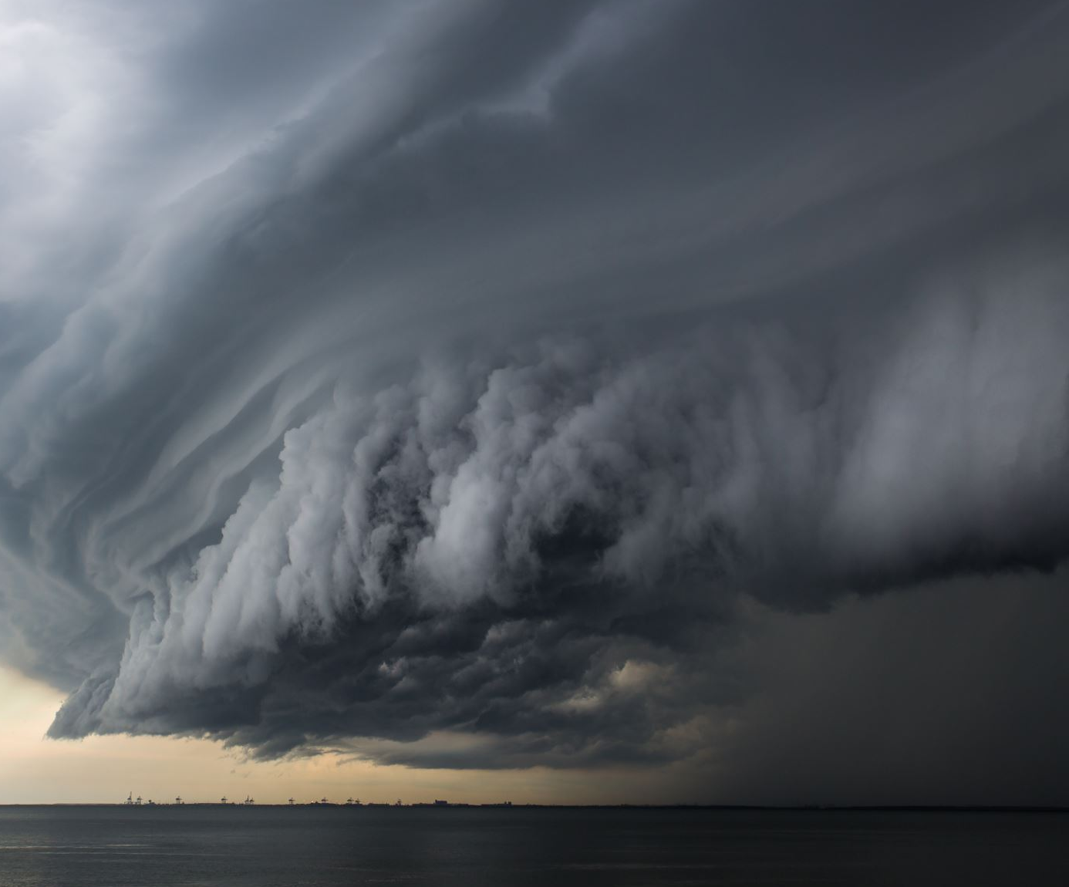
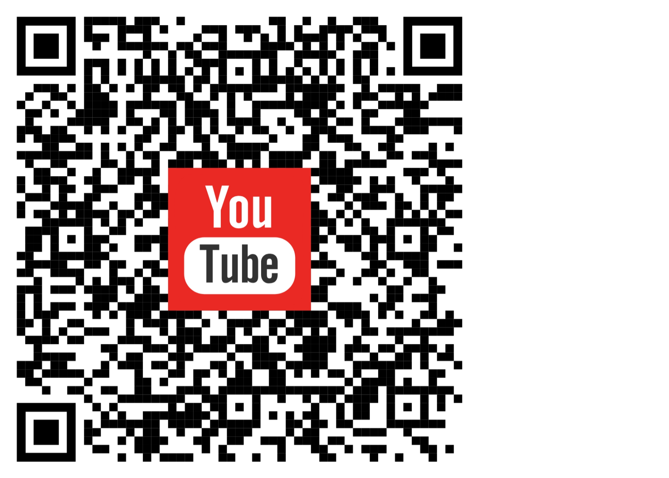
Songs for the Struggle

Slide 36

Hebrews 4:15
For we do not have a High Priest who cannot sympathize with our weaknesses, but was in all points tempted as we are, yet without sin.
II Timothy 1:7
For God has not given us a spirit of fear, but of power and of love and of a sound mind.

Slide 37

Bringing It Together
The Intersections of Faith and Mental Health

