Slide 1
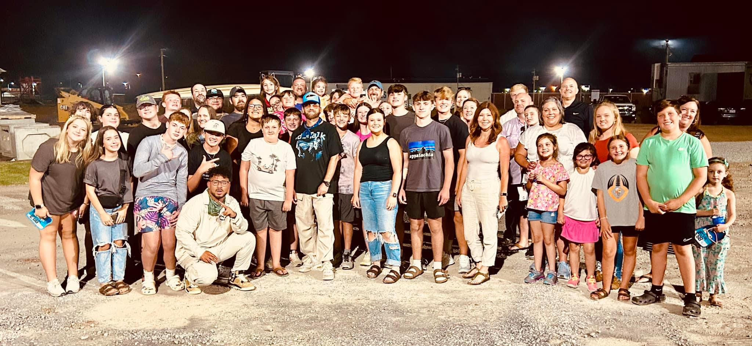

Slide 2

DANIEL 1 : 8 – 14
⁸ But Daniel purposed in his heart that he would not defile himself with the portion of the king's meat, nor with the wine which he
drank: …

Slide 3
⁸ … therefore he requested of the prince of the eunuchs that he might not defile himself.

Slide 4
⁹ Now God had brought Daniel into favour and tender love with the prince of the eunuchs.

Slide 5
¹⁰ And the prince of the eunuchs said unto Daniel, I fear my lord the king, who hath appointed
your meat and
your drink: …

Slide 6
¹⁰ … for why should he see your faces worse liking than the children which are of your sort? then shall ye make me endanger my head to the king.

Slide 7
¹¹ Then said Daniel to Melzar, whom the prince of the eunuchs had set over Daniel, Hananiah, Mishael, and Azariah,

Slide 8
¹² Prove thy servants, I beseech thee, ten days; and let them give us pulse to eat, and water to drink.

Slide 9
¹³ Then let our countenances be looked upon before thee, and the countenance of the children that eat of the portion of the king's meat: and as thou seest, deal with thy servants.

Slide 10
¹⁴ So he consented to them in this matter, and proved them ten days.

Slide 11
THE TEST OF
INFLUENCE
A
⁸ But

Slide 12
INFLUENCE
1. Define PURPOSE

Slide 13
INFLUENCE
1. Define PURPOSE
2. Decide PRINCIPLES

Slide 14
INFLUENCE
1. Define PURPOSE
2. Decide PRINCIPLES
3. Direction PATH

Slide 15
INFLUENCE
1. Define PURPOSE
2. Decide PRINCIPLES
3. Direction PATH
4. Dedicated PRAYER

Slide 16
INFLUENCE
1. Define PURPOSE
2. Decide PRINCIPLES
3. Direction PATH
4. Dedicated PRAYER
5. Determined PERSISTENCE

Slide 17
DANIEL 1 : 15 – 21
¹⁵ And at the end of ten days their countenances appeared fairer and fatter in flesh than all the children which did eat the portion of the king's meat.

Slide 18
¹⁶ Thus Melzar took away the portion of their meat, and the wine that they should drink; and gave
them pulse.

Slide 19
¹⁷ As for these four children, God gave them knowledge and skill in all learning and wisdom: and Daniel had understanding in all visions and dreams.

Slide 20
¹⁸ Now at the end of the days that the king had said he should bring them in, then the prince of the eunuchs brought them in before Nebuchadnezzar.

Slide 21
¹⁹ And the king communed with them; and among them all was found none like Daniel, Hananiah, Mishael, and Azariah: therefore stood they before the king.

Slide 22
²⁰ And in all matters of wisdom and understanding, that the king enquired of them, he found them ten times better than all the magicians and astrologers that were in all his realm.

Slide 23
²¹ And Daniel continued even unto the first year of king Cyrus.

