Slide 1

The King and His Kingdom Part 39
“Costs and Rewards”
Matthew 10:34-42
September 21, 2025

Slide 2

Matthew 10:34-42 (ESV) – [34] “Do not think that I have come to bring peace to the earth. I have not come to bring peace, but a sword. [35] For I have come to set a man against his father, and a daughter against her mother, and a daughter-in-law against her mother-in-law. [36] And a person’s enemies will be those of his own household.

Slide 3
[37] Whoever loves father or mother more than me is not worthy of me, and whoever loves son or daughter more than me is not worthy of me. [38] And whoever does not take his cross and follow me is not worthy of me. [39] Whoever finds his life will lose it, and whoever loses his life for my sake will find it.

Slide 4
[40] “Whoever receives you receives me, and whoever receives me receives him who sent me. [41] The one who receives a prophet because he is a prophet will receive a prophet’s reward, and the one who receives a righteous person because he is a righteous person will receive a righteous person’s reward.

Slide 5
[42] And whoever gives one of these little ones even a cup of cold water because he is a disciple, truly, I say to you, he will by no means lose his reward.”

Slide 6
[34] “Do not think that I have come to bring peace to the earth. I have not come to bring peace, but a sword.

Slide 7
[35] For I have come to set a man against his father, and a daughter against her mother, and a daughter-in-law against her mother-in-law. [36] And a person’s enemies will be those of his own household. [37] Whoever loves father or mother more than me is not worthy of me, and whoever loves son or daughter more than me is not worthy of me.

Slide 8
"You don't know what you're asking me. Do you know what would happen if I did that? If I announced it to anybody, my wife would leave me. My family would disown me. My boss would fire me. I may want to leave to go back to the United States, and the government would not give me an exit visa. I'd give up everything. You go back home tomorrow. I would not expect you would support me, and I would starve to death in my own culture."

Slide 9
“If you think that Romans 8:28 – ‘All things work together for good to them who love God, to them who are the called according to his purposes,’ – is a promise that you'll have a middle-class life in a lovely little church in a nice little town where you may even get a pass to the country club, you're wrong.”
–Haddon Robinson

Slide 10
[38] And whoever does not take his cross and follow me is not worthy of me. [39] Whoever finds his life will lose it, and whoever loses his life for my sake will find it.
“Love of one’s own life is often the greatest hindrance to full commitment to Christ.”
–John MacArthur

Slide 11
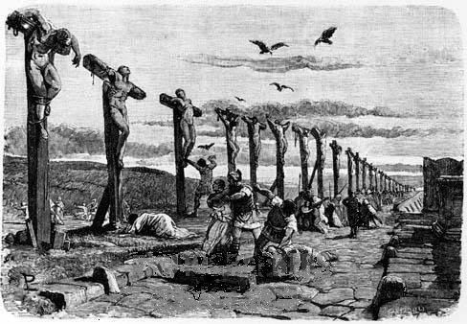

Slide 12
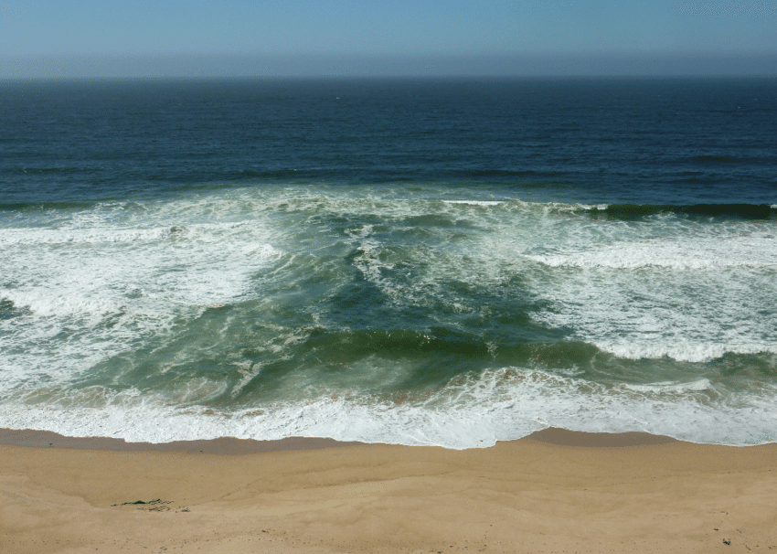
[39] Whoever finds his life will lose it, and whoever loses his life for my sake will find it.

Slide 13
“If you try to go the way your gut tells you to go –the shortest distance into shore – you will die. If you think for yourself, you will die. God says, ‘If you come to me, you will live.’ That's it – death or life.”
–John Ortberg

Slide 14
[40] “Whoever receives you receives me, and whoever receives me receives him who sent me. [41] The one who receives a prophet because he is a prophet will receive a prophet’s reward, and the one who receives a righteous person because he is a righteous person will receive a righteous person’s reward. [42] And whoever gives one of these little ones even a cup of cold water because he is a disciple, truly, I say to you, he will by no means lose his reward.”

Slide 15
Resources (1):
J. Vernon McGee. “Thru the Bible with J. Vernon McGee, Volume IV, Matthew-Romans.” Thomas Nelson Publishing, 1982.
John MacArthur. “The MacArthur New Testament Commentary.” Moody Publishers, 1985.
Warren W. Wiersbe. “The Wiersbe Bible Commentary, The Complete New Testament in One Volume.” David C. Cook, 2007.
David Platt. “Christ Centered Exposition: Exalting Jesus in Matthew.” Series Editors: David Platt, Daniel L. Akin, and Tony Merida. B&H Publishing Group, 2013.

Slide 16
Resources (2):
Charles H. Spurgeon. “Commentary on Matthew: The Gospel of the Kingdom.” The Banner of Truth Trust, first publication 1893, reprinted 2010, 2013.
Haddon Robinson. From the sermon, "Love Keeps Going." PreachingToday.com. https://www.preachingtoday.com/illustrations/2011/october/1102411.html
John Ortberg. From the sermon, "Thee Way of Wisdom." PreachingToday.com. https://www.preachingtoday.com/illustrations/2009/october/2101909.html

Slide 17
Resources (3):
Image - https://bobowenblog.com/2016/03/17/cross/
Image - https://www.researchgate.net/figure/Example-of-a-typical-rip-current-at-Marina-Beach-California-The-rip-current-can-be_fig1_321741831

