Slide 1

The King and His Kingdom Part 73
“Grace in the Vineyard”
Matthew 20:1-16 August 23, 2026

Slide 2

Parables are “earthly stories with heavenly meaning.”
Mark 4:34 – “He (Jesus) did not say anything to them without using a parable.”

Slide 3
Matthew 19:30 – But many who are first will be last, and the last first.

Slide 4
Matthew 20:1-16 (ESV) – [1] “For the kingdom of heaven is like a master of a house who went out early in the morning to hire laborers for his vineyard. [2] After agreeing with the laborers for a denarius a day, he sent them into his vineyard. [3] And going out about the third hour he saw others standing idle in the marketplace,

Slide 5
[4] and to them he said, ‘You go into the vineyard too, and whatever is right I will give you.’ [5] So they went. Going out again about the sixth hour and the ninth hour, he did the same. [6] And about the eleventh hour he went out and found others standing. And he said to them, ‘Why do you stand here idle all day?’

Slide 6
[7] They said to him, ‘Because no one has hired us.’ He said to them, ‘You go into the vineyard too.’ [8] And when evening came, the owner of the vineyard said to his foreman, ‘Call the laborers and pay them their wages, beginning with the last, up to the first.’ [9] And when those hired about the eleventh hour came, each of them received a denarius.

Slide 7
[10] Now when those hired first came, they thought they would receive more, but each of them also received a denarius. [11] And on receiving it they grumbled at the master of the house, [12] saying, ‘These last worked only one hour, and you have made them equal to us who have borne the burden of the day and the scorching heat.’

Slide 8
[13] But he replied to one of them, ‘Friend, I am doing you no wrong. Did you not agree with me for a denarius? [14] Take what belongs to you and go. I choose to give to this last worker as I give to you. [15] Am I not allowed to do what I choose with what belongs to me? Or do you begrudge my generosity?’ [16] So the last will be first, and the first last.”

Slide 9
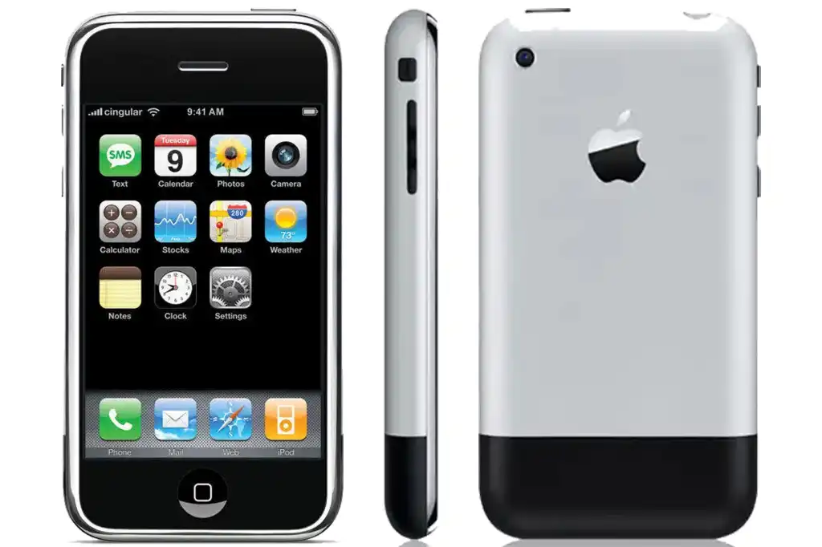

Slide 10
The disciples were often concerned about being the first and/or the greatest.
Examples:
Matthew 18:1 – All of the disciples
Matthew 20:20 – James and John
Matthew 19:27 – Peter

Slide 11
[1] “For the kingdom of heaven is like a master of a house who went out early in the morning to hire laborers for his vineyard. [2] After agreeing with the laborers for a denarius a day, he sent them into his vineyard.

Slide 12
[3] And going out about the third hour he saw others standing idle in the marketplace, [4] and to them he said, ‘You go into the vineyard too, and whatever is right I will give you.’

Slide 13
[5] So they went. Going out again about the sixth hour and the ninth hour, he did the same.

Slide 14
[6] And about the eleventh hour he went out and found others standing. And he said to them, ‘Why do you stand here idle all day?’ [7] They said to him, ‘Because no one has hired us.’ He said to them, ‘You go into the vineyard too.’

Slide 15
[8] And when evening came, the owner of the vineyard said to his foreman, ‘Call the laborers and pay them their wages, beginning with the last, up to the first.’ [9] And when those hired about the eleventh hour came, each of them received a denarius.

Slide 16
[10] Now when those hired first came, they thought they would receive more, but each of them also received a denarius. [11] And on receiving it they grumbled at the master of the house,

Slide 17
[12] saying, ‘These last worked only one hour, and you have made them equal to us who have borne the burden of the day and the scorching heat.’

Slide 18
[13] But he replied to one of them, ‘Friend, I am doing you no wrong. Did you not agree with me for a denarius? [14] Take what belongs to you and go. I choose to give to this last worker as I give to you. [15] Am I not allowed to do what I choose with what belongs to me? Or do you begrudge my generosity?’ [16] So the last will be first, and the first last.”

Slide 19
Parable of the Laborers in the Vineyard
owner = God the Father
foreman = Jesus
workers = believers
denarius = eternal life in heaven
workday = lifetime
evening = eternity

Slide 20
“God’s grace in salvation is, by definition, not fair.”
– David Platt
“Do you really want nothing but totally effective, instantaneous justice? Then go to hell…”
– D.A. Carson

Slide 21
Romans 3:23 – “for all have sinned and fall short of the glory of God.”
Isaiah 64:6 – “All of us have become like one who is unclean, and all our righteous acts are like filthy rags…”

Slide 22
“God doesn’t owe us salvation for something we have done; He gives us salvation despite everything we have done. Salvation is a free gift of divine mercy totally devoid of human merit. God owes us nothing, yet He gives us everything in Christ.”
– David Platt

Slide 23
Resources (1):
J. Vernon McGee. “Thru the Bible with J. Vernon McGee, Volume IV, Matthew-Romans.” Thomas Nelson Publishing, 1982.
John MacArthur. “The MacArthur New Testament Commentary.” Moody Publishers, 1985.
Warren W. Wiersbe. “The Wiersbe Bible Commentary, The Complete New Testament in One Volume.” David C. Cook, 2007.
David Platt. “Christ Centered Exposition: Exalting Jesus in Matthew.” Series Editors: David Platt, Daniel L. Akin, and Tony Merida. B&H Publishing Group, 2013.
Charles H. Spurgeon. “Commentary on Matthew: The Gospel of the Kingdom.” The Banner of Truth Trust, first publication 1893, reprinted 2010, 2013.

Slide 24
Resources (2):
https://www.gotquestions.org/what-is-a-parable.html
https://www.gotquestions.org/parable-laborers-vineyard.html
May Wong, "Many iPhone owners relish being first." www.news.yahoo.com, 09-07-07.
Image - https://www.macworld.com/article/186335/original-iphone-review-2.html

