Slide 1

The King and His Kingdom Part 74
“A Different Kind of Greatness”
Matthew 20:17-28 September 6, 2026

Slide 2

Matthew 20:17-19 (ESV) – [17] And as Jesus was going up to Jerusalem, he took the twelve disciples aside, and on the way he said to them, [18] “See, we are going up to Jerusalem. And the Son of Man will be delivered over to the chief priests and scribes, and they will condemn him to death [19] and deliver him over to the Gentiles to be mocked and flogged and crucified, and he will be raised on the third day.”

Slide 3
Jerusalem is about 15 miles west of Jericho.
Jericho is around 1,000 feet below sea level.
Jerusalem is 2,500 feet above sea level.
Luke 9:51 – When the days drew near for him to be taken up, he set his face to go to Jerusalem.

Slide 4
“They were still thinking lion, but He was thinking Lamb. They were thinking kingdom, but He was thinking sacrifice. They were thinking glory, but He was thinking suffering and death.”
– John MacArthur

Slide 5
Jesus dying on the cross was always God’s “Plan A” from the beginning.
There was never a backup plan.
Jesus knew this was the plan all along.

Slide 6
2 Corinthians 5:21 – For our sake he made him to be sin who knew no sin, so that in him we might become the righteousness of God.

Slide 7
Jesus chose the cross.
Hebrews 12:2 – looking to Jesus, the founder and perfecter of our faith, who for the joy that was set before him endured the cross, despising the shame, and is seated at the right hand of the throne of God.

Slide 8
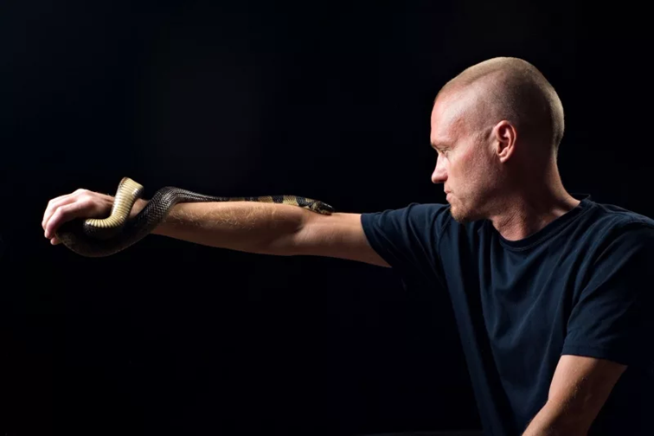

Slide 9
Matthew 20:20-28 – [20] Then the mother of the sons of Zebedee came up to him with her sons, and kneeling before him she asked him for something. [21] And he said to her, “What do you want?” She said to him, “Say that these two sons of mine are to sit, one at your right hand and one at your left, in your kingdom.”

Slide 10
[22] Jesus answered, “You do not know what you are asking. Are you able to drink the cup that I am to drink?” They said to him, “We are able.” [23] He said to them, “You will drink my cup, but to sit at my right hand and at my left is not mine to grant, but it is for those for whom it has been prepared by my Father.” [24] And when the ten heard it, they were indignant at the two brothers.

Slide 11
[25] But Jesus called them to him and said, “You know that the rulers of the Gentiles lord it over them, and their great ones exercise authority over them. [26] It shall not be so among you. But whoever would be great among you must be your servant, [27] and whoever would be first among you must be your slave, [28] even as the Son of Man came not to be served but to serve, and to give his life as a ransom for many.”

Slide 12
[21] And he said to her, “What do you want?” She said to him, “Say that these two sons of mine are to sit, one at your right hand and one at your left, in your kingdom.” [22] Jesus answered, “You do not know what you are asking. Are you able to drink the cup that I am to drink?” They said to him, “We are able.”

Slide 13
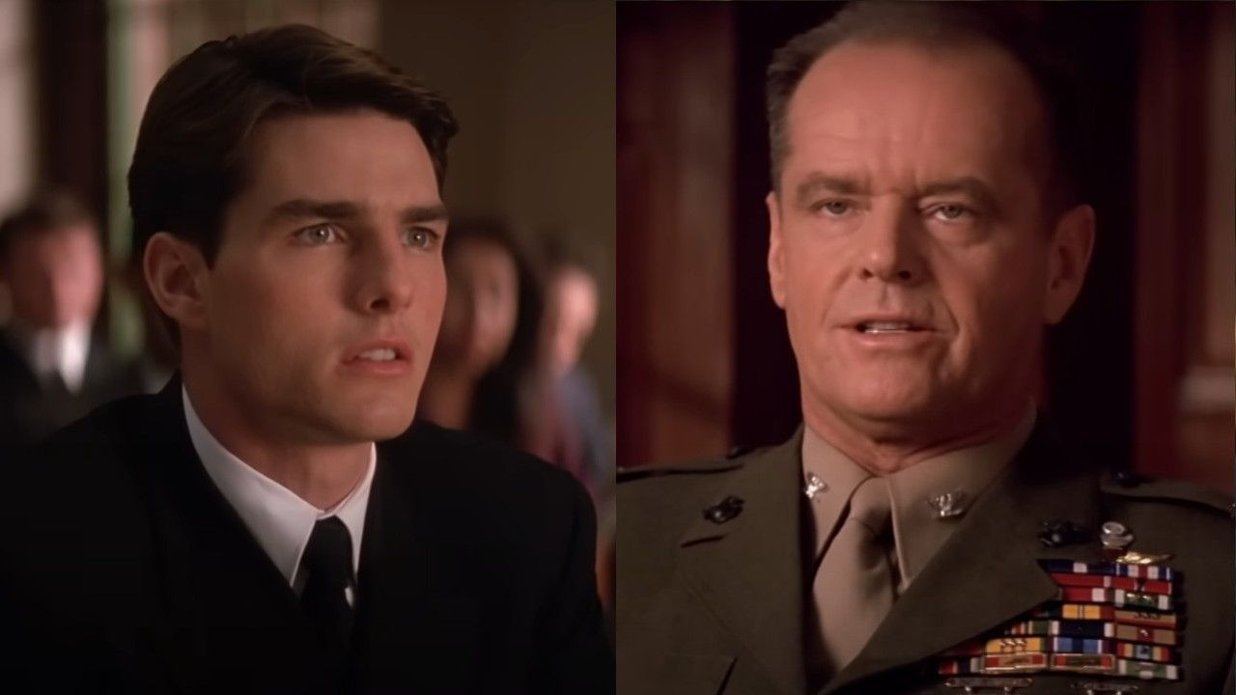

Slide 14
Matthew 26:39 – And going a little farther he fell on his face and prayed, saying, “My Father, if it be possible, let this cup pass from me; nevertheless, not as I will, but as you will.”

Slide 15
Matthew 20:23 – He said to them, “You will drink my cup, but to sit at my right hand and at my left is not mine to grant, but it is for those for whom it has been prepared by my Father.”

Slide 16
Matthew 20:24 – And when the ten heard it, they were indignant at the two brothers.
“Indignant” means to feel or show anger because of something that seems unfair, wrong, or insulting.

Slide 17
Matthew 20:25-28 – [25] But Jesus called them to him and said, “You know that the rulers of the Gentiles lord it over them, and their great ones exercise authority over them. [26] It shall not be so among you. But whoever would be great among you must be your servant, [27] and whoever would be first among you must be your slave, [28] even as the Son of Man came not to be served but to serve, and to give his life as a ransom for many.”

Slide 18
Point of application: Jesus defines greatness in His Kingdom by humility and servanthood.
Greatness in God’s Kingdom is the opposite of greatness in the world.
SERVE - - - - - GIVE - - - - - SACRIFICE

Slide 19
Matthew 20:28 – even as the Son of Man came not to be served but to serve, and to give his life as a ransom for many.”
The example Jesus set in humility and servanthood extended all the way to the cross.

Slide 20
Resources (1):
J. Vernon McGee. “Thru the Bible with J. Vernon McGee, Volume IV, Matthew-Romans.” Thomas Nelson Publishing, 1982.
John MacArthur. “The MacArthur New Testament Commentary.” Moody Publishers, 1985.
Warren W. Wiersbe. “The Wiersbe Bible Commentary, The Complete New Testament in One Volume.” David C. Cook, 2007.
David Platt. “Christ Centered Exposition: Exalting Jesus in Matthew.” Series Editors: David Platt, Daniel L. Akin, and Tony Merida. B&H Publishing Group, 2013.
Charles H. Spurgeon. “Commentary on Matthew: The Gospel of the Kingdom.” The Banner of Truth Trust, first publication 1893, reprinted 2010, 2013.

Slide 21
Resources (2):
Ari Daniel. "Snakebite Cure Developed Through Extreme Self-Sacrifice." All Things Considered, NPR, May 2, 2025, www.npr.org/sections/goats-and-soda/2025/05/02/nx-s1-5381017/snake-bite-venom-antivenom-tim-friede-universal
Image - https://www.cinemablend.com/movies/tom-cruise-on-working-with-jack-nicholson-a-few-good-men-filming-iconic-courtroom-scene

