Slide 1

The King and His Kingdom Part 72
“Lose Everything to Gain Everything”
Matthew 19:13-30 August 16, 2026

Slide 2

“Jesus receives the humble. Jesus rejects the proud.”
– David Platt

Slide 3
Matthew 19:13-30 (ESV) – [13] Then children were brought to him that he might lay his hands on them and pray. The disciples rebuked the people, [14] but Jesus said, “Let the little children come to me and do not hinder them, for to such belongs the kingdom of heaven.” [15] And he laid his hands on them and went away.

Slide 4
[16] And behold, a man came up to him, saying, “Teacher, what good deed must I do to have eternal life?” [17] And he said to him, “Why do you ask me about what is good? There is only one who is good. If you would enter life, keep the commandments.”

Slide 5
[18] He said to him, “Which ones?” And Jesus said, “You shall not murder, You shall not commit adultery, You shall not steal, You shall not bear false witness, [19] Honor your father and mother, and, You shall love your neighbor as yourself.”

Slide 6
[20] The young man said to him, “All these I have kept. What do I still lack?” [21] Jesus said to him, “If you would be perfect, go, sell what you possess and give to the poor, and you will have treasure in heaven; and come, follow me.” [22] When the young man heard this he went away sorrowful, for he had great possessions.

Slide 7
[23] And Jesus said to his disciples, “Truly, I say to you, only with difficulty will a rich person enter the kingdom of heaven. [24] Again I tell you, it is easier for a camel to go through the eye of a needle than for a rich person to enter the kingdom of God.”

Slide 8
[25] When the disciples heard this, they were greatly astonished, saying, “Who then can be saved?” [26] But Jesus looked at them and said, “With man this is impossible, but with God all things are possible.”

Slide 9
[27] Then Peter said in reply, “See, we have left everything and followed you. What then will we have?” [28] Jesus said to them, “Truly, I say to you, in the new world, when the Son of Man will sit on his glorious throne, you who have followed me will also sit on twelve thrones, judging the twelve tribes of Israel.

Slide 10
[29] And everyone who has left houses or brothers or sisters or father or mother or children or lands, for my name’s sake, will receive a hundredfold and will inherit eternal life. [30] But many who are first will be last, and the last first.

Slide 11
[13] Then children were brought to him that he might lay his hands on them and pray. The disciples rebuked the people,

Slide 12
[14] But when Jesus saw it, he was indignant and said to them, “Let the children come to me; do not hinder them, for to such belongs the kingdom of God.

Slide 13
“Let us draw encouragement from these verses to attempt great things in the religious instruction of children. Let us begin from their very earliest years to deal with them as having souls to be lost or saved, and let us strive to bring them to Christ;

Slide 14
… let us make them acquainted with the Bible as soon as they can understand anything; let us pray with them, and pray for them, and teach them to pray for themselves. The seed sown in infancy is often found after many days.”
– J.C. Ryle

Slide 15
Jesus receives the humble.
Jesus rejects the proud.
[16] And behold, a man came up to him, saying, “Teacher, what good deed must I do to have eternal life?”

Slide 16
[17] And he said to him, “Why do you ask me about what is good? There is only one who is good. If you would enter life, keep the commandments.” [18] He said to him, “Which ones?” And Jesus said, “You shall not murder, You shall not commit adultery, You shall not steal, You shall not bear false witness, [19] Honor your father and mother, and, You shall love your neighbor as yourself.” [20] The young man said to him, “All these I have kept. What do I still lack?”

Slide 17
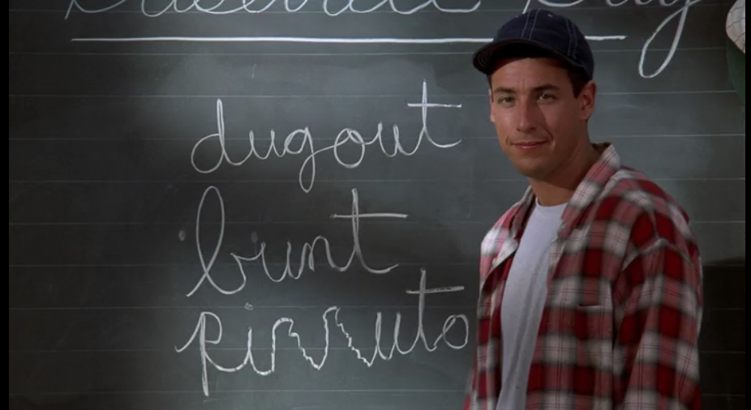

Slide 18
[20] The young man said to him, “All these I have kept. What do I still lack?” [21] Jesus said to him, “If you would be perfect, go, sell what you possess and give to the poor, and you will have treasure in heaven; and come, follow me.” [22] When the young man heard this he went away sorrowful, for he had great possessions.

Slide 19
The rich young ruler did not come to Jesus humbly to seek salvation. Rather he came proudly to display all of his own merits that he thought would earn eternal life.

Slide 20
[23] And Jesus said to his disciples, “Truly, I say to you, only with difficulty will a rich person enter the kingdom of heaven. [24] Again I tell you, it is easier for a camel to go through the eye of a needle than for a rich person to enter the kingdom of God.”

Slide 21
[25] When the disciples heard this, they were greatly astonished, saying, “Who then can be saved?”

Slide 22
[26] But Jesus looked at them and said, “With man this is impossible, but with God all things are possible.”
“Salvation has absolutely nothing to do with human merit and absolutely everything to do with divine mercy.”
– David Platt

Slide 23
[27] Then Peter said in reply, “See, we have left everything and followed you. What then will we have?” [28] Jesus said to them, “Truly, I say to you, in the new world, when the Son of Man will sit on his glorious throne, you who have followed me will also sit on twelve thrones, judging the twelve tribes of Israel.

Slide 24
[29] And everyone who has left houses or brothers or sisters or father or mother or children or lands, for my name’s sake, will receive a hundredfold and will inherit eternal life. [30] But many who are first will be last, and the last first.

Slide 25
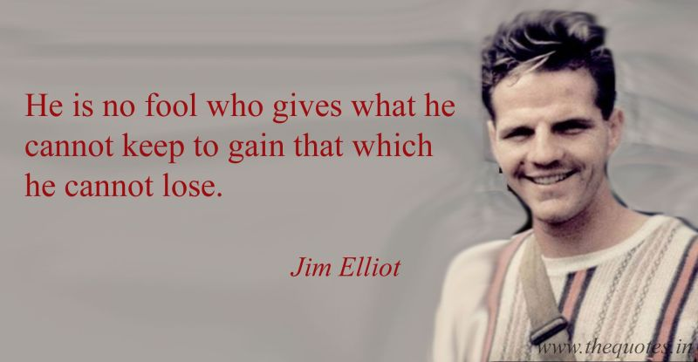

Slide 26
Resources (1):
J. Vernon McGee. “Thru the Bible with J. Vernon McGee, Volume IV, Matthew-Romans.” Thomas Nelson Publishing, 1982.
John MacArthur. “The MacArthur New Testament Commentary.” Moody Publishers, 1985.
Warren W. Wiersbe. “The Wiersbe Bible Commentary, The Complete New Testament in One Volume.” David C. Cook, 2007.
David Platt. “Christ Centered Exposition: Exalting Jesus in Matthew.” Series Editors: David Platt, Daniel L. Akin, and Tony Merida. B&H Publishing Group, 2013.
Charles H. Spurgeon. “Commentary on Matthew: The Gospel of the Kingdom.” The Banner of Truth Trust, first publication 1893, reprinted 2010, 2013.

Slide 27
Resources (2):

