Slide 1

The King and His Kingdom Part 70
“The Parable of the Unforgiving Servant”
Matthew 18:21-35 July 19, 2026

Slide 2

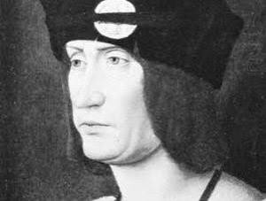
“Nothing smells so sweet as the dead body of your enemy.”
– King Louis XII of France

Slide 3
Matthew 18:21-35 – [21] Then Peter came up and said to him, “Lord, how often will my brother sin against me, and I forgive him? As many as seven times?” [22] Jesus said to him, “I do not say to you seven times, but seventy-seven times.

Slide 4
[23] “Therefore the kingdom of heaven may be compared to a king who wished to settle accounts with his servants. [24] When he began to settle, one was brought to him who owed him ten thousand talents. [25] And since he could not pay, his master ordered him to be sold, with his wife and children and all that he had, and payment to be made.

Slide 5
[26] So the servant fell on his knees, imploring him, ‘Have patience with me, and I will pay you everything.’ [27] And out of pity for him, the master of that servant released him and forgave him the debt. [28] But when that same servant went out, he found one of his fellow servants who owed him a hundred denarii, and seizing him, he began to choke him, saying, ‘Pay what you owe.’

Slide 6
[29] So his fellow servant fell down and pleaded with him, ‘Have patience with me, and I will pay you.’ [30] He refused and went and put him in prison until he should pay the debt. [31] When his fellow servants saw what had taken place, they were greatly distressed, and they went and reported to their master all that had taken place.

Slide 7
[32] Then his master summoned him and said to him, ‘You wicked servant! I forgave you all that debt because you pleaded with me. [33] And should not you have had mercy on your fellow servant, as I had mercy on you?’

Slide 8
[34] And in anger his master delivered him to the jailers, until he should pay all his debt. [35] So also my heavenly Father will do to every one of you, if you do not forgive your brother from your heart.”

Slide 9
Peter suggests offering forgiveness seven times.
Jewish rabbis suggested only three times.

Slide 10
[22] Jesus said to him, “I do not say to you seven times, but seventy-seven times.
We should offer forgiveness more times than we can count.

Slide 11
[23] “Therefore the kingdom of heaven may be compared to a king who wished to settle accounts with his servants. [24] When he began to settle, one was brought to him who owed him ten thousand talents.

Slide 12
“Ten thousand talents”
1 talent = 6,000 denarii
1 denarius = wage for one day of work
10,000 talents = 60,000,000 days of wages
10,000 talents = $15-$18 billion US dollars

Slide 13
[25] And since he could not pay, his master ordered him to be sold, with his wife and children and all that he had, and payment to be made. [26] So the servant fell on his knees, imploring him, ‘Have patience with me, and I will pay you everything.’ [27] And out of pity for him, the master of that servant released him and forgave him the debt.

Slide 14
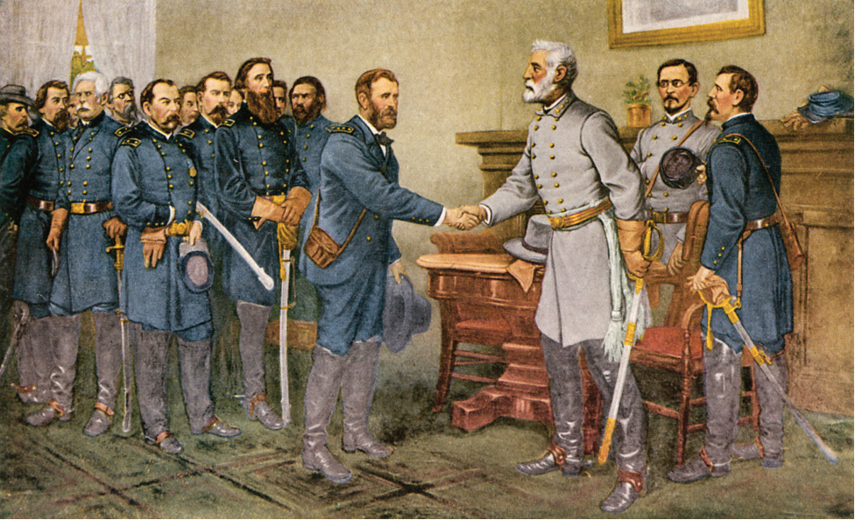

Slide 15
[28] But when that same servant went out, he found one of his fellow servants who owed him a hundred denarii, and seizing him, he began to choke him, saying, ‘Pay what you owe.’ [29] So his fellow servant fell down and pleaded with him, ‘Have patience with me, and I will pay you.’ [30] He refused and went and put him in prison until he should pay the debt.

Slide 16
100 denarii = 100 days of wages
100 denarii = $25,000-$30,000 US dollars
First servant owed $15-$18 billion dollars
Second servant owed $25-$30 thousand dollars

Slide 17
[31] When his fellow servants saw what had taken place, they were greatly distressed, and they went and reported to their master all that had taken place. [32] Then his master summoned him and said to him, ‘You wicked servant! I forgave you all that debt because you pleaded with me.

Slide 18
[33] And should not you have had mercy on your fellow servant, as I had mercy on you?’ [34] And in anger his master delivered him to the jailers, until he should pay all his debt. [35] So also my heavenly Father will do to every one of you, if you do not forgive your brother from your heart.”

Slide 19
Ephesians 4:32 – Be kind to one another, tenderhearted, forgiving one another, as God in Christ forgave you.
Colossians 3:13 – bearing with one another and, if one has a complaint against another, forgiving each other; as the Lord has forgiven you, so you also must forgive.

Slide 20


Slide 21
Resources (1):
J. Vernon McGee. “Thru the Bible with J. Vernon McGee, Volume IV, Matthew-Romans.” Thomas Nelson Publishing, 1982.
John MacArthur. “The MacArthur New Testament Commentary.” Moody Publishers, 1985.
Warren W. Wiersbe. “The Wiersbe Bible Commentary, The Complete New Testament in One Volume.” David C. Cook, 2007.
David Platt. “Christ Centered Exposition: Exalting Jesus in Matthew.” Series Editors: David Platt, Daniel L. Akin, and Tony Merida. B&H Publishing Group, 2013.

Slide 22
Resources (2):
Charles H. Spurgeon. “Commentary on Matthew: The Gospel of the Kingdom.” The Banner of Truth Trust, first publication 1893, reprinted 2010, 2013.
The Associated Press, "Whopping $100 Million Water Bill Shocks North Carolina Man," Yahoo! News (6-15-2017).
Harold Holzer, Gabor S.Boritt and Mark E. Neely Jr., "Appomattox Courthouse," HistoryNet. https://www.christianitytoday.com/pastors/preaching/sermon-illustrations/civil-war-surrender-brings-life-not-retribution/

Slide 23
Resources (3):
Image - https://billofrightsinstitute.org/essays/grant-and-lee-at-appomattox/
Laura Hildenbrand, “Unbroken.” Random House, 2010, pp. 376-379.
Image - https://www.universalpicturesathome.com/movies/unbroken

