Slide 1

The King and His Kingdom Part 67
“Fishing for a Miracle”
Matthew 17:24-27 June 21, 2026

Slide 2

Matthew 17:24-27
Miracle performed by Jesus
Only Gospel to record the miracle is Matthew
Only miracle where Jesus met His own needs
Only miracle involving the use of money
Only miracle where the results are not recorded

Slide 3
Matthew 17:24-27 – [24] When they came to Capernaum, the collectors of the two-drachma tax went up to Peter and said, “Does your teacher not pay the tax?” [25] He said, “Yes.” And when he came into the house, Jesus spoke to him first, saying, “What do you think, Simon? From whom do kings of the earth take toll or tax? From their sons or from others?”

Slide 4
[26] And when he said, “From others,” Jesus said to him, “Then the sons are free. [27] However, not to give offense to them, go to the sea and cast a hook and take the first fish that comes up, and when you open its mouth you will find a shekel. Take that and give it to them for me and for yourself.”

Slide 5
“Fishing for a Miracle”
Jesus Declares His Identity - Verses 24-26
Jesus Displays His Humility - Verse 27
Jesus Demonstrates His Sovereignty - Verse 27

Slide 6
Jesus Declares His Identity - Verses 24-26
Temple tax originating from Exodus 30:11-16
Matthew was a tax collector before following Jesus.

Slide 7
Amount of taxes owed = two-drachma
Two days of wages
Approximately $500 in 2026

Slide 8
[25] He said, “Yes.” And when he came into the house, Jesus spoke to him first, saying, “What do you think, Simon? From whom do kings of the earth take toll or tax? From their sons or from others?” [26] And when he said, “From others,” Jesus said to him, “Then the sons are free.

Slide 9
Jesus Displays His Humility – Verse 27
[27] However, not to give offense to them, go to the sea and cast a hook and take the first fish that comes up, and when you open its mouth you will find a shekel. Take that and give it to them for me and for yourself.”

Slide 10
Taxes should be paid.
Matthew 21:12-13 – [12] And Jesus entered the temple and drove out all who sold and bought in the temple, and he overturned the tables of the money-changers and the seats of those who sold pigeons. [13] He said to them, “It is written, ‘My house shall be called a house of prayer,’ but you make it a den of robbers.”

Slide 11
We must be willing to lay down personal preferences (and even rights at times) in order to not cause others to stumble.
What Would Jesus Do?

Slide 12
Jesus Demonstrates His Sovereignty - Verse 27
[27] However, not to give offense to them, go to the sea and cast a hook and take the first fish that comes up, and when you open its mouth you will find a shekel. Take that and give it to them for me and for yourself.”

Slide 13
“Consider what had to take place for this miracle to occur: Jesus ordained that somebody would drop a coin into the water, that a fish would scoop it up in its mouth but not swallow it all the way, that the fish would swim over to the shore at the exact moment when Peter walked up, and as Peter cast out a hook,…

Slide 14
… that he would catch that fish. All of that happened so that a temple tax could be paid in order not to bring unnecessary offense to people who God desires to save from sin. Jesus is sovereign over the sea, yet He graciously stoops for our salvation.”
      – David Platt

Slide 15
It was absolutely crucial that Peter was obedient because it was his obedience that led to God’s provision.

Slide 16
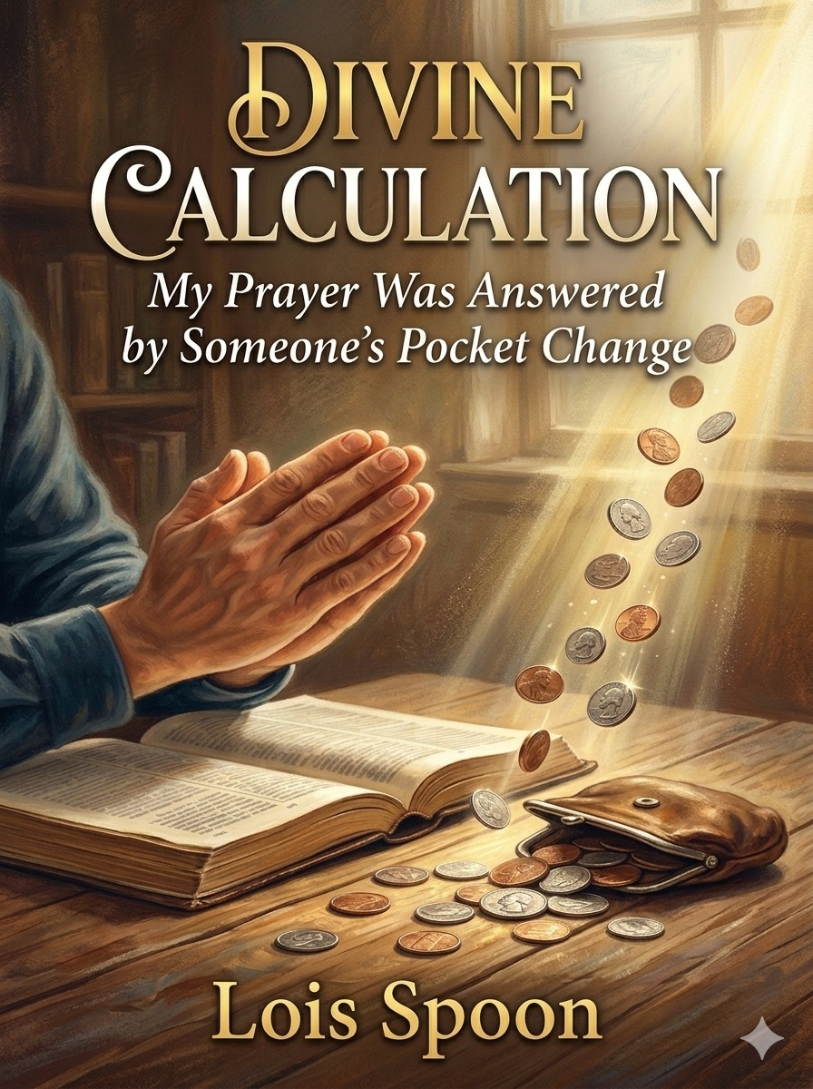

Slide 17
Resources (1):
J. Vernon McGee. “Thru the Bible with J. Vernon McGee, Volume IV, Matthew-Romans.” Thomas Nelson Publishing, 1982.
John MacArthur. “The MacArthur New Testament Commentary.” Moody Publishers, 1985.
Warren W. Wiersbe. “The Wiersbe Bible Commentary, The Complete New Testament in One Volume.” David C. Cook, 2007.
David Platt. “Christ Centered Exposition: Exalting Jesus in Matthew.” Series Editors: David Platt, Daniel L. Akin, and Tony Merida. B&H Publishing Group, 2013.

Slide 18
Resources (2):
Charles H. Spurgeon. “Commentary on Matthew: The Gospel of the Kingdom.” The Banner of Truth Trust, first publication 1893, reprinted 2010, 2013.
Lois Spoon. "Divine Calculation: My Prayer Was Answered by Someone's Pocket Change." Today's Christian, Sept/Oct 1999.

