Slide 1
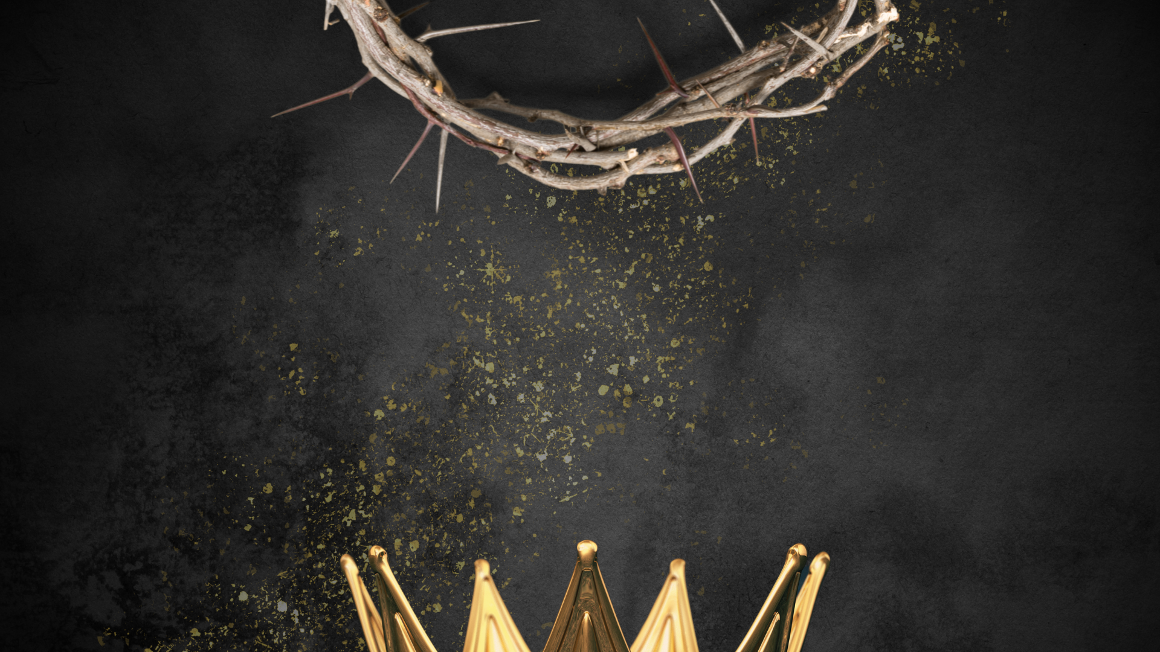
The King and His Kingdom Part 66
“A Little Faith”
Matthew 17:14-23 June 14, 2026

Slide 2

Matthew 17:14-23 – [14] And when they came to the crowd, a man came up to him and, kneeling before him, [15] said, “Lord, have mercy on my son, for he has seizures and he suffers terribly. For often he falls into the fire, and often into the water. [16] And I brought him to your disciples, and they could not heal him.”

Slide 3
[17] And Jesus answered, “O faithless and twisted generation, how long am I to be with you? How long am I to bear with you? Bring him here to me.” [18] And Jesus rebuked the demon, and it came out of him, and the boy was healed instantly. [19] Then the disciples came to Jesus privately and said, “Why could we not cast it out?”

Slide 4
[20] He said to them, “Because of your little faith. For truly, I say to you, if you have faith like a grain of mustard seed, you will say to this mountain, ‘Move from here to there,’ and it will move, and nothing will be impossible for you.”

Slide 5
[22] As they were gathering in Galilee, Jesus said to them, “The Son of Man is about to be delivered into the hands of men, [23] and they will kill him, and he will be raised on the third day.” And they were greatly distressed.

Slide 6
“The contrasts between the two incidents are striking. One happened on a mountain, the other in a valley. There was glory on the mountain, tragedy in the valley. On the mountain Jesus Christ displayed His glorious majesty, while in the valley Satan displayed his ugly, cruel violence.

Slide 7
Two sons are in view, one God-possessed, the other demon-possessed; one in whom His Father was well pleased, the other whose father was tortured with displeasure over his condition… One Son was the destroyer of demons; the other son was destroyed by demons.”
– John MacArthur

Slide 8
Matthew 17:14-15 – [14] And when they came to the crowd, a man came up to him and, kneeling before him, [15] said, “Lord, have mercy on my son, for he has seizures and he suffers terribly. For often he falls into the fire, and often into the water.
Luke 9:38 – And behold, a man from the crowd cried out, “Teacher, I beg you to look at my son, for he is my only child.

Slide 9
Children are a blessing from the Lord.
Children helped with the family business (farming, fishing, etc.).
Children were responsible for caring for their aging parents.
The family legacy rested on this one son.

Slide 10
“We have in these verses an example of what a parent should do when he is troubled about his children.”
– J.C. Ryle

Slide 11
[14] And when they came to the crowd, a man came up to him and, kneeling before him, [15] said, “Lord, have mercy on my son, for he has seizures and he suffers terribly…
“We are worse than stupid, if a condition so wretched does not arouse us to prayer.”
    – John Calvin

Slide 12
[15] said, “Lord, have mercy on my son, for he has seizures and he suffers terribly. For often he falls into the fire, and often into the water.
Seizures
Exposed to hazards
Deaf
Mute

Slide 13
[16] And I brought him to your disciples, and they could not heal him.”
Their lack of faith led them to a lack of prayer.

Slide 14
“(The disciples) allowed their devotional disciplines to erode... No matter what spiritual gifts we may have, their exercise is never automatic.”
– Warren Wiersbe

Slide 15
We should turn to prayer as our first response instead of our last resort.
Example: Young children attempting to fix a broken toy.

Slide 16
[17] And Jesus answered, “O faithless and twisted generation, how long am I to be with you? How long am I to bear with you? Bring him here to me.”

Slide 17
Mark 9:23-24 – [23] And Jesus said to him, “‘If you can’! All things are possible for one who believes.” [24] Immediately the father of the child cried out and said, “I believe; help my unbelief!”
“A little bit of faith in a great God can accomplish great things.”
– David Platt

Slide 18
[18] And Jesus rebuked the demon, and it came out of him, and the boy was healed instantly.
Come to Jesus where you are right now.

Slide 19
[19] Then the disciples came to Jesus privately and said, “Why could we not cast it out?” [20] He said to them, “Because of your little faith. For truly, I say to you, if you have faith like a grain of mustard seed, you will say to this mountain, ‘Move from here to there,’ and it will move, and nothing will be impossible for you.”

Slide 20
[22] As they were gathering in Galilee, Jesus said to them, “The Son of Man is about to be delivered into the hands of men, [23] and they will kill him, and he will be raised on the third day.” And they were greatly distressed.

Slide 21
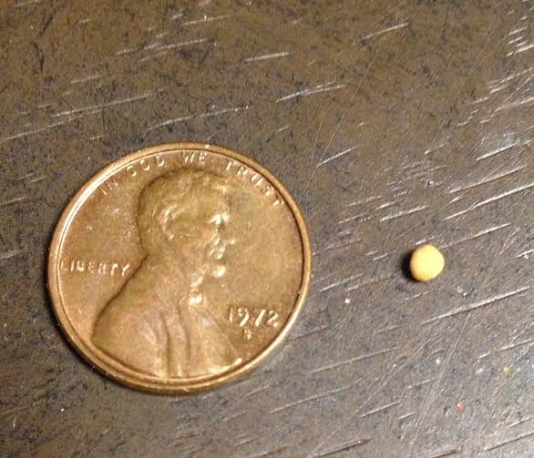
It’s not the size of your faith that matters; it’s the object of your faith that counts.
Standard mustard seed:
1-2 millimeters
1/10th of an inch

Slide 22
Verse 23 - … And they were greatly distressed.

Slide 23
Prayer should be our first response, not our last resort.
It’s not the size of your faith that matters; it’s the object of your faith that counts.

Slide 24
Resources (1):
J. Vernon McGee. “Thru the Bible with J. Vernon McGee, Volume IV, Matthew-Romans.” Thomas Nelson Publishing, 1982.
John MacArthur. “The MacArthur New Testament Commentary.” Moody Publishers, 1985.
Warren W. Wiersbe. “The Wiersbe Bible Commentary, The Complete New Testament in One Volume.” David C. Cook, 2007.
David Platt. “Christ Centered Exposition: Exalting Jesus in Matthew.” Series Editors: David Platt, Daniel L. Akin, and Tony Merida. B&H Publishing Group, 2013.
Charles H. Spurgeon. “Commentary on Matthew: The Gospel of the Kingdom.” The Banner of Truth Trust, first publication 1893, reprinted 2010, 2013.

