Slide 1
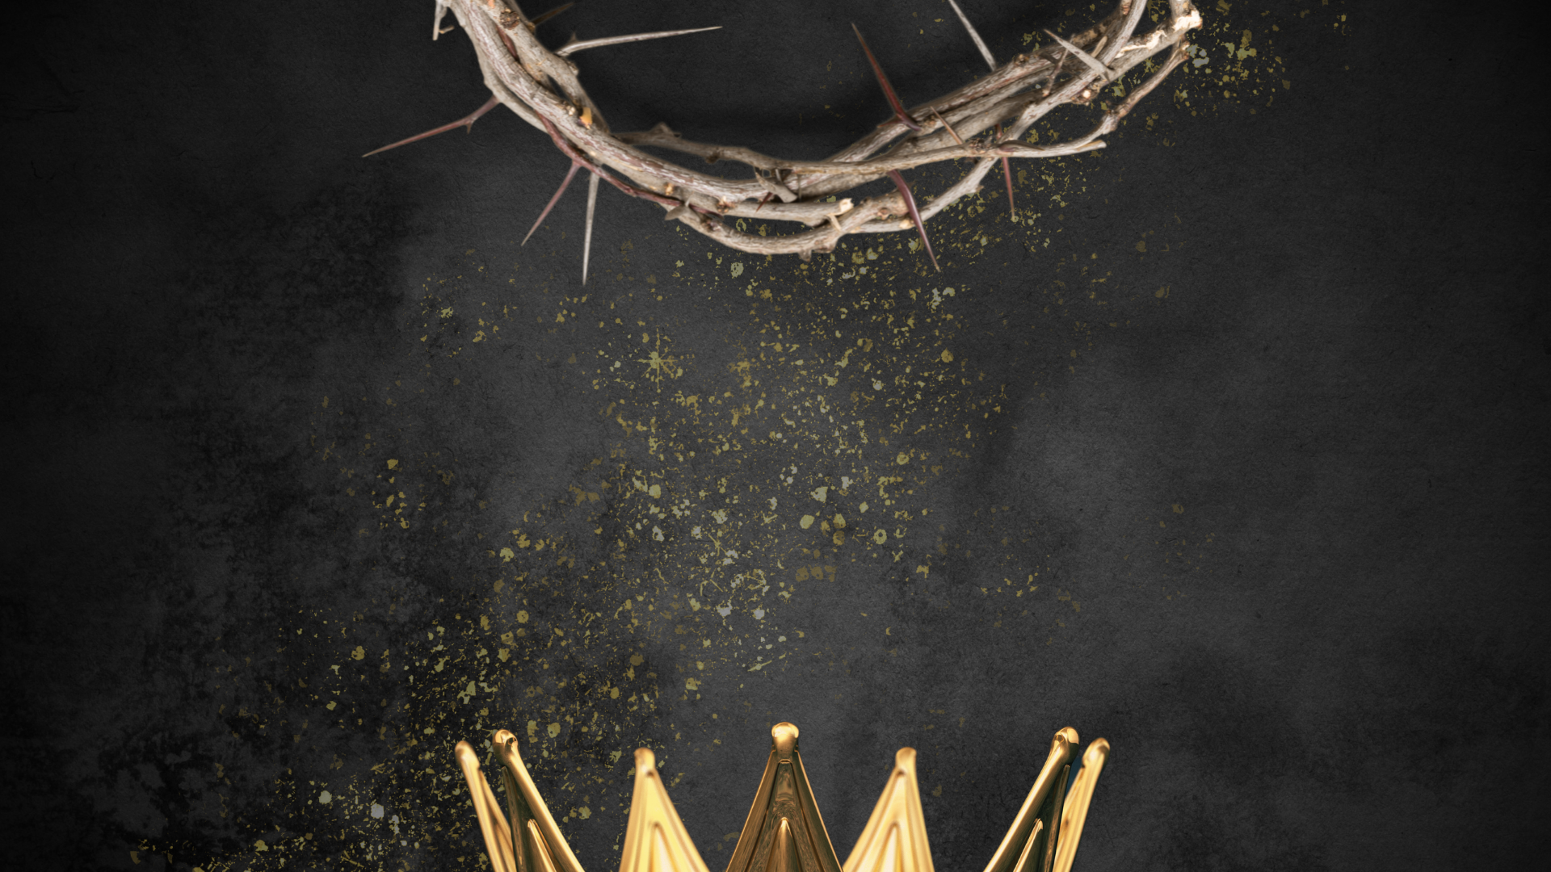
The King and His Kingdom Part 65
“Glory in the Details”
Matthew 17:1-13 June 7, 2026

Slide 2

Matthew 17:1-13 – [1] And after six days Jesus took with him Peter and James, and John his brother, and led them up a high mountain by themselves. [2] And he was transfigured before them, and his face shone like the sun, and his clothes became white as light. [3] And behold, there appeared to them Moses and Elijah, talking with him.

Slide 3
[4] And Peter said to Jesus, “Lord, it is good that we are here. If you wish, I will make three tents here, one for you and one for Moses and one for Elijah.” [5] He was still speaking when, behold, a bright cloud overshadowed them, and a voice from the cloud said, “This is my beloved Son, with whom I am well pleased; listen to him.”

Slide 4
[6] When the disciples heard this, they fell on their faces and were terrified. [7] But Jesus came and touched them, saying, “Rise, and have no fear.” [8] And when they lifted up their eyes, they saw no one but Jesus only.

Slide 5
[9] And as they were coming down the mountain, Jesus commanded them, “Tell no one the vision, until the Son of Man is raised from the dead.” [10] And the disciples asked him, “Then why do the scribes say that first Elijah must come?”

Slide 6
[11] He answered, “Elijah does come, and he will restore all things. [12] But I tell you that Elijah has already come, and they did not recognize him, but did to him whatever they pleased. So also the Son of Man will certainly suffer at their hands.” [13] Then the disciples understood that he was speaking to them of John the Baptist.

Slide 7
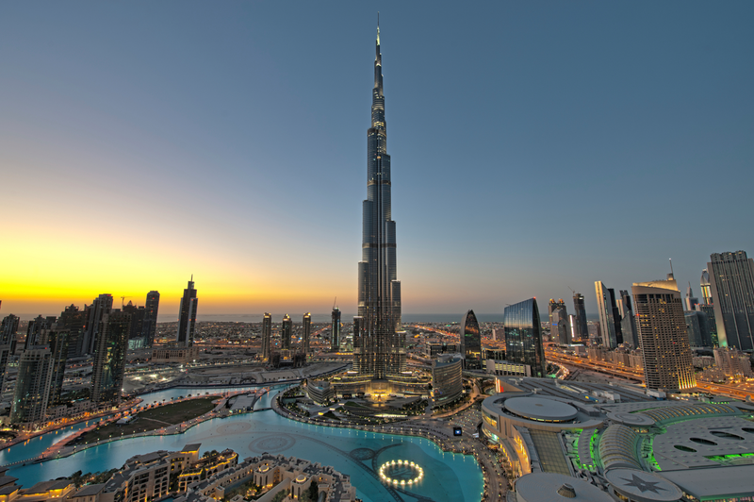

Slide 8
“There is no perfection like God's perfection. There is no holiness as holy as God's holiness. If you allow yourself to gaze upon his holiness, you will feel incredibly small and sinful. It is a good thing spiritually to have the assessments of your own grandeur decimated by divine glory.”
– Paul David Tripp

Slide 9
2 Peter 1:16-18 – 16 For we did not follow cleverly devised myths when we made known to you the power and coming of our Lord Jesus Christ, but we were eyewitnesses of his majesty. 17 For when he received honor and glory from God the Father, and the voice was borne to him by the Majestic Glory, “This is my beloved Son, with whom I am well pleased,” 18 we ourselves heard this very voice borne from heaven, for we were with him on the holy mountain.

Slide 10
John 1:14 – And the Word became flesh and dwelt among us, and we have seen his glory, glory as of the only Son from the Father, full of grace and truth.
“The event that most powerfully and dramatically proved Jesus Christ to be the true glory of God…”
– John MacArthur

Slide 11
Matthew 17:1 – And after six days Jesus took with him Peter and James, and John his brother, and led them up a high mountain by themselves.
Luke 9:28 – … he took with him Peter and John and James and went up on the mountain to pray.

Slide 12
Prayer Prepares
“Note that our Lord was once again praying, which suggests that prayer is one of the keys to a transformed life.”
      – Warren Wiersbe

Slide 13
Luke 9:29 – And as he was praying, the appearance of his face was altered, and his clothing became dazzling white.
Matthew 17:2 – And he was transfigured before them, and his face shone like the sun, and his clothes became white as light.

Slide 14
The Beauty of Heaven
Matthew 17:3 – And behold, there appeared to them Moses and Elijah, talking with him.
“All is not over when the last breath is drawn.”
– J.C. Ryle

Slide 15
Everything in the Bible points to Jesus.
Moses represented the Law.
Elijah represented the Prophets.
Jesus is the fulfillment of the Law, the Prophets, and the entire Bible.

Slide 16
Luke 9:30-31 – [30] And behold, two men were talking with him, Moses and Elijah, [31] who appeared in glory and spoke of his departure, which he was about to accomplish at Jerusalem.
“… His death was the fulfillment of God’s eternal plan, not a breach of it.”
– John MacArthur

Slide 17
It is good to be in the presence of Jesus.
Matthew 17:4 – And Peter said to Jesus, “Lord, it is good that we are here. If you wish, I will make three tents here, one for you and one for Moses and one for Elijah.”

Slide 18
God gives us what we need to know when we need to know it.
God did not have to arrange the events of the Transfiguration; and He especially did not have to include Peter, James, and John.

Slide 19
“For we did not follow cleverly devised myths when we made known to you the power and coming of our Lord Jesus Christ, but we were eyewitnesses of his majesty.”
– 2 Peter 1:16
Verification of God’s Kingdom
Foundation of Gospel Preaching

Slide 20
Matthew 17:4 – … If you wish, I will make three tents here, one for you and one for Moses and one for Elijah.
Peter did not subscribe to the plan of suffering and death Jesus told him was coming.

Slide 21
Matthew 17:5 – He was still speaking when, behold, a bright cloud overshadowed them, and a voice from the cloud said, “This is my beloved Son, with whom I am well pleased; listen to him.”
Unanswered prayers can be a demonstration of God’s grace.

Slide 22
Listen to God, not yourself.
Peter’s plan was not bad, but it also was not God’s plan.
We must invest energy and effort in obedience, not in trying to determine our own plans.

Slide 23
Have a posture of humility.
Matthew 17:6 – When the disciples heard this, they fell on their faces and were terrified.
The fear of the Lord leads to a posture of humility.

Slide 24
Matthew 17:7-8 – [7] But Jesus came and touched them, saying, “Rise, and have no fear.” [8] And when they lifted up their eyes, they saw no one but Jesus only.
Example of the selfless nature of Jesus

Slide 25
Matthew 17:9-13 – [9] And as they were coming down the mountain, Jesus commanded them, “Tell no one the vision, until the Son of Man is raised from the dead.” [10] And the disciples asked him, “Then why do the scribes say that first Elijah must come?”

Slide 26
[11] He answered, “Elijah does come, and he will restore all things. [12] But I tell you that Elijah has already come, and they did not recognize him, but did to him whatever they pleased. So also the Son of Man will certainly suffer at their hands.” [13] Then the disciples understood that he was speaking to them of John the Baptist.

Slide 27
God gives us grace in order for us to make it through the tough days.
God provided a gift of grace through the Transfiguration to encourage and sustain the disciples for the tough days ahead.

Slide 28
“As wonderful as these experiences are, they are not the basis for a consistent Christian life. That can come only through the Word of God. Experiences come and go, but the Word remains. Our recollection of past experiences will fade, but God’s Word never changes.”
– Warren Wiersbe

Slide 29
Resources (1):
J. Vernon McGee. “Thru the Bible with J. Vernon McGee, Volume IV, Matthew-Romans.” Thomas Nelson Publishing, 1982.
John MacArthur. “The MacArthur New Testament Commentary.” Moody Publishers, 1985.
Warren W. Wiersbe. “The Wiersbe Bible Commentary, The Complete New Testament in One Volume.” David C. Cook, 2007.
David Platt. “Christ Centered Exposition: Exalting Jesus in Matthew.” Series Editors: David Platt, Daniel L. Akin, and Tony Merida. B&H Publishing Group, 2013.

Slide 30
Resources (2):
Charles H. Spurgeon. “Commentary on Matthew: The Gospel of the Kingdom.” The Banner of Truth Trust, first publication 1893, reprinted 2010, 2013.
Adapted from Paul David Tripp, “Do You Believe?” Crossway, 2021, pp. 102-103.

