Slide 1

The King and His Kingdom Part 56
“Jesus Feeds the Five Thousand”
Matthew 14:13-21 March 8, 2026

Slide 2

We must look for ways to show compassion.
We must be willing to give everything we have to Jesus.
We must take the first step of obedience.

Slide 3
Matthew 14:13-21 – [13] Now when Jesus heard this, he withdrew from there in a boat to a desolate place by himself. But when the crowds heard it, they followed him on foot from the towns. [14] When he went ashore he saw a great crowd, and he had compassion on them and healed their sick.

Slide 4
[15] Now when it was evening, the disciples came to him and said, “This is a desolate place, and the day is now over; send the crowds away to go into the villages and buy food for themselves.” [16] But Jesus said, “They need not go away; you give them something to eat.” [17] They said to him, “We have only five loaves here and two fish.”

Slide 5
[18] And he said, “Bring them here to me.” [19] Then he ordered the crowds to sit down on the grass, and taking the five loaves and the two fish, he looked up to heaven and said a blessing. Then he broke the loaves and gave them to the disciples, and the disciples gave them to the crowds.

Slide 6
[20] And they all ate and were satisfied. And they took up twelve baskets full of the broken pieces left over. [21] And those who ate were about five thousand men, besides women and children.

Slide 7
[13] Now when Jesus heard this, he withdrew from there in a boat to a desolate place by himself. But when the crowds heard it, they followed him on foot from the towns.

Slide 8
If the Son of God needed time away to rest, it’s safe to say we also need intentional time away specifically for rest.

Slide 9
[13] Now when Jesus heard this, he withdrew from there in a boat to a desolate place by himself. But when the crowds heard it, they followed him on foot from the towns.

Slide 10
[14] When he went ashore he saw a great crowd, and he had compassion on them and healed their sick.
We must look for ways to show compassion.

Slide 11
[15] Now when it was evening, the disciples came to him and said, “This is a desolate place, and the day is now over; send the crowds away to go into the villages and buy food for themselves.” [16] But Jesus said, “They need not go away; you give them something to eat.” [17] They said to him, “We have only five loaves here and two fish.”

Slide 12
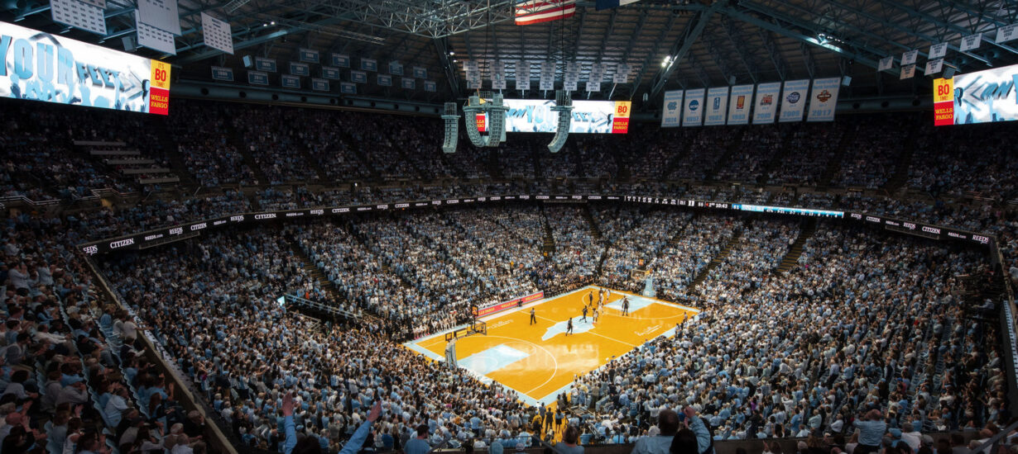

Slide 13
The disciples were focused on earthly circumstances rather than heavenly opportunities.

Slide 14
[16] But Jesus said, “They need not go away; you give them something to eat.” [17] They said to him, “We have only five loaves here and two fish.”

Slide 15
“Have you ever been asked by God to do something that just seems, feels, and senses to be impossible?”
“Have you ever been asked by God to do something where you’re going, ‘I don’t even know how I possibly could be obedient to this?’”
– Matt Chandler

Slide 16
“Before we ask the impossible, let’s start with the possible and give Him (Jesus) what we have.”
– Warren Wiersbe
We must be willing to give everything we have to Jesus.

Slide 17
[18] And he said, “Bring them here to me.” [19] Then he ordered the crowds to sit down on the grass, and taking the five loaves and the two fish, he looked up to heaven and said a blessing. Then he broke the loaves and gave them to the disciples, and the disciples gave them to the crowds.

Slide 18
We must take the first step of obedience.
“Sometimes obedience must precede understanding.”
– Robert Stein

Slide 19
[19] Then he ordered the crowds to sit down on the grass, and taking the five loaves and the two fish, he looked up to heaven and said a blessing. Then he broke the loaves and gave them to the disciples, and the disciples gave them to the crowds.

Slide 20
[20] And they all ate and were satisfied. And they took up twelve baskets full of the broken pieces left over. [21] And those who ate were about five thousand men, besides women and children.

Slide 21
“Perhaps the most well-attested, eye-witness, account of any miracle that Jesus ever performed during his earthly ministry.”
– R.C. Sproul

Slide 22
“You cannot out give God.”
Money
Talent
Time
Energy

Slide 23
“The people were more interested in their stomachs than their souls, and completely missed the spiritual impact of the miracle.”
– Warren Wiersbe

Slide 24
“In the crisis hours of life, when your resources are low and your responsibilities are great, it is good to remember that God already has the problem solved... Look on problems as opportunities for God to work…”
– Warren Wiersbe

Slide 25
Resources (1):
J. Vernon McGee. “Thru the Bible with J. Vernon McGee, Volume IV, Matthew-Romans.” Thomas Nelson Publishing, 1982.
John MacArthur. “The MacArthur New Testament Commentary.” Moody Publishers, 1985.
Warren W. Wiersbe. “The Wiersbe Bible Commentary, The Complete New Testament in One Volume.” David C. Cook, 2007.
David Platt. “Christ Centered Exposition: Exalting Jesus in Matthew.” Series Editors: David Platt, Daniel L. Akin, and Tony Merida. B&H Publishing Group, 2013.

Slide 26
Resources (2):
Charles H. Spurgeon. “Commentary on Matthew: The Gospel of the Kingdom.” The Banner of Truth Trust, first publication 1893, reprinted 2010, 2013.
Picture – https://alumni.unc.edu/news/renovate-smith-center-or-build-new-arena/

