Slide 1

The King and His Kingdom Part 53
“Have You Understood?”
Matthew 13:44-52 February 15, 2026

Slide 2

Matthew 13:44-52 (ESV) – [44] “The kingdom of heaven is like treasure hidden in a field, which a man found and covered up. Then in his joy he goes and sells all that he has and buys that field. [45] “Again, the kingdom of heaven is like a merchant in search of fine pearls, [46] who, on finding one pearl of great value, went and sold all that he had and bought it.

Slide 3
[47] “Again, the kingdom of heaven is like a net that was thrown into the sea and gathered fish of every kind. [48] When it was full, men drew it ashore and sat down and sorted the good into containers but threw away the bad.

Slide 4
[49] So it will be at the end of the age. The angels will come out and separate the evil from the righteous [50] and throw them into the fiery furnace. In that place there will be weeping and gnashing of teeth.

Slide 5
[51] “Have you understood all these things?” They said to him, “Yes.” [52] And he said to them, “Therefore every scribe who has been trained for the kingdom of heaven is like a master of a house, who brings out of his treasure what is new and what is old.”

Slide 6
“The kingdom of heaven is like …”
Verse 44
Verse 45
Verse 47
Verse 52

Slide 7
[44] “The kingdom of heaven is like treasure hidden in a field, which a man found and covered up. Then in his joy he goes and sells all that he has and buys that field.

Slide 8
[45] “Again, the kingdom of heaven is like a merchant in search of fine pearls, [46] who, on finding one pearl of great value, went and sold all that he had and bought it.

Slide 9
Philippians 3:8-9 – [8] Indeed, I count everything as loss because of the surpassing worth of knowing Christ Jesus my Lord. For his sake I have suffered the loss of all things and count them as rubbish, in order that I may gain Christ

Slide 10
John 15:11 – These things I have spoken to you, that my joy may be in you, and that your joy may be full.

Slide 11
Do we find joy in Christ and the things of His kingdom?
What are we willing to give up to find our treasure in Jesus?

Slide 12
[47] “Again, the kingdom of heaven is like a net that was thrown into the sea and gathered fish of every kind. [48] When it was full, men drew it ashore and sat down and sorted the good into containers but threw away the bad.

Slide 13
[49] So it will be at the end of the age. The angels will come out and separate the evil from the righteous [50] and throw them into the fiery furnace. In that place there will be weeping and gnashing of teeth.

Slide 14


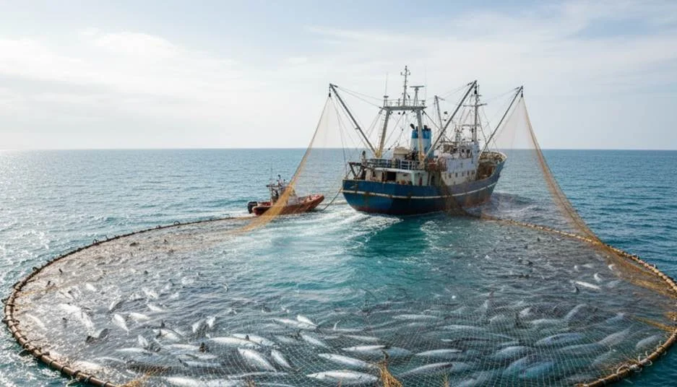

Slide 15
“The dragnet of God’s judgment moves silently through the sea of mankind and draws all men to the shores of eternity for final separation to their ultimate destiny – believers to eternal life and unbelievers to eternal damnation.”
– John MacArthur

Slide 16
2 Peter 3:9 – [9] The Lord is not slow to fulfill his promise as some count slowness, but is patient toward you, not wishing that any should perish, but that all should reach repentance.

Slide 17
Matthew 13:51-52 – [51] “Have you understood all these things?” They said to him, “Yes.” [52] And he said to them, “Therefore every scribe who has been trained for the kingdom of heaven is like a master of a house, who brings out of his treasure what is new and what is old.”

Slide 18
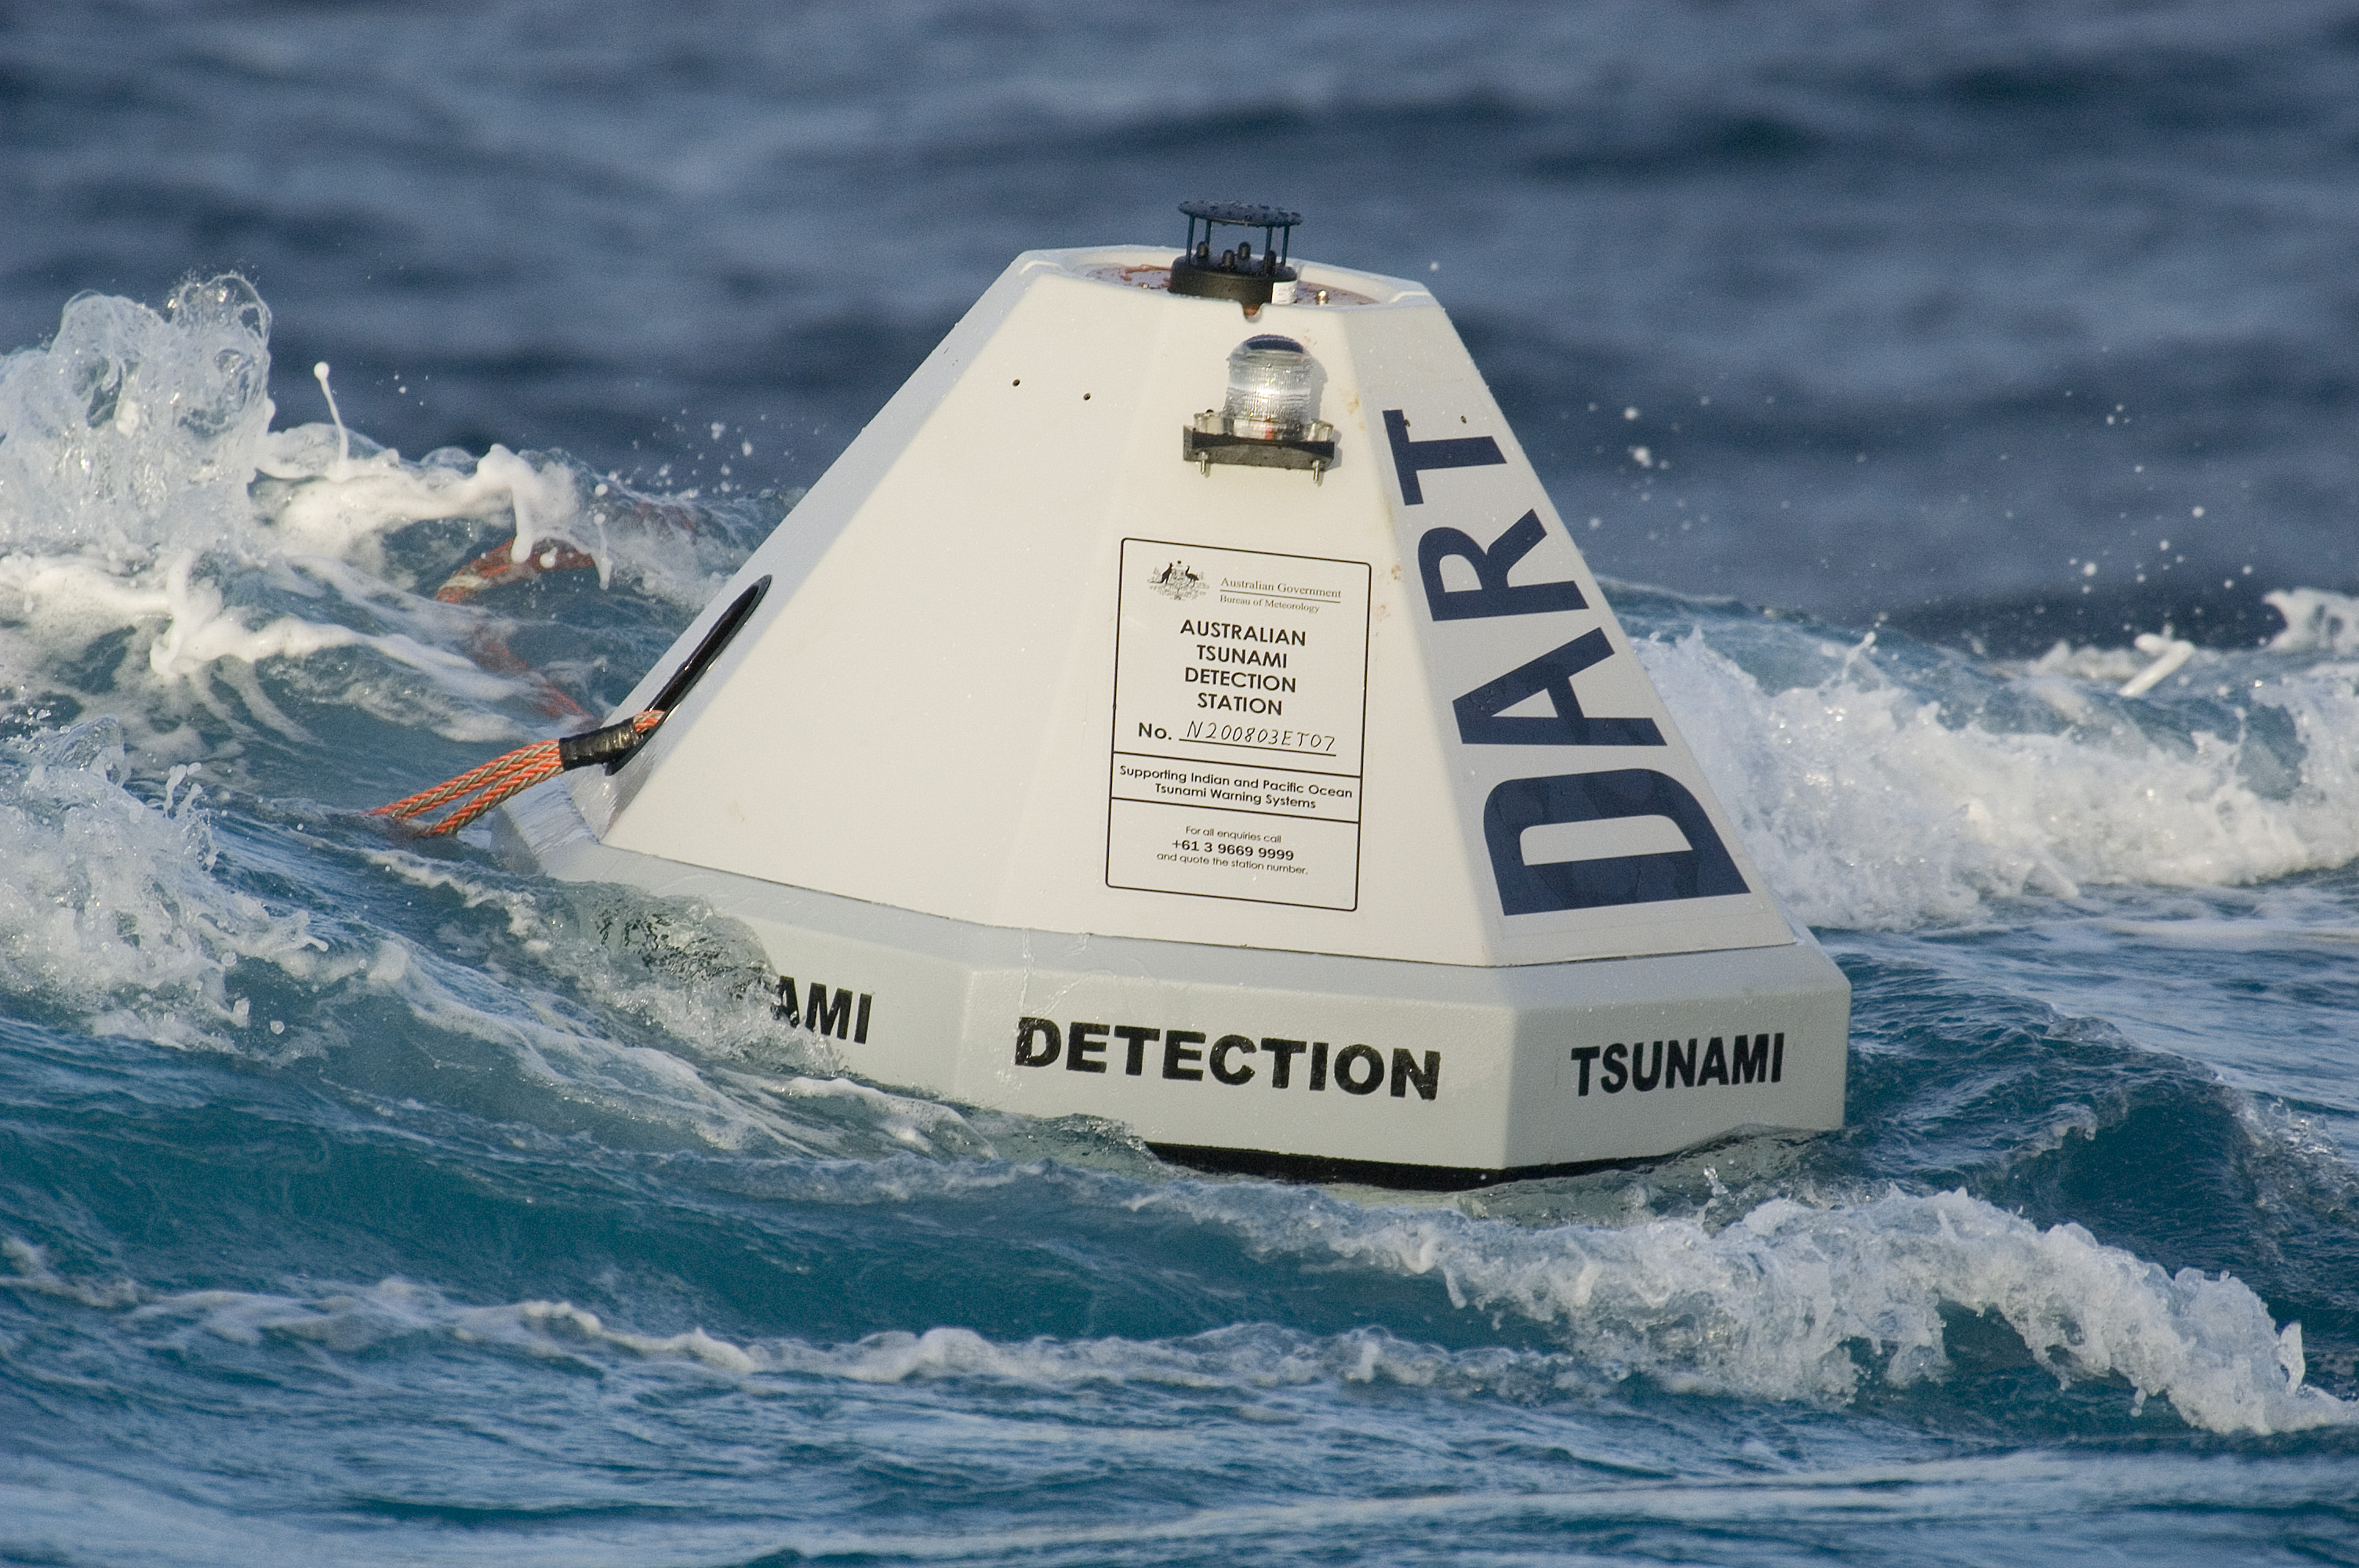

Slide 19
Two Main Truths:
Knowing Jesus is the greatest treasure.
Take the call to share the Gospel with other people seriously.

Slide 20
Resources (1):
J. Vernon McGee. “Thru the Bible with J. Vernon McGee, Volume IV, Matthew-Romans.” Thomas Nelson Publishing, 1982.
John MacArthur. “The MacArthur New Testament Commentary.” Moody Publishers, 1985.
Warren W. Wiersbe. “The Wiersbe Bible Commentary, The Complete New Testament in One Volume.” David C. Cook, 2007.
David Platt. “Christ Centered Exposition: Exalting Jesus in Matthew.” Series Editors: David Platt, Daniel L. Akin, and Tony Merida. B&H Publishing Group, 2013.

Slide 21
Resources (2):
Charles H. Spurgeon. “Commentary on Matthew: The Gospel of the Kingdom.” The Banner of Truth Trust, first publication 1893, reprinted 2010, 2013.
Associated Press, "Sold! One Declaration of Independence Copy," MSNBC.com. 03-23-2007.
Smithsonian Magazine, "Did Broken Buoys Fail to Warn Victims of the Mentawai Tsunami?" October 28, 2010.

